Slide 1

Java Programming
A Project Based Approach to Learning Java

Slide 2
UNIT 2 : Methods and Object-Oriented Programming
Methods | Reusable code blocks which complete a specific task and return to main program
Overloading Methods | Defining a method multiple times with different parameters
Object-Oriented Programming | Creating java objects which model items and concepts and act as a template
Defining Classes | Defining variables and methods that define an object
Class Instances and Methods | Creating a specific instance of a class object with details unique to that instance
Instantiating a Class and the Class Constructor | Constructors are special methods which are always call to create the instance
Getter and Setter Methods | Methods found in classes to either modify or retrieve instance variable values
Inheritance | Borrowing code from parent superclasses
Access Modifiers | Restricting access to variables and methods between classes
Inner Classes | Classes can be nested to make code more maintainable without inheritance

Slide 3
Java Methods – Creating Reusable Code
import java.util.*;
public class MethodExamples {
//Functions
public static double circArea(double r){
double area = Math.PI * Math.pow(r, 2);
return area;
}
public static double circVol(double r){
double volume = (4/3)*Math.PI*Math.pow(r, 3);
return volume;
}
public static void main(String[] args) throws Exception {
double radius;
Scanner input = new Scanner(System.in);
System.out.print("Enter the radius: ");
radius = input.nextDouble();
System.out.printf("Calculated Area of Sphere Is: %.2f\n", circArea(radius));
System.out.printf("Calculated Volume of the Sphere Is: %.2f\n", circVol(radius));
input.close();
}
}
Methods can be defined in the main class OR in an inherited class
Here are two that are defined above the main method and return
a number (double)
Methods can be called anywhere in the code an can accept arguments, returning a value (in some cases) wherever they are called

Slide 4
Defining And Calling
‘access level’ can be:
1) private: restricts access to only instances of a that class within that class
2) protected: restricts access to classes in the same package or subclasses
3) public: access available to all
Return type
‘void’ if no value returned
Method name
Parameters
Taken as arguments for the method, type must be declared
public static double circArea(double r){
double area = Math.PI * Math.pow(r, 2);
return area;
}
Can be accessed without creating a class instance
Return keyword
Used if value is returned

Slide 5
Method Overloading
/*- FULL CODE IN COURSE CODE ON GIT -*/
//Method refuel accepting String argument
public void refuel(String TankLevel){
System.out.print("Refueling ");
for (int i = 0; i < 10; i++){
System.out.print(". ");
try{
TimeUnit.SECONDS.sleep(1);
}catch(Exception e){
System.out.println(e.fillInStackTrace());
}
}
System.out.printf("Gas Tank Is Now: %s\n", TankLevel);
}
//Overloaded refuel method accepting int argument
public void refuel(int TankLevel){
System.out.print("Refueling ");
for (int i = 0; i < 10; i++){
System.out.print(". ");
try{
TimeUnit.SECONDS.sleep(1);
}catch(Exception e){
System.out.println(e.fillInStackTrace());
}
}
System.out.printf("Gas Tank Is Now: %d\n", TankLevel);
}
Methods can be defined multiple times with different parameters depending on their expected use
This is called ‘Overloading’
This example first defines refuel() to take a single string argument
The overloaded method also takes a single int as an alternate argument
This example introduces the ‘sleep()’ method which is a simple way to add a delay to your program.
It is inherited from the ‘util’ package
TimeUnit is an enum, with SECONDS as one of its elements

Slide 6
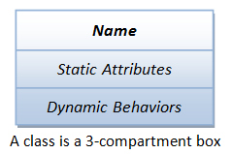
Class Components – Object Blueprints
This part of your program will describe the properties/attributes (called instance variables) and behaviors (methods) of the object.
//instance var, in the Student class example
protected String first_name;
We often use diagrams to describe the properties and behaviors that a class should have:
//method, in the Student class example
public void goToClass(){
System.out.println(“I’m Going to Class!");
}

Slide 7
Square Class – OOP Example 1
Square
- sideLength:double = 12 - color:String = “red”
+ Square() + Square(sideLength:double) + getPerimeter():double + getArea():double
public class Square {
//instance variables
private double sideLength = 12; //These are default values
private String colour = "red";
public Square(){} //empty constructure,
//instance will have default values
public Square(double sideLength){
this.sideLength = sideLength;
}
//methods
public double getPerimeter(){
return sideLength*4;
}
public double getArea(){
return Math.pow(sideLength, 2);
}
}
Plus (+) means public
Minus (-) means private
private variables/methods can only be accessed from inside the class they’re in

Slide 8
Main Class - Example 1 (cont’d)
public class SquareExample {
public static void main(String[] args) throws Exception {
Square square1 = new Square(); //create an instance of the Square class, square1
Square square2 = new Square(3); //create an instance of the Square class, s2
//print the information about square1:
System.out.println("Square square1:");
//call the getPerimeter() method that we wrote in Square.java:
System.out.println("perimeter = " + square1.getPerimeter());
//call the getArea() method that we wrote in Square.java:
System.out.println("area = " + square1.getArea());
//print the information about square2:
System.out.println("Square square2:");
System.out.println("perimeter = " + square2.getPerimeter());
System.out.println("area = " + square2.getArea());
}
}
Creating TWO
new Class
Instances

Slide 9
Getters & Setters- OOP Example 1 (cont’d)
public class Square {
//instance variables
private double sideLength = 12; //These are default values
private String colour = "red";
public Square(){} //empty constructure, instance will have default values
public Square(double sideLength){
this.sideLength = sideLength;
}
//getter and setter methods
public void setLength(double sideLength){
this.sideLength = sideLength; //sets sideLength to value
}
public double getLength(){
return this.sideLength; //gets sideLength value
}
//methods
public double getPerimeter(){
return sideLength*4;
}
public double getArea(){
return Math.pow(sideLength, 2);
}
}
Getter and Setter methods can be
called from an instance of Square
Ex. square1.setLength(15) resets var to 15

Slide 10

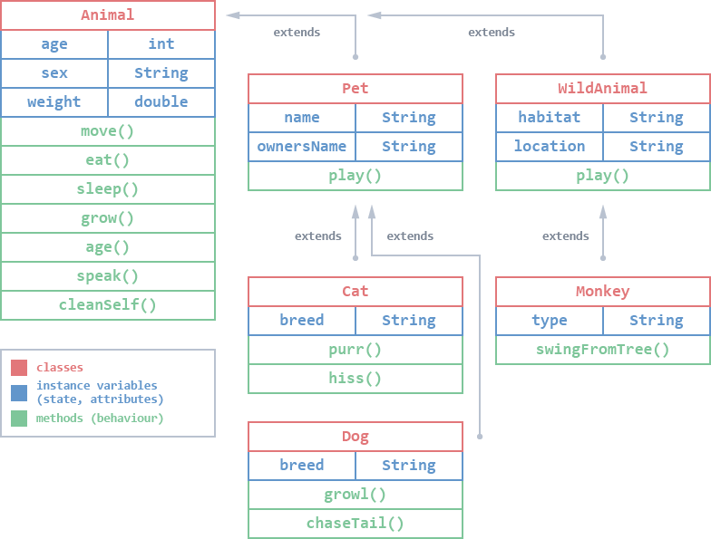
Inheritance –Subclasses extends Superclasses
Inheritance is the process by which one class (subclass) inherits the properties and functionality of another class (superclass).
Enables code reusability
Less development time
Increased performance
Increased memory
Less maintenance time/easier maintenance
Extending a subclass syntax:
public class Pet extends Animal{
//CODE GOES HERE…
}

Slide 11
Inheritance –”IS-A” Test
“IS-A” Test
When designing with inheritance, you should use the “IS-A” test. This is a simple test that helps you determine if a subclass is an accurate extension of the superclass.
To use the “IS-A” test, ask yourself if it makes sense to say “<subclass> is a <superclass>”. If yes, you can use inheritance. If no, you cannot.
 | Inheritance Relationship | “IS-A” Test | Pass or Fail?
Ex. 1 | Superclass: Animal Subclasses: Pet; WildAnimal; | Pet IS-A Animal WildAnimal IS-A Animal | TRUE
Ex. 2 | Superclass: Pet Subclasses: Cat; Dog; | Cat IS-A Pet Dog IS-A Pet | TRUE
Non-Examples | Superclass: Pet Subclasses: Monkey; | Monkey IS-A Pet | FALSE

Slide 12
Multiclass Java Program Using Inheritance – OOP Example 2
public class Animal {
public int age;
public String sex;
public double weight;
public String name;
public Animal(int ageIn,
String sexIn,
double weightIn,
String nameIn){
this.age = ageIn;
this.sex = sexIn;
this.weight = weightIn;
this.name = nameIn;
}
//methods common to all subclasses
public void move(){
System.out.println(name + " is moving!");
}
public void eat(){
System.out.println(name + " is eating!");
}
public void sleep(){
System.out.println(name + " is sleeping!");
}
public void speak(){
System.out.println(name + " is speaking!");
}
public void cleanSelf(){
System.out.println(name + " is grooming itself!");
}
public void grow(double growBy){
this.weight += growBy;
}
public void age(){
this.age++;
}
}
public class Pet extends Animal{
public String ownersName;
public Pet(int ageIn,
String sexIn,
double weightIn,
String nameIn,
String ownersNameIn){
super(ageIn, sexIn, weightIn, nameIn);
this.ownersName = ownersNameIn;
}
public void play(){
System.out.println(name + " is playing with " + ownersName +
"!");
}
}
Constructor of
Extended subclass
REMEMBER!
Constructors are code that initialize the newly created object. Constructors are similar to methods, but unlike methods, they are NOT inherited.
Therefore, subclasses still need their own constructors, but you can (and should) use the constructor from the superclass in the subclass.
super() takes parent class variables as arguments so you don’t have to re-write this code

Slide 13
Access Modifiers and Inheritance
Java “packages” group related classes. Think of it as a folder in a file directory
There are Built-In (API) and User-Defined Packs
package Private;
import java.util.concurrent.TimeUnit;
public class Server {
private static String serverLoc = "Toronto";
protected static String serverName = "GlaDos";
public void selfDestruct(){
System.out.print("Self Destruct Initiated. Detontation in ");
for(int i = 5; i > 0; i--){
System.out.printf("%d ", i);
try{
TimeUnit.SECONDS.sleep(1);
}catch (Exception e){
System.out.println(e.fillInStackTrace());
}
}
System.out.println("... BOOM");
}
}
Access modifiers refer to the Java keywords including “public”, “private” and “protected”
Public methods and variables can be accessed from any other program.
Private methods and variables can only be accessed from within the class, and are not inherited by subclasses.
Protected methods and variables cannot be accessed from any other program, but they will be inherited by subclasses or classes within the same package.

Slide 14
Multiclass Java Program Using Inheritance – OOP Example 3
import Student.StudentClass;
import Student.ScienceStudent;
public class ClassExampleBasic {
public static void main(String[] args) throws Exception {
//Creating an instance of the StudentClass
StudentClass student1 = new StudentClass("Joe", "Smith", "102445");
System.out.println("New Student Record Created!");
//Initializing Instance variables with setter methods:
student1.setAge(14);
student1.setGrade(4);
student1.setYear(11);
//We now have access to other class variables and methods:
System.out.printf("Student's Full Name: %s\n", student1.getFullname());
System.out.printf("Student Email: %s\n", student1.getEmail().toLowerCase());
System.out.printf("Student School: %s\n", student1.schoolName);
//Create an instance of ScienceStudent:
ScienceStudent student2 = new ScienceStudent("Jennifer", "Knox", "103346");
student2.setFavSub("Physics");
System.out.printf("Student's Full Name: %s\n", student2.getFullname());
System.out.printf("Student Email: %s\n", student2.getEmail().toLowerCase());
System.out.printf("Student's Favorite Subject: %s\n", student2.getFavSub());
}
}
OOP programs will contain at least 2 different classes
The main class contains the main() method
The program two additional classes found in the package ‘Student’ (next slide)
These external classes contain variables and methods which can extend the functionality of our program by defining an object
A class object is like a template ready to fill in with the specifics of an ‘instance’
We’ve been importing classes for some time now: think java.util and java.io etc…

Slide 15
Multiclass Java Program Using Inheritance – OOP Example 3 (cont’d)
package Student;
public class StudentClass {
//Instance Variables
//private
protected String first_name;
protected String last_name;
protected String fullname;
protected String id;
protected int age;
protected int grade;
//public
public int year;
public String schoolName = "Leo Hayes High School";
public boolean busStudent;
//Class instance constructor
public StudentClass(String first_name, String last_name, String id){
this.first_name = first_name;
this.last_name = last_name;
this.id = id;
}
//getter and setter methods
public void setID(String id){
this.id = id;
}
public String getID(){
return id;
}
//COMPLETE CODE IN COURSE CODE
package Student;
public class ScienceStudent extends StudentClass{
//class attribute unique to ScienceStudent Class
protected String favSubject;
//ScienceStudent Class Constructor
public ScienceStudent(String first_name, String last_name, String id){
super(first_name, last_name, id);
}
public void setFavSub(String favSubject){
this.favSubject = favSubject;
}
public String getFavSub(){
return favSubject;
}
}
Here are two classes:
One general ‘Student Class’ and a more specific ‘ScienceStudent’
Both classes are found in the ‘Student Package’
‘ScienceStudent’ inherits variables and methods from ‘Student’
Notice the ‘access level’ key words (private, protected and public)…more on these later

Slide 16
Inner Classes
public class OuterClass {
static String username = "Jeff";
public class InnerClass{
//Created an static method callable without creating instance, has acces to OuterClass's username var
public static void printMsg(String guestName){
System.out.printf("Hello %1$s and %2$s, Welcome To The Inner Class\n", username, guestName);
}
} }
Nested classes group classes that belong together without a package
Code more readable and maintainable
The inner class has access to vars and methods of the outer class
It can be made private
It can be made static and its static method called without making an instance of either inner or outer classes
public class InnerClassExample {
public static void main(String[] args) throws Exception {
String guestName = "Friends";
//Callable from this class without an instance
OuterClass.InnerClass.printMsg(guestName);
//method gets on String from the OuterClass
//and one from InnerClassExample
}
}
OUTPUT: Hello Jeff and Friends, Welcome To The Inner Class

