Slide 1
Nailgun Defense
Chenxu Wang and Fengwei Zhang

Slide 2
Outline
1. Introduction
2. Background
3. Design and Implementation
4. Possible Q&A
5. Necessary materials

Slide 3
Introduction: Nailgun Attack
An attack to break the privilege isolation via debugging
HOST processor escalates the privilege of TARGET processor by sending instructions (e.g., dcps3) via memory-mapped debug registers.

Slide 4
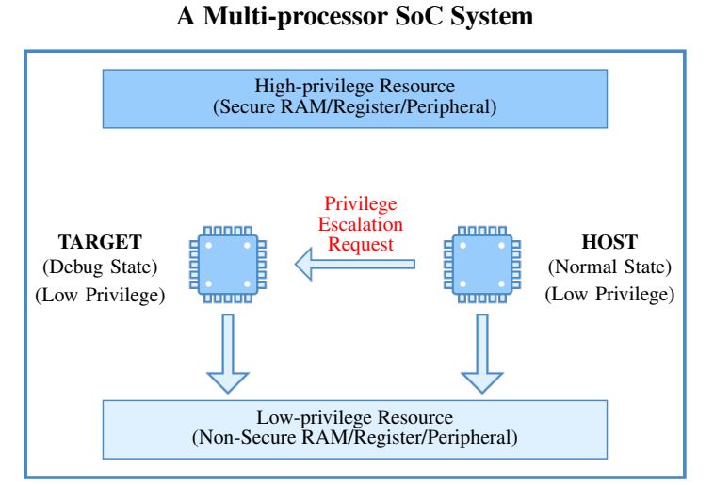
Introduction: Nailgun Attack
Source: Nailgun Attack Lecture slides

Slide 5
Introduction: How to defend?
Disabling the debug authentication signals? Great challenges!
Heavily influence most debug tools
Management of debug authentication is not publicly available
…

Slide 6
Introduction: How to defend?
Strict restriction in the inter-processor debugging?
Hardware-based access control to the debug registers?
Manufactures can implement it on the future devices.
But a great callback of current devices is expensive.
How about some software-based access control?

Slide 7
Introduction: Our defense
Implement the defense on higher privilege.
Control the access of the debug registers via memory mapping.
Fortunately, Arm provides Stage-2 translation.
It is controlled by EL2, and restrict the memory access in EL1&0.

Slide 8
Background

Slide 9
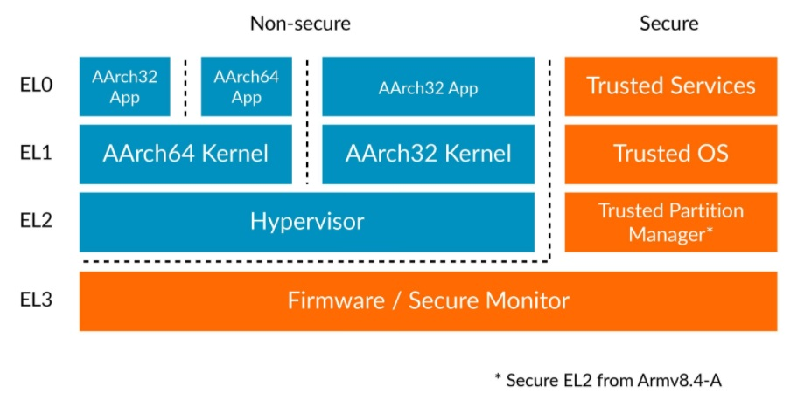
Background: Arm Exception Levels
Two worlds, Four ELs with different privileges.
Different CPUs can be in different ELs.
*Source: https://developer.arm.com/documentation/102412/0100/Execution-and-Security-states

Slide 10
Background: Arm Address Translation
Arm introduces three types of address:
Virtual Address (VA)
Intermediate Physical Address (IPA)
Physical Address (PA)
It can be used to isolate the process’ address space, access control, etc.

Slide 11
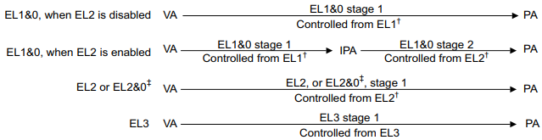
Background: Arm Address Translation
Arm also defines the address translation regimes.
*Source: D5-2684 (64-bit address translation), also you can see G5-6264 (32-bit address translation)

Slide 12
Background: Arm Address Translation
Stage 1 translation exists in all ELs.
But EL1&0 contains an additional translation: Stage-2 translation.
It is controlled by EL2.
Hypervisor in Arm architecture can use it to handle the memory management for VMs.
Similarly, we can use it in access control for EL1&0 CPUs.

Slide 13
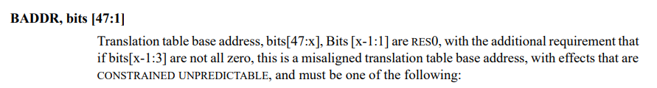
Background: Stage-2 translation
How to provide the table?
VTTBR register defines the address of the S-2 translation table.
Put the address of translation table into this register.
*Source: G8-6942

Slide 14
Background: Stage-2 translation
How to use it?
We (1) Enable the S-2 translation, and (2) Provide the table of S-2 translation, then Memory Management Unit (MMU) will perform the S-2 translation after the S-1 translation.
You may ask these questions:
How to enable it?
How to provide the table?
How to create the table?

Slide 15
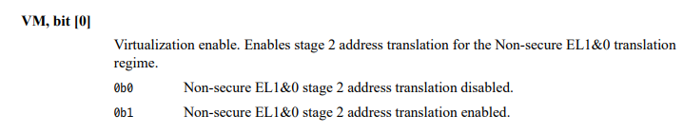
Background: Stage-2 translation
How to enable it?
HCR register controls the S-2 translation.
Set the bit[0] of HCR register as 0x1.
*Source: G8-6599

Slide 16
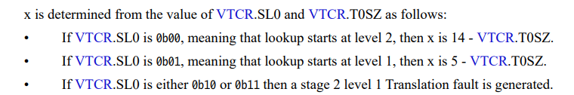
Background: Stage-2 translation
Actually, it does not need the specific table address.
It cuts the offset of the table address, which is provided in VTCR register.
We will configure this register later.
*Source: G8-6942

Slide 17
Background: Stage-2 translation
How to create the table?
The translation table consists of several levels and page entries (descriptors).
Each descriptor indicates the attributes of a region.
Attributes: Read, Write, Execute, Cacheable…
Region: the size is decided by the level of the descriptor.
Level1: 1GB region
Level2: 2MB region
Level3: 4KB region

Slide 18
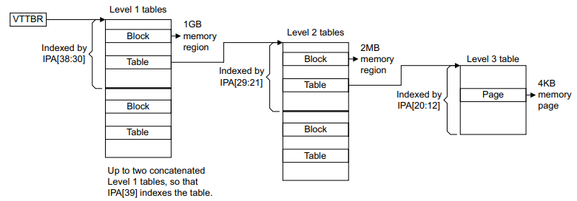
Background: Stage-2 translation
It shows the architecture of the translation table, the “Block”“Table”“Page” are different types of the descriptors.
*Source: G5-6289

Slide 19
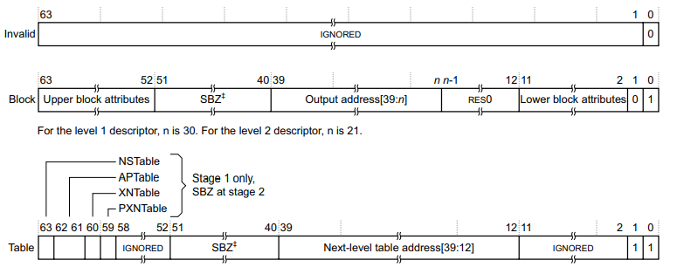
Background: Stage-2 translation
When we get a descriptor, it looks like this:
(Stage-2 translation uses Long descriptor, be careful when read manual.)
*Source: G5-6290

Slide 20

Background: Stage-2 translation
In a descriptor, the last two bits indicate the type of the descriptor.
Block (Level 1,2)/Page (Level 3): translation end, directly get the output
Invalid: translation fault
Table (Level 1,2): translation continue, go to next level.
*Source: G5-6290

Slide 21
Background: Stage-2 translation
It contains some attributes (which is not important in this Lab).
It indicates the output address, or the address of the next descriptor.
To get them, add the provided address (e.g., bit[39:12]) and the offset of your input address (e.g., bit[11:0]).
*Source: G5-6290, SBZ=should be zero, means fill 0; RES0: reserved as 0, means fill 0; IGNORED: fill anything you like

Slide 22
Background: Stage-2 translation
Example:
Your Input address is 0x12345678
Bit[39:12] (Next-level table address) is 0xdeadb
Then next address (0xdeadb<<12)+0x678=0xdeadb678.
Read it to get the value of the descriptor.
*Source: G5-6290, SBZ=should be zero, means fill 0; RES0: reserved as 0, means fill 0; IGNORED: fill anything you like

Slide 23
Design

Slide 24
Design
Goals in this Lab:
Enable the Stage-2 translation.
Invalid the mapping of the debug registers.
Invalid the mapping of S-2 translation table.

Slide 25
Design: Enable Stage-2 translation
Modified the device tree files to reserve a memory for the table.
In kernel booting stages, creating the S-2 translation table.
And configure related registers.
Replace the kernel image and compiled device tree files (.dtb) in “/boot” directory.
Boot your Raspberry Pi.

Slide 26
Design: Invalidate Mapping
The mapped memory of the debug registers is 0x4003_0000 ~ 0x4003_0FFF.
It is a 4KB region, you should split your table to 4KB-size granule.
Also, do not forget to invalidate the mapping of your table.
It just affect the EL1 attacker to read it, but not affect the EL2.

Slide 27
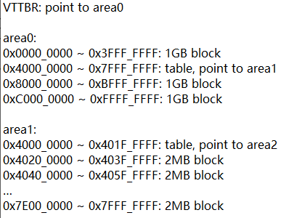
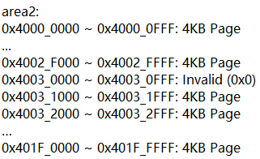
Design: Example
Here is one example of the table layout in 0x0 ~ 0xFFFF_FFFF (only invalid dbg)

Slide 28


Design: Example Translation Table Walk
Here we give an example of a successful address translation.
You can see the whole translation process in K7-8498.
We recommend you configure these bits of VTCR registers
SL0[7:6]: 0x1 (Starting at Level 1)
T0SZ[3:0]: 0x0 (Indicating the PA size is 2^32-1)

Slide 29
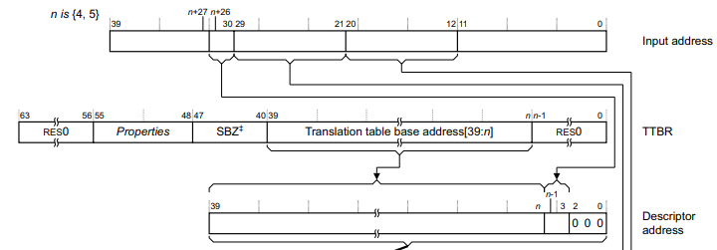
Design: Example Translation Table Walk
When we translate the IPA 0x4003_1234, starting at Level 1.
(1) We do Level 0 translation, and VTTBR tells us to go to area 0.
(2) We go to area 0 and get the descriptor of 0x4000_0000 ~ 0x7FFF_FFFF
*Source: K7-8498

Slide 30
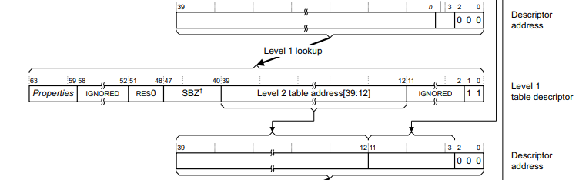
Design: Example Translation Table Walk
When we translate the IPA 0x4003_1234, starting at Level 1.
(3) We do Level 1 lookup of the descriptor 0x4000_0000 ~ 0x7FFF_FFFF, it is a table, and we should go to area2 to find the next descriptor.
(4) We go to area2 and get the descriptor of 0x4000_0000 ~ 0x401F_FFFF
*Source: K7-8498

Slide 31
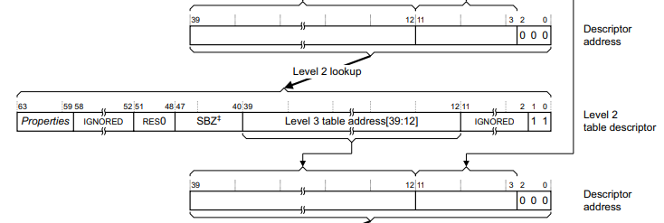
Design: Example Translation Table Walk
When we translate the IPA 0x4003_1234, starting at Level 1.
(5) We do Level 2 lookup of the descriptor 0x4000_0000 ~ 0x401F_FFFF, it is a table, and we should go to area3 to find the next descriptor.
(6) We go to area3 and get the descriptor of 0x4003_0000 ~ 0x4003_0FFF
*Source: K7-8498

Slide 32
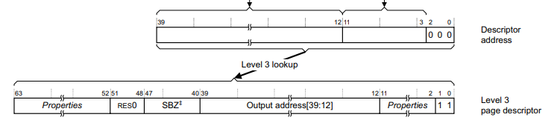
Design: Example Translation Table Walk
When we translate the IPA 0x4003_1234, starting at Level 1.
(7) We do Level 3 lookup of the descriptor 0x4003_0000 ~ 0x4003_0FFF, it is a page.
(8) Our translation result is (OA[39:12]<<12)+0x123
*Source: K7-8498

Slide 33
Possible Q&A

Slide 34
Possible Q&A
The system crashes when I load the Nailgun attack, why?
When we access the invalid region, it will trigger a translation fault.
But we have not designed the corresponding exception handler.
So the system cannot jump to the correct PC to exit the attack.

Slide 35
Possible Q&A
How about the cache and TLB attacks?
Actually, this Lab have not considered these attacks.
You can call them as “side-channel attack”, which is a popular topic.
We may extend the discussion in the future.

Slide 36
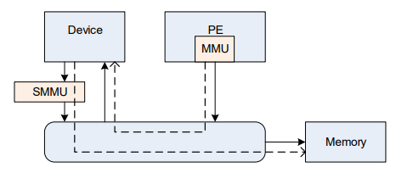
Possible Q&A
How about peripheral attacks?
Attacker can use the peripherals, such as GPU and DMA, to bypass the MMU (Specifically, the MMU for CPU).
But we can config the MMU for them with S-2 translation, which is called as SMMU (or IOMMU).
*Source: https://developer.arm.com/documentation/ihi0070/latest

Slide 37
Possible Q&A
Do we have technical support?
The biggest support is the reference manual.
Look up it and solve your problem.
Also, you can contact partial designers of this Lab.
12150073@mail.sustech.edu.cn (WANG Chenxu)

Slide 38
Necessary materials
1. Armv8-A Reference Manual
Download: https://developer.arm.com/documentation/ddi0487/latest
A dictionary of Armv8-A architecture.
Important part in this Lab: G5.1-G5.7, K7.2
(They are reference about 32-bit Armv8-A architecture)

Slide 39
Necessary materials
2. Linux Kernel Source file
Raspberry Pi provides the source codes for its kernel.
Download: https://github.com/raspberrypi/linux
Here we use the branch rpi-4.14.y or rpi-4.14.y-rt, you can also use the other branches.

Slide 40
Necessary materials
3. Cross-compile Tools
Raspberry Pi provide it: https://github.com/raspberrypi/tools
We use it because the environment of our VM and Raspberry Pi are different.
Mostly we use Ubuntu, which is based on Intel x86 architecture.
But Raspberry Pi uses Cortex-A53 cores, which support Armv8-A architecture.
*If you build Kernel files on Raspberry Pi, you will not use it.

