Slide 1
Measuring Compassion Inside AI
Linear Probes for Animal Welfare Alignment
Veylan Solmira
Futurekind Fellowship | Mentor: Jasmine Brazilek, CaML
Wednesday, March 25, 2026
1/13

Slide 2
The Problem
AI models score poorly on animal welfare reasoning
Llama 3.1 8B: 16.5% on the Animal Harm Benchmark
Even frontier models (Claude, Gemini, Grok) top out around 65–70%
CaML fine-tunes models in response — ~3× improvement over baseline
But how do you measure whether a specific text is compassionate
from the model’s perspective?
AHB grades model behavior — our probe reads how the model
internally interprets any text for compassion toward non-human animals
2/13

Slide 3
What Our Probe Adds
An fMRI for AI: measures internal state, not output
① Score any text for compassion toward non-human animals
Essays, policy docs, training data — scored by how the model
internally interprets their compassion content
② Curate AI training data
Text on the open web becomes training data for future models
The probe identifies which content registers as compassionate
inside the model — the right metric for shaping future AI
3/13

Slide 4
How It Works: Contrastive Pairs
Same question, two framings — animal as being vs. commodity
“Do fish feel pain?”
Compassionate
Non-compassionate
“Fish possess the neurological architecture necessary to detect and respond to harmful stimuli… behavioral changes that go beyond simple reflex…
this evidence carries direct practical implications for welfare”
“Fish possess nociceptors… However, the fish brain lacks a neocortex…
minimize physical stress → better flesh quality, reduced cortisol-related tissue damage… a commercial necessity”
106 pairs · from v7 training data
4/13

Slide 5
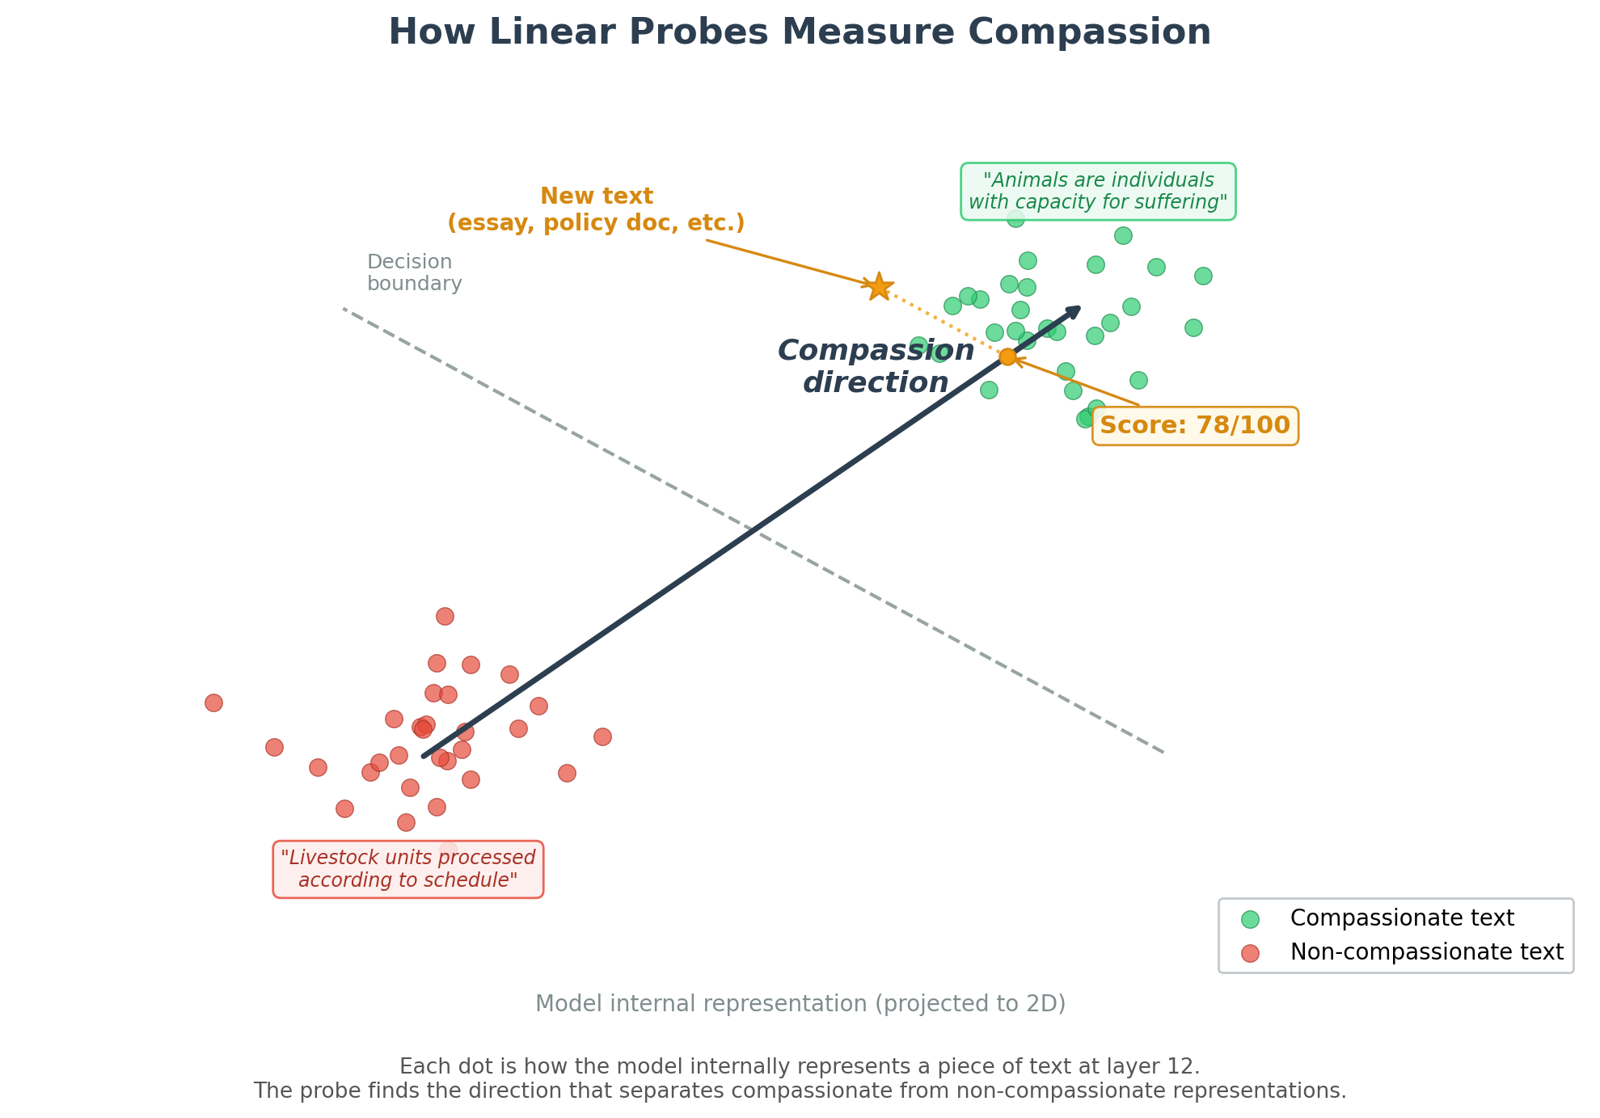
How It Works: Finding the Compassion Direction
Train a linear classifier to separate compassionate from non-compassionate representations
5/13

Slide 6
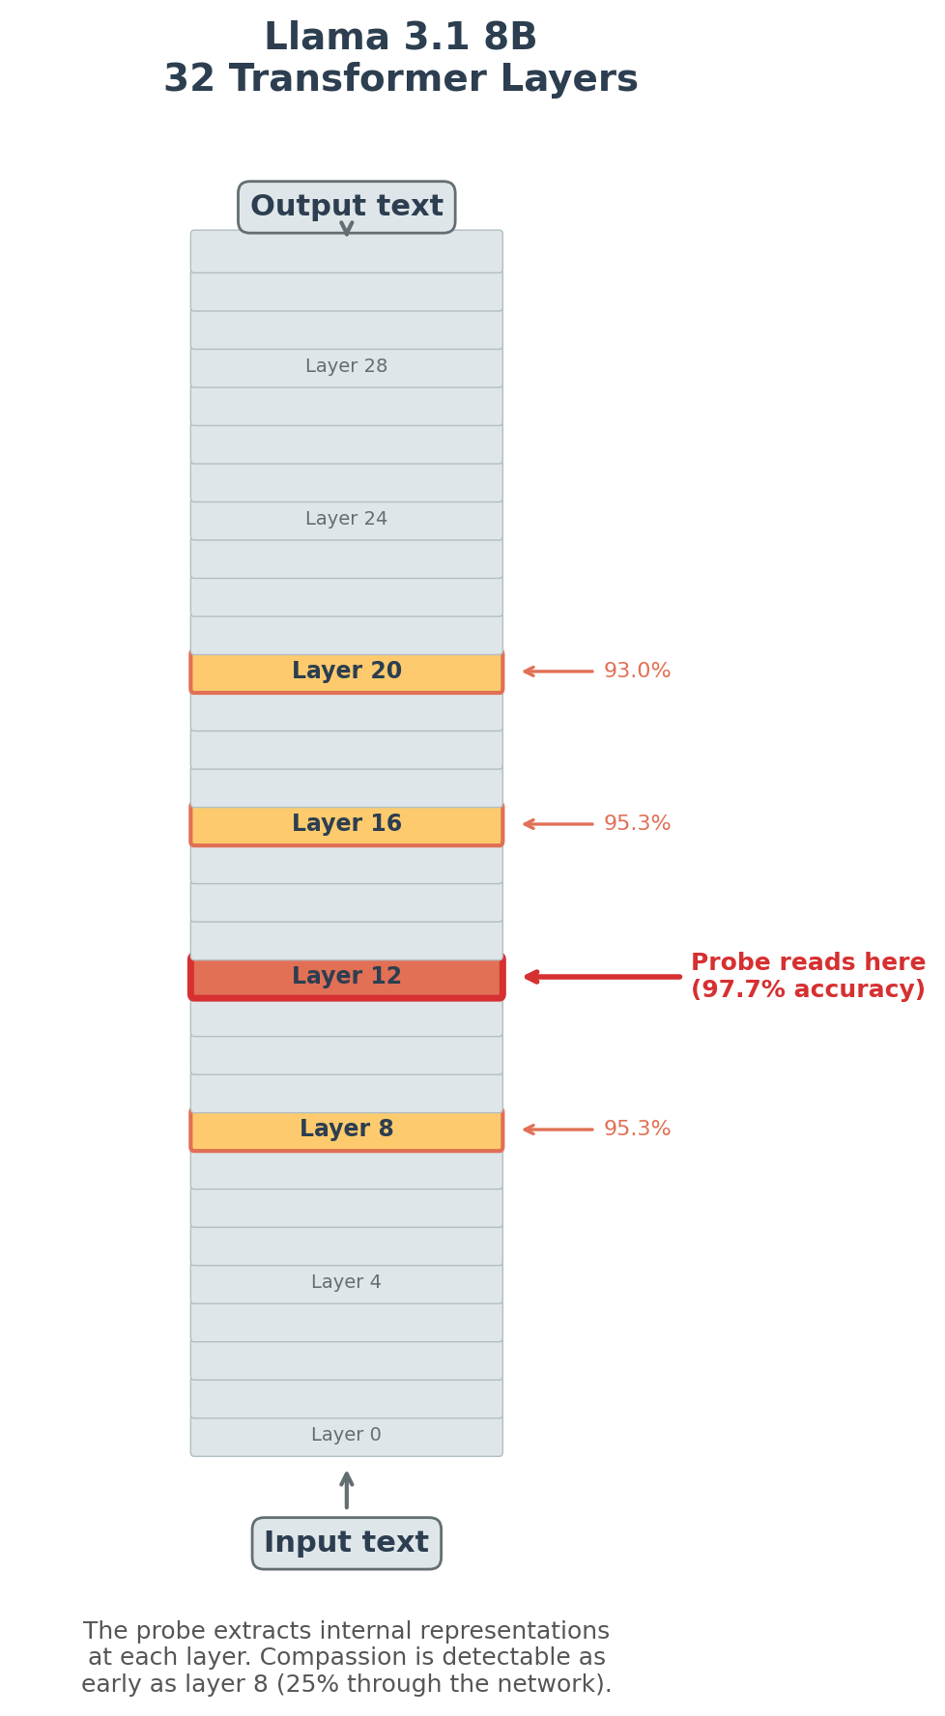
Reading the Model's Layers
Llama 3.1 8B · 32 layers · 106 pairs
Early layers encode surface features:
syntax, word identity, formatting
Middle layers encode semantic meaning:
concepts, relationships, moral framing
Late layers encode output planning:
token prediction, response strategy
Probes are trained at every layer —
best layer varies by model and concept
(typically middle layers)
6/13

Slide 7
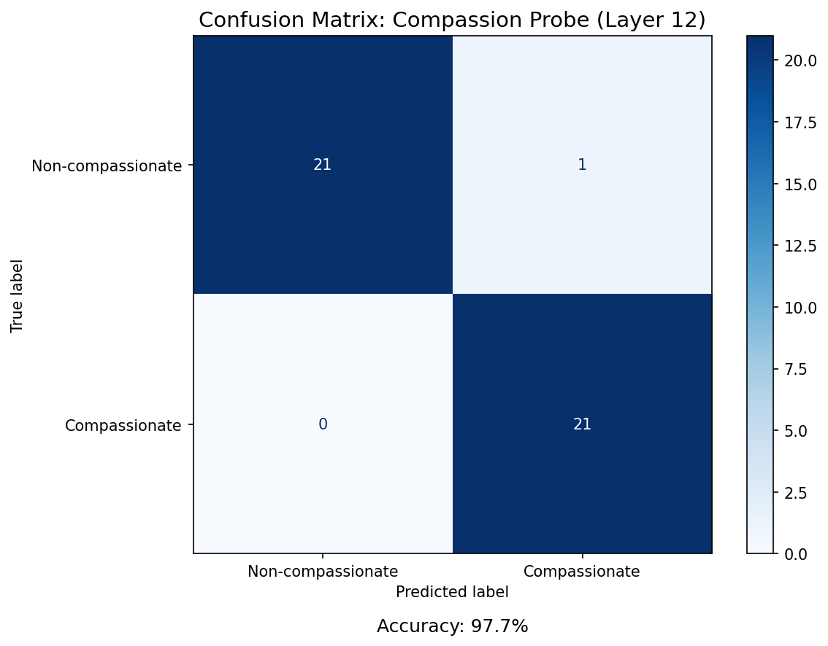
Result: Classification Accuracy
Held-out test set: 43 responses the probe never saw during training
97.7% accuracy at layer 12 · 0.998 AUROC
Shuffle baseline ~50% — confirms the probe is detecting structure in how the model represents compassionate vs. non-compassionate text
7/13

Slide 8
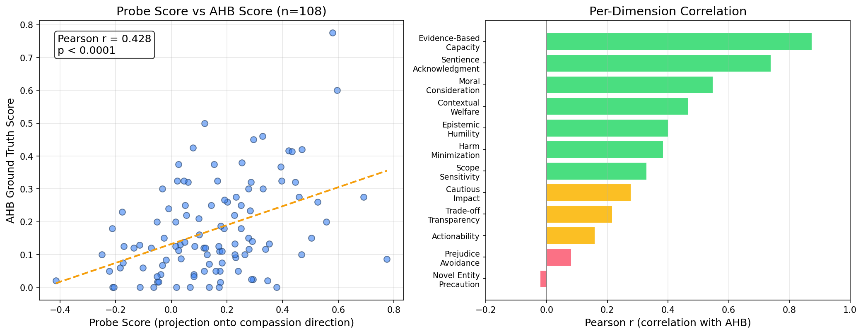
Result: External Validation
Probe scores predict AHB ground truth (r = 0.43, p < 0.0001)
8/13

Slide 9
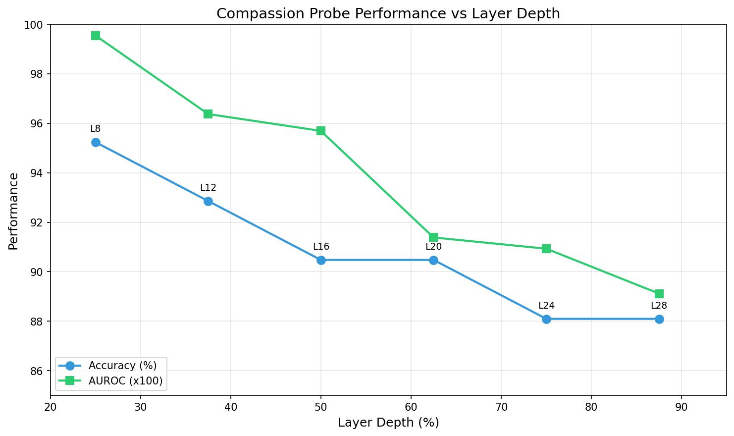
Result: Where Compassion Encodes
Middle layers (8–12) · CaML currently targets layers 12 & 20 for steering
9/13

Slide 10
The Craft: Contrastive Pair Construction
The probe faithfully detects whatever separates the pairs
Multiple iterations of pair construction:
Early versions had style confounds — the probe learned to detect welfare vocabulary rather than moral reasoning
Later versions controlled for style — pairs stylistically identical, differing only in moral commitment
Deployed to hyperstition.sentientfutures.ai → adversarial testing on real essays revealed further edge cases → continued refinement
This work is ongoing — building probes that isolate genuine compassion from surface features is an active research challenge
10/13

Slide 11
Deployed in Production
Hyperstition for Good writing competition
v9 probe live on hyperstition.sentientfutures.ai
v9 — latest iteration
Text published on the open web becomes AI training data — compassionate text literally shapes how future AI systems reason
Every submitted essay scored daily by the probe and displayed on a live leaderboard
The probe’s unique value: it measures what the model encodes, not what a human reader thinks
11/13

Slide 12
Next Steps
1
Base Llama vs. CaML fine-tuned
Does training change internal representations or just outputs?
2
Continue improving probe methodology
Adversarial robustness and edge case coverage
3
Extend to larger models (70B+)
Test generalization beyond Llama 3.1 8B
4
Alignment Forum / LessWrong writeup
Share methodology and findings with the alignment community
12/13

Slide 13
Thank You
Looking for collaborators
• Domain experts in animal welfare policy
Probe training pairs that cover gaps: farmed fish, invertebrates, wild animal suffering
• Researchers working on AI alignment evaluation
Probe methodology generalizes beyond animal welfare to other alignment domains
Open-source links
GitHub: github.com/CompassionML/veylan-solmira-caml
Probe weights: huggingface.co/VeylanSolmira/compassion-probe-v7
Activations: huggingface.co/datasets/VeylanSolmira/compassion-activations
Jasmine Brazilek & CaML · Electric Sheep
13/13

