Slide 1
CompeteMcGill Dynamic programming
Andre Kaba

Slide 2
Topics today:
What is dynamic programming?
Fibonacci - a very simple example.
Coin change - a classical example.
Couple of interesting problems

Slide 3
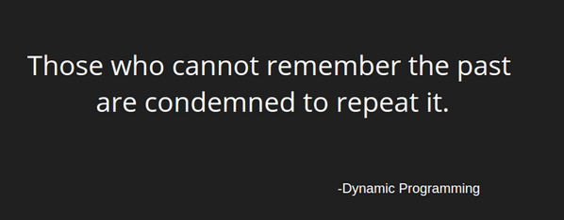

Slide 4
Dynamic Programming
Idea is that we want to brute-force the search space only once!
Solution steps:
Split the problem into overlapping subproblems
Solve each subproblem recursively
Combine solutions to subproblems
Store the computed solution for later use

Slide 5

Fibonacci
Compute the ith fibonacci number!
$$F_{0} =0$$
$$F_{1} = 1$$
$$F_{n} = F_{n − 2} + F_{n − 1}$$

Slide 6
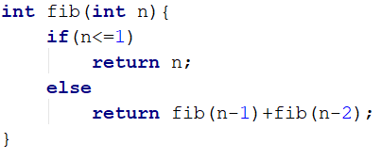
Fibonacci
Plain recursion

Slide 7
Fibonacci
Plain recursion
Any Drawbacks?

Slide 8

Fibonacci
Plain recursion
Any Drawbacks?
Running time: $O\left(2^{n}\right)$

Slide 9
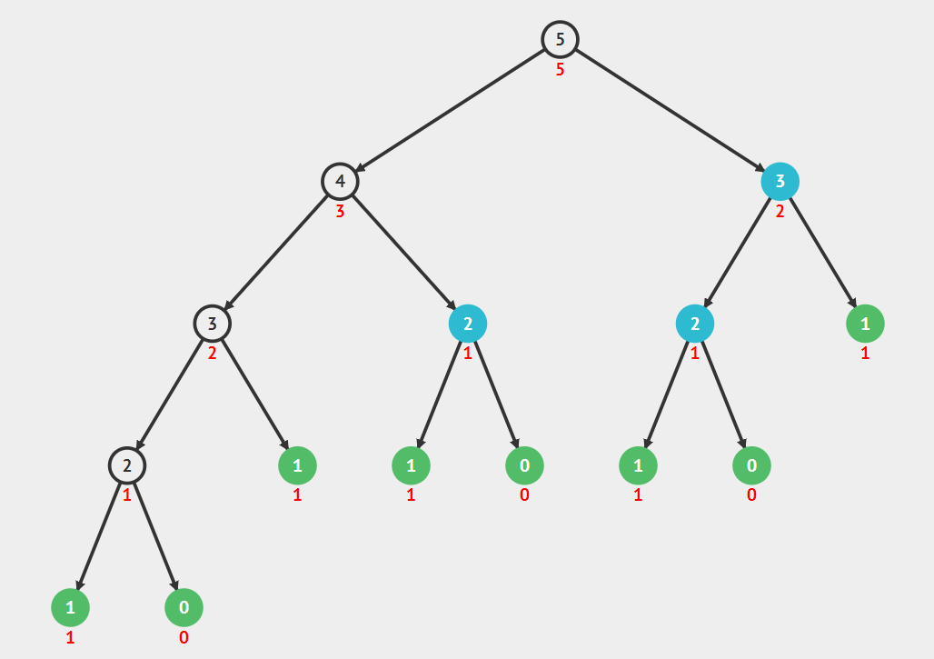
Fibonacci

Slide 10
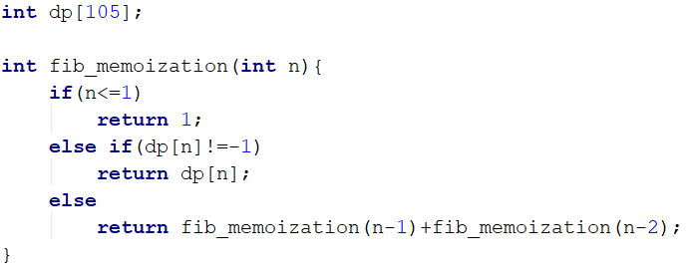
Fibonacci:
Dynamic programming
Top down (Memoization)

Slide 11
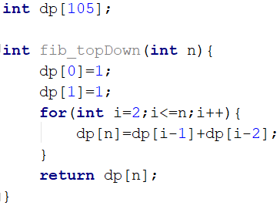
Fibonacci:
Dynamic programming
Top down (Memoization)
Bottom up

Slide 12
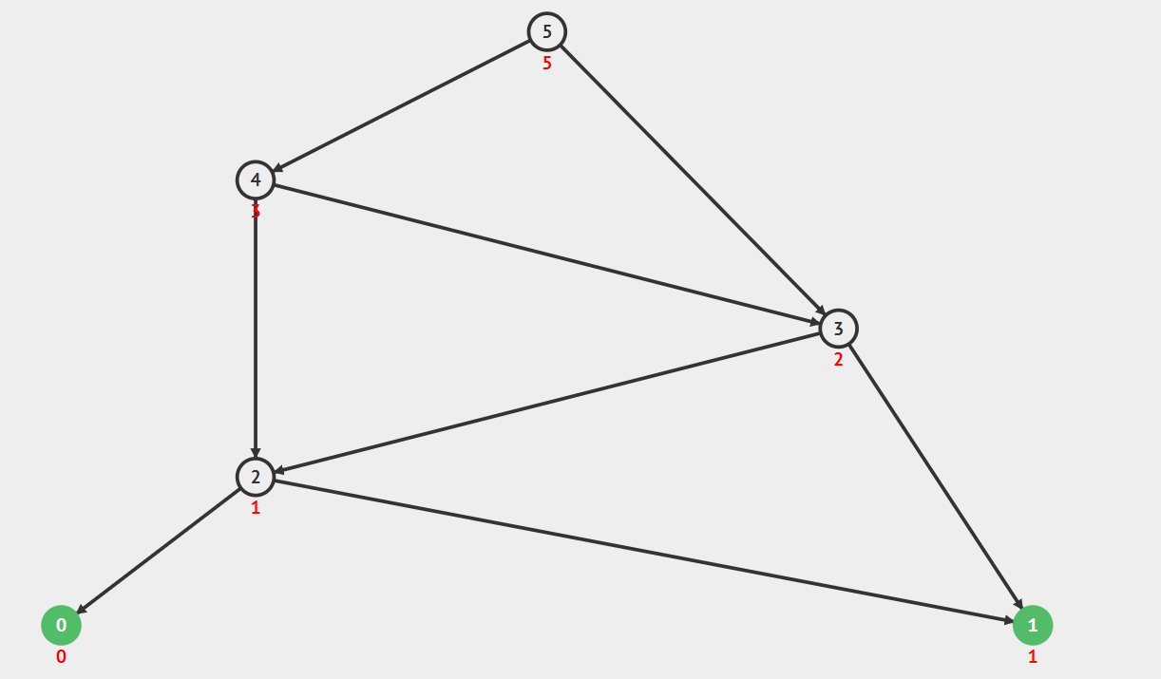
Fibonacci:
Dynamic programming

Slide 13
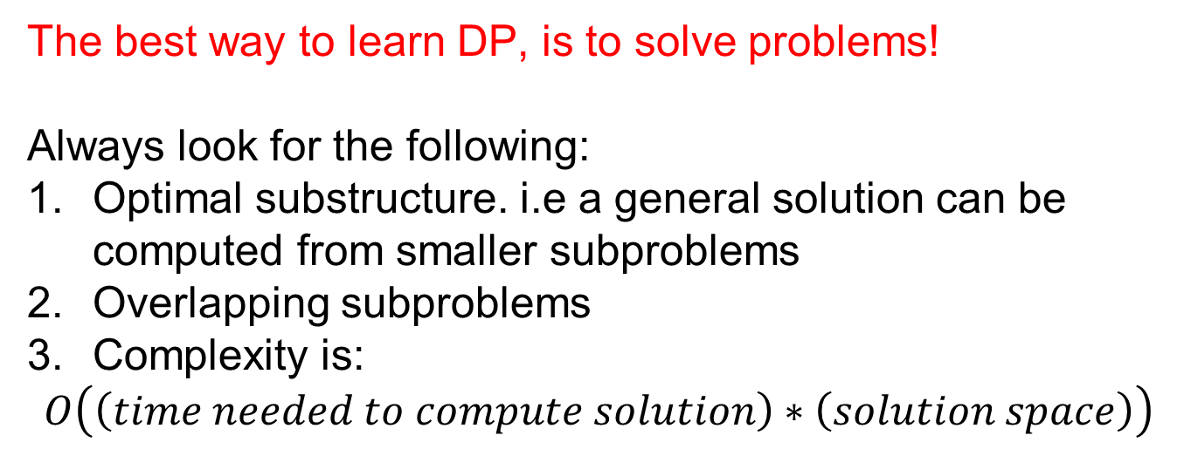
Dynamic Programming problems
The best way to learn DP, is to solve problems!
Always look for the following:
Optimal substructure. i.e a general solution can be computed from smaller subproblems
Overlapping subproblems
Complexity is:
$$O\left(\left(time needed to compute solution\right)∗\left(solution space\right)\right)$$

Slide 14





Back to our DP implementation:
$$O(n)$$
$$…$$
$$O(1)$$
$$…$$
$$O(1)$$

Slide 15
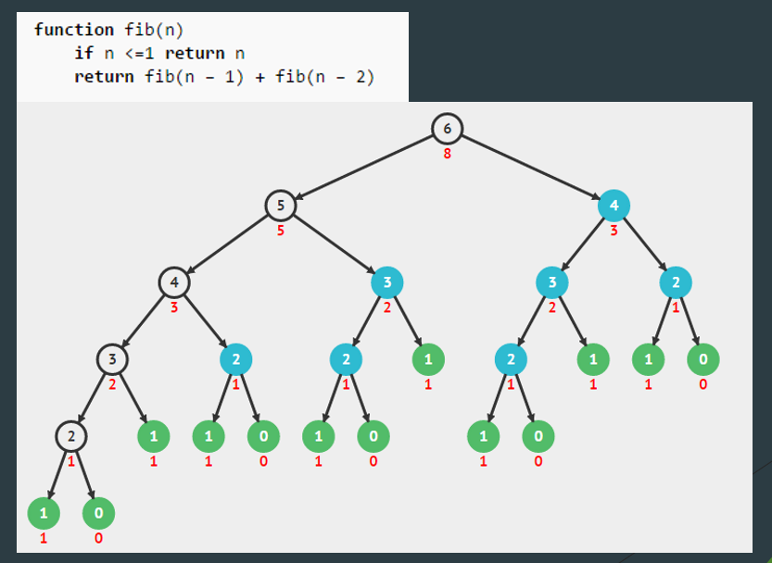
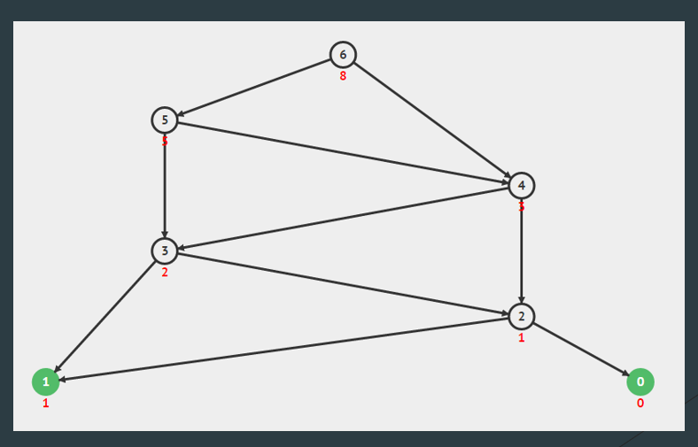
Recursion vs DP:

Slide 16
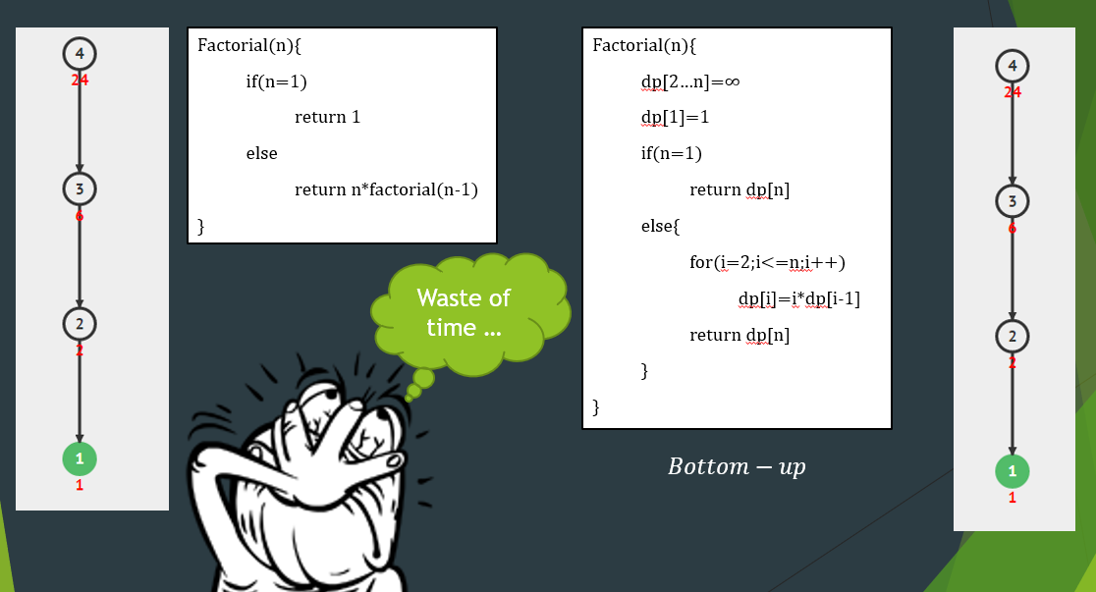
Doesn’t always work:

Slide 17
Coin change - a classical example.

Slide 18
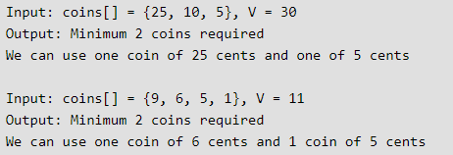
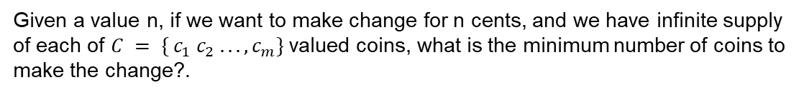
Coin change
Given a value n, if we want to make change for n cents, and we have infinite supply of each of $C = \{ c_{1} c_{2} .. . , c_{m}\}$valued coins, what is the minimum number of coins to make the change?.
Example:
25
5
6
5

Slide 19
Greedy?
Given a value n, if we want to make change for n cents, and we have infinite supply of each of $C = \{ c_{1} c_{2} .. . , c_{m}\}$valued coins, what is the minimum number of coins to make the change?.
Example:
25
5
6
5
Just pick the minimum coin that fits in n!

Slide 20
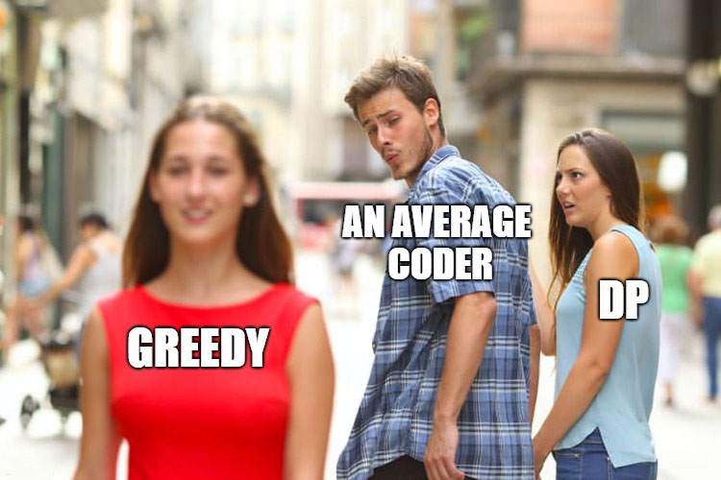

Slide 21
Greedy?
Given a value n, if we want to make change for n cents, and we have infinite supply of each of $C = \{ c_{1} c_{2} .. . , c_{m}\}$valued coins, what is the minimum number of coins to make the change?.
Example:
25
5
6
5
Just pick the largest coin that fits in n!
Only for canonical coin systems, Consider $n=6$with $C=\{1,3,4\}$

Slide 22
Brute-force?
Given a value n, if we want to make change for n cents, and we have infinite supply of each of $C = \{ c_{1} c_{2} .. . , c_{m}\}$valued coins, what is the minimum number of coins to make the change?.
Example:
25
5
6
5
What about brute force?

Slide 23
Brute-force?
Given a value n, if we want to make change for n cents, and we have infinite supply of each of $C = \{ c_{1} c_{2} .. . , c_{m}\}$valued coins, what is the minimum number of coins to make the change?.
Example:
25
5
6
5
What about brute force? Yes … but

Slide 24
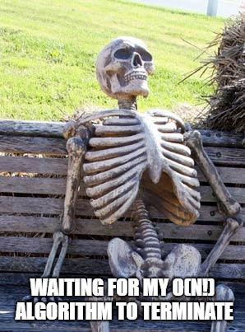

Slide 25
Dynamic programming Bottom-top approach

Slide 26
Recursive formula
Can we use recursion to describe a solution?

Slide 27
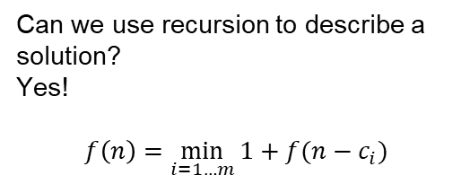
Recursive formula
Can we use recursion to describe a solution?
Yes!
$$f\left(n\right)=\min_{i=1…m}{1+f(n−c_{i})}$$

Slide 28
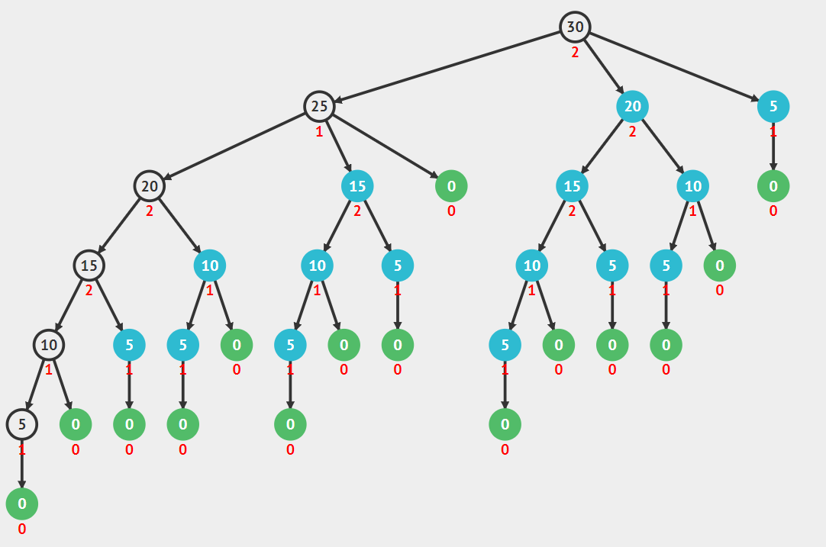
Recursive formula
Can we use recursion to describe a solution?
Yes!
$$f\left(n\right)=\min_{i=1…m}{1+f(n−c_{i})}$$

Slide 29
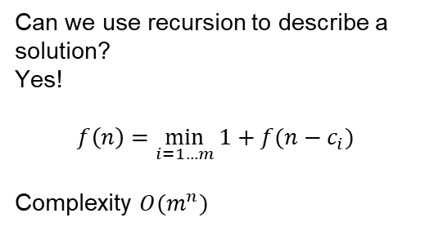
Recursive formula
Can we use recursion to describe a solution?
Yes!
$$f\left(n\right)=\min_{i=1…m}{1+f(n−c_{i})}$$
Complexity $O(m^{n})$

Slide 30
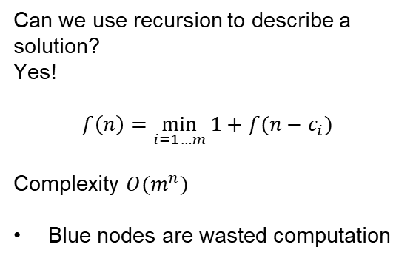
Recursive formula
Can we use recursion to describe a solution?
Yes!
$$f\left(n\right)=\min_{i=1…m}{1+f(n−c_{i})}$$
Complexity $O(m^{n})$
Blue nodes are wasted computation

Slide 31
Bottom up approach
We would like to store solutions and use them later.

Slide 32
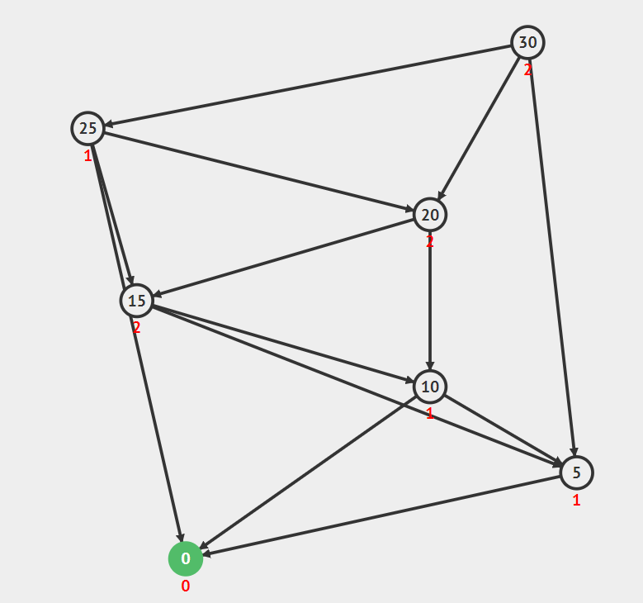
Bottom up approach
We would like to store solutions and use them later.

Slide 33
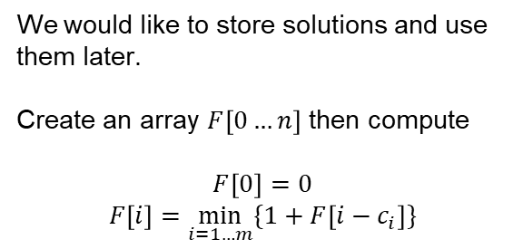
Bottom up approach
We would like to store solutions and use them later.
Create an array $F\left[0…n\right]$ then compute
$$F\left[0\right]=0$$
$$F\left[i\right]=\min_{i=1…m}{\{1+F\left[i−c_{i}\right]\}}$$

Slide 34
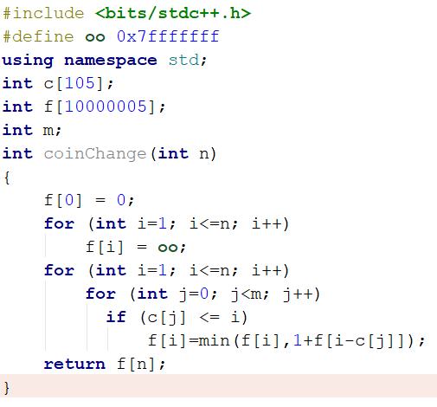
Bottom up approach
We would like to store solutions and use them later.
Create an array $F\left[0…n\right]$ then compute
$$F\left[0\right]=0$$
$$F\left[i\right]=\min_{i=1…m}{\{1+F\left[i−c_{i}\right]\}}$$

Slide 35

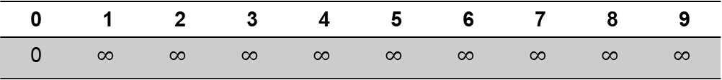

Understand the solution
$$C_{i}$$
1 | 2 | 4
$$n=9$$
0 | 1 | 2 | 3 | 4 | 5 | 6 | 7 | 8 | 9
0 | $$∞$$ | $$∞$$ | $$∞$$ | $$∞$$ | $$∞$$ | $$∞$$ | $$∞$$ | $$∞$$ | $$∞$$

Slide 36
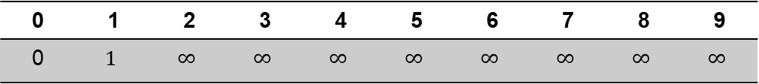
Understand the solution
$$C_{i}$$
1 | 2 | 4
$$n=9$$
0 | 1 | 2 | 3 | 4 | 5 | 6 | 7 | 8 | 9
0 | $$1$$ | $$∞$$ | $$∞$$ | $$∞$$ | $$∞$$ | $$∞$$ | $$∞$$ | $$∞$$ | $$∞$$

Slide 37
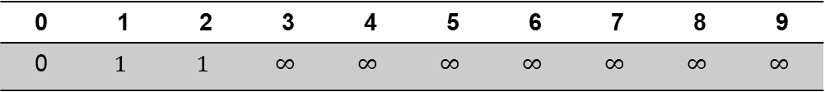
Understand the solution
$$C_{i}$$
1 | 2 | 4
$$n=9$$
0 | 1 | 2 | 3 | 4 | 5 | 6 | 7 | 8 | 9
0 | $$1$$ | $$1$$ | $$∞$$ | $$∞$$ | $$∞$$ | $$∞$$ | $$∞$$ | $$∞$$ | $$∞$$

Slide 38
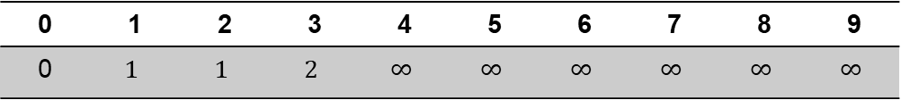
Understand the solution
$$C_{i}$$
1 | 2 | 4
$$n=9$$
0 | 1 | 2 | 3 | 4 | 5 | 6 | 7 | 8 | 9
0 | $$1$$ | $$1$$ | $$2$$ | $$∞$$ | $$∞$$ | $$∞$$ | $$∞$$ | $$∞$$ | $$∞$$

Slide 39
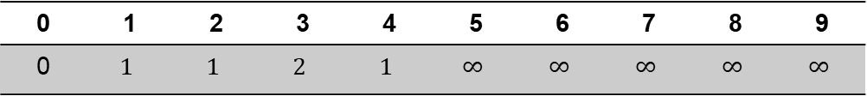
Understand the solution
$$C_{i}$$
1 | 2 | 4
$$n=9$$
0 | 1 | 2 | 3 | 4 | 5 | 6 | 7 | 8 | 9
0 | $$1$$ | $$1$$ | $$2$$ | $$1$$ | $$∞$$ | $$∞$$ | $$∞$$ | $$∞$$ | $$∞$$

Slide 40
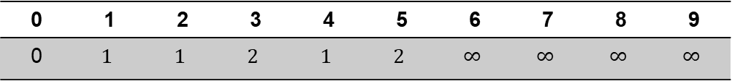
Understand the solution
$$C_{i}$$
1 | 2 | 4
$$n=9$$
0 | 1 | 2 | 3 | 4 | 5 | 6 | 7 | 8 | 9
0 | $$1$$ | $$1$$ | $$2$$ | $$1$$ | $$2$$ | $$∞$$ | $$∞$$ | $$∞$$ | $$∞$$

Slide 41
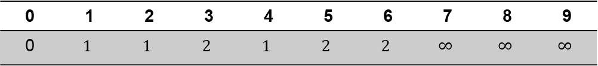
Understand the solution
$$C_{i}$$
1 | 2 | 4
$$n=9$$
0 | 1 | 2 | 3 | 4 | 5 | 6 | 7 | 8 | 9
0 | $$1$$ | $$1$$ | $$2$$ | $$1$$ | $$2$$ | $$2$$ | $$∞$$ | $$∞$$ | $$∞$$

Slide 42
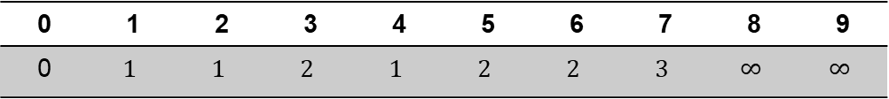
Understand the solution
$$C_{i}$$
1 | 2 | 4
$$n=9$$
0 | 1 | 2 | 3 | 4 | 5 | 6 | 7 | 8 | 9
0 | $$1$$ | $$1$$ | $$2$$ | $$1$$ | $$2$$ | $$2$$ | $$3$$ | $$∞$$ | $$∞$$

Slide 43
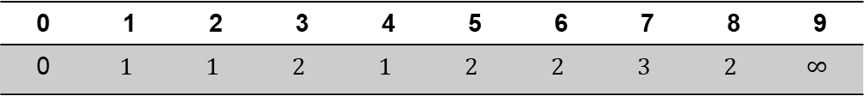
Understand the solution
$$C_{i}$$
1 | 2 | 4
$$n=9$$
0 | 1 | 2 | 3 | 4 | 5 | 6 | 7 | 8 | 9
0 | $$1$$ | $$1$$ | $$2$$ | $$1$$ | $$2$$ | $$2$$ | $$3$$ | $$2$$ | $$∞$$

Slide 44
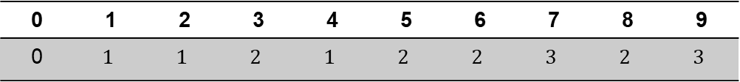
Understand the solution
$$C_{i}$$
1 | 2 | 4
$$n=9$$
0 | 1 | 2 | 3 | 4 | 5 | 6 | 7 | 8 | 9
0 | $$1$$ | $$1$$ | $$2$$ | $$1$$ | $$2$$ | $$2$$ | $$3$$ | $$2$$ | $$3$$

Slide 45
Top-bottom approach (Memoization)

Slide 46
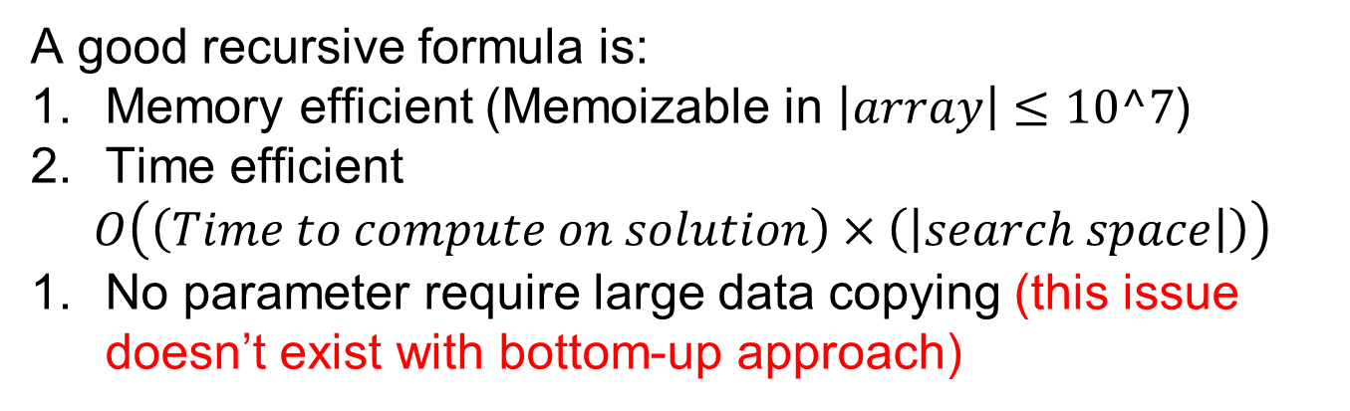
Holy grail of Memoization:
Derive a “good” recursive formula then Memoize it
A good recursive formula is:
Memory efficient (Memoizable in $\left|array\right|≤10^7$)
Time efficient
$$O\left(\left(Time to compute on solution\right)×\left(\left|search space\right|\right)\right)$$
No parameter require large data copying (this issue doesn’t exist with bottom-up approach)

Slide 47
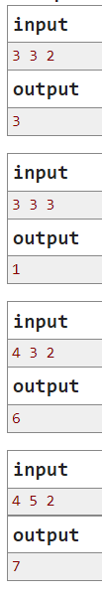
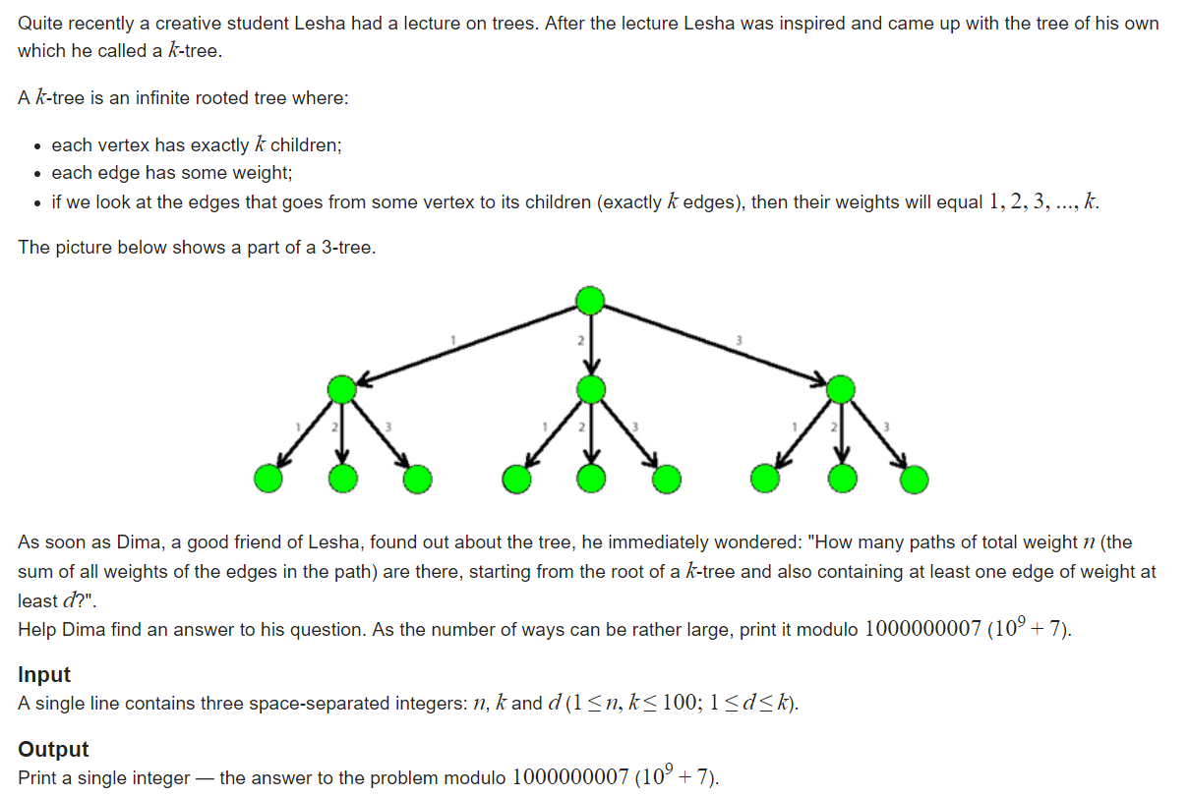
k-Tree
Source: https://www.hackerrank.com/challenges/merging-communities/problem

Slide 48
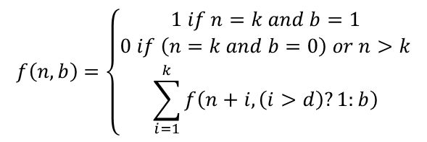
Recursive formula: (n,k,d)=(3,3,2)
$$f\left(n,b\right)=\left\{\begin{aligned}1 if n=k and b=1 \\ 0 if \left(n=k and b=0\right) or n>k \\ \sum_{i=1}^{k}{f\left(n+i,\left(i>d\right)?1:b\right)}\end{aligned}\right.$$
3
1
2
…
…
…

Slide 49










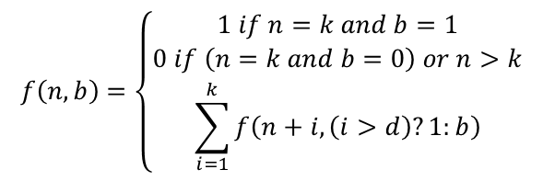
Recursive formula:
$$f\left(n,b\right)=\left\{\begin{aligned}1 if n=k and b=1 \\ 0 if \left(n=k and b=0\right) or n>k \\ \sum_{i=1}^{k}{f\left(n+i,\left(i>d\right)?1:b\right)}\end{aligned}\right.$$
$$f\left(0,0\right)$$
$$f\left(1,0\right)$$
$$f\left(2,1\right)$$
$$f\left(3,1\right)$$
$$f\left(2,0\right)$$
$$f\left(3,1\right)$$
$$f\left(4,1\right)$$
$$f\left(3,1\right)$$
$$f\left(4,1\right)$$
$$f\left(5,1\right)$$

Slide 50




Recursive formula:
$$f\left(n,b\right)=\left\{\begin{aligned}1 if n=k and b=1 \\ 0 if \left(n=k and b=0\right) or n>k \\ \sum_{i=1}^{k}{f\left(n+i,\left(i>d\right)?1:b\right)}\end{aligned}\right.$$
$$f\left(0,0\right)$$
$$f\left(1,0\right)$$
$$f\left(2,0\right)$$
$$f\left(3,1\right)$$
$$f\left(2,0\right)$$
$$f\left(3,0\right)$$
$$f\left(4,1\right)$$
$$f\left(3,0\right)$$
$$f\left(4,0\right)$$
$$f\left(5,1\right)$$

Slide 51


Slide 52
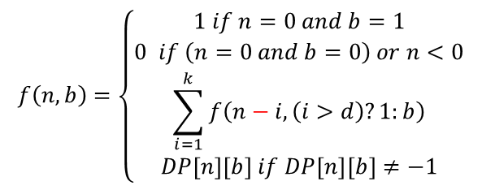
Memoize: (n,k,d)=(3,3,2)
1
3
$$f\left(n,b\right)=\left\{\begin{aligned}1 if n=0 and b=1 \\ 0 if \left(n=0 and b=0\right) or n<0 \\ \sum_{i=1}^{k}{f\left(n−i,\left(i>d\right)?1:b\right)} \\ DP\left[n\right]\left[b\right] if DP\left[n\right]\left[b\right]≠−1\end{aligned}\right.$$
2
…
…
…
Memoization!

Slide 53
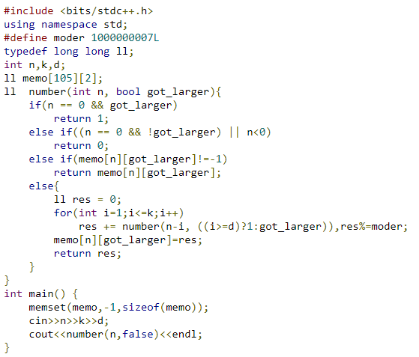
Solution:

Slide 54

Bottom-up view:
$$f\left(n,b\right)=\left\{\begin{aligned}1 if n=0 and b=1 \\ 0 if \left(n=0 and b=0\right) or n<0 \\ \sum_{i=1}^{k}{f\left(n−i,\left(i≥d\right)?1:b\right)} \\ DP\left[n\right]\left[b\right] if DP\left[n\right]\left[b\right]≠−1\end{aligned}\right.$$
1
3
2
…
…
…
DP(k) | 0 | 1 | 2 | 3 | 4 | 5 | 6 | 7
b=0 | 0 | -1 | -1 | -1 | -1 | -1 | -1 | -1
b=1 | 1 | -1 | -1 | -1 | -1 | -1 | -1 | -1
…

Slide 55




Bottom-up view:
$$f\left(n,b\right)=\left\{\begin{aligned}1 if n=0 and b=1 \\ 0 if \left(n=0 and b=0\right) or n<0 \\ \sum_{i=1}^{k}{f\left(n−i,\left(i≥d\right)?1:b\right)} \\ DP\left[n\right]\left[b\right] if DP\left[n\right]\left[b\right]≠−1\end{aligned}\right.$$
1
3
2
…
…
…
$$n−3$$
$$n−2$$
$$n−1$$
$$n$$
DP(k) | 0 | 1 | 2 | 3 | 4 | 5 | 6 | 7
b=0 | 0 | 0 | -1 | -1 | -1 | -1 | -1 | -1
b=1 | 1 | 1 | -1 | -1 | -1 | -1 | -1 | -1
…

Slide 56
Bottom-up view:
$$f\left(n,b\right)=\left\{\begin{aligned}1 if n=0 and b=1 \\ 0 if \left(n=0 and b=0\right) or n<0 \\ \sum_{i=1}^{k}{f\left(n−i,\left(i≥d\right)?1:b\right)} \\ DP\left[n\right]\left[b\right] if DP\left[n\right]\left[b\right]≠−1\end{aligned}\right.$$
1
3
2
…
…
…
$$n−3$$
$$n−2$$
$$n−1$$
$$n$$
DP(k) | 0 | 1 | 2 | 3 | 4 | 5 | 6 | 7
b=0 | 0 | 0 | 1 | -1 | -1 | -1 | -1 | -1
b=1 | 1 | 1 | 2 | -1 | -1 | -1 | -1 | -1
…

Slide 57
Bottom-up view:
$$f\left(n,b\right)=\left\{\begin{aligned}1 if n=0 and b=1 \\ 0 if \left(n=0 and b=0\right) or n<0 \\ \sum_{i=1}^{k}{f\left(n−i,\left(i≥d\right)?1:b\right)} \\ DP\left[n\right]\left[b\right] if DP\left[n\right]\left[b\right]≠−1\end{aligned}\right.$$
1
3
2
…
…
…
$$n−3$$
$$n−2$$
$$n−1$$
$$n$$
DP(k) | 0 | 1 | 2 | 3 | 4 | 5 | 6 | 7
b=0 | 0 | 0 | 1 | 3 | -1 | -1 | -1 | -1
b=1 | 1 | 1 | 2 | 4 | -1 | -1 | -1 | -1
…

Slide 58
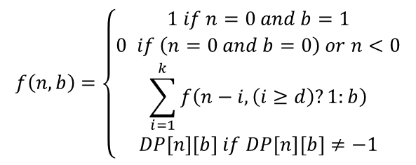
Bottom-up view:
$$f\left(n,b\right)=\left\{\begin{aligned}1 if n=0 and b=1 \\ 0 if \left(n=0 and b=0\right) or n<0 \\ \sum_{i=1}^{k}{f\left(n−i,\left(i≥d\right)?1:b\right)} \\ DP\left[n\right]\left[b\right] if DP\left[n\right]\left[b\right]≠−1\end{aligned}\right.$$
1
3
2
…
…
…
$$n−3$$
$$n−2$$
$$n−1$$
$$n$$
DP(k) | 0 | 1 | 2 | 3 | 4 | 5 | 6 | 7
b=0 | 0 | 0 | 1 | 3 | 6 | 12 | 23 | 43
b=1 | 1 | 1 | 2 | 4 | 7 | 13 | 24 | 44
…

Slide 59
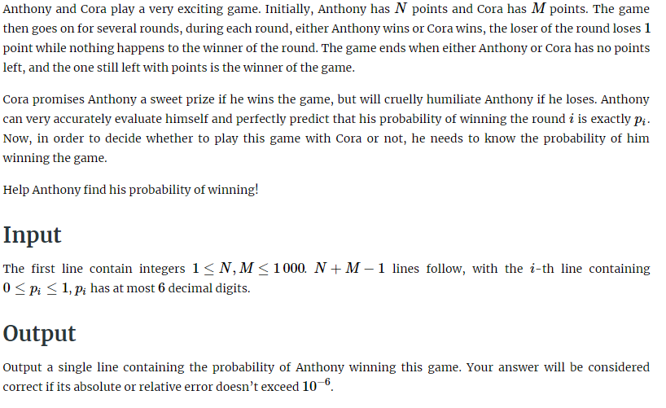
Anthony and Cora
Source: https://www.hackerrank.com/challenges/merging-communities/problem

Slide 60
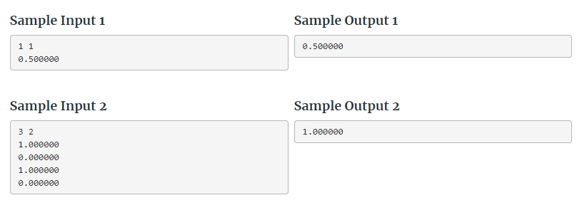
Anthony and Cora

Slide 61
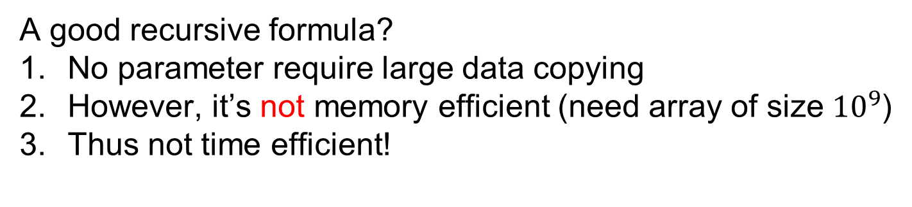
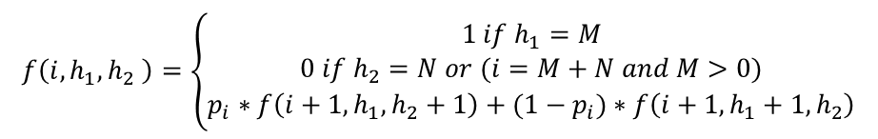
Representation
$$f\left(i,h_{1},h_{2} \right)=\left\{\begin{aligned}1 if h_{1}=M \\ 0 if h_{2}=N or (i=M+N and M>0) \\ p_{i}∗f\left(i+1,h_{1},h_{2}+1\right)+(1−p_{i})∗f\left(i+1,h_{1}+1,h_{2}\right)\end{aligned}\right.$$
A good recursive formula?
No parameter require large data copying
However, it’s not memory efficient (need array of size ${10}^{9}$)
Thus not time efficient!

Slide 62

Representation
$$f\left(i,h_{1},h_{2} \right)=\left\{\begin{aligned}1 if h_{1}=M \\ 0 if h_{2}=N or (i=M+N and M>0) \\ p_{i}∗f\left(i+1,h_{1},h_{2}+1\right)+(1−p_{i})∗f\left(i+1,h_{1}+1,h_{2}\right)\end{aligned}\right.$$
Let’s try to drop one of the parameters…
Notice that:
$$h_{2}= (i−h_{1})$$

Slide 63
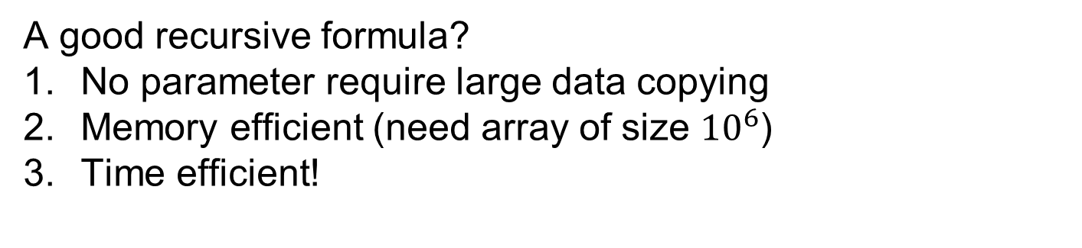
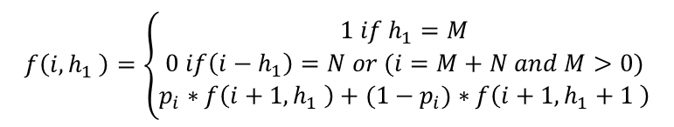
Representation
$$f\left(i,h_{1} \right)=\left\{\begin{aligned}1 if h_{1}=M \\ 0 if\left(i−h_{1}\right)=N or (i=M+N and M>0) \\ p_{i}∗f\left(i+1,h_{1} \right)+(1−p_{i})∗f\left(i+1,h_{1}+1 \right)\end{aligned}\right.$$
A good recursive formula?
No parameter require large data copying
Memory efficient (need array of size ${10}^{6}$)
Time efficient!

Slide 64
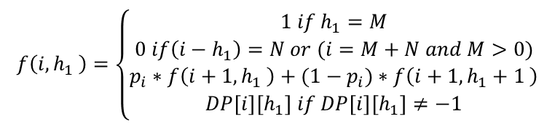
Memoization
$$f\left(i,h_{1} \right)=\left\{\begin{aligned}1 if h_{1}=M \\ 0 if\left(i−h_{1}\right)=N or (i=M+N and M>0) \\ p_{i}∗f\left(i+1,h_{1} \right)+(1−p_{i})∗f\left(i+1,h_{1}+1 \right) \\ DP\left[i\right]\left[h_{1}\right] if DP\left[i\right]\left[h_{1}\right]≠−1\end{aligned}\right.$$

Slide 65
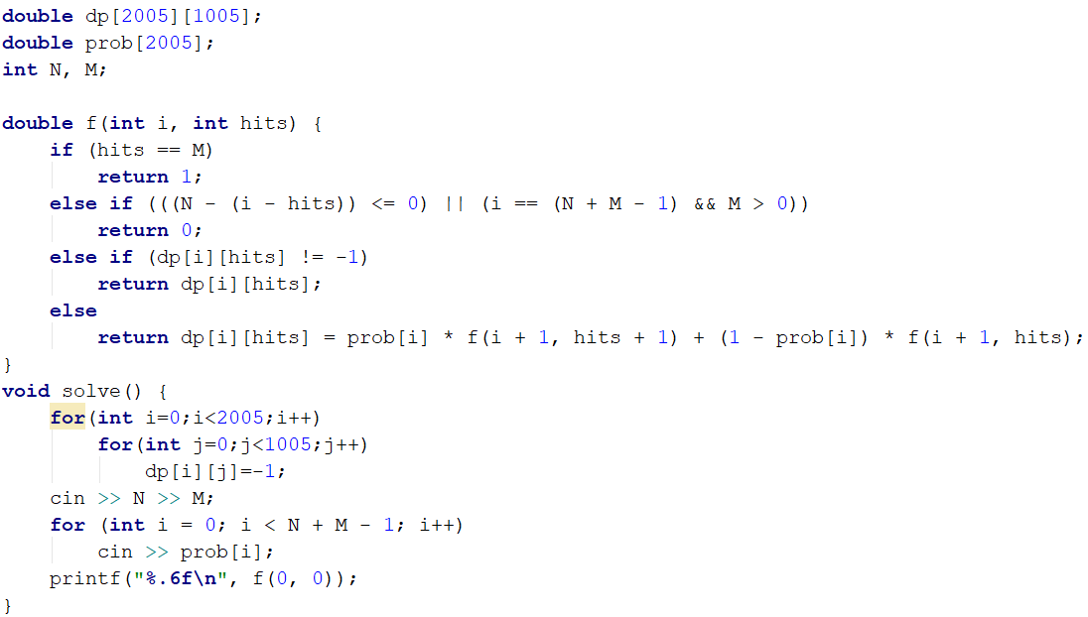
Solution

Slide 66
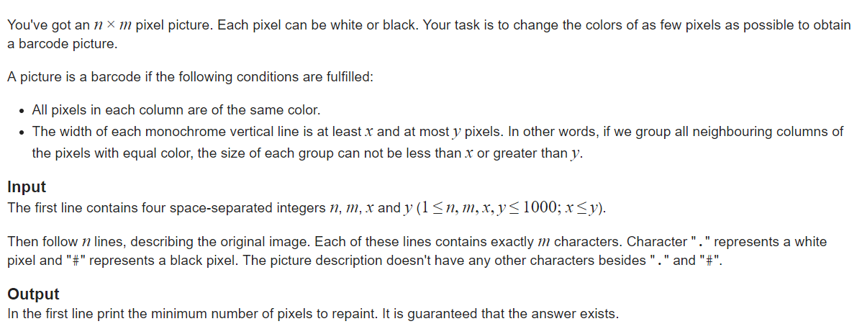
Barcode
Source: http://codeforces.com/problemset/problem/225/C

Slide 67
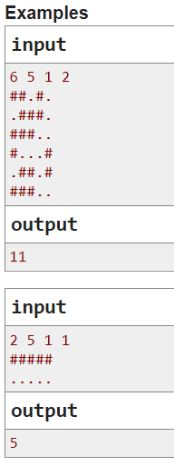
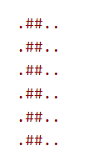

Barcode - examples

Slide 68

Representation
$$f(????)$$
Any ideas?

Slide 69

Representation
$$f(c,????)$$
Maybe we need to iterate over the columns?

Slide 70
Representation
2
1

Slide 71
Representation
2
1
3
4
2
3
…
…
…
…

Slide 72
Representation
At one column we have two choices:
New color
Previous color

Slide 73

Representation
Considering the constraints, let:
$$min=minimum width of one bar$$
$$max=maximum width of one bar$$
New color
 | We are maintaining the same color | We are flipping the color
 | We are flipping the color | We are maintaining the same color
Previous color

Slide 74

Representation
Considering the constraints, let:
$$min=minimum width of one bar$$
$$max=maximum width of one bar$$
New color
 | Is the previous streak of white $<max$? | Is the previous streak of white $∈[x,y]$?
 | Is the previous streak of black $∈[x,y]$? | Is the previous streak of black $<max$?
Previous color

Slide 75
Corner case
2
1
On the first column we always need to consider both cases!

Slide 76

Barcode (solution)
Full solution can be found here:
http://codeforces.com/contest/225/submission/36890610

Slide 77
Hope you had fun
Thank you!

