Slide 1
McGill Competitive programming
-Adv. Data structures
Andre Kaba

Slide 2
Topics today:
Disjoint sets
Segment tree (Range queries)
Lazy propagation
Sample problems

Slide 3
Disjoint sets

Slide 4
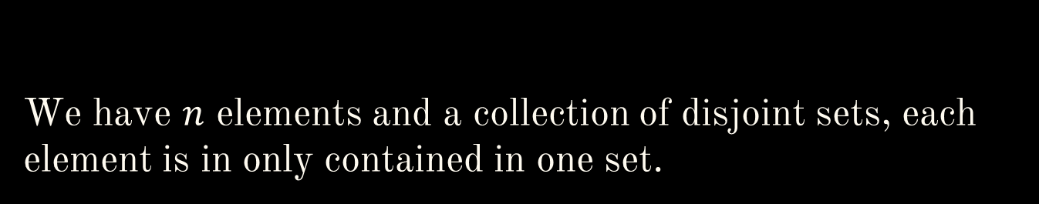
We have $n$ elements and a collection of disjoint sets, each element is in only contained in one set.

Slide 5
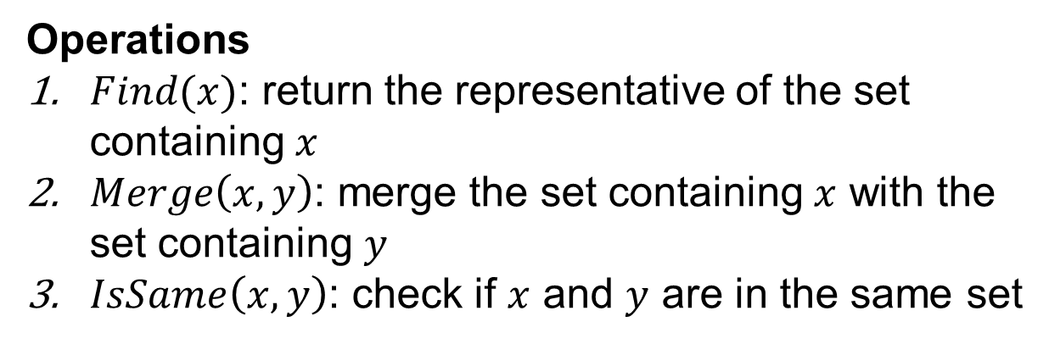
Disjoint sets
Idea:
One element of each set will be the representative
We want to support the following operations efficiently:
Operations
$Find(x)$: return the representative of the set containing $x$
$Merge\left(x, y\right)$: merge the set containing $x$ with the set containing $y$
$IsSame\left(x,y\right)$: check if $x$ and $y$ are in the same set

Slide 6
Disjoint sets
7
1
4
2
5
3
6

Slide 7
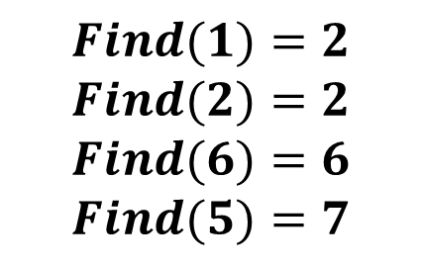
Disjoint sets
7
1
4
2
$$Find(1)=2$$
$$Find(2)=2$$
$$Find(6)=6$$
$$Find(5)=7$$
5
3
6

Slide 8
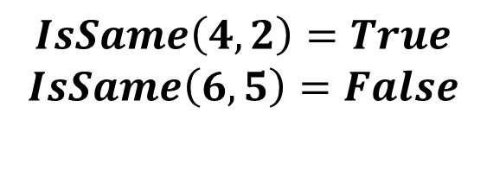
Disjoint sets
7
1
4
2
5
3
6
$$IsSame\left(4,2\right)=True$$
$$IsSame\left(6,5\right)=False$$

Slide 9

Disjoint sets
1
7
4
2
$$Merge(3,5)$$
5
3
6

Slide 10
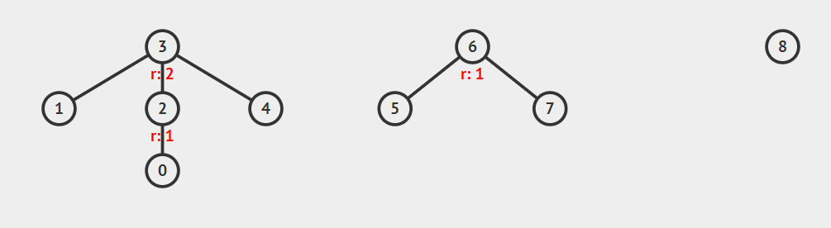
Disjoint sets
Idea:
We use a tree like structure to simulate this behavior!

Slide 11
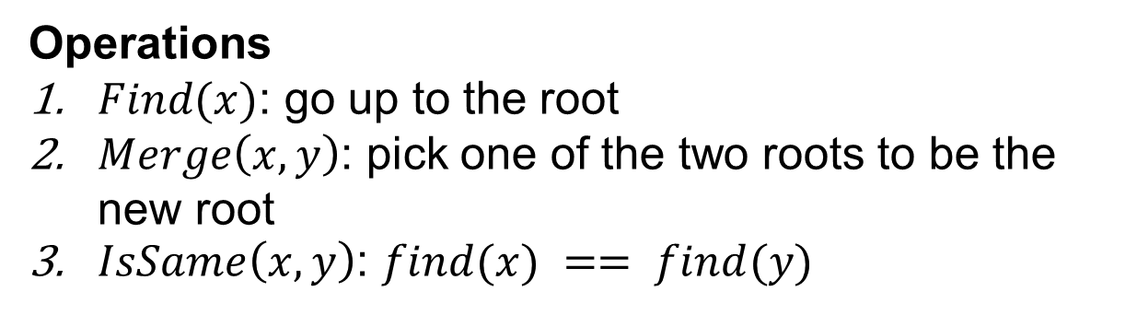
Disjoint sets
Operations
$Find(x)$: go up to the root
$Merge\left(x, y\right)$: pick one of the two roots to be the new root
$IsSame\left(x,y\right)$: $find(x) == find(y)$

Slide 12
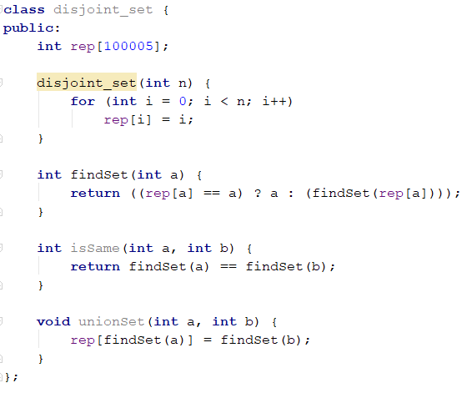
Implementation:
Good enough for most cases!

Slide 13
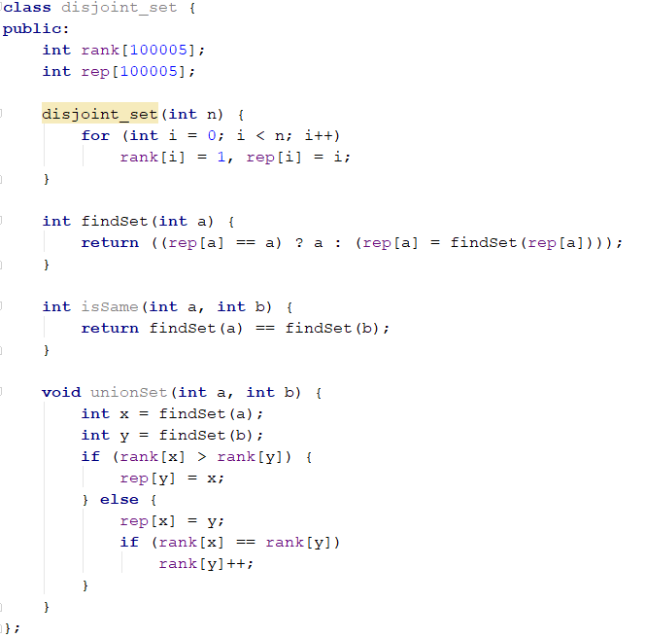
Two optimizations:
Path compression
Ranking

Slide 14
Range queries & segment trees

Slide 15


Problem: Given an array $\{a_{0},…,a_{n−1}\}$ compute a range query:
$\max\left\{a_{i}\right\}, s≤i≤e$
$\min\left\{a_{i}\right\}, s≤i≤e$
$\operatorname{sum}\left\{a_{i}\right\}, s≤i≤e$
…

Slide 16
Prefix sum !

Slide 17

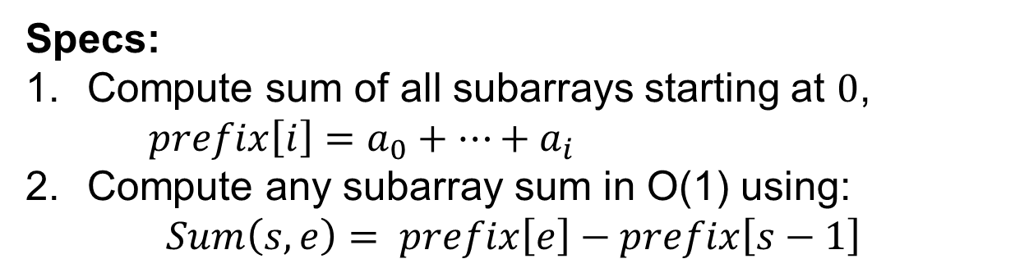


Prefix sum:
Specs:
Compute sum of all subarrays starting at $0$, $prefix\left[i\right]=a_{0}+…+a_{i}$
Compute any subarray sum in O(1) using:
$$Sum\left(s,e\right)= prefix\left[e\right]−prefix\left[s−1\right]$$
$$a_{0}+…+a_{n−1}$$
$$prefix\left[s−1\right]$$
$$prefix\left[e\right]$$
$$s−1$$
$$e$$

Slide 18

Prefix sum:
Very efficient, $O(n)$pre-processing, $O(1)$query time
Only $O(n)$storage needed

Slide 19
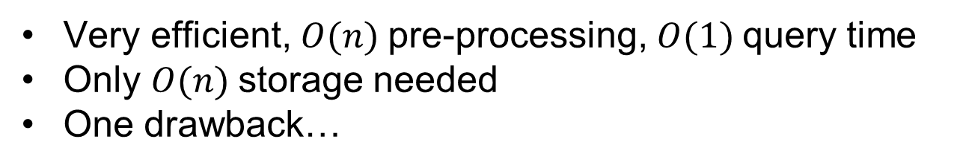
Prefix sum:
Very efficient, $O(n)$pre-processing, $O(1)$query time
Only $O(n)$storage needed
One drawback…

Slide 20
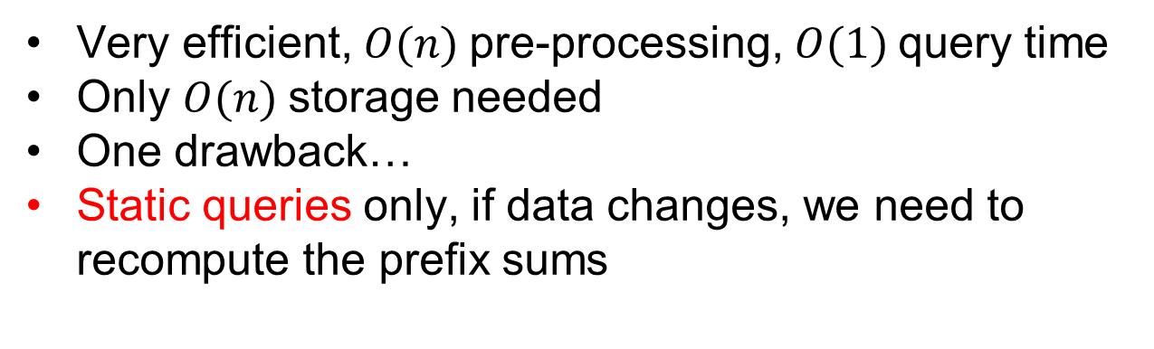
Prefix sum:
Very efficient, $O(n)$pre-processing, $O(1)$query time
Only $O(n)$storage needed
One drawback…
Static queries only, if data changes, we need to recompute the prefix sums

Slide 21
One the way to dynamic queries!

Slide 22

Precomputed info:
If we know $sum[i…t]$ and $sum[t…j]$
What is $sum[i…j]$?

Slide 23

Precomputed info:
If we know $sum[i…t]$ and $sum[t…j]$
What is $sum[i…j]= sum[i…t]+sum[t…j]$

Slide 24
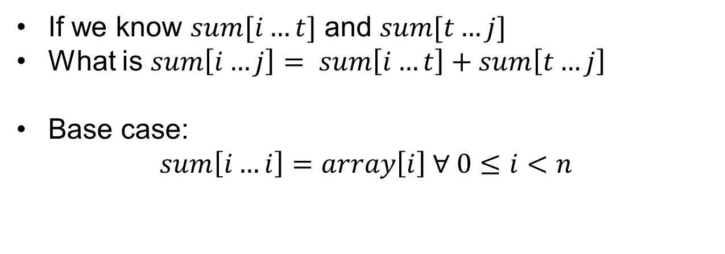
Precomputed info:
If we know $sum[i…t]$ and $sum[t…j]$
What is $sum\left[i…j\right]= sum\left[i…t\right]+sum\left[t…j\right]$
Base case:
$$sum\left[i…i\right]=array\left[i\right] ∀ 0≤i<n$$

Slide 25
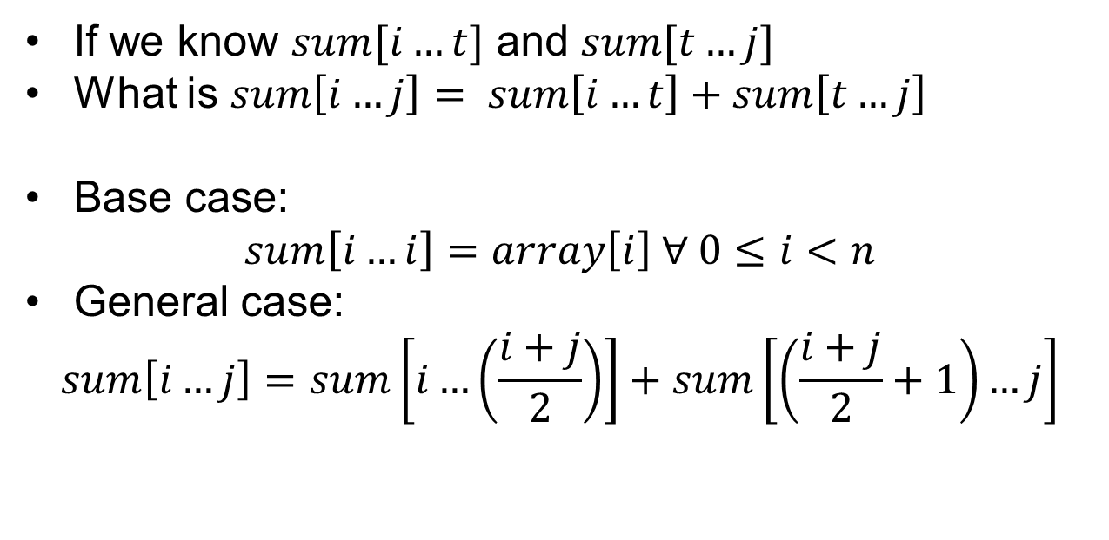
Precompute answers:
If we know $sum[i…t]$ and $sum[t…j]$
What is $sum\left[i…j\right]= sum\left[i…t\right]+sum\left[t…j\right]$
Base case:
$$sum\left[i…i\right]=array\left[i\right] ∀ 0≤i<n$$
General case:
$$sum\left[i…j\right]=sum\left[i…\left(\frac{i+j}{2}\right)\right]+sum\left[\left(\frac{i+j}{2}+1\right)…j\right]$$

Slide 26
Segment trees

Slide 27
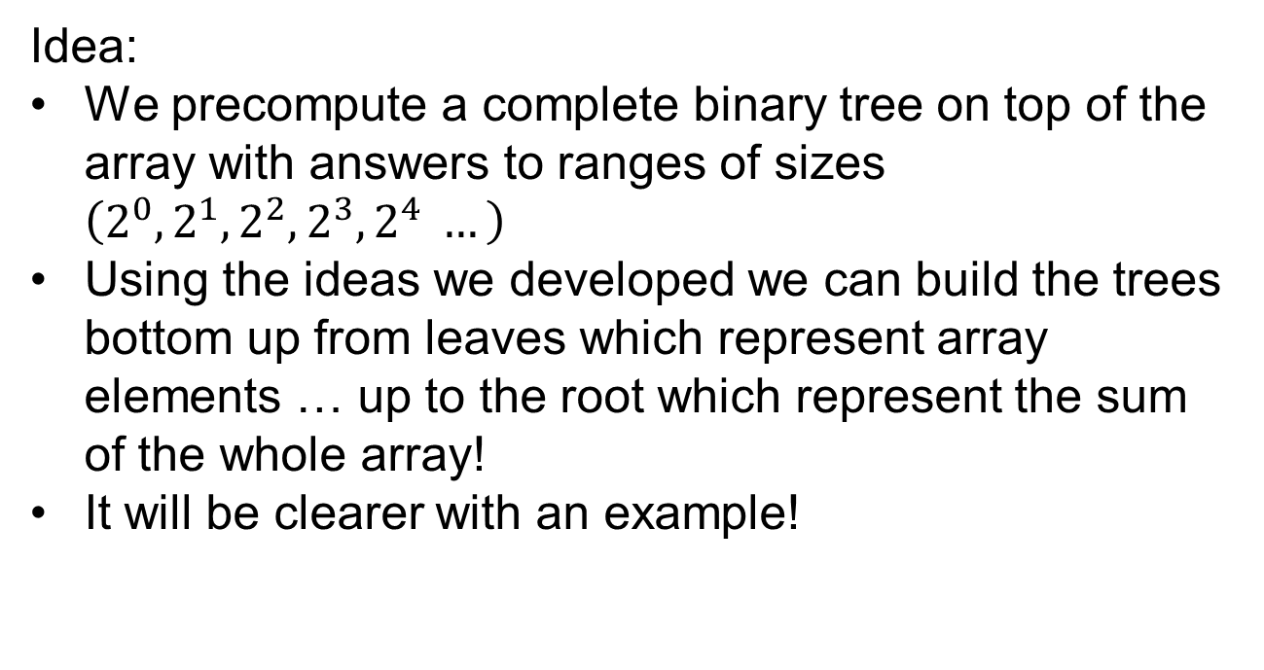
Segment Tree:
Idea:
We precompute a complete binary tree on top of the array with answers to ranges of sizes $\left(2^{0},2^{1},2^{2},2^{3},2^{4} …\right)$
Using the ideas we developed we can build the trees bottom up from leaves which represent array elements … up to the root which represent the sum of the whole array!
It will be clearer with an example!
Let’s check some animations on: https://visualgo.net/en/segmenttree

Slide 28
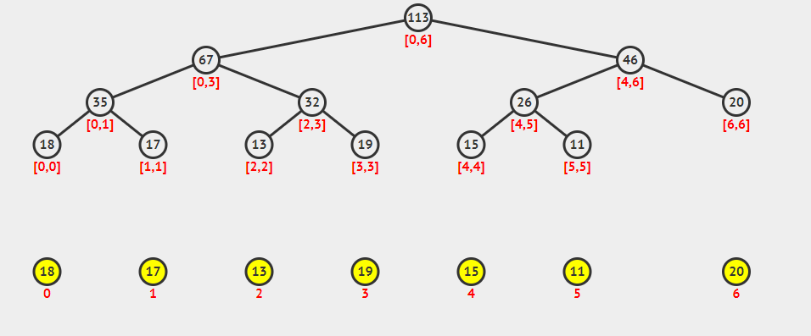
Segment Tree:

Slide 29
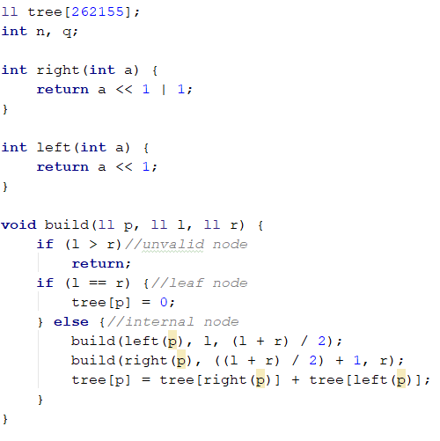
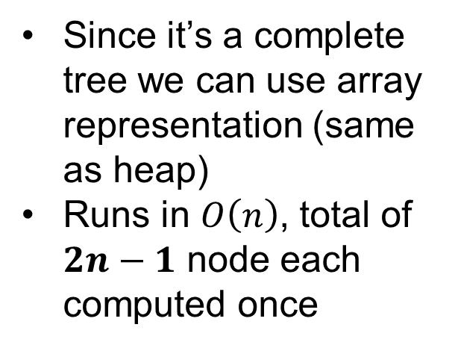
Segment Tree: build routine
Since it’s a complete tree we can use array representation (same as heap)
Runs in $O\left(n\right)$, total of $2n−1$ node each computed once

Slide 30
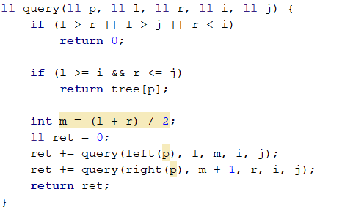

Segment Tree: query routine
Runs in $O(logn)$

Slide 31
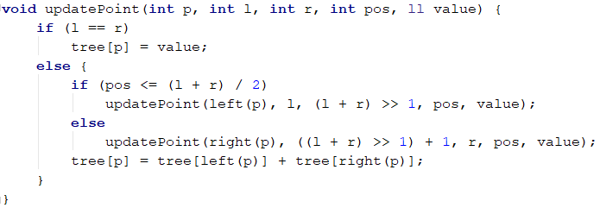

Segment Tree: updatePoint routine
Runs in $O(logn)$

Slide 32
Segment Tree: updateRange routine
Can we do still do this efficiently?

Slide 33

Segment Tree: updateRange routine
Can we do still do this efficiently?
Run $O(n\log{n})$ single point updates

Slide 34

Segment Tree: updateRange routine
Can we do still do this efficiently?
Run $O(n\log{n})$ single point updates
Might just rebuild the tree instead…

Slide 35
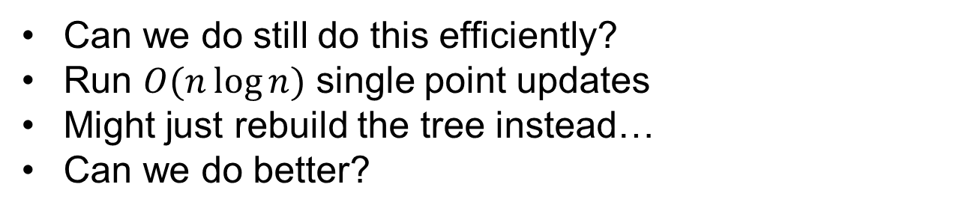
Segment Tree: updateRange routine
Can we do still do this efficiently?
Run $O(n\log{n})$ single point updates
Might just rebuild the tree instead…
Can we do better?

Slide 36
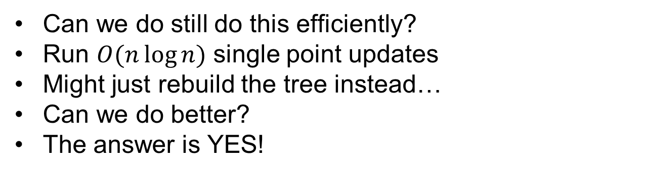
Segment Tree: updateRange routine
Can we do still do this efficiently?
Run $O(n\log{n})$ single point updates
Might just rebuild the tree instead…
Can we do better?
The answer is YES!

Slide 37
Lazy propagation

Slide 38
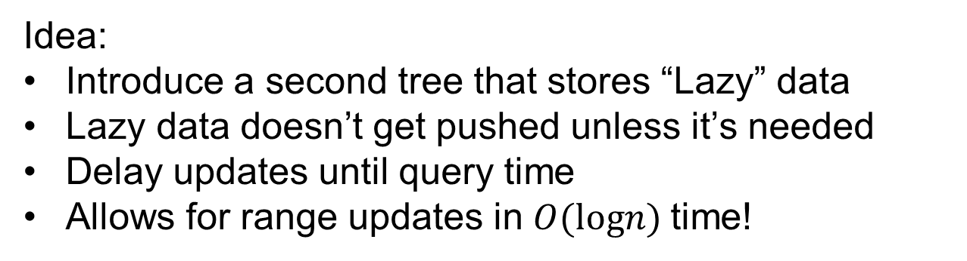
Lazy propagation:
Idea:
Introduce a second tree that stores “Lazy” data
Lazy data doesn’t get pushed unless it’s needed
Delay updates until query time
Allows for range updates in $O(logn)$time!
Segment Tree
Range Update
Lazy Tree
Array Values

Slide 39
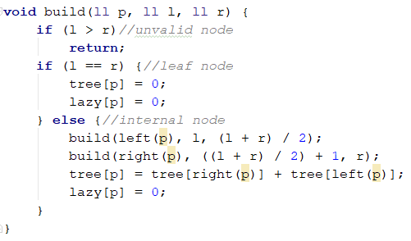

Lazy Segment Tree: build routine
Runs in $O(n)$

Slide 40
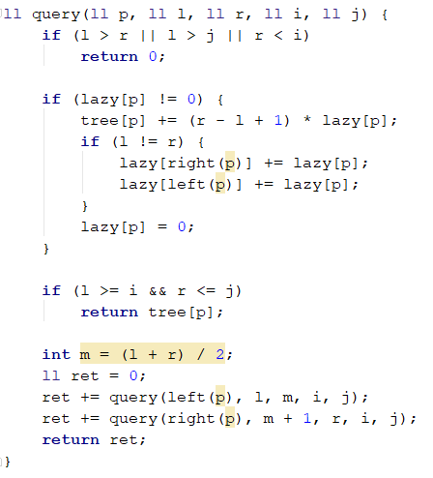

Lazy Segment Tree: query routine
Runs in $O(logn)$

Slide 41
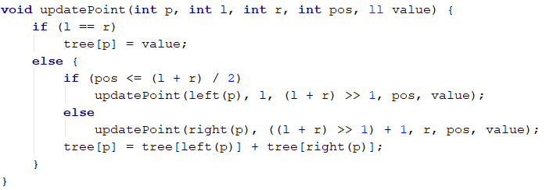

Lazy Segment Tree: updatePoint routine
Runs in $O(logn)$

Slide 42
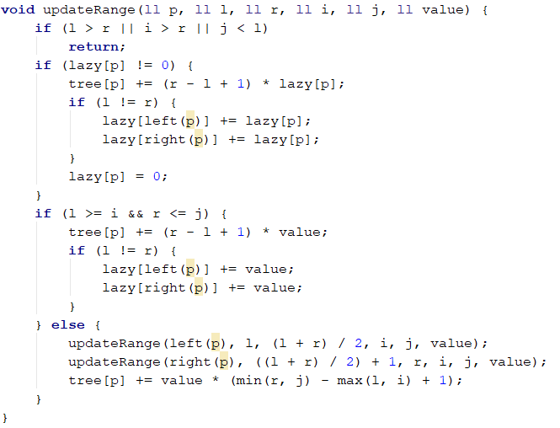

Lazy Segment Tree: updateRange routine
Runs in $O(logn)$

Slide 43
Notes:

Slide 44
Notes
This may not seem important but …

Slide 45
Notes
This may not seem important but …
It allows to compute LCA in $O(\log{n})$time

Slide 46
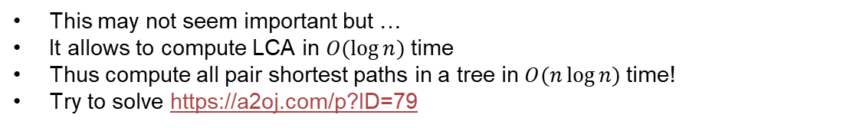
Notes
This may not seem important but …
It allows to compute LCA in $O(\log{n})$time
Thus compute all pair shortest paths in a tree in $O(n\log{n})$time!
Try to solve https://a2oj.com/p?ID=79

Slide 47
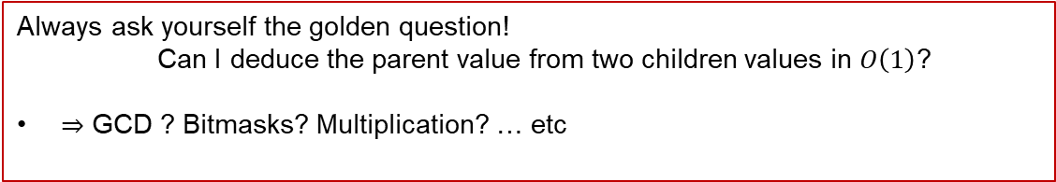
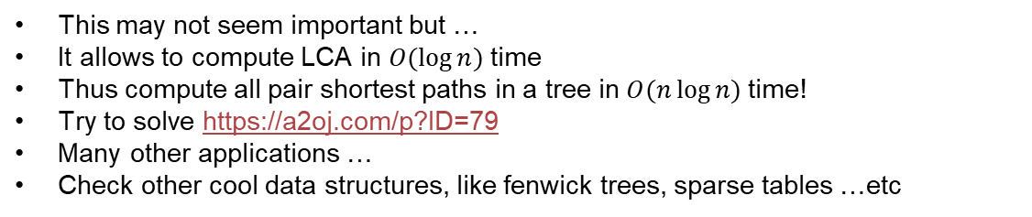
Notes
This may not seem important but …
It allows to compute LCA in $O(\log{n})$time
Thus compute all pair shortest paths in a tree in $O(n\log{n})$time!
Try to solve https://a2oj.com/p?ID=79
Many other applications …
Check other cool data structures, like fenwick trees, sparse tables …etc
Always ask yourself the golden question!
Can I deduce the parent value from two children values in $O\left(1\right)$?
$⇒$ GCD ? Bitmasks? Multiplication? … etc

Slide 48
Let’s try all that magic!

Slide 49
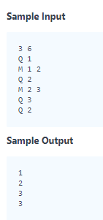
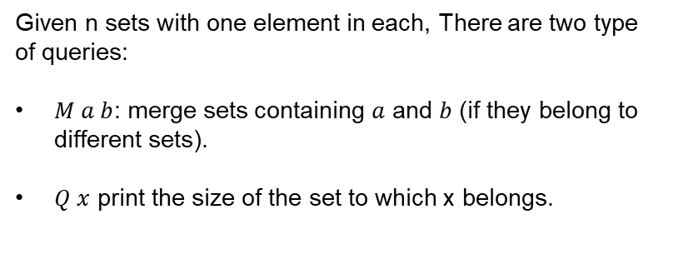
Merging communities
Given n sets with one element in each, There are two type of queries:
$M a b$: merge sets containing $a$ and $b$ (if they belong to different sets).
$Q x$ print the size of the set to which x belongs.
Source: https://www.hackerrank.com/challenges/merging-communities/problem

Slide 50
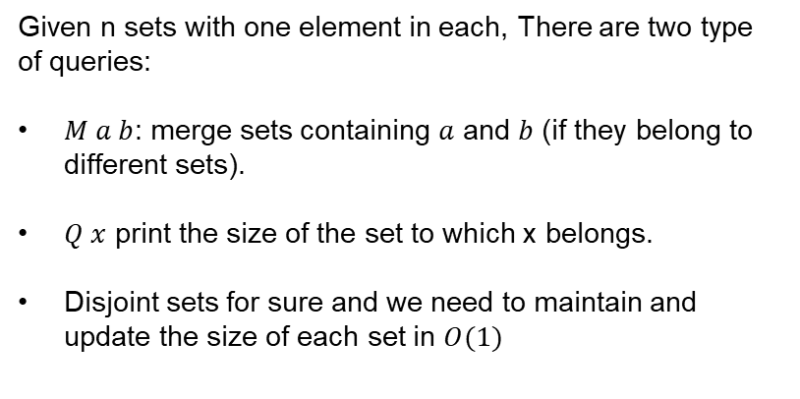
Merging communities
Given n sets with one element in each, There are two type of queries:
$M a b$: merge sets containing $a$ and $b$ (if they belong to different sets).
$Q x$ print the size of the set to which x belongs.
Disjoint sets for sure and we need to maintain and update the size of each set in $O(1)$
Source: https://www.hackerrank.com/challenges/merging-communities/problem

Slide 51
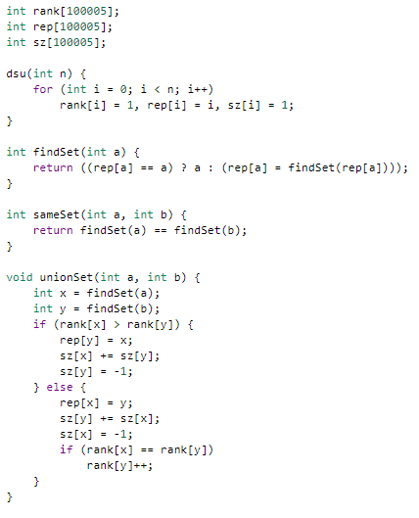
Solution
Constructor

Slide 52
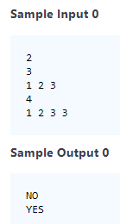
Sherlock and the array
Given an array of size n, check if there is an element with the property that the sum of the elements on it’s left is equal to the sum of the elements on it’s right
Source: https://www.hackerrank.com/challenges/sherlock-and-array/problem

Slide 53
Sherlock and the array
Given an array of size n, check if there is an element with the property that the sum of the elements on it’s left is equal to the sum of the elements on it’s right.
Compute prefix sum and “suffix sum”
Source: https://www.hackerrank.com/challenges/sherlock-and-array/problem

Slide 54
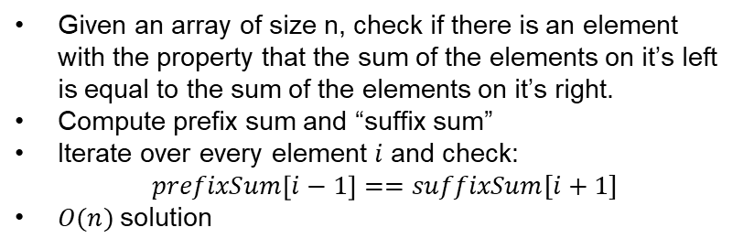
Sherlock and the array
Given an array of size n, check if there is an element with the property that the sum of the elements on it’s left is equal to the sum of the elements on it’s right.
Compute prefix sum and “suffix sum”
Iterate over every element $i$ and check:
$prefixSum\left[i−1\right]==suffixSum[i+1]$
$O(n)$solution
Source: https://www.hackerrank.com/challenges/sherlock-and-array/problem

Slide 55
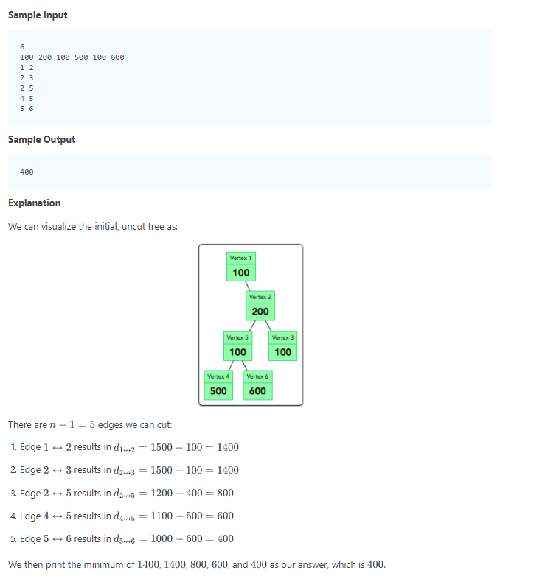
Cut the tree
Given a tree with weighted vertices, we want to remove one edge such that the resulting two trees have equal sum
Source: https://www.hackerrank.com/challenges/cut-the-tree/problem

Slide 56
Cut the tree
Given a tree with weighted vertices, we want to remove one edge such that the resulting two trees have equal sum
Similar way of thinking as before
Source: https://www.hackerrank.com/challenges/cut-the-tree/problem

Slide 57
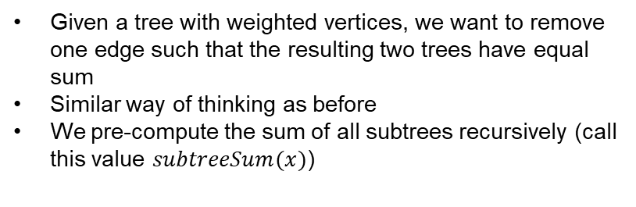
Cut the tree
Given a tree with weighted vertices, we want to remove one edge such that the resulting two trees have equal sum
Similar way of thinking as before
We pre-compute the sum of all subtrees recursively (call this value $subtreeSum(x)$)
Source: https://www.hackerrank.com/challenges/cut-the-tree/problem

Slide 58
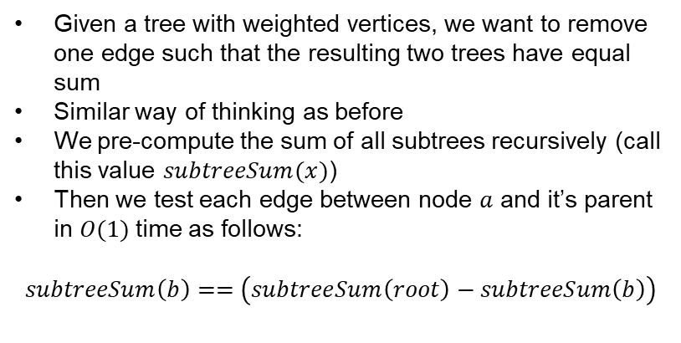
Cut the tree
Given a tree with weighted vertices, we want to remove one edge such that the resulting two trees have equal sum
Similar way of thinking as before
We pre-compute the sum of all subtrees recursively (call this value $subtreeSum(x)$)
Then we test each edge between node $a$ and it’s parent in $O(1)$time as follows:
$$subtreeSum\left(b\right)==\left(subtreeSum\left(root\right)−subtreeSum\left(b\right)\right)$$
a
Source: https://www.hackerrank.com/challenges/cut-the-tree/problem

Slide 59
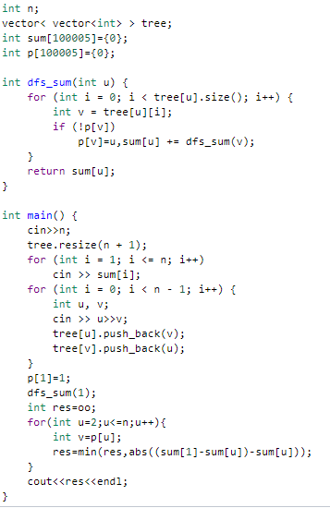
Solution

Slide 60
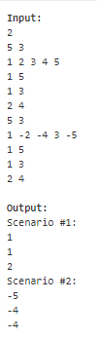
Negative Score
Min variant of segment tree applies here.
Source: http://www.spoj.com/problems/RPLN/

Slide 61
Negative Score
Min variant of segment tree applies here.
Maybe there is a modification of prefix sum that can do that job? You tell me! ☺
Source: http://www.spoj.com/problems/RPLN/

Slide 62
Negative Score
Min variant of segment tree applies here.
Maybe there is a modification of prefix sum that can do that job? You tell me! ☺
Maybe a good way to learn about sparse table too!
Source: http://www.spoj.com/problems/RPLN/

Slide 63

Horrible queries
Classic dynamic sum queries on an array of size $n$
Query type
Source: http://www.spoj.com/problems/HORRIBLE/

Slide 64

Horrible queries
Classic dynamic sum queries on an array of size $n$
Clearly we cannot use prefix sum … We need segment tree
Query type
Source: http://www.spoj.com/problems/HORRIBLE/

Slide 65
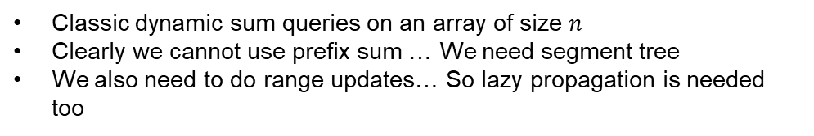
Horrible queries
Classic dynamic sum queries on an array of size $n$
Clearly we cannot use prefix sum … We need segment tree
We also need to do range updates… So lazy propagation is needed too
Query type
Source: http://www.spoj.com/problems/HORRIBLE/

Slide 66
Table compression
Classic dynamic sum queries on an array of size $n$
Clearly we cannot use prefix sum … We need segment tree
We also need to do range updates… So lazy propagation is needed too
Query type
Source: http://www.spoj.com/problems/HORRIBLE/

Slide 67
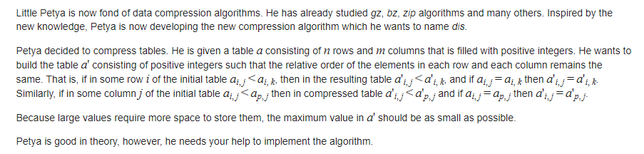
Table compression

Slide 68
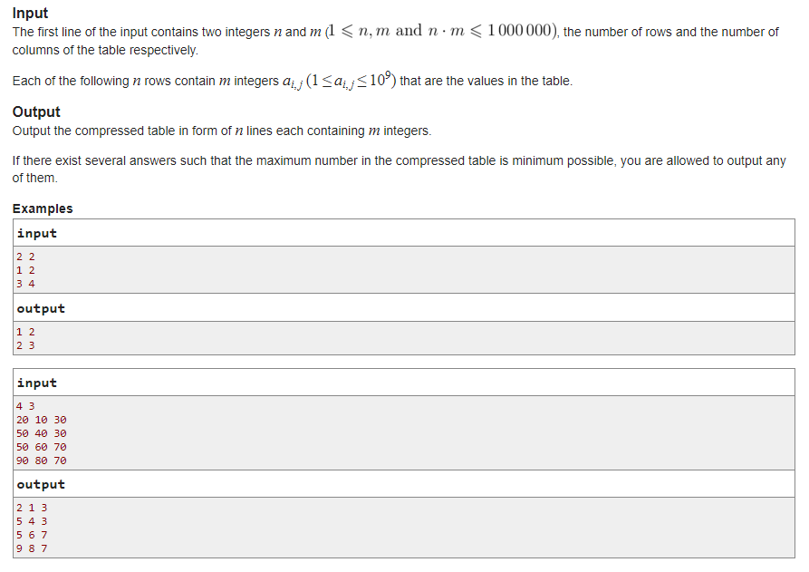
Table compression
Source: http://codeforces.com/contest/650/submission/16663550

Slide 69
Table compression (solution)
Requirement:
Disjoint sets
Topological sort
My Code: http://codeforces.com/contest/650/submission/16663550

Slide 70
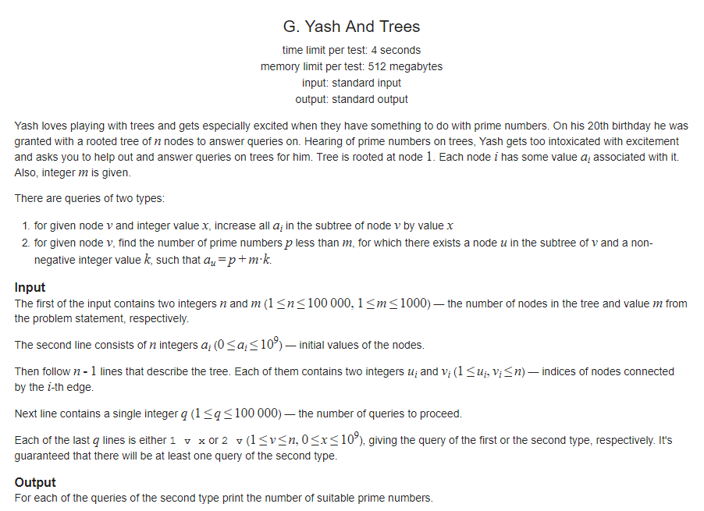
Yash and trees
Source: http://codeforces.com/problemset/problem/633/G

Slide 71
Yash and trees (solution)
Requirement:
Tree compression
Prime sieve
Segment tree
Lazy propagation
My Code: http://codeforces.com/contest/633/submission/16702874

Slide 72
Hope you had fun
Thank you!

