Slide 1
McGill Competitive programming
-Introduction
Andre Kaba

Slide 2
We will cover
What is competitive programming?
Our experience!
How does it work?
We will solve sample problems

Slide 3
What is it?

Slide 4
Given a problem, you want to:
Solve it as quickly and efficiently as possible
Use algorithms and data structures to help you out
code up a bug free solution using Python, C++ or Java

Slide 5




Examples
Ace classes!
Rock technical interviews!
Prestigious on your Resume!
Free vacations!

Slide 6
Prof. Devroye

Slide 7





What are we going to do:
Learn common types of problems and algorithms
Learn a practical problem solving approach to solve problems
Touch on some advanced topics in competitive programming
Apply learned techniques to problems on online judges.

Slide 8
Few things to mention:
This is not the “best” way to develop software in any means

Slide 9
Few things to mention:
This is not the “best” way to develop software in any means
Do it for fun and to improve your problem solving skills

Slide 10
Few things to mention:
This is not the “best” way to develop software in any means
Do it for fun and to improve your problem solving skills
Will not do proofs of the algorithms, we will mostly do applied stuff

Slide 11
Few things to mention:
This is not the “best” way to develop software in any means
Do it for fun and to improve your problem solving skills
Will not do proofs of the algorithms, we will mostly do applied stuff
Best way to learn is solving problems. ~200 A,B,C codeforces problems would be a good goal to aim for.

Slide 12
Few things to mention:
This is not the “best” way to develop software in any means
Do it for fun and to improve your problem solving skills
Will not do proofs of the algorithms, we will mostly do applied stuff
Best way to learn is solving problems. ~200 A,B,C codeforces problems would be a good goal to aim for.
Please feel free to ask questions any time, I want you to grasp

Slide 13
Few things to mention:
This is not the “best” way to develop software in any means
Do it for fun and to improve your problem solving skills
Will not do proofs of the algorithms, we will mostly do applied stuff
Best way to learn is solving problems. ~200 A,B,C codeforces problems would be a good goal to aim for.
Please feel free to ask questions any time
Most importantly, our goal is to wreck MIT!

Slide 14
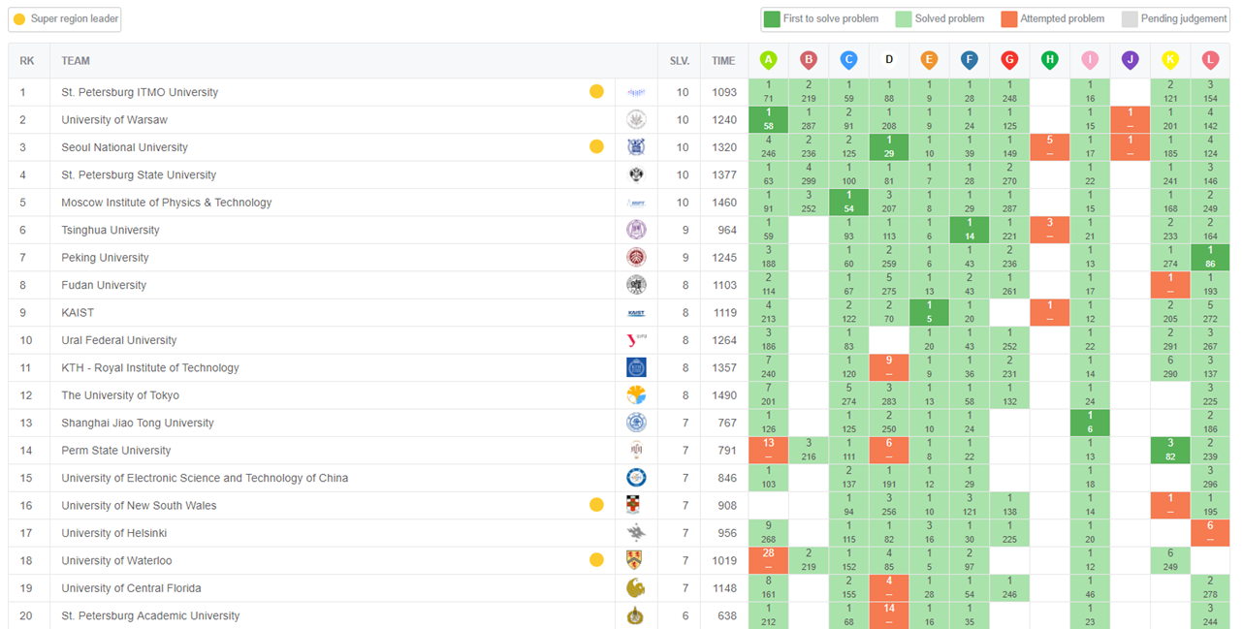
Finals 2017

Slide 15
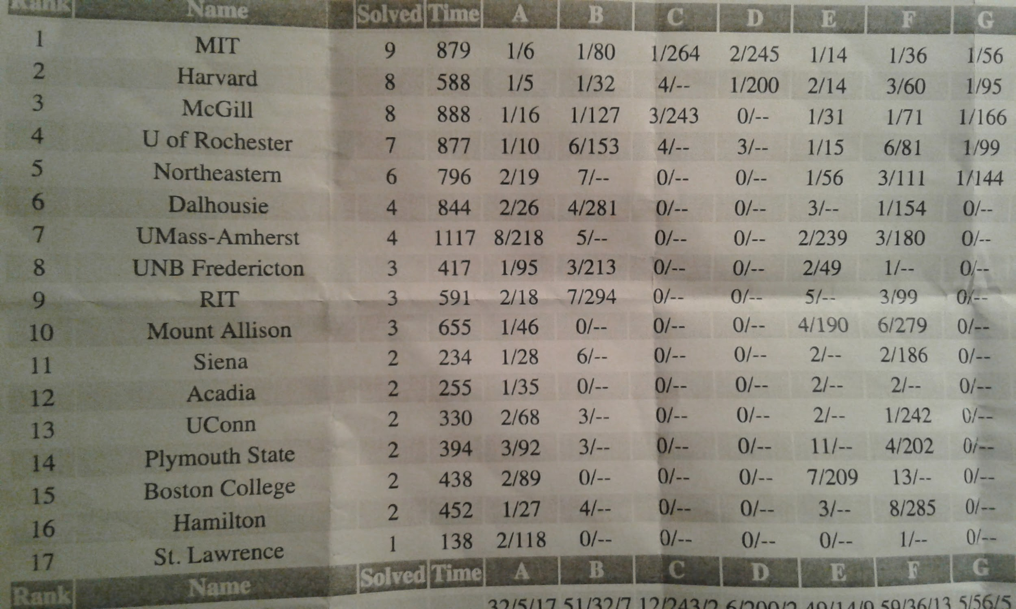
My experience

Slide 16
Topics include

Slide 17
[1]

Slide 18
Intro
Ad-hoc problems and basic data Structures
Adv. Data Structures
Mathematics
Basic search, Backtrack, Greedy, Dynamic programming
Graph theory
Adv. Graph theory
Strings
Geometry (If time permits)
Game theory (If time permits)

Slide 19
In each tutorial we will:
Motivate new data structures and algorithms
Introduce them in a progressive manner
Practice them on some problems
And most importantly, have fun!

Slide 20
How does this work? (ICPC style)
Your side (team of 3, one PC):
You are given 8-12 problems
You need to solve as many problems in 5 hours.
Scoreboard is visible for the first 4 hours.
Each team is assigned a penalty.
Teams are sorted by number of problems solved then by penalty then by the time of last solution.
Judge side:
4 Verdicts:

Slide 21
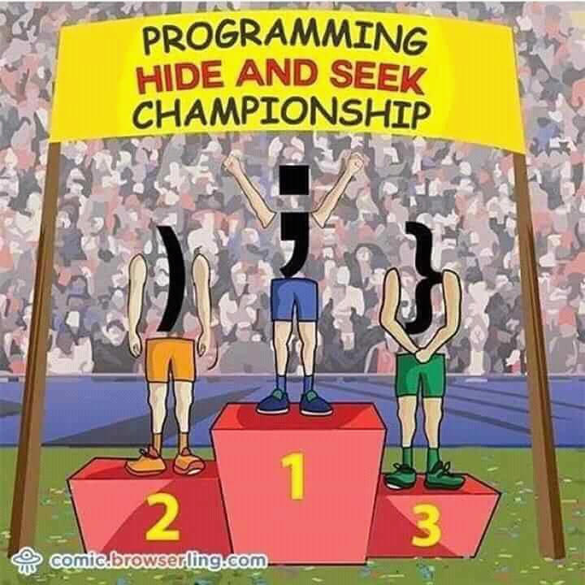

Slide 22
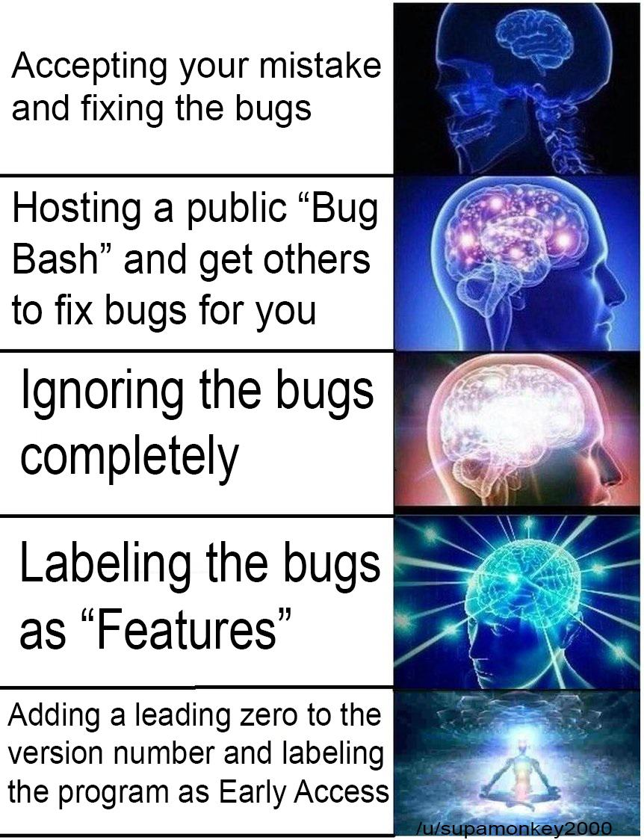

Slide 23
How does this work? (ICPC style)
Your side (team of 3, one PC):
You are given 8-12 problems
You need to solve as many problems in 5 hours.
Scoreboard is visible for the first 4 hours.
Each team is assigned a penalty.
Teams are sorted by number of problems solved then by penalty then by the time of last solution.
Judge side:
4 Verdicts:
Wrong answer
RE/Compile Errors
Time limit exceeded
Accepted
Each failed submission will cost you 20 penalty
No partial score
Will not tell you which test case failed.

Slide 24
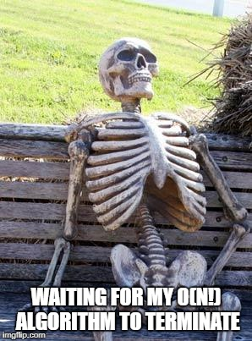

Slide 25
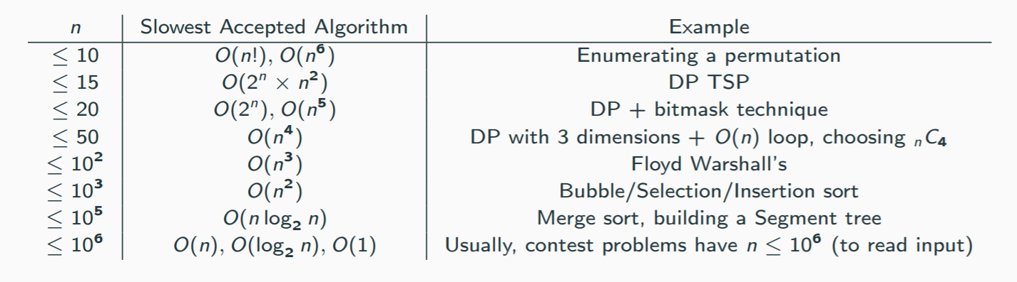
Algorithm analysis:
[2]

Slide 26
Sample problems

Slide 27
Hello CP
Given two numbers A and B output A*B
Input:
Two numbers separated with a space
Output:
The result of A*B on a seperate line

Slide 28
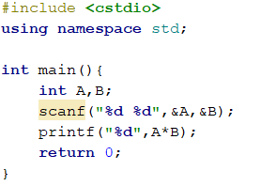
Solution:
Try max int? (0x7FFFFFFF=2147483647 )

Slide 29
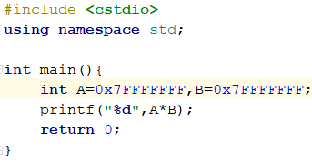

Solution:
We are overflowing the result!
Wrong answer!

Slide 30
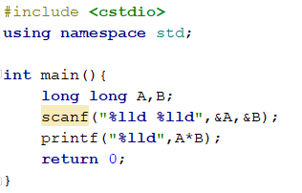

Solution:
Will give the right answer as long as the result fits in 64 bit signed integer!
So this is an accepted solution!

Slide 31
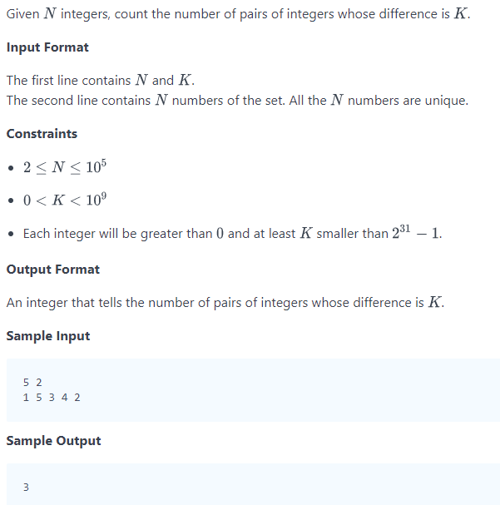
Pairs
What are your thoughts?
Input limits
Data representation?
Possible solution?
source: https://www.hackerrank.com/challenges/pairs/problem

Slide 32
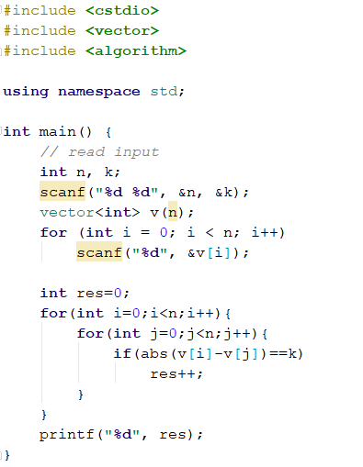
Solution:

Slide 33
Solution:
Counting twice?

Slide 34

Solution:

Slide 35
Solution:
Whats the time complexity? Can we do better?

Slide 36

Solution:
Half the number of operations.
Same complexity O(n^2)

Slide 37
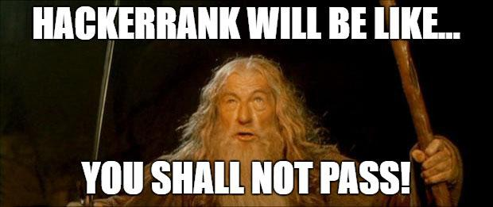

Slide 38
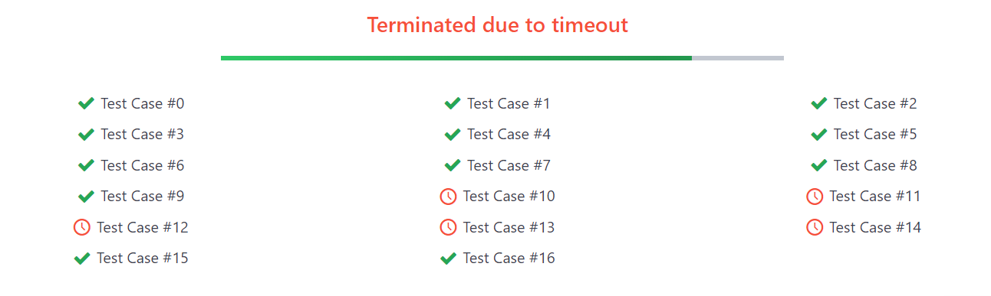
Too slow!
~((10^5)^2)/2 operations > 10^8 (remember our rule of thumb)

Slide 39

Let’s think… assume sorted

Slide 40
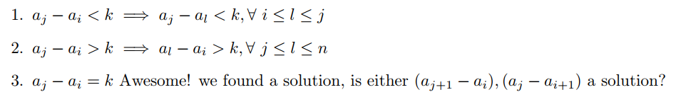
Let’s think…

Slide 41
Let’s think…

Slide 42
Let’s think…

Slide 43
Let’s think…
Visually… (k=2)
Too large...
1 | 2 | 3 | 4 | 5
i
j

Slide 44
Let’s think…
Visually… (k=2)
Too large...
Too small...
1 | 2 | 3 | 4 | 5
1 | 2 | 3 | 4 | 5
i
j
i
j

Slide 45
Let’s think…
Visually… (k=2)
Too large...
Too small...
Prefect!
1 | 2 | 3 | 4 | 5
1 | 2 | 3 | 4 | 5
1 | 2 | 3 | 4 | 5
i
j
i
j
i
j

Slide 46
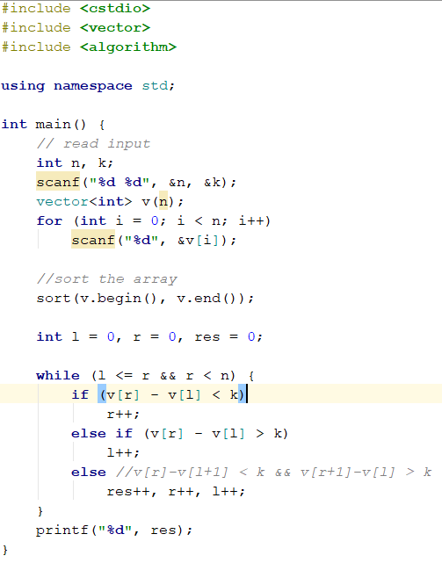
Efficient Solution:
Shrink if too large
Extend if too small
Move to next feasible solution if we already have a solution
O(nlogn) solution < 10^8 ops/sec

Slide 47
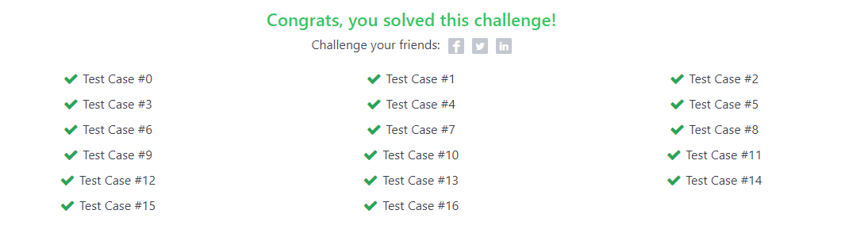
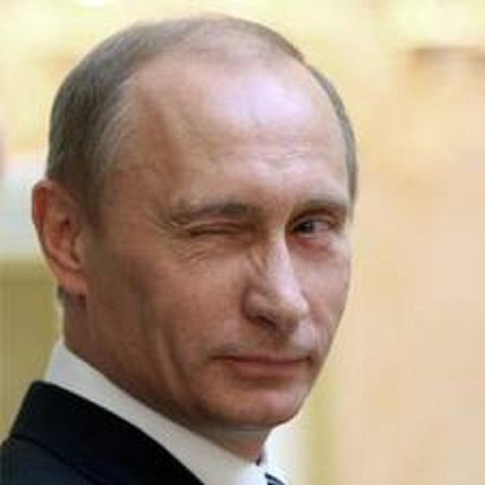
We are golden!
Note: Almost equally good solution is to use binary search

Slide 48

Last but not least:
https://open.kattis.com/problems/keytocrypto
https://open.kattis.com/problems/plantingtrees
https://open.kattis.com/problems/hittingtargets
https://a2oj.com/p?ID=26
http://codeforces.com/problemset/problem/12/B

Slide 49
Hope you had fun
Thank you!

Slide 50
References
[1] https://visualgo.net/en
[2] https://cpbook.net/#CP3details

