Slide 1
McGill Competitive programming
-Mathematics
Andre Kaba

Slide 2
What’s next?
Contact David Romero?
We need someone to sponsor the teams, a prof?
Organize contests? I can work on that
Work on team training?

Slide 3
Your thoughts?
Maybe we start a students group/club?
Organize events, contests and tech talks
Anyone interested in the idea?
Also let me know what you think of these tutorials!

Slide 4
Topics today:
Preliminaries & Number theory
Combinatorics
Matrix power
Problems

Slide 5
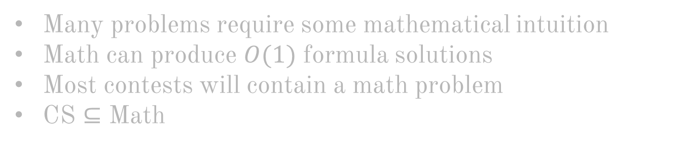
Why math?
Many problems require some mathematical intuition
Math can produce $O(1)$ formula solutions
Most contests will contain a math problem
CS $⊆$ Math

Slide 6
Useful stuff to know

Slide 7
$$Cheatsheet$$
Check this:
https://www.tug.org/texshowcase/cheat.pdf
More than enough for most contests

Slide 8
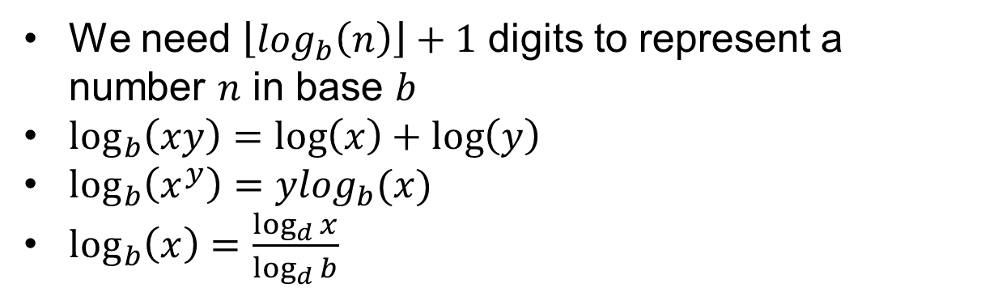
$$Common log\left(n\right)facts:$$
We need $\left\lfloor log_{b}\left(n\right)\right\rfloor +1$ digits to represent a number $n$ in base $b$
$\log_{b}\left(xy\right)=\log\left(x\right)+\log\left(y\right)$
$\log_{b}\left(x^{y}\right)=ylog_{b}(x)$
$\log_{b}\left(x\right)=\frac{\log_{d}{x}}{\log_{d}{b}}$

Slide 9
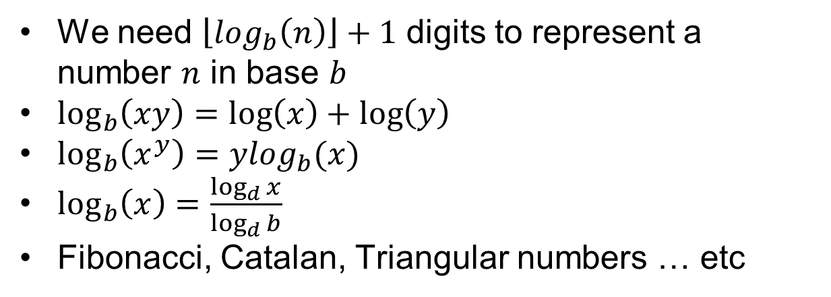
$$Common log\left(n\right)facts:$$
We need $\left\lfloor log_{b}\left(n\right)\right\rfloor +1$ digits to represent a number $n$ in base $b$
$\log_{b}\left(xy\right)=\log\left(x\right)+\log\left(y\right)$
$\log_{b}\left(x^{y}\right)=ylog_{b}(x)$
$\log_{b}\left(x\right)=\frac{\log_{d}{x}}{\log_{d}{b}}$
Fibonacci, Catalan, Triangular numbers … etc

Slide 10
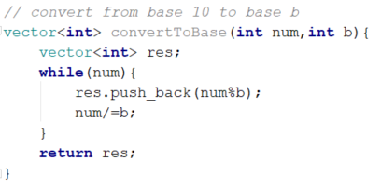
$$Base conversion$$
Can generalize for different bases conversion
One last note: https://docs.oracle.com/javase/7/docs/api/java/math/BigInteger.html
Can be used if arbitrary large numbers are needed.

Slide 11
Number theory

Slide 12
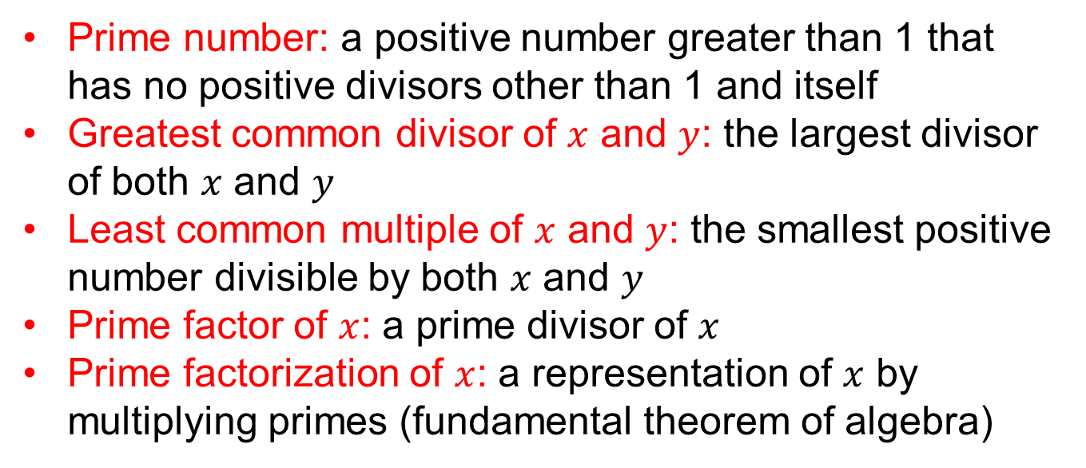
$$Definations$$
Prime number: a positive number greater than 1 that has no positive divisors other than 1 and itself
Greatest common divisor of $x$ and $y$: the largest divisor of both $x$ and $y$
Least common multiple of $x$ and $y$: the smallest positive number divisible by both $x$ and $y$
Prime factor of $x$: a prime divisor of $x$
Prime factorization of $x$: a representation of $x$ by multiplying primes (fundamental theorem of algebra)

Slide 13
Prime numbers

Slide 14
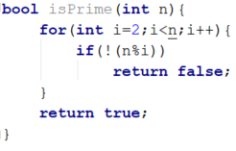

$$Primality checking$$
Is $x$ prime?
$$O(n)$$

Slide 15
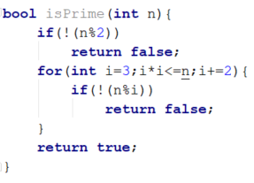

$$Primality checking$$
Is $x$ prime?
$$O(n)$$
$$O(√n)$$

Slide 16

$$Primality checking$$
Is $x$ prime?
$$O(n)$$
$$O(√n)$$
Even better, just iterate over primes $≤√n$

Slide 17
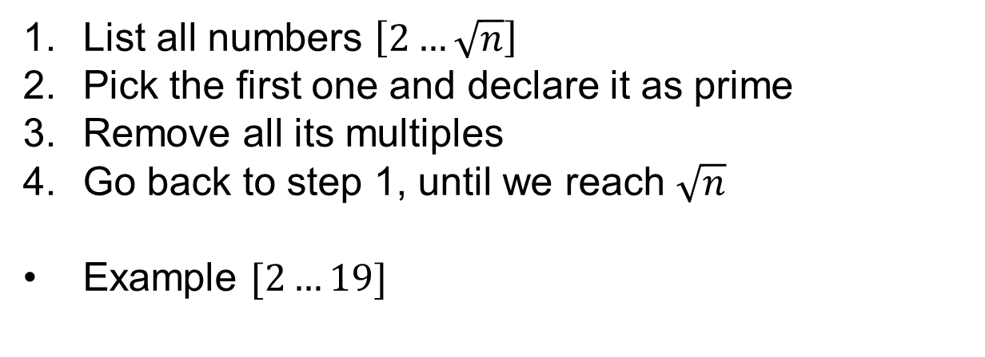
$$Sieve of Eratosthenes$$
List all numbers $\left[2…\sqrt{n}\right]$
Pick the first one and declare it as prime
Remove all its multiples
Go back to step 1, until we reach $\sqrt{n}$
Example $[2…19]$
2 | 3 | 4 | 5 | 6 | 7 | 8 | 9 | 10 | 11 | 12 | 13 | 14 | 15 | 16 | 17 | 18 | 19

Slide 18
$$Sieve of Eratosthenes$$
List all numbers $\left[2…\sqrt{n}\right]$
Pick the first one and declare it as prime
Remove all its multiples
Go back to step 1, until we reach $\sqrt{n}$
Example $[2…19]$
2 | 3 | 4 | 5 | 6 | 7 | 8 | 9 | 10 | 11 | 12 | 13 | 14 | 15 | 16 | 17 | 18 | 19
Prime!

Slide 19
$$Sieve of Eratosthenes$$
List all numbers $\left[2…\sqrt{n}\right]$
Pick the first one and declare it as prime
Remove all its multiples
Go back to step 1, until we reach $\sqrt{n}$
Example $[2…19]$
2 | 3 | 4 | 5 | 6 | 7 | 8 | 9 | 10 | 11 | 12 | 13 | 14 | 15 | 16 | 17 | 18 | 19
Remove multiples of 2

Slide 20
$$Sieve of Eratosthenes$$
List all numbers $\left[2…\sqrt{n}\right]$
Pick the first one and declare it as prime
Remove all its multiples
Go back to step 1, until we reach $\sqrt{n}$
Example $[2…19]$
2 | 3 | 4 | 5 | 6 | 7 | 8 | 9 | 10 | 11 | 12 | 13 | 14 | 15 | 16 | 17 | 18 | 19
Prime!

Slide 21
$$Sieve of Eratosthenes$$
List all numbers $\left[2…\sqrt{n}\right]$
Pick the first one and declare it as prime
Remove all its multiples
Go back to step 1, until we reach $\sqrt{n}$
Example $[2…19]$
2 | 3 | 4 | 5 | 6 | 7 | 8 | 9 | 10 | 11 | 12 | 13 | 14 | 15 | 16 | 17 | 18 | 19
Remove multiples of 3

Slide 22
$$Sieve of Eratosthenes$$
List all numbers $\left[2…\sqrt{n}\right]$
Pick the first one and declare it as prime
Remove all its multiples
Go back to step 1, until we reach $\sqrt{n}$
Example $[2…19]$
2 | 3 | 4 | 5 | 6 | 7 | 8 | 9 | 10 | 11 | 12 | 13 | 14 | 15 | 16 | 17 | 18 | 19
Prime

Slide 23
$$Sieve of Eratosthenes$$
List all numbers $\left[2…\sqrt{n}\right]$
Pick the first one and declare it as prime
Remove all its multiples
Go back to step 1, until we reach $\sqrt{n}$
Example $[2…19]$
2 | 3 | 4 | 5 | 6 | 7 | 8 | 9 | 10 | 11 | 12 | 13 | 14 | 15 | 16 | 17 | 18 | 19
Remove multiples of 5

Slide 24
$$Sieve of Eratosthenes$$
List all numbers $\left[2…\sqrt{n}\right]$
Pick the first one and declare it as prime
Remove all its multiples
Go back to step 1, until we reach $\sqrt{n}$
Example $[2…19]$
2 | 3 | 4 | 5 | 6 | 7 | 8 | 9 | 10 | 11 | 12 | 13 | 14 | 15 | 16 | 17 | 18 | 19
Prime

Slide 25
$$Sieve of Eratosthenes$$
List all numbers $\left[2…\sqrt{n}\right]$
Pick the first one and declare it as prime
Remove all its multiples
Go back to step 1, until we reach $\sqrt{n}$
Example $[2…19]$
2 | 3 | 4 | 5 | 6 | 7 | 8 | 9 | 10 | 11 | 12 | 13 | 14 | 15 | 16 | 17 | 18 | 19
Remove multiples of 7 … and so on …

Slide 26
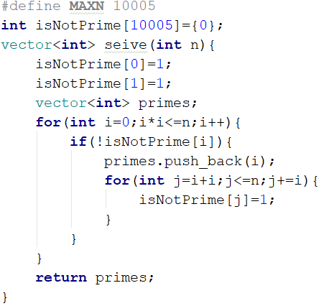
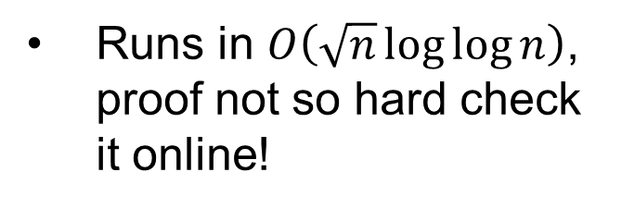
$$Sieve of Eratosthenes$$
Runs in $O\left(\sqrt{n}\log{\log{n}}\right)$, proof not so hard check it online!

Slide 27
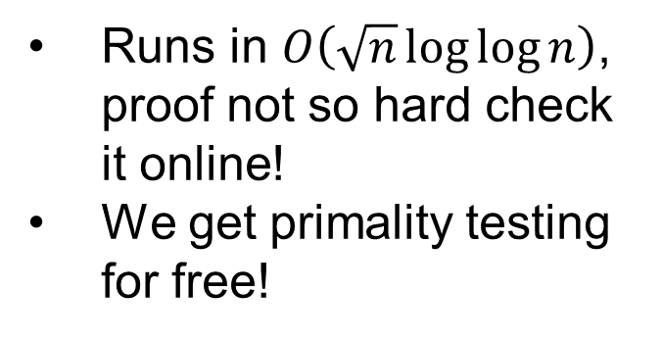
$$Sieve of Eratosthenes$$
Runs in $O\left(\sqrt{n}\log{\log{n}}\right)$, proof not so hard check it online!
We get primality testing for free!

Slide 28
GCD & LCM

Slide 29
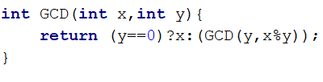
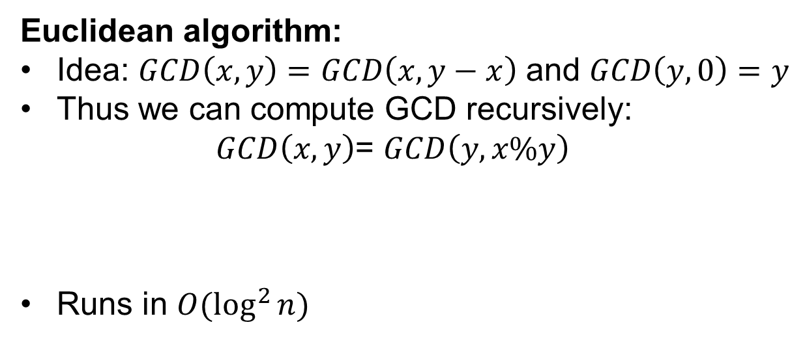
$$GCD(x,y)$$
Euclidean algorithm:
Idea: $GCD\left(x,y\right)=GCD\left(x,y−x\right)$ and $GCD\left(y,0\right)=y$
Thus we can compute GCD recursively:
$GCD\left(x,y\right)$= $GCD\left(y,x\%y\right)$
Runs in $O(\log^{2}{n})$

Slide 30
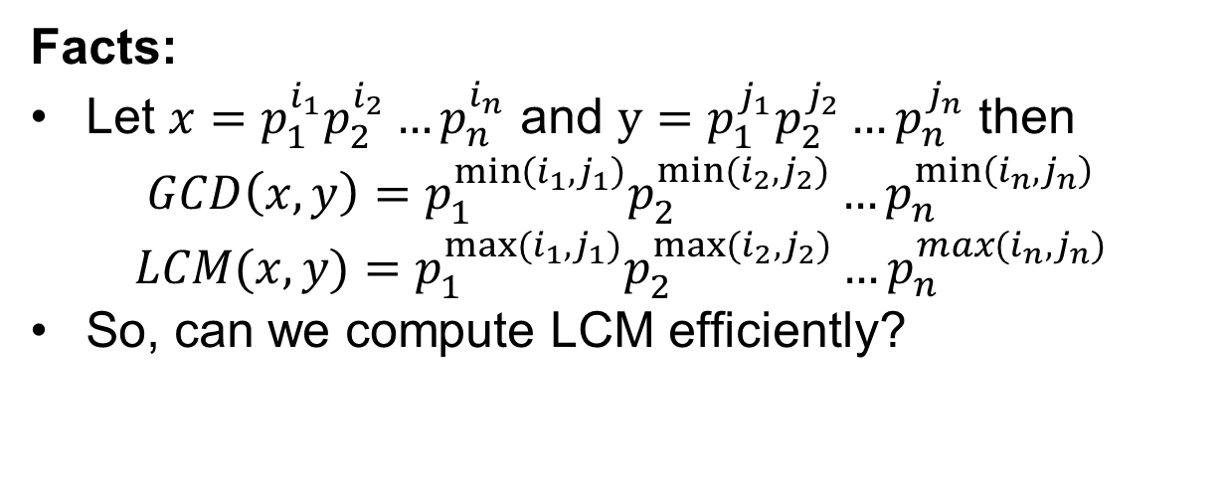
$$GCD and LCM$$
Facts:
Let $x=p_{1}^{i_{1}}p_{2}^{i_{2}}…p_{n}^{i_{n}}$ and $y=p_{1}^{j_{1}}p_{2}^{j_{2}}…p_{n}^{j_{n}}$ then
$$GCD\left(x,y\right)=p_{1}^{\min\left(i_{1},j_{1}\right)}p_{2}^{{min⁡(i}_{2},j_{2})}…p_{n}^{\min\left(i_{n},j_{n}\right)}$$
$$LCM(x,y)=p_{1}^{max⁡(i_{1},j_{1})}p_{2}^{{max⁡(i}_{2},j_{2})}…p_{n}^{max(i_{n},j_{n})}$$
So, can we compute LCM efficiently?

Slide 31
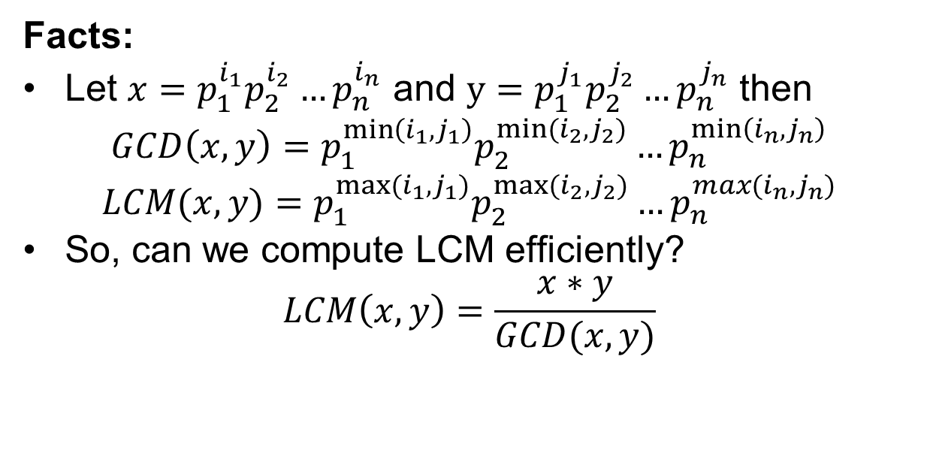
$$GCD and LCM$$
Facts:
Let $x=p_{1}^{i_{1}}p_{2}^{i_{2}}…p_{n}^{i_{n}}$ and $y=p_{1}^{j_{1}}p_{2}^{j_{2}}…p_{n}^{j_{n}}$ then
$$GCD\left(x,y\right)=p_{1}^{\min\left(i_{1},j_{1}\right)}p_{2}^{{min⁡(i}_{2},j_{2})}…p_{n}^{\min\left(i_{n},j_{n}\right)}$$
$$LCM(x,y)=p_{1}^{max⁡(i_{1},j_{1})}p_{2}^{{max⁡(i}_{2},j_{2})}…p_{n}^{max(i_{n},j_{n})}$$
So, can we compute LCM efficiently?
$$LCM\left(x,y\right)=\frac{x∗y}{GCD(x,y)}$$

Slide 32
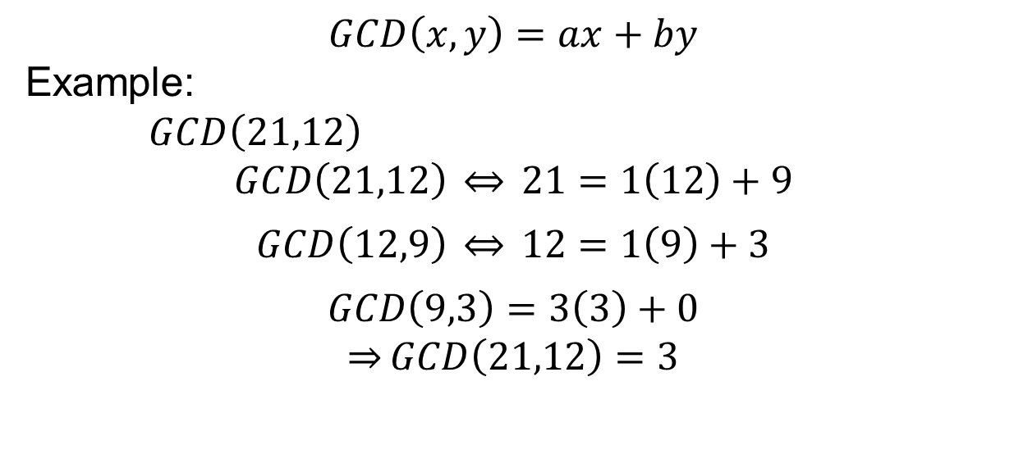
$$Bezout^{′}s identity$$
$$GCD\left(x,y\right)=ax+by$$
Example:
$GCD\left(21,12\right)$
$$GCD\left(21,12\right) \overset{⇔}{} 21=1\left(12\right)+9$$
$$GCD\left(12,9\right) \overset{⇔}{} 12=1\left(9\right)+3$$
$$GCD\left(9,3\right)=3\left(3\right)+0$$
$$\overset{⇒}{}GCD\left(21,12\right)=3$$

Slide 33

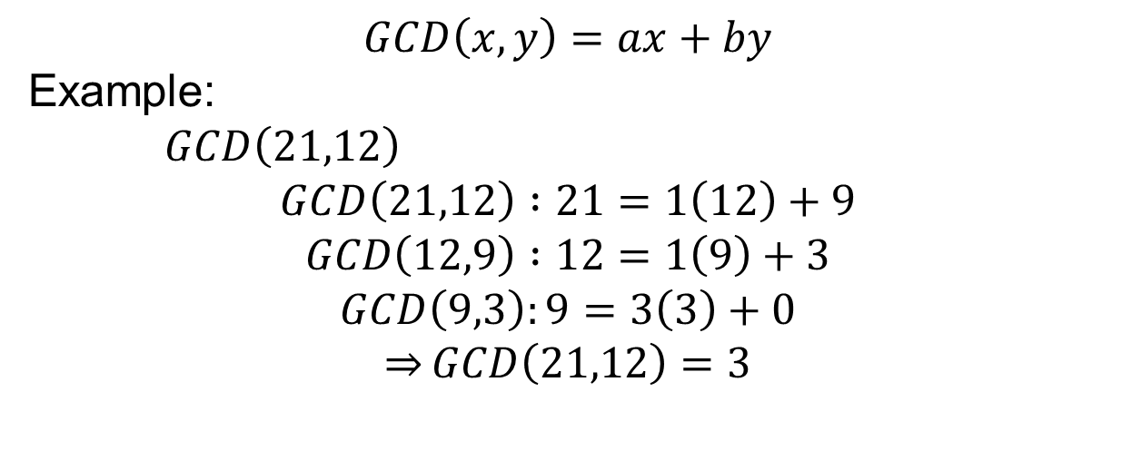
$$Bezout^{′}s identity$$
$$GCD\left(x,y\right)=ax+by$$
Example:
$GCD\left(21,12\right)$
$$GCD\left(21,12\right) :21=1\left(12\right)+9$$
$$GCD\left(12,9\right) :12=1\left(9\right)+3$$
$$GCD\left(9,3\right):9=3\left(3\right)+0$$
$$\overset{⇒}{}GCD\left(21,12\right)=3$$
Back tracing gives us
$$3=−1\left(21\right)+2(12)$$

Slide 34
Fast exponentiation

Slide 35
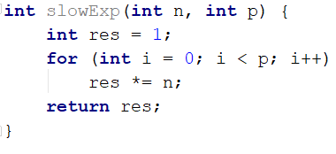
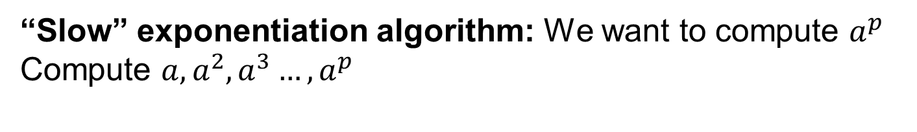
$$Exp(a,p)$$
“Slow” exponentiation algorithm: We want to compute $a^{p}$
Compute $a,a^{2},a^{3}…,a^{p}$

Slide 36
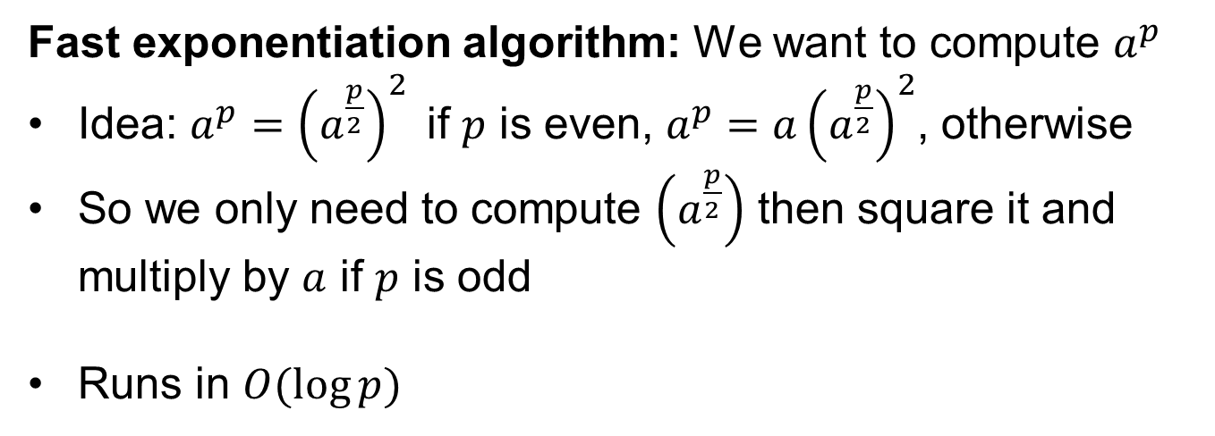
$$Exp(a,p)$$
Fast exponentiation algorithm: We want to compute $a^{p}$
Idea: $a^{p}={\left(a^{\frac{p}{2}}\right)}^{2}$if $p$ is even, $a^{p}={a\left(a^{\frac{p}{2}}\right)}^{2}$, otherwise
So we only need to compute $\left(a^{\frac{p}{2}}\right)$ then square it and multiply by $a$ if $p$ is odd
Runs in $O(\log{p})$

Slide 37
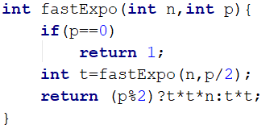
$$Exp(a,p)$$
Fast exponentiation algorithm: We want to compute $a^{p}$
Idea: $a^{p}={\left(a^{\frac{p}{2}}\right)}^{2}$if $p$ is even, $a^{p}={a\left(a^{\frac{p}{2}}\right)}^{2}$, otherwise
So we only need to compute $\left(a^{\frac{p}{2}}\right)$ then square it and multiply by $a$ if $p$ is odd
Runs in $O(\log{p})$

Slide 38
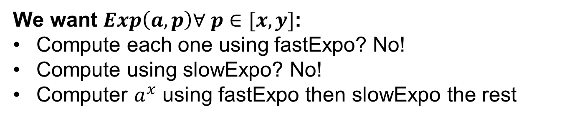
$$Exp\left(a,p\right) n times$$
We want $Exp\left(a,p\right)∀ p∈[x,y]$:
Compute each one using fastExpo? No!
Compute using slowExpo? No!
Computer $a^{x}$ using fastExpo then slowExpo the rest

Slide 39
Modulo arithmetic

Slide 40
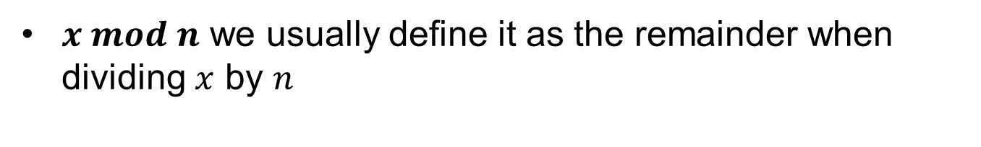
$$x mod n$$
$x mod n$ we usually define it as the remainder when dividing $x$ by $n$

Slide 41
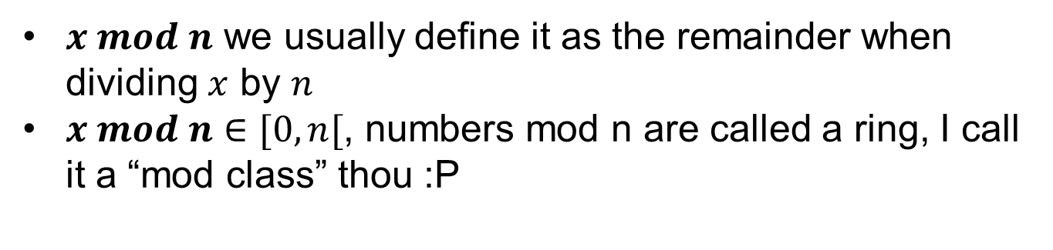
$$x mod n$$
$x mod n$ we usually define it as the remainder when dividing $x$ by $n$
$x mod n∈[0,n[$, numbers mod n are called a ring, I call it a “mod class” thou :P

Slide 42
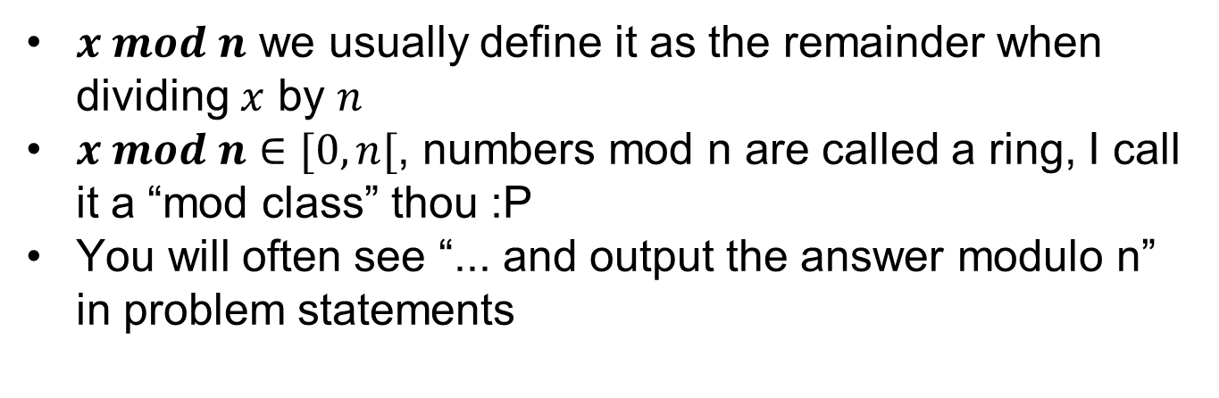
$$x mod n$$
$x mod n$ we usually define it as the remainder when dividing $x$ by $n$
$x mod n∈[0,n[$, numbers mod n are called a ring, I call it a “mod class” thou :P
You will often see “... and output the answer modulo n” in problem statements

Slide 43
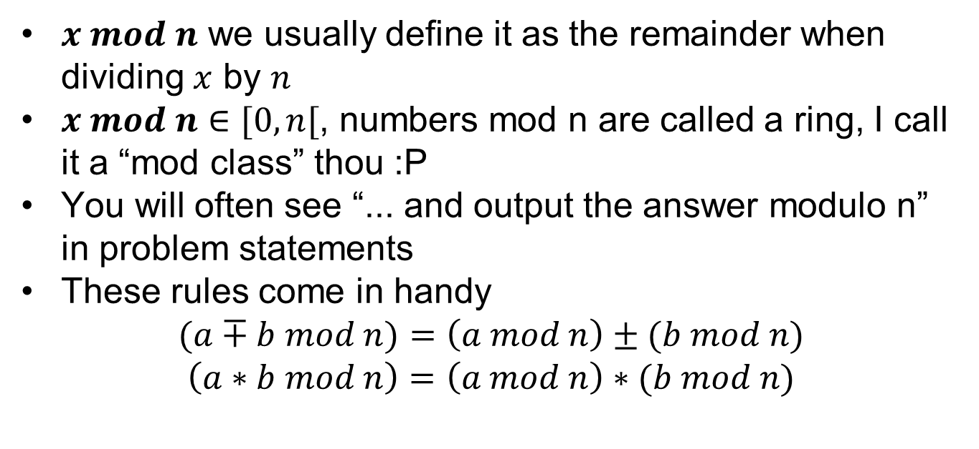
$$x mod n$$
$x mod n$ we usually define it as the remainder when dividing $x$ by $n$
$x mod n∈[0,n[$, numbers mod n are called a ring, I call it a “mod class” thou :P
You will often see “... and output the answer modulo n” in problem statements
These rules come in handy
$$(a∓b mod n)=\left(a mod n\right)±(b mod n)$$
$$\left(a∗b mod n\right)=\left(a mod n\right)∗(b mod n)$$

Slide 44
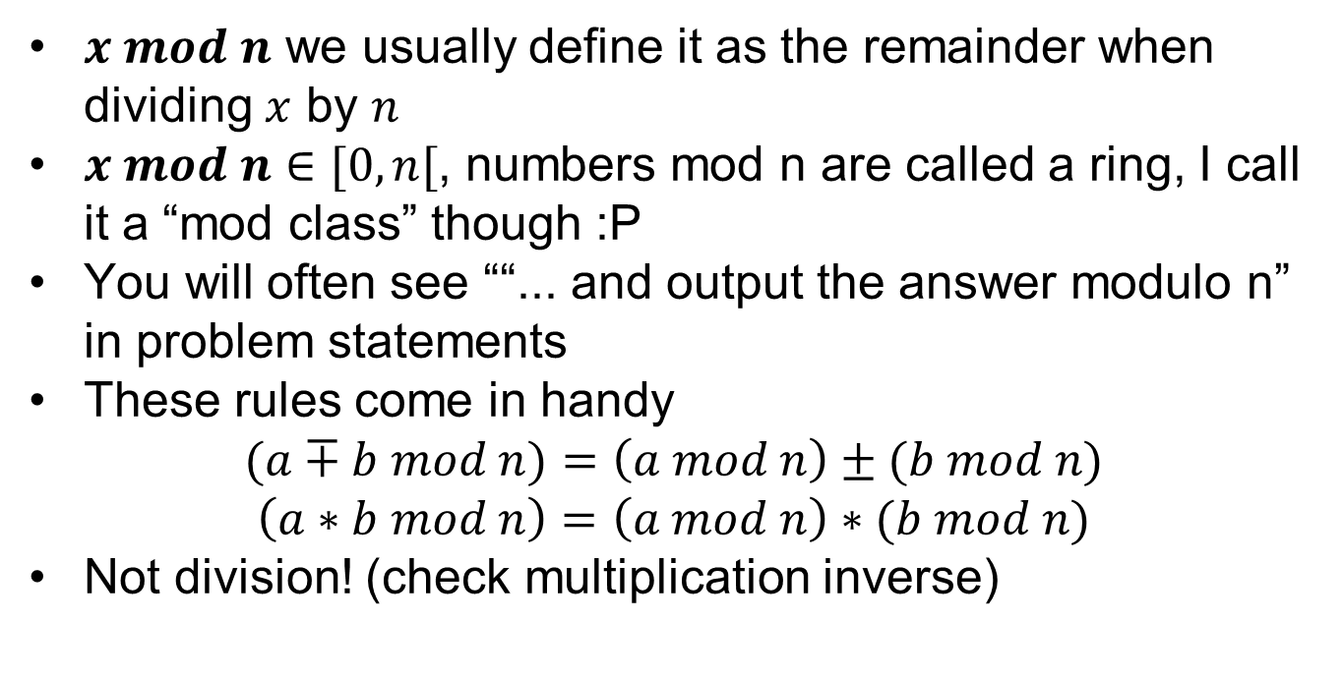
$$x mod n$$
$x mod n$ we usually define it as the remainder when dividing $x$ by $n$
$x mod n∈[0,n[$, numbers mod n are called a ring, I call it a “mod class” though :P
You will often see ““... and output the answer modulo n” in problem statements
These rules come in handy
$$(a∓b mod n)=\left(a mod n\right)±(b mod n)$$
$$\left(a∗b mod n\right)=\left(a mod n\right)∗(b mod n)$$
Not division! (check multiplication inverse)

Slide 45
$$Important note!$$
We are talking about the CS version of $mod$ here

Slide 46
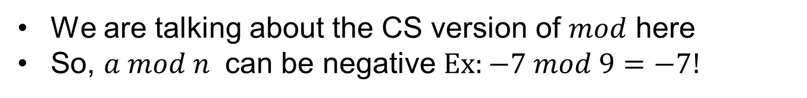
$$Important note!$$
We are talking about the CS version of $mod$ here
So, $a mod n$ can be negative $Ex:−7 mod 9=−7!$

Slide 47
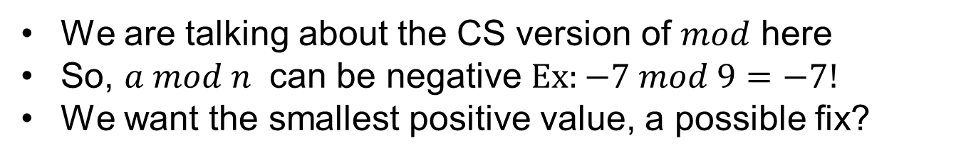
$$Important note!$$
We are talking about the CS version of $mod$ here
So, $a mod n$ can be negative $Ex:−7 mod 9=−7!$
We want the smallest positive value, a possible fix?

Slide 48
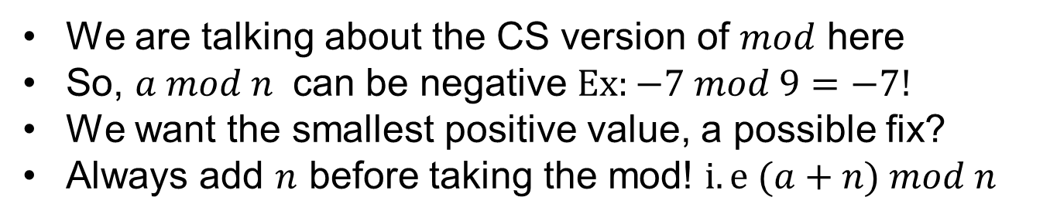
$$Important note!$$
We are talking about the CS version of $mod$ here
So, $a mod n$ can be negative $Ex:−7 mod 9=−7!$
We want the smallest positive value, a possible fix?
Always add $n$ before taking the mod! $i.e (a+n) mod n$

Slide 49
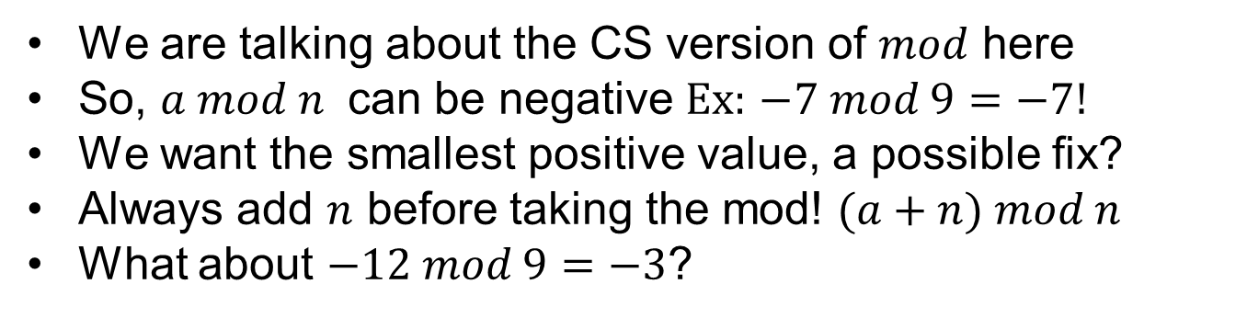
$$Important note!$$
We are talking about the CS version of $mod$ here
So, $a mod n$ can be negative $Ex:$ $−7 mod 9=−7!$
We want the smallest positive value, a possible fix?
Always add $n$ before taking the mod! $(a+n) mod n$
What about $−12 mod 9=−3$?

Slide 50
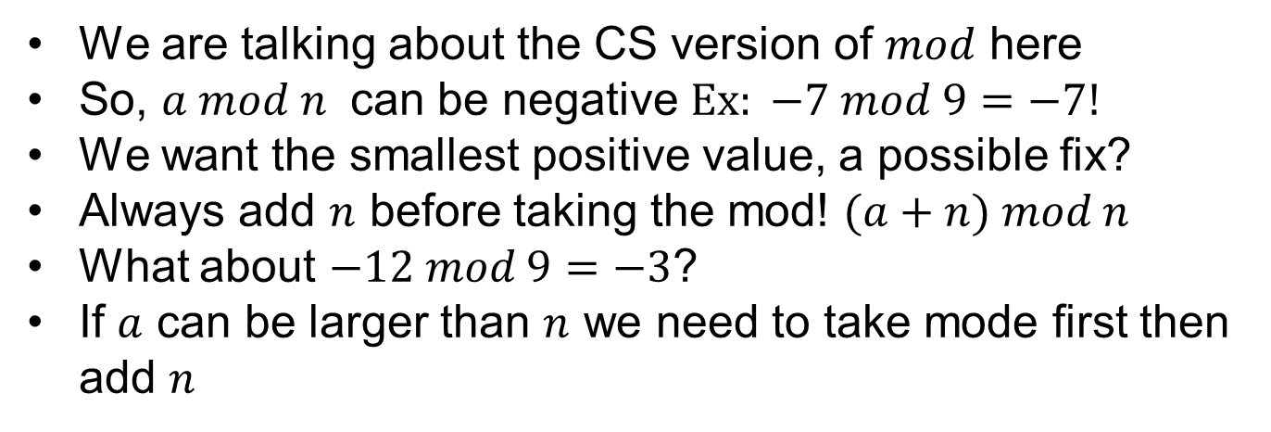
$$Important note!$$
We are talking about the CS version of $mod$ here
So, $a mod n$ can be negative $Ex: −7 mod 9=−7!$
We want the smallest positive value, a possible fix?
Always add $n$ before taking the mod! $(a+n) mod n$
What about $−12 mod 9=−3$?
If $a$ can be larger than $n$ we need to take mode first then add $n$

Slide 51
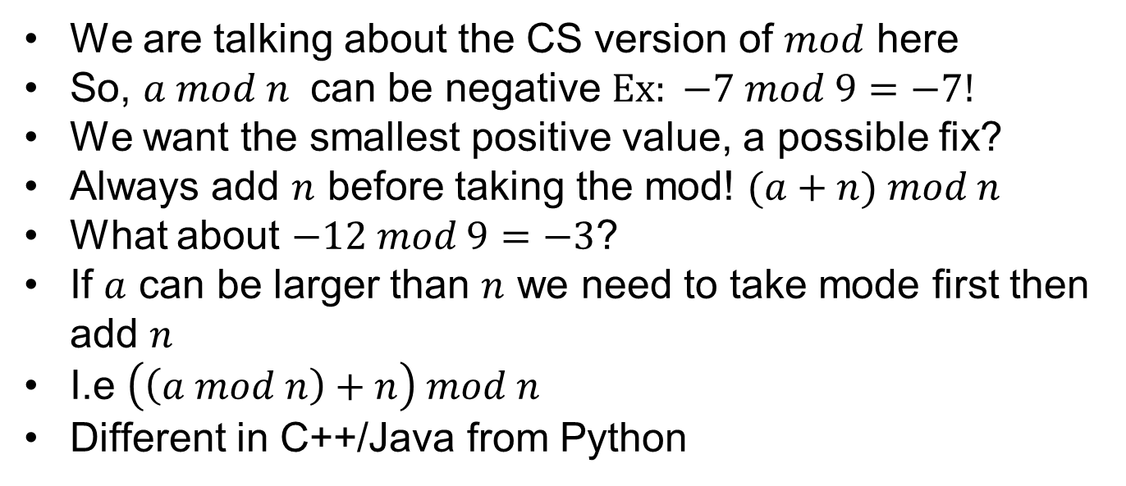
$$Important note!$$
We are talking about the CS version of $mod$ here
So, $a mod n$ can be negative $Ex: −7 mod 9=−7!$
We want the smallest positive value, a possible fix?
Always add $n$ before taking the mod! $(a+n) mod n$
What about $−12 mod 9=−3$?
If $a$ can be larger than $n$ we need to take mode first then add $n$
I.e $\left(\left(a mod n\right)+n\right) mod n$
Different in C++/Java from Python

Slide 52
Divisors & factorization

Slide 53
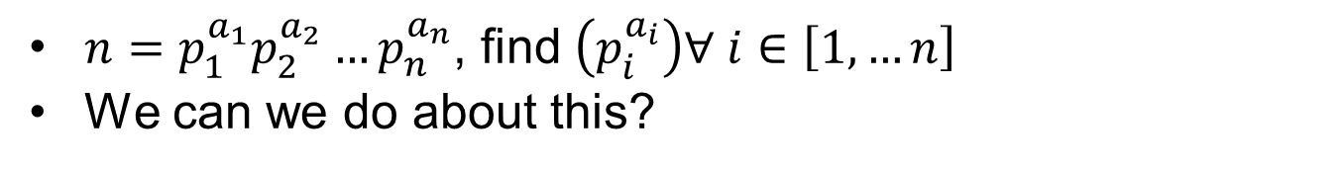
$$Factorization of n$$
$n=p_{1}^{a_{1}}p_{2}^{a_{2}}…p_{n}^{a_{n}}$, find $\left(p_{i}^{a_{i}}\right)∀ i∈\left[1,…n\right]$
We can we do about this?

Slide 54
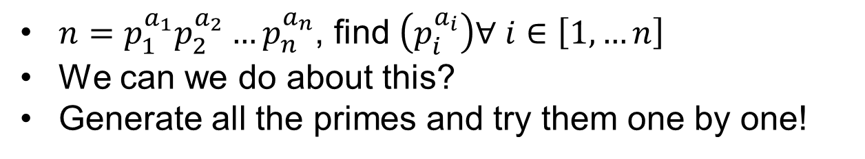
$$Factorization of n$$
$n=p_{1}^{a_{1}}p_{2}^{a_{2}}…p_{n}^{a_{n}}$, find $\left(p_{i}^{a_{i}}\right)∀ i∈\left[1,…n\right]$
We can we do about this?
Generate all the primes and try them one by one!

Slide 55
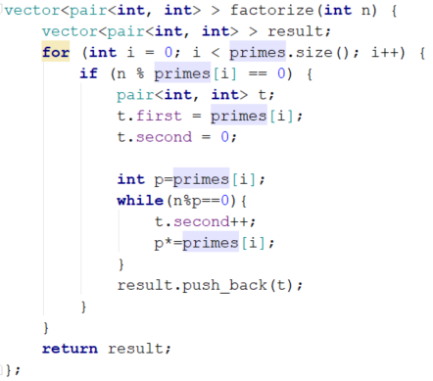
$$Factorization of n$$
$$Why is this bad??$$

Slide 56


Slide 57
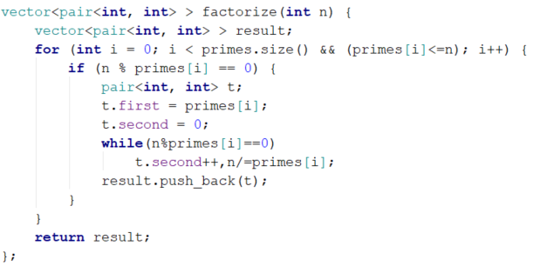
$$Factorization of n, no overflow$$

Slide 58
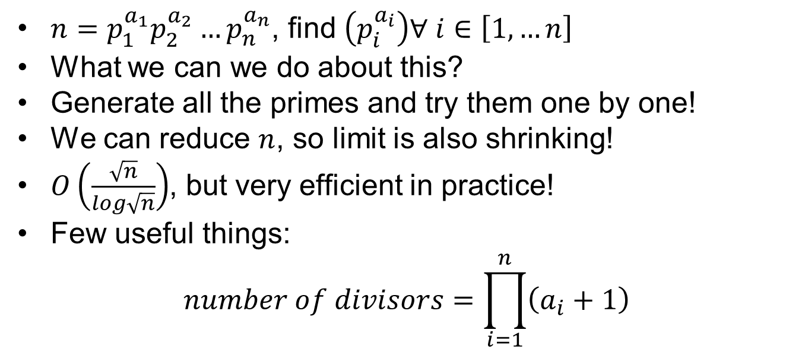
$$Factorization of n$$
$n=p_{1}^{a_{1}}p_{2}^{a_{2}}…p_{n}^{a_{n}}$, find $\left(p_{i}^{a_{i}}\right)∀ i∈\left[1,…n\right]$
What we can we do about this?
Generate all the primes and try them one by one!
We can reduce $n$, so limit is also shrinking!
$O\left(\frac{\sqrt{n}}{log\sqrt{n}}\right)$, but very efficient in practice!
Few useful things:
$$number of divisors=\prod_{i=1}^{n}{\left(a_{i}+1\right)}$$

Slide 59
Combinatorics

Slide 60
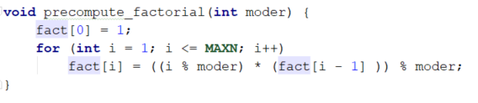
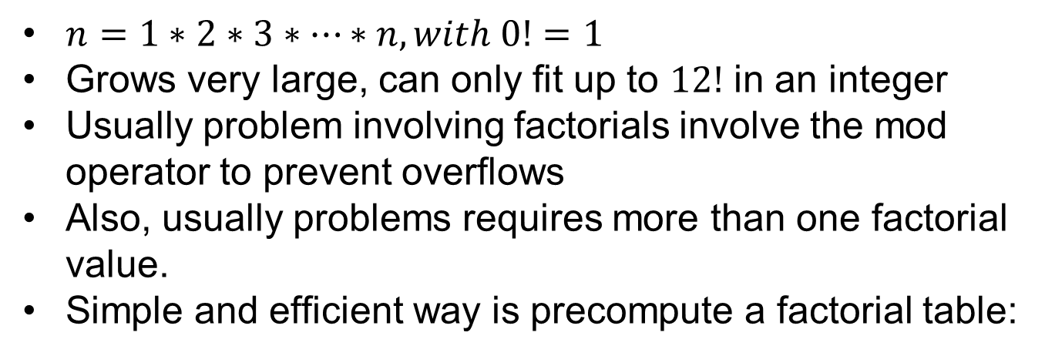
$$Factorial$$
$n=1∗2∗3∗…∗n, with 0!=1$
Grows very large, can only fit up to $12!$ in an integer
Usually problem involving factorials involve the mod operator to prevent overflows
Also, usually problems requires more than one factorial value.
Simple and efficient way is precompute a factorial table:

Slide 61
$$Binomial coefficient$$
$\left({n \atop k}\right)=\frac{n!}{\left(n−k\right)!k!}$

Slide 62
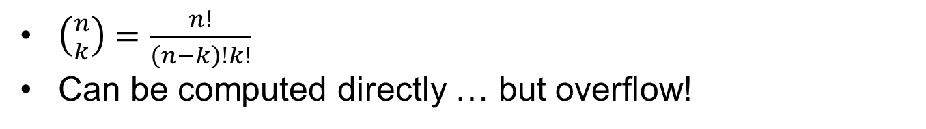
$$Binomial coefficient$$
$\left({n \atop k}\right)=\frac{n!}{\left(n−k\right)!k!}$
Can be computed directly … but overflow!

Slide 63
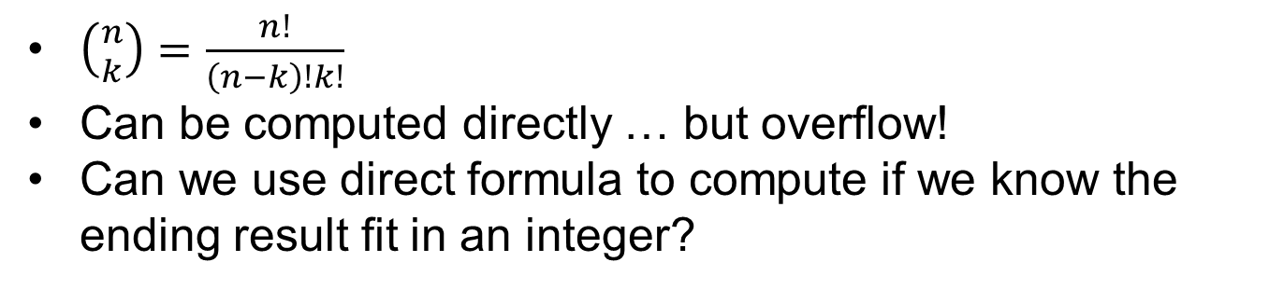
$$Binomial coefficient$$
$\left({n \atop k}\right)=\frac{n!}{\left(n−k\right)!k!}$
Can be computed directly … but overflow!
Can we use direct formula to compute if we know the ending result fit in an integer?

Slide 64
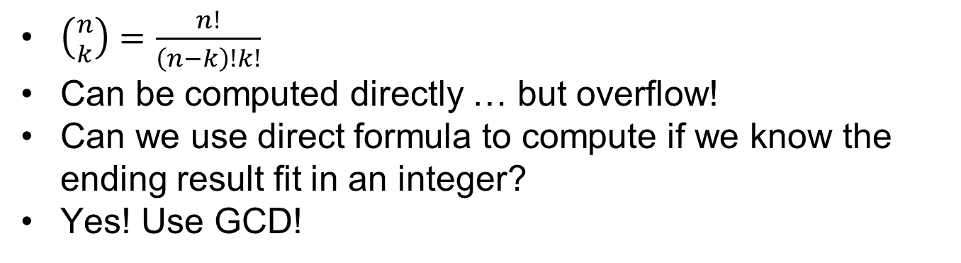
$$Binomial coefficient$$
$\left({n \atop k}\right)=\frac{n!}{\left(n−k\right)!k!}$
Can be computed directly … but overflow!
Can we use direct formula to compute if we know the ending result fit in an integer?
Yes! Use GCD!

Slide 65
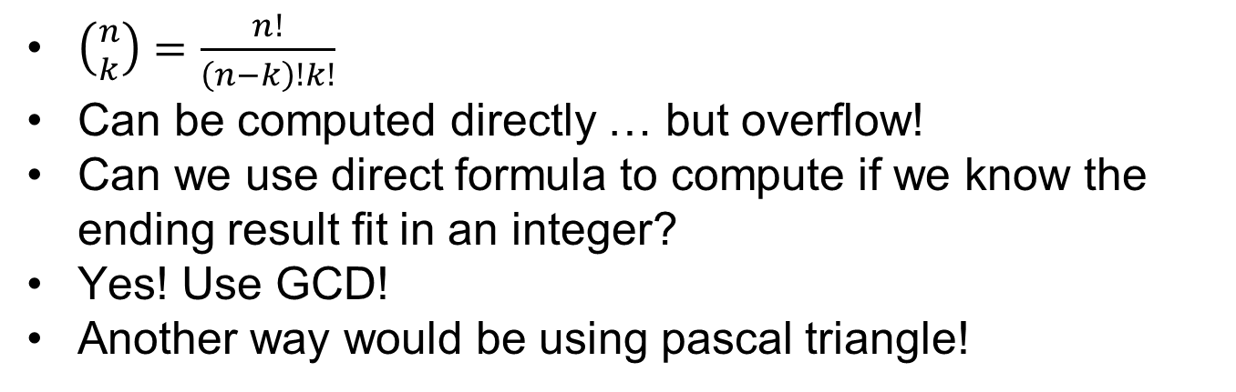
$$Binomial coefficient$$
$\left({n \atop k}\right)=\frac{n!}{\left(n−k\right)!k!}$
Can be computed directly … but overflow!
Can we use direct formula to compute if we know the ending result fit in an integer?
Yes! Use GCD!
Another way would be using pascal triangle!

Slide 66
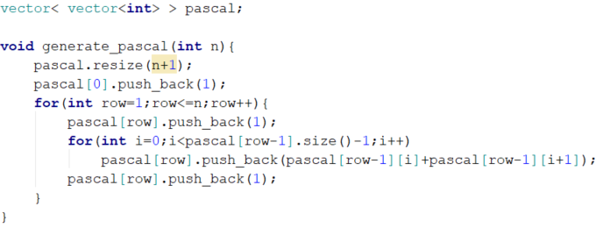
$$Pascal triangle$$

Slide 67
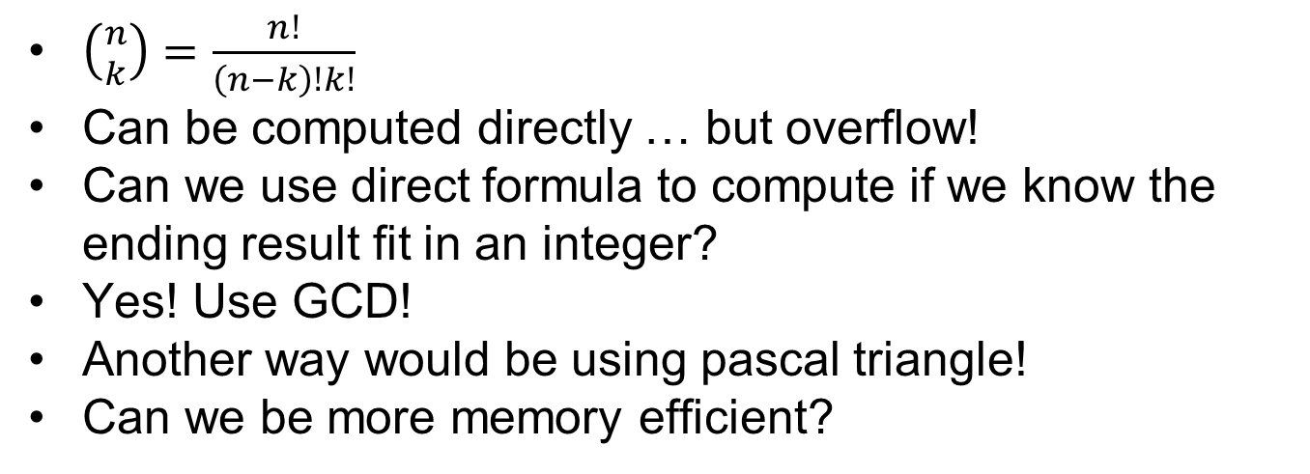
$$Binomial coefficient$$
$\left({n \atop k}\right)=\frac{n!}{\left(n−k\right)!k!}$
Can be computed directly … but overflow!
Can we use direct formula to compute if we know the ending result fit in an integer?
Yes! Use GCD!
Another way would be using pascal triangle!
Can we be more memory efficient?

Slide 68
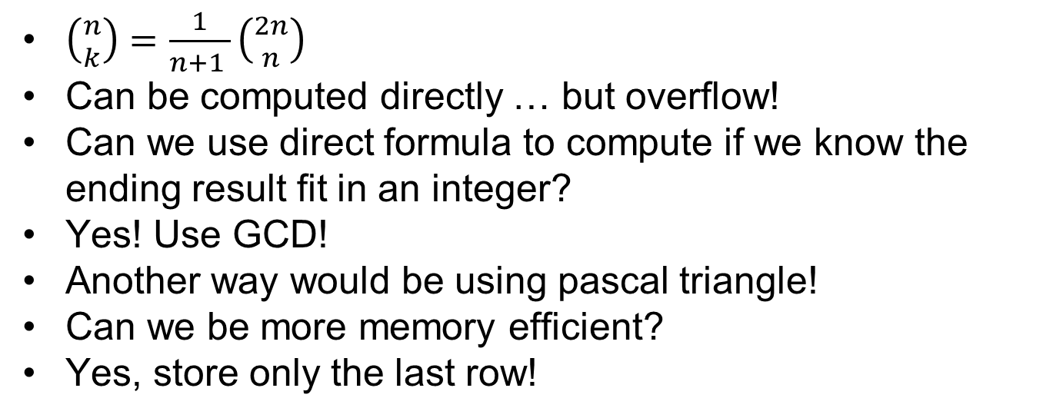
$$Binomial coefficient$$
$\left({n \atop k}\right)=\frac{1}{n+1 }\left({2n \atop n}\right)$
Can be computed directly … but overflow!
Can we use direct formula to compute if we know the ending result fit in an integer?
Yes! Use GCD!
Another way would be using pascal triangle!
Can we be more memory efficient?
Yes, store only the last row!

Slide 69
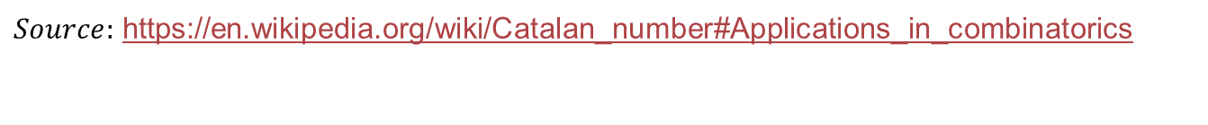
$$Catalan numbers$$
$C_{n}=\frac{1}{\left(n−k\right)!k!}$ and it counts
$Source:$ https://en.wikipedia.org/wiki/Catalan_number#Applications_in_combinatorics

Slide 70
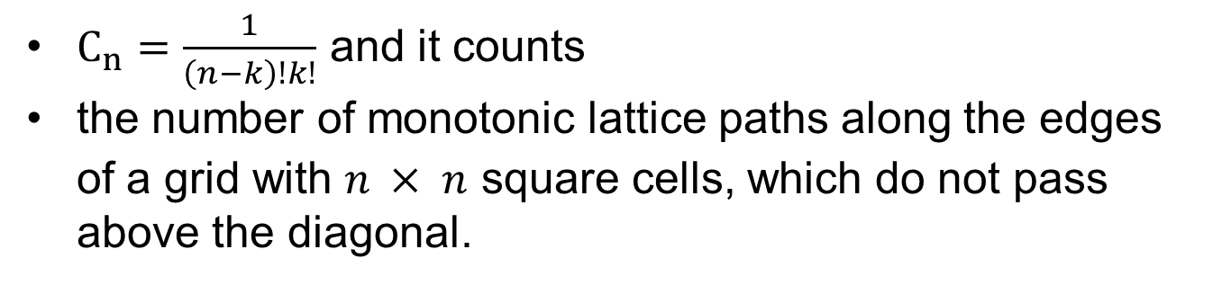
$$Catalan numbers$$
$C_{n}=\frac{1}{\left(n−k\right)!k!}$ and it counts
the number of monotonic lattice paths along the edges of a grid with $n × n$ square cells, which do not pass above the diagonal.
$Source:$ https://en.wikipedia.org/wiki/Catalan_number#Applications_in_combinatorics

Slide 71
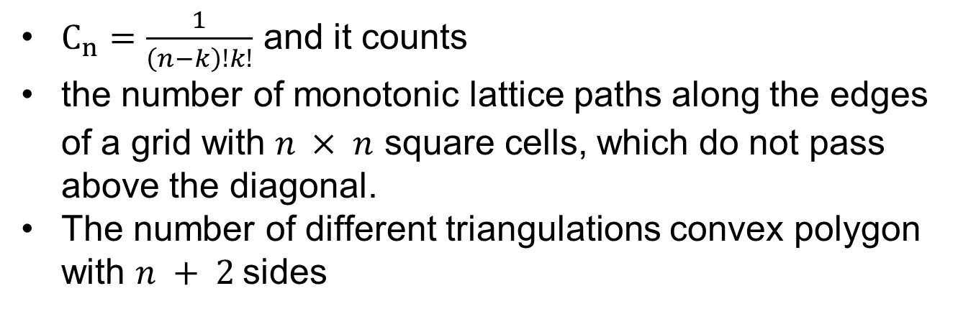
$$Catalan numbers$$
$C_{n}=\frac{1}{\left(n−k\right)!k!}$ and it counts
the number of monotonic lattice paths along the edges of a grid with $n × n$ square cells, which do not pass above the diagonal.
The number of different triangulations convex polygon with $n + 2$sides
$Source:$ https://en.wikipedia.org/wiki/Catalan_number#Applications_in_combinatorics

Slide 72

$$Catalan numbers$$
$C_{n}=\frac{1}{\left(n−k\right)!k!}$ and it counts
the number of monotonic lattice paths along the edges of a grid with $n × n$ square cells, which do not pass above the diagonal.
The number of different triangulations convex polygon with $n + 2$sides
The number of expressions containing $n$ pairs of parentheses which are correctly matched
And many more…
$Source:$ https://en.wikipedia.org/wiki/Catalan_number#Applications_in_combinatorics

Slide 73



$$Catalan numbers$$
$C_{n}=\frac{1}{\left(n−k\right)!k!}$
$$\text{((())) ()(()) ()()() (())() (()())}$$
$Source:$ https://en.wikipedia.org/wiki/Catalan_number#Applications_in_combinatorics

Slide 74
Matrix power

Slide 75

$$Motivation$$
Idea:
Can we compute $fib\left(n\right)$ faster than $O(n)$ ?

Slide 76

$$Motivation$$
Idea:
Can we compute $fib\left(n\right)$ faster than $O(n)$ ?
Yes!
Use raising $T$ to power $n$ then multiplying by $B$ gives us $f_{n+2}$
$$T=\left(\begin{matrix}1 & 1 \\ 1 & 0\end{matrix}\right),B=\left({0 \atop 1}\right)$$

Slide 77

$$Motivation$$
Idea:
Can we compute $fib\left(n\right)$ faster than $O(n)$ ?
Yes!
Use raising $T$ to power $n$ then multiplying by $B$ gives us $f_{n+2}$
$$T=\left(\begin{matrix}1 & 1 \\ 1 & 0\end{matrix}\right),B=\left({0 \atop 1}\right)$$
$$\left({f_{n+2} \atop f_{n+1}}\right)=\left(\begin{matrix}1 & 1 \\ 1 & 0\end{matrix}\right).\left({f_{n+1} \atop f_{n}}\right)$$

Slide 78

$$Matrix power$$
We can generalize to any linear recurrence
$$f_{n}=c_{1}f_{n−1}+…+c_{k}f_{n−k}$$
$$\left(\begin{matrix}f_{n} \\ \begin{matrix}f_{n−1} \\ \begin{matrix}⋮ \\ f_{n−k+1}\end{matrix}\end{matrix}\end{matrix}\right)=\left(\begin{matrix}\begin{matrix}\begin{matrix}c_{1} & c_{2}\end{matrix} \\ \begin{matrix}1 & 0\end{matrix}\end{matrix} & ⋯ & \begin{matrix}c_{k} \\ 0\end{matrix} \\ ⋮ & ⋱ & ⋮ \\ \begin{matrix}0 & 0\end{matrix} & ⋯ & 0\end{matrix}\right)\left(\begin{matrix}f_{n−1} \\ \begin{matrix}f_{n} \\ \begin{matrix}⋮ \\ f_{n−k}\end{matrix}\end{matrix}\end{matrix}\right)$$
Complexity is $O\left(k^{3}\log\left(n\right)\right)$

Slide 79

$$Matrix power$$
We can generalize to any linear recurrence
$$f_{n}=c_{1}f_{n−1}+…+c_{k}f_{n−k}$$
$$\left(\begin{matrix}f_{n} \\ \begin{matrix}f_{n−1} \\ \begin{matrix}⋮ \\ f_{n−k+1}\end{matrix}\end{matrix}\end{matrix}\right)=\left(\begin{matrix}\begin{matrix}\begin{matrix}c_{1} & c_{2}\end{matrix} \\ \begin{matrix}1 & 0\end{matrix}\end{matrix} & ⋯ & \begin{matrix}c_{k} \\ 0\end{matrix} \\ ⋮ & ⋱ & ⋮ \\ \begin{matrix}0 & 0\end{matrix} & ⋯ & 0\end{matrix}\right)\left(\begin{matrix}f_{n−1} \\ \begin{matrix}f_{n} \\ \begin{matrix}⋮ \\ f_{n−k}\end{matrix}\end{matrix}\end{matrix}\right)$$

Slide 80
Problems

Slide 81

Factstone benchmark
Idea: what is the largest $n$ such that $n!$ can fit in $k$ bits
Source: https://open.kattis.com/problems/factstone

Slide 82

Factstone benchmark
Idea: what is the largest $n$ such that $n!$ can fit in $k$ bits
We cannot compute every factorial …
Source: https://open.kattis.com/problems/factstone

Slide 83

Factstone benchmark
Idea: what is the largest $n$ such that $n!$ can fit in $k$ bits
We cannot compute every factorial …
We only care about the number of digits of the factorial
Source: https://open.kattis.com/problems/factstone

Slide 84

Factstone benchmark
Idea: what is the largest $n$ such that $n!$ can fit in $k$ bits
We cannot compute every factorial …
We only care about the number of digits of the factorial
More specifically we only care about $\left\lfloor log_{2}\left(n\right)\right\rfloor +1$ and we want to solve $\left\lfloor log_{2}\left(n\right)\right\rfloor +1=k$ for the largest possible $n$
Source: https://open.kattis.com/problems/factstone

Slide 85

Factstone benchmark
Idea: what is the largest $n$ such that $n!$ can fit in $k$ bits
We cannot compute every factorial …
We only care about the number of digits of the factorial
More specifically we only care about $\left\lfloor log_{2}\left(n\right)\right\rfloor +1$ and we want to solve $\left\lfloor log_{2}\left(n\right)\right\rfloor +1=k$ for the largest possible $n$
Since $n!$ Grows very fast, it’s sufficient to try $[1…n]$
Source: https://open.kattis.com/problems/factstone

Slide 86

Factstone benchmark
Idea: what is the largest $n$ such that $n!$ can fit in $k$ bits
We cannot compute every factorial …
We only care about the number of digits of the factorial
More specifically we only care about $\left\lfloor log_{2}\left(n\right)\right\rfloor +1$ and we want to solve $\left\lfloor log_{2}\left(n\right)\right\rfloor +1=k$ for the largest possible $n$
Since $n!$ Grows very fast, it’s sufficient to try $[1…n]$
Maybe a better solution exists!
Source: https://open.kattis.com/problems/factstone

Slide 87

Factstone benchmark
Idea: what is the largest $n$ such that $n!$ can fit in $k$ bits
We cannot compute every factorial …
We only care about the number of digits of the factorial
More specifically we only care about $\left\lfloor log_{2}\left(n\right)\right\rfloor +1$ and we want to solve $\left\lfloor log_{2}\left(n\right)\right\rfloor +1=k$ for the largest possible $n$
Since $n!$ Grows very fast, it’s sufficient to try $[1…n]$
Maybe a better solution exists!
Source: https://open.kattis.com/problems/factstone

Slide 88

Factstone benchmark
Idea: what is the largest $n$ such that $n!$ can fit in $k$ bits
We cannot compute every factorial …
We only care about the number of digits of the factorial
More specifically we only care about $\left\lfloor log_{2}\left(n\right)\right\rfloor +1$ and we want to solve $\left\lfloor log_{2}\left(n\right)\right\rfloor +1=k$ for the largest possible $n$
Since $n!$ Grows very fast, it’s sufficient to try $[1…n]$
Maybe a better solution exists!
Bonus problem: Compute inverse factorial of $n$ in $O(N)$where $N$ is digit count of $n$
Source: https://open.kattis.com/problems/factstone

Slide 89


Fox and the number game
Source: http://codeforces.com/problemset/problem/389/A

Slide 90
Fox and the number game
How does the optimal solution look like?

Slide 91

Fox and the number game
How does the optimal solution look like?
Can we have some $x_{i}≠x_{j}$

Slide 92

Fox and the number game
How does the optimal solution look like?
Can we have some $x_{i}≠x_{j}$
What else?

Slide 93

Fox and the number game
How does the optimal solution look like?
Can we have some $x_{i}≠x_{j}$
What else?
Something is preserved about the numbers

Slide 94

Fox and the number game
How does the optimal solution look like?
Can we have some $x_{i}≠x_{j}$
What else?
Something is preserved about the numbers
It’s GCD, our change doesn’t change the GCD of the whole array!

Slide 95

Fox and the number game
How does the optimal solution look like?
Can we have some $x_{i}≠x_{j}$
What else?
Something is preserved about the numbers
It’s GCD, our change doesn’t change the GCD of the whole array!

Slide 96

T-primes
Source: http://codeforces.com/contest/230/problem/B

Slide 97

T-primes
Any ideas? We need to do this in at least $O\left(logn\right)$time

Slide 98

T-primes
Any ideas? We need to do this in at least $O\left(logn\right)$time
How do we get divisors?

Slide 99

T-primes
Any ideas? We need to do this in at least $O\left(logn\right)$time
How do we get divisors?
Let’s try couple of numbers…

Slide 100

T-primes
Any ideas? We need to do this in at least $O\left(logn\right)$time
How do we get divisors?
Let’s try couple of numbers…
Divisors come in pairs! i.e if $x$ divide $y$ then $y/x$ divides $y$ too!

Slide 101

T-primes
Any ideas? We need to do this in at least $O\left(logn\right)$time
How do we get divisors?
Let’s try couple of numbers…
Divisors come in pairs! i.e if $x$ divide $y$ then $y/x$ divides $y$ too!
Only maybe perfect squares?

Slide 102

T-primes
Any ideas? We need to do this in at least $O\left(logn\right)$time
How do we get divisors?
Let’s try couple of numbers…
Divisors come in pairs! i.e if $x$ divide $y$ then $y/x$ divides $y$ too!
Only maybe perfect squares?
No, but close … it’s perfect squares of primes!

Slide 103

T-primes
Any ideas? We need to do this in at least $O\left(logn\right)$time
How do we get divisors?
Let’s try couple of numbers…
Divisors come in pairs! i.e if $x$ divide $y$ then $y/x$ divides $y$ too!
Only maybe perfect squares?
No, but close … it’s perfect squares of primes!

Slide 104


Summing sums
Source: http://www.spoj.com/problems/SUMSUMS/

Slide 105

Summing sums
Any ideas?
Let’s solve it for one cow, if we can do it efficiently enough then we can compute the answer for every cow independently using the same approach.
Can we write a recursion?
Let $S^{n}$ denote the sum of all the numbers after $n$ steps
Let $S_{i}^{n}$ denote the number of the ith cow after n steps
Then $S^{n}=2S^{n−1}$ and $S_{i}^{n}=S^{n−1}−S_{i}^{n−1}$
Let’s design a matrix to exponentiate in order to computer $S_{i}^{n}$
$$T=\left(\begin{matrix}1 & 2 \\ 1 & 0\end{matrix}\right),B=\left(\begin{matrix}S−S_{i} & 0 \\ S_{i} & 0\end{matrix}\right)$$
Only $O\left(logT\right)$ per cow, Run it on all cows for total complexity of $O\left(nlogT\right)$

Slide 106
Summing sums
Any ideas?

Slide 107
Summing sums
Any ideas?
Let’s solve it for one cow, if we can do it efficiently enough then we can compute the answer for every cow independently using the same approach.

Slide 108
Summing sums
Any ideas?
Let’s solve it for one cow, if we can do it efficiently enough then we can compute the answer for every cow independently using the same approach.
Can we write a recursion?

Slide 109

Summing sums
Any ideas?
Let’s solve it for one cow, if we can do it efficiently enough then we can compute the answer for every cow independently using the same approach.
Can we write a recursion?
Let $S^{n}$ denote the sum of all the numbers after $n$ steps
Let $S_{i}^{n}$ denote the number of the ith cow after n steps
Then $S^{n}=2S^{n−1}$ and $S_{i}^{n}=S^{n−1}−S_{i}^{n−1}$

Slide 110

Summing sums
Any ideas?
Let’s solve it for one cow, if we can do it efficiently enough then we can compute the answer for every cow independently using the same approach.
Can we write a recursion?
Let $S^{n}$ denote the sum of all the numbers after $n$ steps
Let $S_{i}^{n}$ denote the number of the ith cow after n steps
Then $S^{n}=2S^{n−1}$ and $S_{i}^{n}=S^{n−1}−S_{i}^{n−1}$
Let’s design a matrix to exponentiate in order to computer $S_{i}^{n}$

Slide 111

Summing sums
Any ideas?
Let’s solve it for one cow, if we can do it efficiently enough then we can compute the answer for every cow independently using the same approach.
Can we write a recursion?
Let $S^{n}$ denote the sum of all the numbers after $n$ steps
Let $S_{i}^{n}$ denote the number of the ith cow after n steps
Then $S^{n}=2S^{n−1}$ and $S_{i}^{n}=S^{n−1}−S_{i}^{n−1}$
Let’s design a matrix to exponentiate in order to computer $S_{i}^{n}$
$$T=\left(\begin{matrix}1 & 2 \\ 1 & 0\end{matrix}\right),B=\left(\begin{matrix}S−S_{i} & 0 \\ S_{i} & 0\end{matrix}\right)$$

Slide 112
Summing sums
Any ideas?
Let’s solve it for one cow, if we can do it efficiently enough then we can compute the answer for every cow independently using the same approach.
Can we write a recursion?
Let $S^{n}$ denote the sum of all the numbers after $n$ steps
Let $S_{i}^{n}$ denote the number of the ith cow after n steps
Then $S^{n}=2S^{n−1}$ and $S_{i}^{n}=S^{n−1}−S_{i}^{n−1}$
Let’s design a matrix to exponentiate in order to computer $S_{i}^{n}$
$$T=\left(\begin{matrix}1 & 2 \\ 1 & 0\end{matrix}\right),B=\left(\begin{matrix}S−S_{i} & 0 \\ S_{i} & 0\end{matrix}\right)$$
Only $O\left(logT\right)$ per cow, Run it on all cows for total complexity of $O\left(nlogT\right)$

Slide 113
Hope you had fun
Thank you!

