Slide 1
Customer Churn Prediction Helping SyriaTel Keep More Customers
Name: Chris Mau Karagu
Phase 3 Project

Slide 2
Overview
SyriaTel is losing customers every month.
Losing customers means losing revenue.
It is much cheaper to keep current customers than to find new ones.
The goal is to create a simple tool that predicts which customers are likely to leave soon.

Slide 3
Business Problem
Customer churn is a major challenge for SyriaTel.
The company needs to identify customers likely to leave.
Early intervention can reduce customer loss.
The project aims to support customer retention decisions using machine learning.
Stakeholders:
Customer Retention Team
Marketing Team
Customer Support Department

Slide 4
Data Understanding
Dataset contains information from 3,333 telecom customers.
Features include:
call usage
international plan
voicemail plan
customer service calls
customer churn status.
Dataset contained: No missing values and No duplicate records.
Key Observation: Only 14.5% of customers churned.

Slide 5
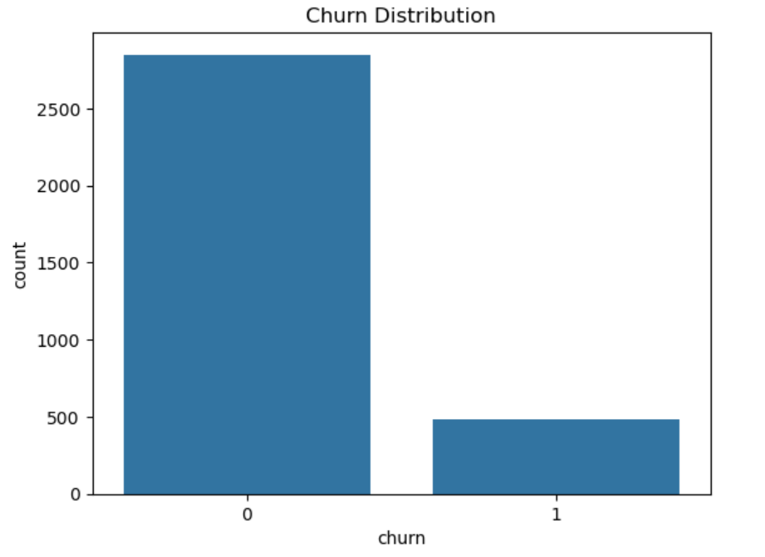
Data Understanding: Chun Distribution

Slide 6
Exploratory Data Analysis
Key Behavioural Patterns Identified:
Customers with international plans churned more frequently.
Customers with many customer service calls were more likely to churn.
Customers with voicemail plans were less likely to churn.

Slide 7
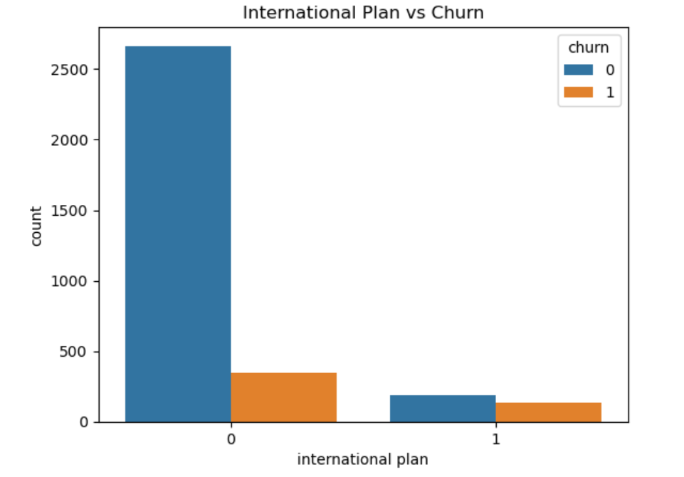
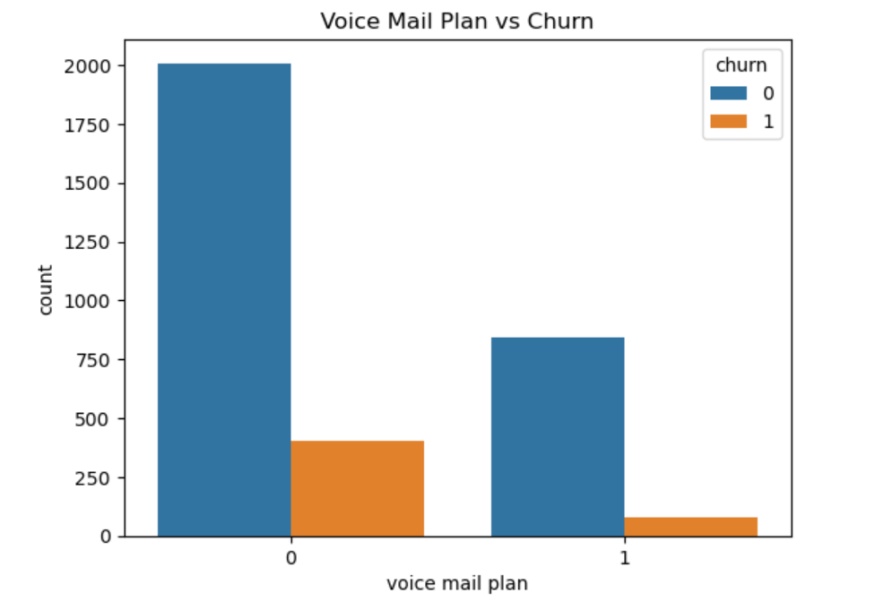
Exploratory Data Analysis

Slide 8
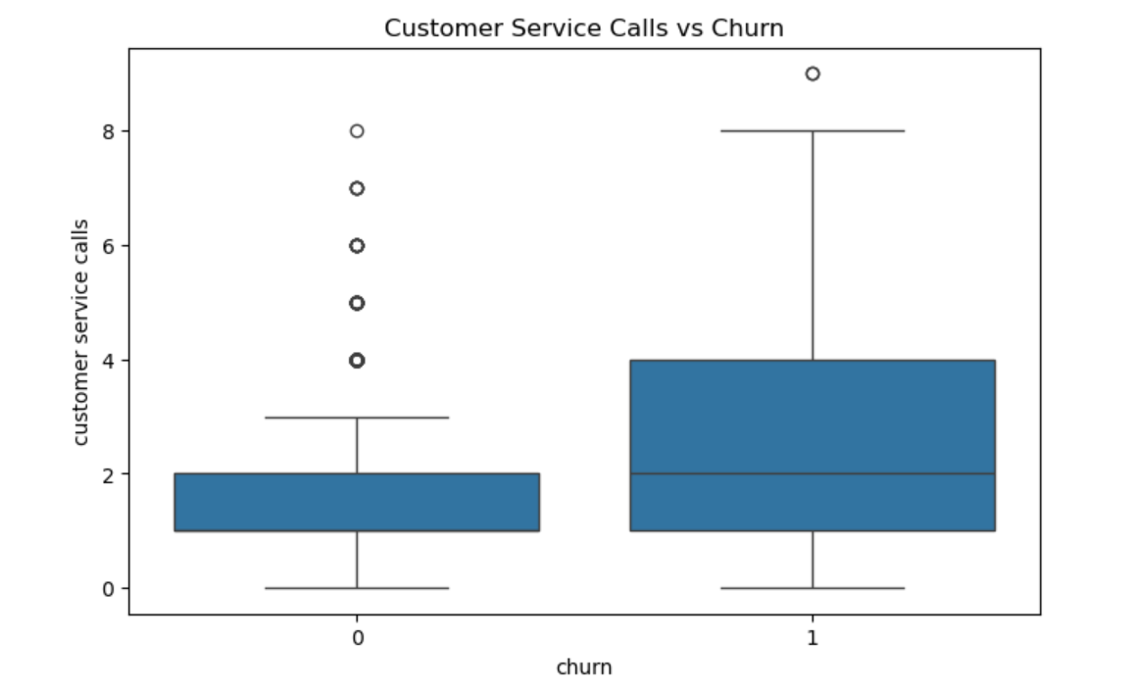
Exploratory Data Analysis

Slide 9
Data Preparation
Data Cleaning and Transformation:
Removed irrelevant columns:
Phone number
State
Area code
Removed highly correlated charge variables.
Encoded categorical variables into numerical format.
Scaled features for Logistic Regression modeling.

Slide 10
Modelling Approach
Why Classification?
Classification helps predict whether a customer will Stay or Churn
Models Tested:
Baseline Logistic Regression
Improved Logistic Regression
Decision Tree
Tuned Decision Tree
The goal is to Identify the model that best predicts churn customers.

Slide 11
Logistic Regression Results
Baseline Logistic Regression:
High overall accuracy (85%)
Poor churn detection recall (17%)
Missed many actual churn customers
Improved Logistic Regression:
Recall improved to 77%
Better at identifying churn customers
Accuracy reduced slightly

Slide 12
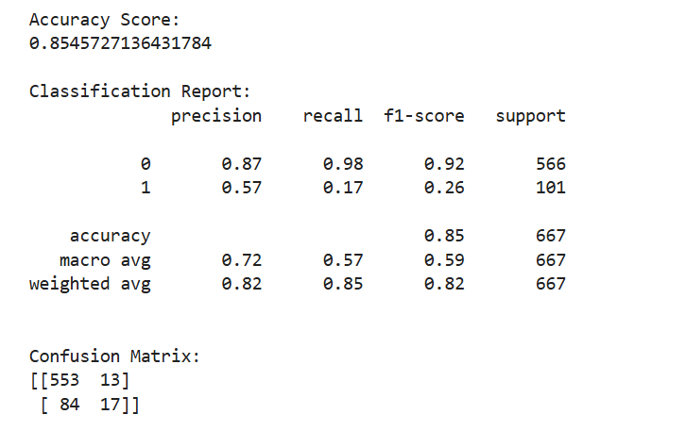
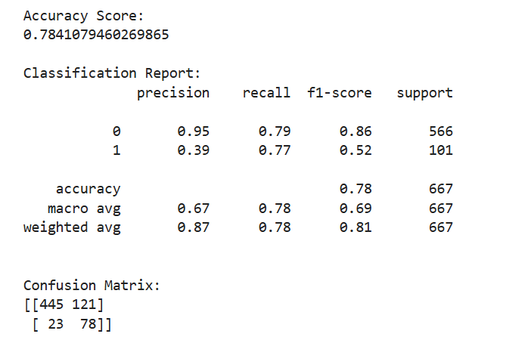
Logistic Regression Comparison

Slide 13
Decision Tree Results
Decision Tree Performance:
Accuracy: 94%
Precision: 88%
Recall: 67%
F1-Score: 76%
Why It Performed Better:
Captured complex customer behavior patterns
Balanced precision and recall effectively

Slide 14
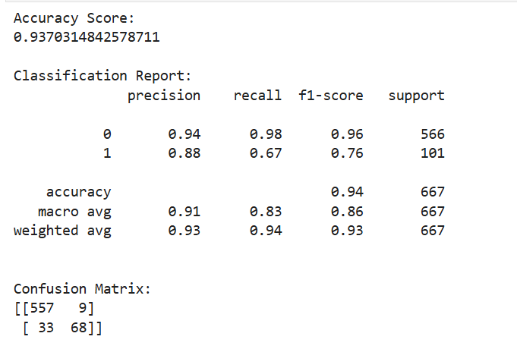
Decision Tree Results

Slide 15
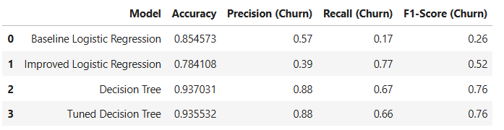
Model Comparison
Conclusion:
Decision Tree achieved the best balance.
Selected as final model.

Slide 16
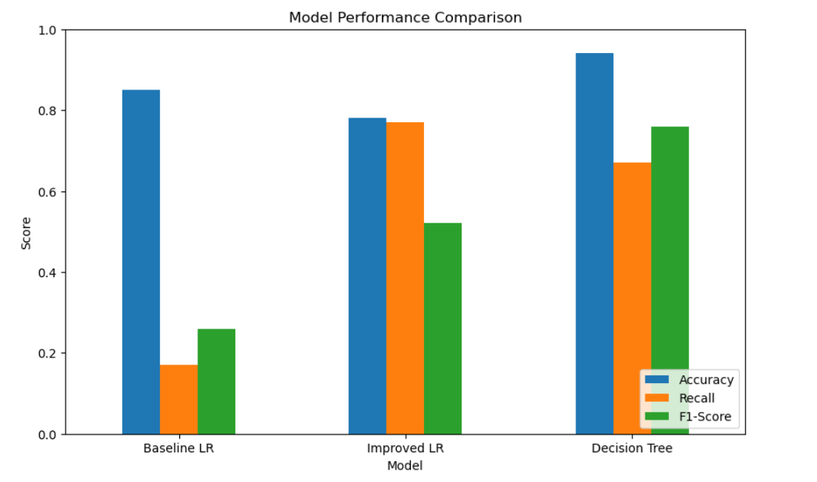
Model Performance Comparison

Slide 17
Key Insights
Important Churn Drivers
High customer service calls increased churn risk.
International plan customers churned more .
Voice mail plan customers tended to stay longer .
Business Meaning
Customer behavior patterns can help SyriaTel intervene before customers leave.

Slide 18
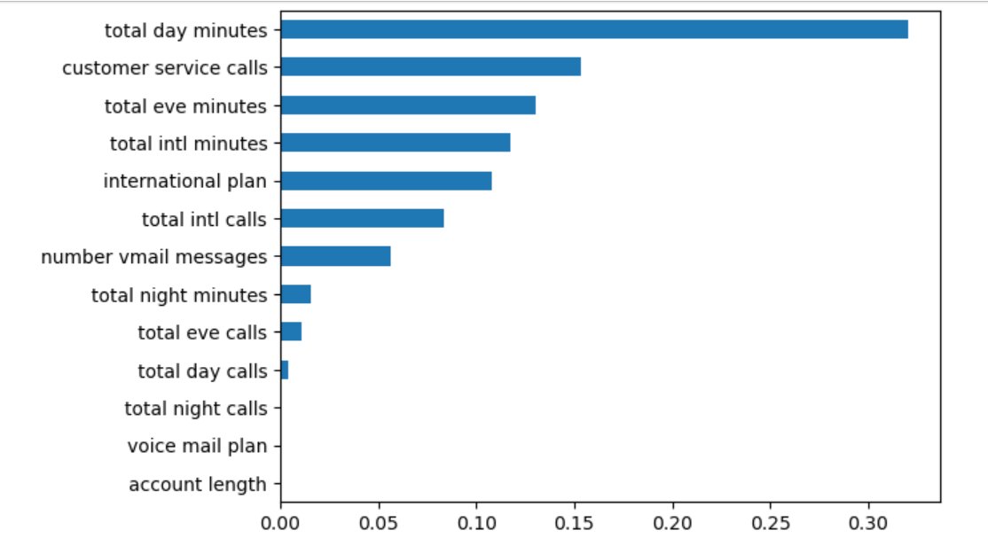
Key Insights

Slide 19
Business Recommendations
Recommended Actions:
Improve customer service quality
Review international plan pricing
Strengthen retention campaigns
Use predictive analytics monthly
Increase customer engagement initiatives

Slide 20
Next Steps
Deploy model into operational systems.
Continuously retrain with updated data.
Monitor churn prediction performance.
Combine predictions with retention offers.

Slide 21
Thank You!

