Slide 1
Predicting Customer Sentiment from Twitter Posts Apple and Google Product Sentiment Analysis
Name: Chris Mau Karagu
Phase 4 Project

Slide 2
Overview
Apple and Google products generate thousands of online discussions.
Understanding customer sentiment manually is difficult.
This project uses machine learning to classify tweets as:
Positive
Neutral
Negative
The goal is to help organizations better understand customer opinions and identify areas requiring attention.

Slide 3
Business Problem
Companies need to understand how customers feel about their products.
Reviewing thousands of tweets manually is time-consuming.
Negative sentiment may indicate product issues or customer dissatisfaction.
The project aims to automate sentiment classification using machine learning.
Stakeholders
Marketing Teams
Product Development Teams
Customer Experience Teams

Slide 4
Data Understanding
Dataset contains 8,914 tweets.
Tweets discuss Apple and Google products.
Each tweet labeled as Positive, Neutral, or Negative.
Dataset cleaned before analysis.
Key Observation: Neutral tweets represent the largest class.

Slide 5
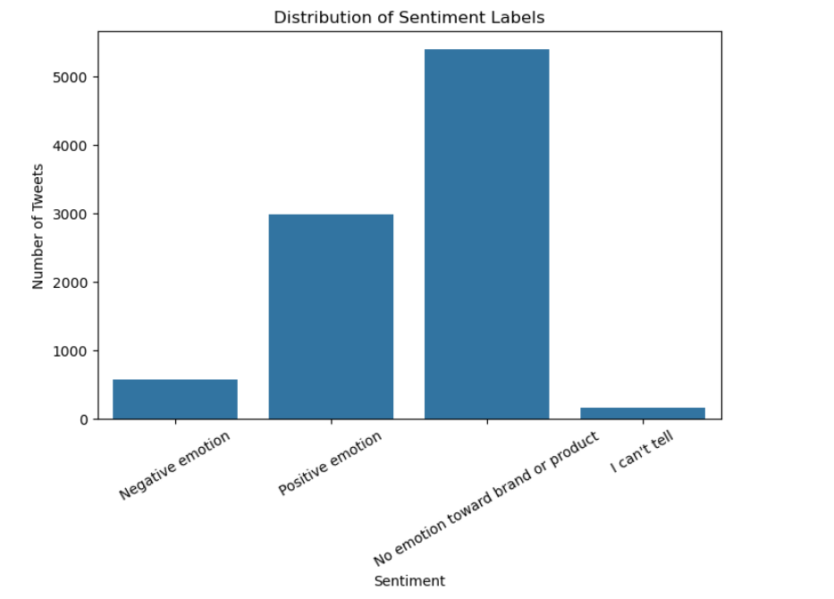
Data Understanding: Sentiment distribution chart

Slide 6
Data Preparation
Removed missing values and duplicates.
Cleaned tweet text.
Removed URLs and punctuation.
Converted text into numerical features using TF-IDF.
Prepared data for machine learning models.

Slide 7
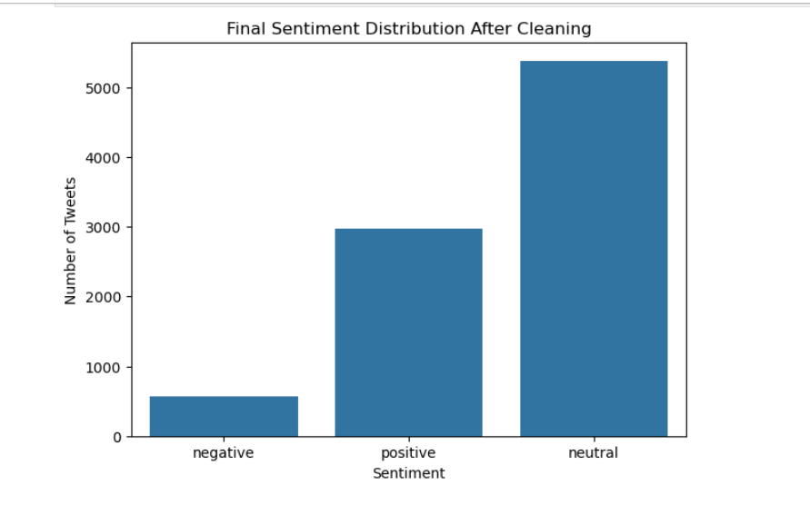
Final Sentiment distribution chart

Slide 8
Modelling Approach
Why Classification?
Classification predicts tweet sentiment.
Models Tested:
❖ Dummy Classifier
❖ Logistic Regression
❖ Decision Tree
❖ Tuned Decision Tree
❖ Random Forest
Goal:
❖ Identify the model that best classifies tweet sentiment.

Slide 9
Logistic Regression Results
Accuracy: 63.1%
Macro F1-Score: 0.56
Negative Recall: 56.1%
Why It Performed Well:
❖ Balanced performance across sentiment classes.
❖ Strong detection of negative tweets.

Slide 10
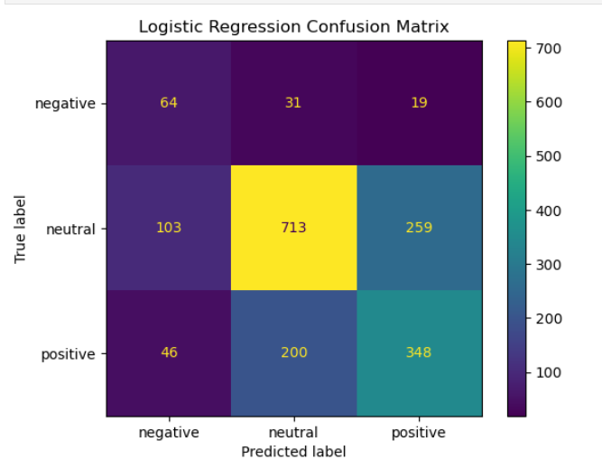
Logistic Regression Results

Slide 11
Model Comparison
Model | Accuracy | Macro F1
Dummy | 0.603 | 0.251
Logistic Regression | 0.631 | 0.556
Decision Tree | 0.600 | 0.478
Tuned Decision Tree | 0.618 | 0.426
Random Forest | 0.672 | 0.515
Conclusion:
• Logistic Regression achieved the best overall balance.
• Selected as final model.

Slide 12
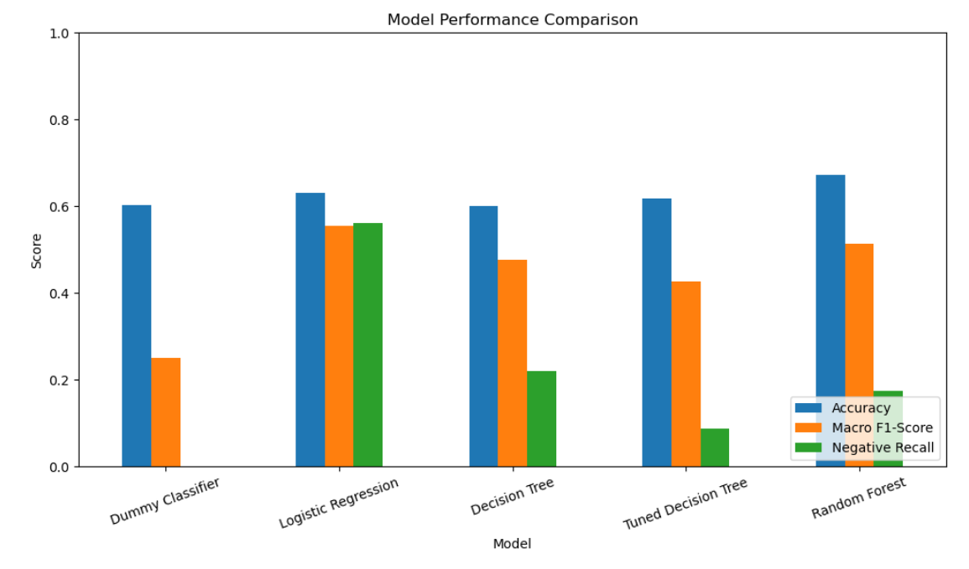
Model Performance Comparison

Slide 13
Key Insights
Important Findings
❖ Positive tweets often contained words such as:
great
awesome
love
❖ Negative tweets often contained words such as:
fail
headache
hate
Business Meaning
Social media sentiment provides valuable customer feedback.
Negative sentiment can highlight customer concerns and product issues.

Slide 14
Business Recommendations
Monitor social media sentiment regularly.
Investigate recurring negative feedback.
Use sentiment trends to support product improvements.
Track customer reactions after product launches.

Slide 15
Next Steps
Expand the dataset with newer tweets.
Explore advanced NLP models such as BERT.
Integrate sentiment monitoring into business dashboards.
Continuously retrain the model with updated data.

Slide 16
Thank You!

