Slide 1
Advanced Algorithms
Randomized Algorithms and Causal Inference
华东师范大学计算机科学与技术学院
石东昱 dyshi@cs.ecnu.edu.cn

Slide 2
Modern Algorithms
Traditional algorithms mainly focus on discrete, rule-based, programming oriented problems. (counting, sorting, matching, searching, satisfactory, graphs, complexity, … )
Modern algorithms are expanded to continuous, data-driven, learning oriented problems. They can make inference or predictions.
Randomness are everywhere. Methods in statistics, optim-ization and information theory are commonly applied.

Slide 3
Inference and Causal Inference
Real world problems require modern algorithms to infer unknown knowledge from known data
The relation of known and unknown variables are depicted by graphs.
There are associative relations and causal relations.
Causal inference are among the most important statistical ideas in past 50 years.

Slide 4
Books
M. Mitzenmacher, E. Upfal : " Probability and Computing: Randomization and Probabilistic Techniques in Algorithms and Data Analysis ", second edition, Cambridge University Press, 2017
J. Peters, D. Janzing, B. Scholkopf : " Elements of Causal Inference: Foundations and Learning Algorithms ", The MIT Press, 2017

Slide 5

Course Information
Course scores:
usual grades, 50%, final exam, 50%
Homeworks/projects:
each in one .ipynb file, sent by email,
titled “学号后4位_姓名_次数”
Course group:

Slide 6
PART I Randomized Algorithms and Statistical Inference

Slide 7
Contents in PART I
Introduction of randomized algorithms
Probabilistic analysis and probabilistic methods
Stochastic processes and sampling based inference

Slide 8
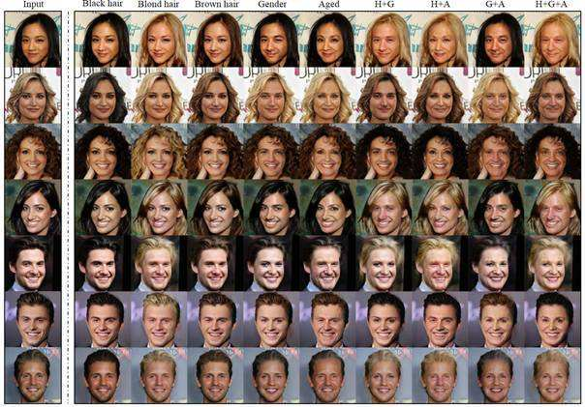
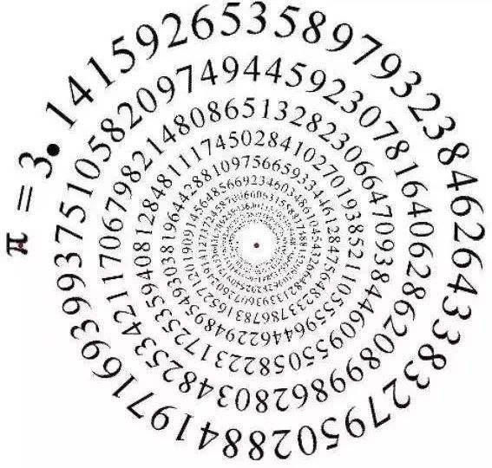

Certainty, Randomness, Distribution

Slide 9

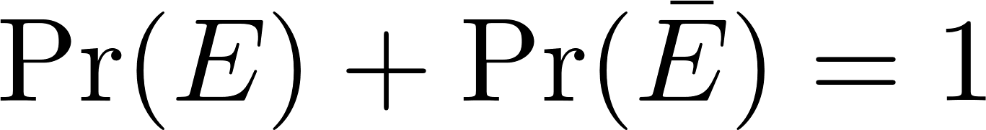
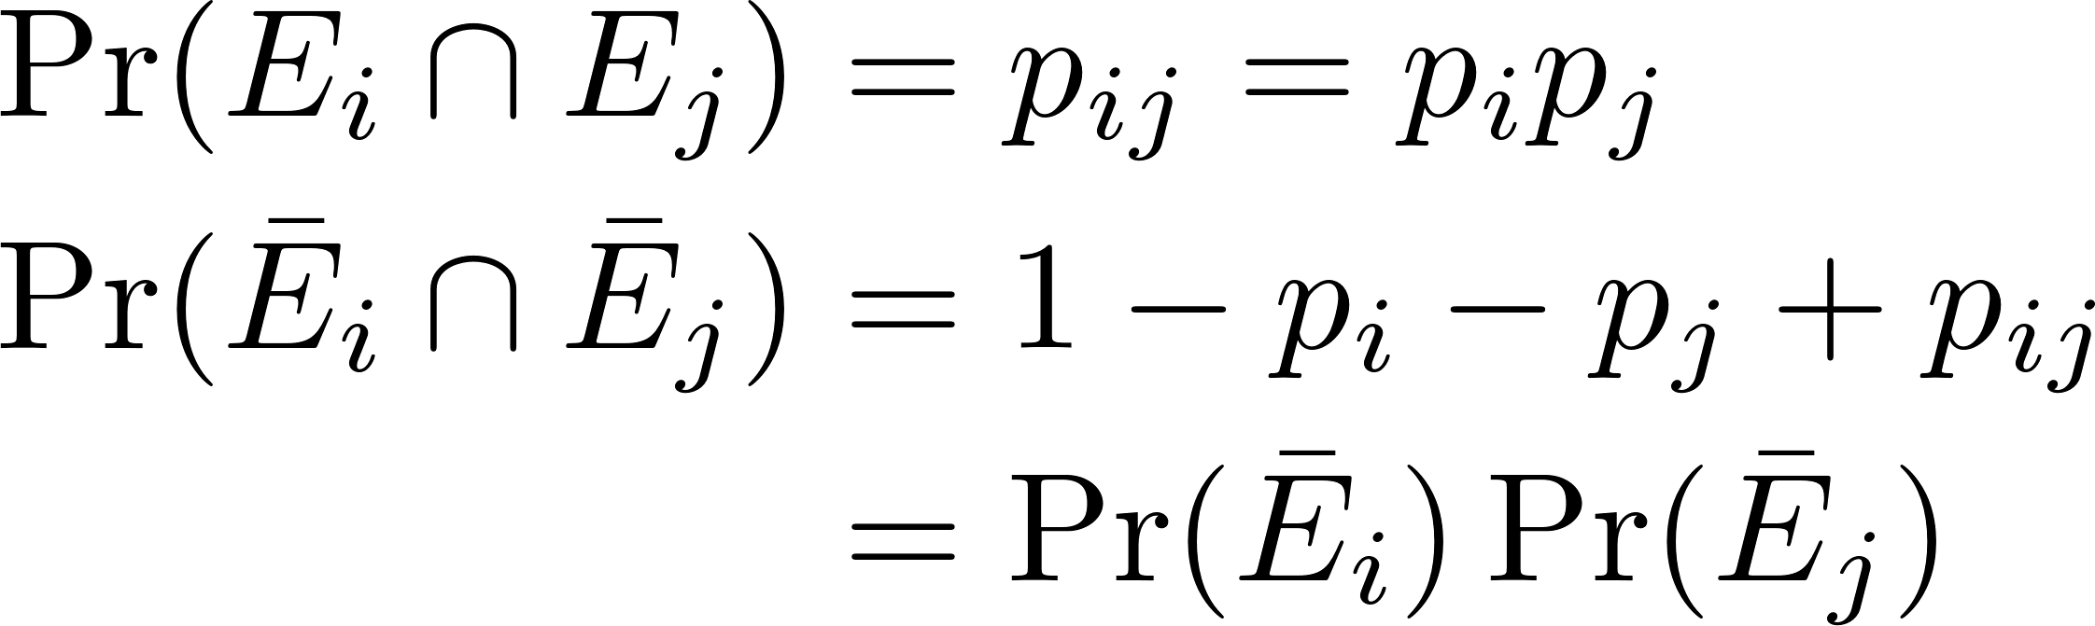
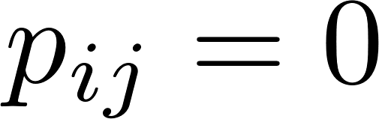

Basic Relations in Probability
Complement Independent: E_{i}⊥E_{j} Positive exclusive
E_{j}~p_{j}
E_{i}~p_{i}
p_{i}
p_{j}
$$E$$
p_{ij}

Slide 10
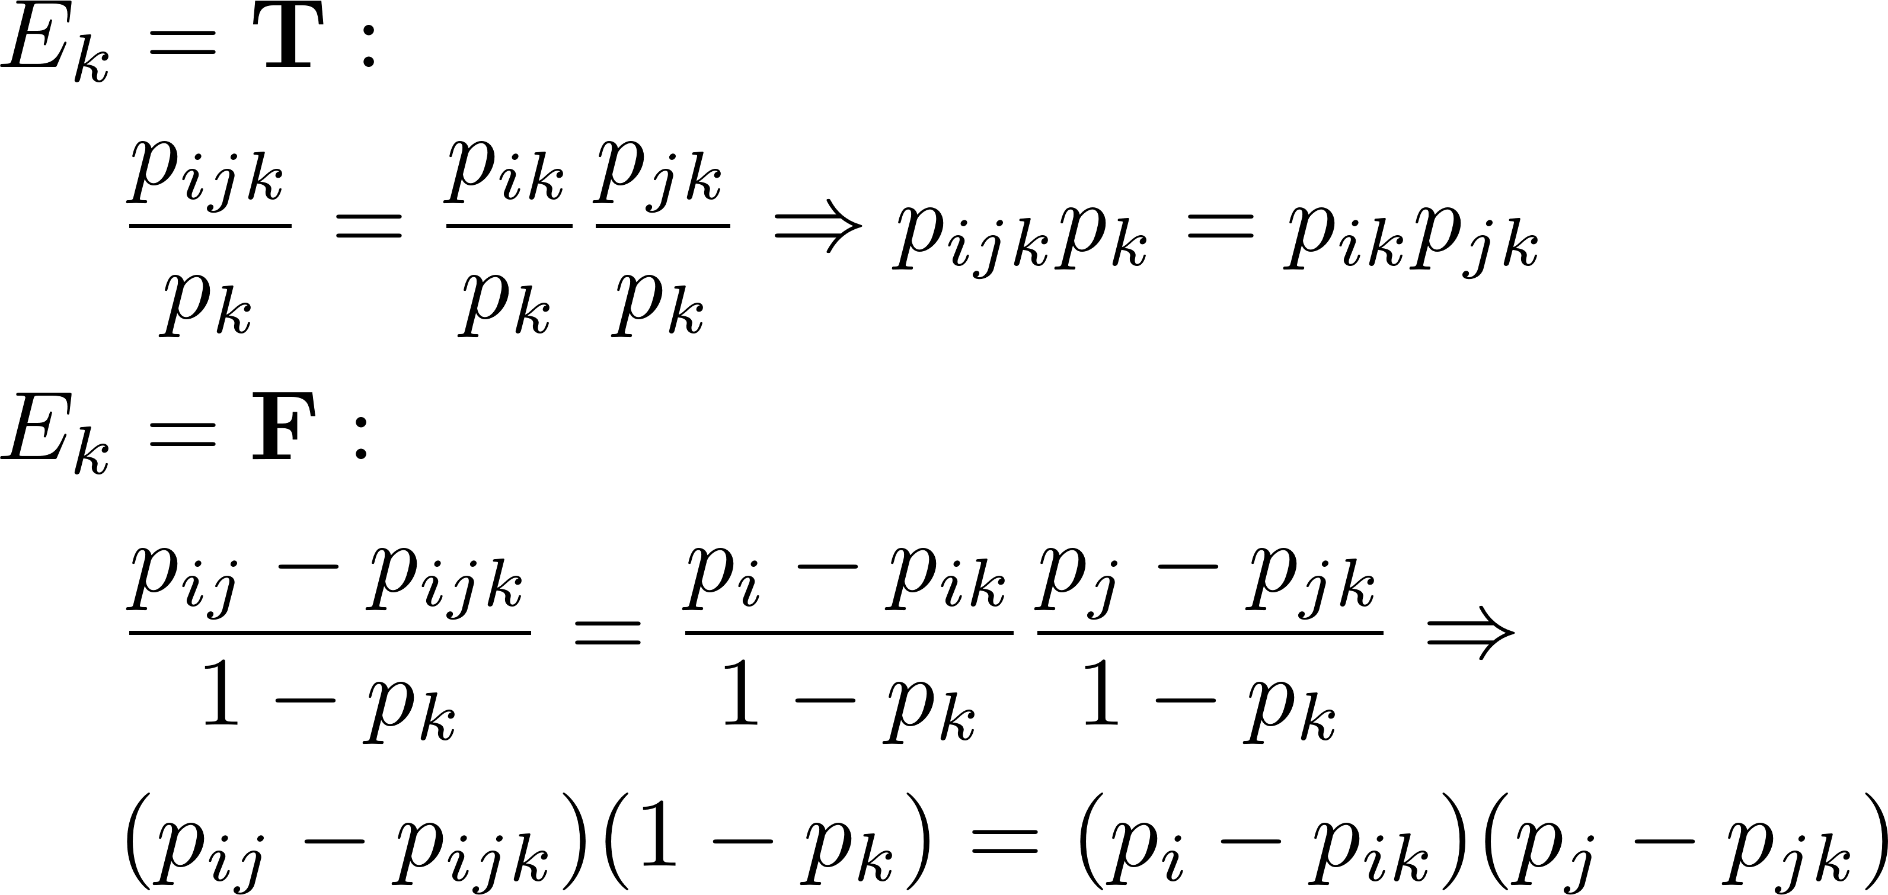
Basic Relations in Probability
Conditionally independent: E_{i}⊥E_{j}|E_{k} , E_{i}⊥E_{j} when E_{k} is given.
p_{i}
p_{j}
p_{k}

Slide 11
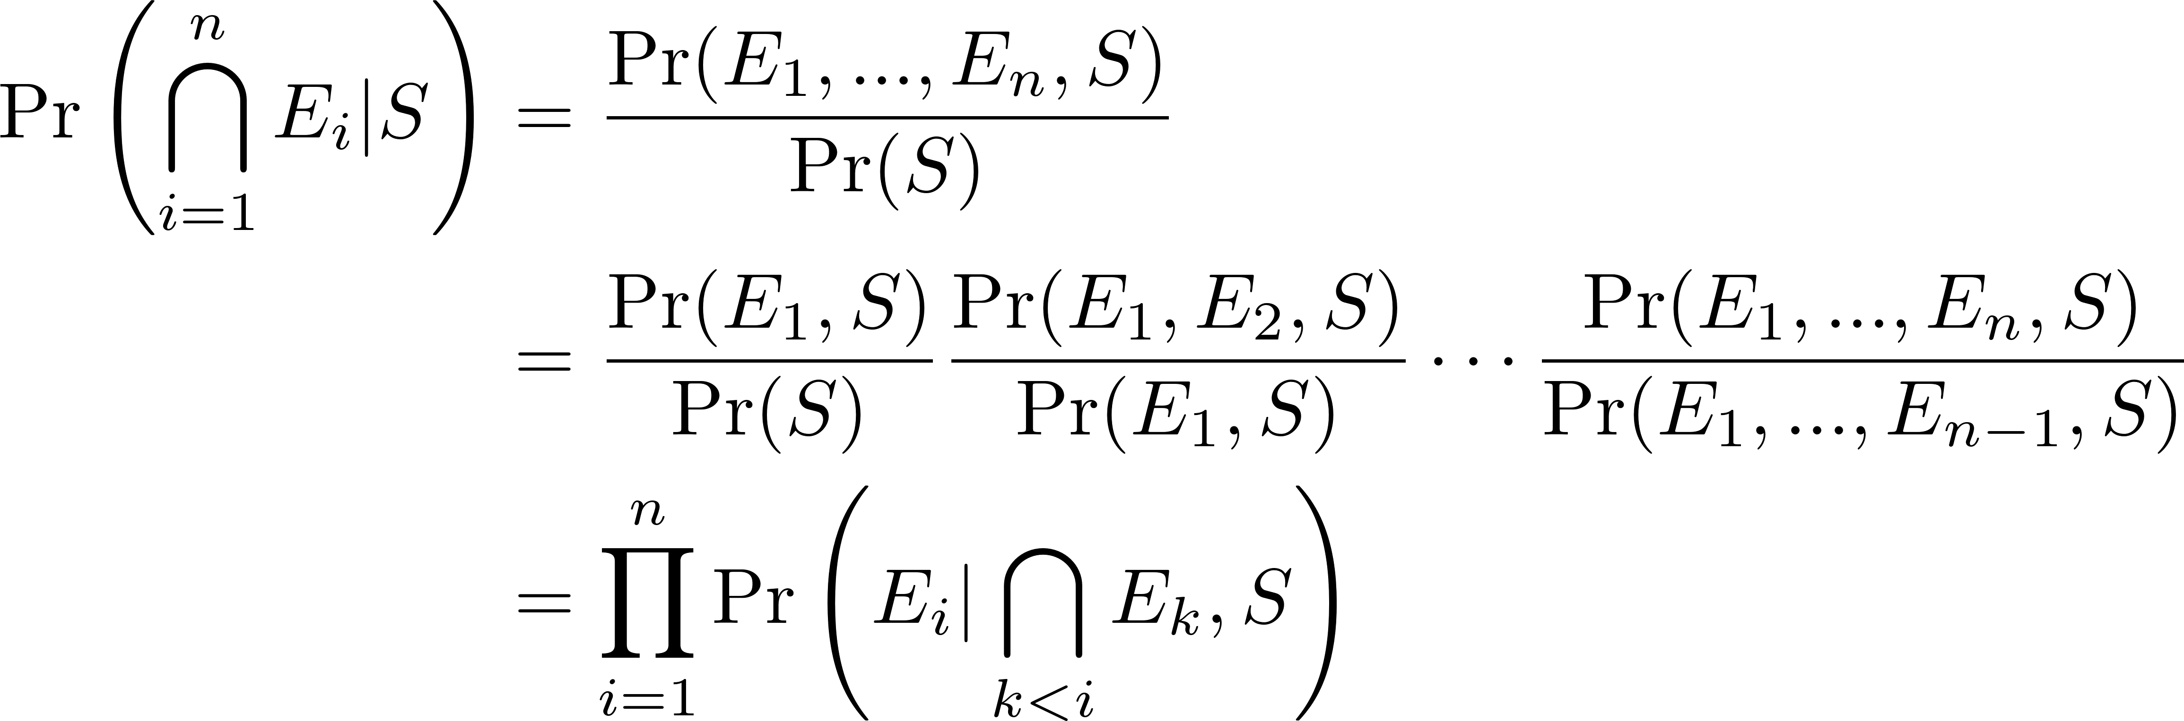
Basic Relations in Probability
Chain rule of conditional probability:

Slide 12
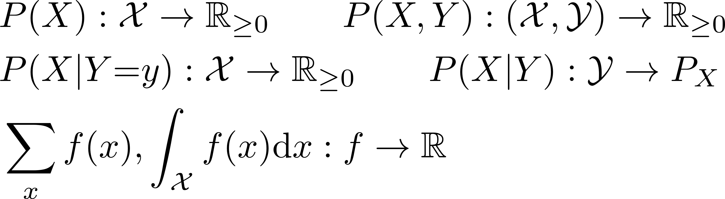
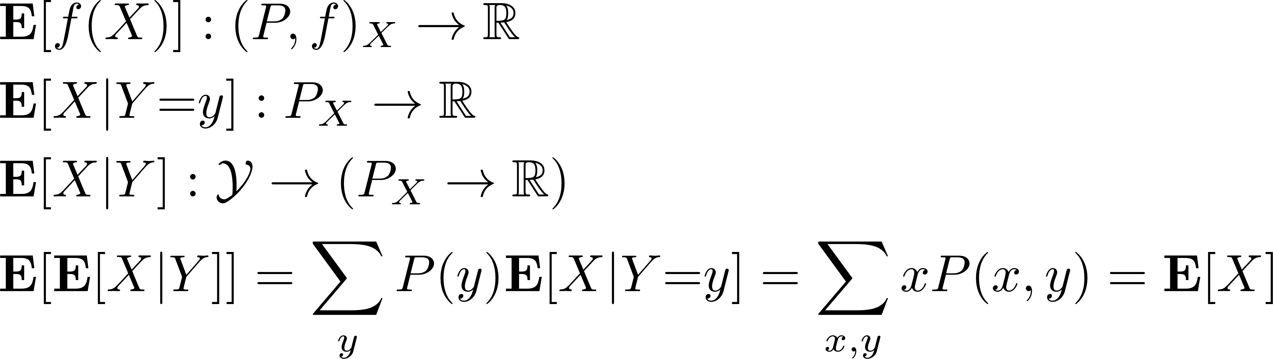
Functions of Probabilities and Expectations

Slide 13
App: Verifying Polynomial Identities
Check whether
(x + 1)(x − 2)(x + 3)(x − 4)(x + 5)(x − 6) ≡? x⁶ − 7x³ + 25
Why might it not be a good idea to write another program to expand the left side into canonical form?
The complexity to expand a d degree polynomial?
O(d²) of multiplications
Using fast-Fourier-transformation: O(d log d)

Slide 14
App: Verifying Polynomial Identities
Check whether
(x + 1)(x − 2)(x + 3)(x − 4)(x + 5)(x − 6) ≡? x⁶ − 7x³ + 25
Consider choosing x randomly from [1, nd] , and check whether they are equal.
What is the chance to get a false result?
What is the complexity to do this?
Can we eliminate the chance of false result? What’s the price?

Slide 15
App: Verifying Matrix Multiplication
Check whether the n-square matrix
AB ≡? C
Is it a good idea to randomly choose i,j from {0,…,n-1} , computing A^{T}_{i}B_{j} , and comparing it to C_{ij} ?
It may require O(n³) to ensure the verification.
Strassen’s divide-n-conquer algorithm is better, O(n^{2.81}) .
Currently best? Coppersmith-Winograd, O(n^{2.376}) .

Slide 16
App: Verifying Matrix Multiplication
Check whether the n-square matrix
AB ≡? C
How about choosing n numbers from {0,1} , forming a vector r , and checking A(Br)=Cr ?
It requies O(n²) .
The chance it returns a false result?
Let D=AB-C ≠ 0 , it has at least one entry d_{ij}≠0 .

Slide 17
App: Verifying Matrix Multiplication
Check whether the n-square matrix
AB ≡? C
However Dr=0, which means Σ_{k}d_{ik}r_{k}=0 , r_{j}=-Σ_{k≠j}d_{ik}r_{k}/d_{ij} .
With the principle of deferred decisions, r_{j} has at most 1/2 chance to choose the “right” value.
Comparing choosing {r_{i}} for multiple times and choosing them from a larger set of numbers.

Slide 18
App: Naïve Bayes Classifier
There is a set of data D (text docs), each D_{i} with m features {x^{i}_{k}} (having/not having a keyword), and a label c (spam/not spam). If a new item D* is presented with the feature set {x*_{k}} , what label does it most likely have?
An important assumption: the features {x_{k}} are conditionally independent given the classification.

Slide 19
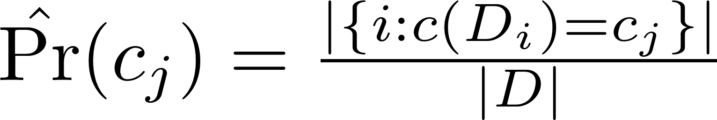
App: Naïve Bayes Classifier
Training:
compute the empirical probabilities

Slide 20
App: Naïve Bayes Classifier
Classifying:
compute the most likely classification
Q: Simple keywords as features? All independent?
However, Naïve Bayes was surprisingly successful in spam-email filtering.

Slide 21
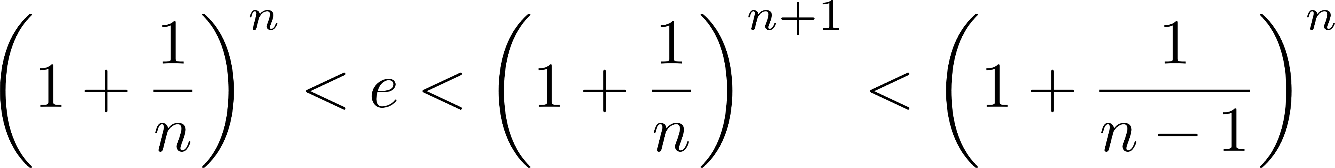
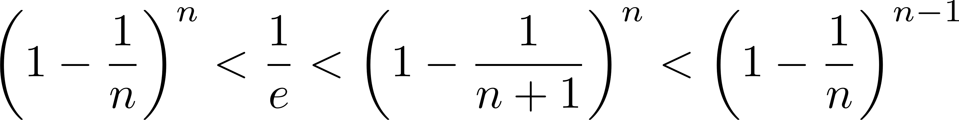
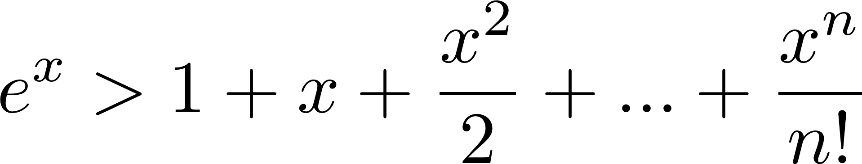
Bound by Natural Constant
Let n≥1 , x>0 ,

Slide 22
App: Randomized Min-Cut
Given graph G(V,E), |V|=n , find a minimum cut-set in it.
With Ford-Fulkerson-Edmonds-Karp algorithm, the max-flow min-cut between any two vertices in a flow graph can be solved in O(n|E|) , which solves this problem in O(n²|E|) .

Slide 23
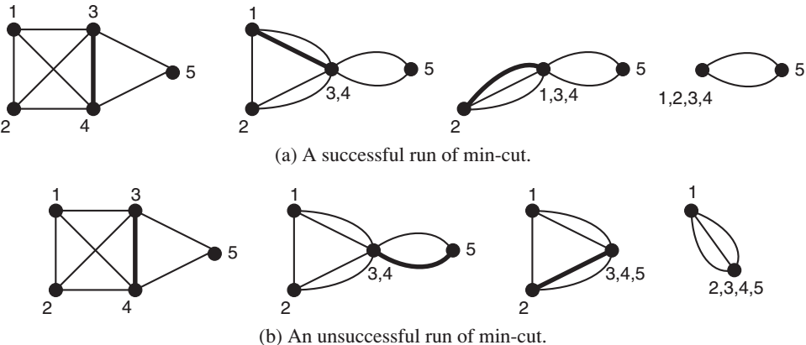
App: Randomized Min-Cut
Randomized Min-Cut :
An edge from |E| edges is selected randomly to be contracted.

Slide 24
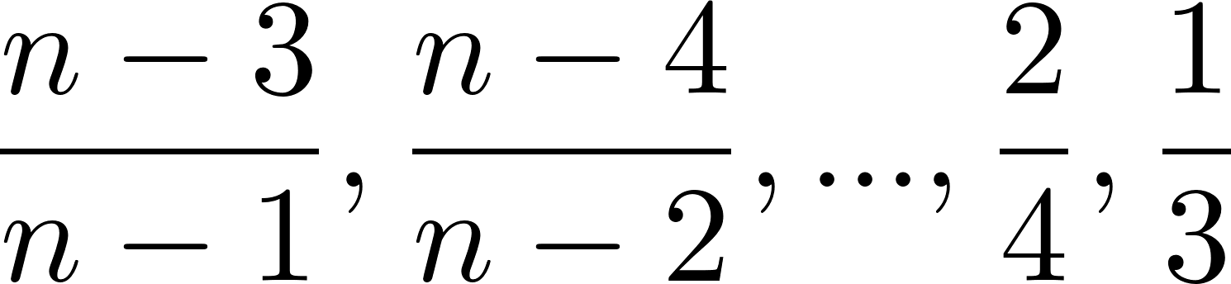
App: Randomized Min-Cut
In the worst case there is only one min-cut edge set C with size k .
Note k ≤ min{d_{i},i∈[1,n]} , thus |E| ≥ nk/2 .
The chance that C is not chosen in the 1st step is 1-k/|E| , which is greater than: 1-k/(nk/2) = (n-2)/n
In 2nd, 3rd, … steps, each chance is greater than:

Slide 25
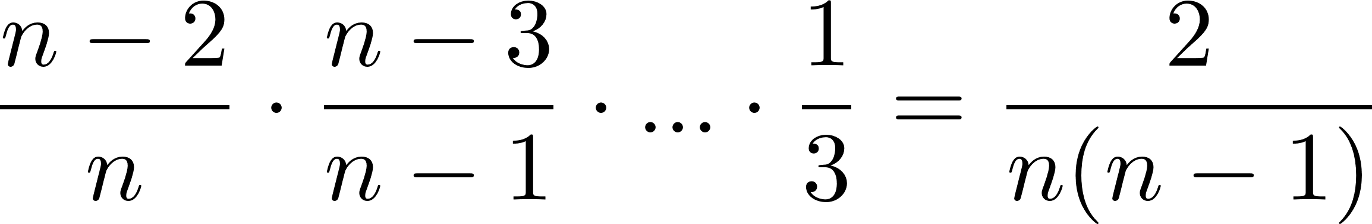
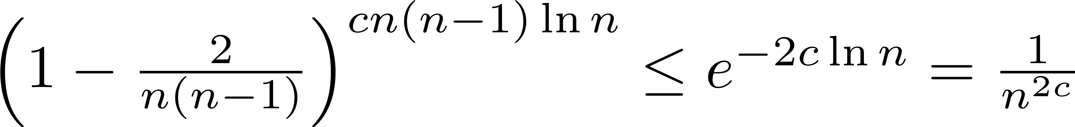
App: Randomized Min-Cut
All together, a successful run has chance greater than
If it is tried cn(n-1)ln(n) times, using 1+x≤e^{x} ,

Slide 26
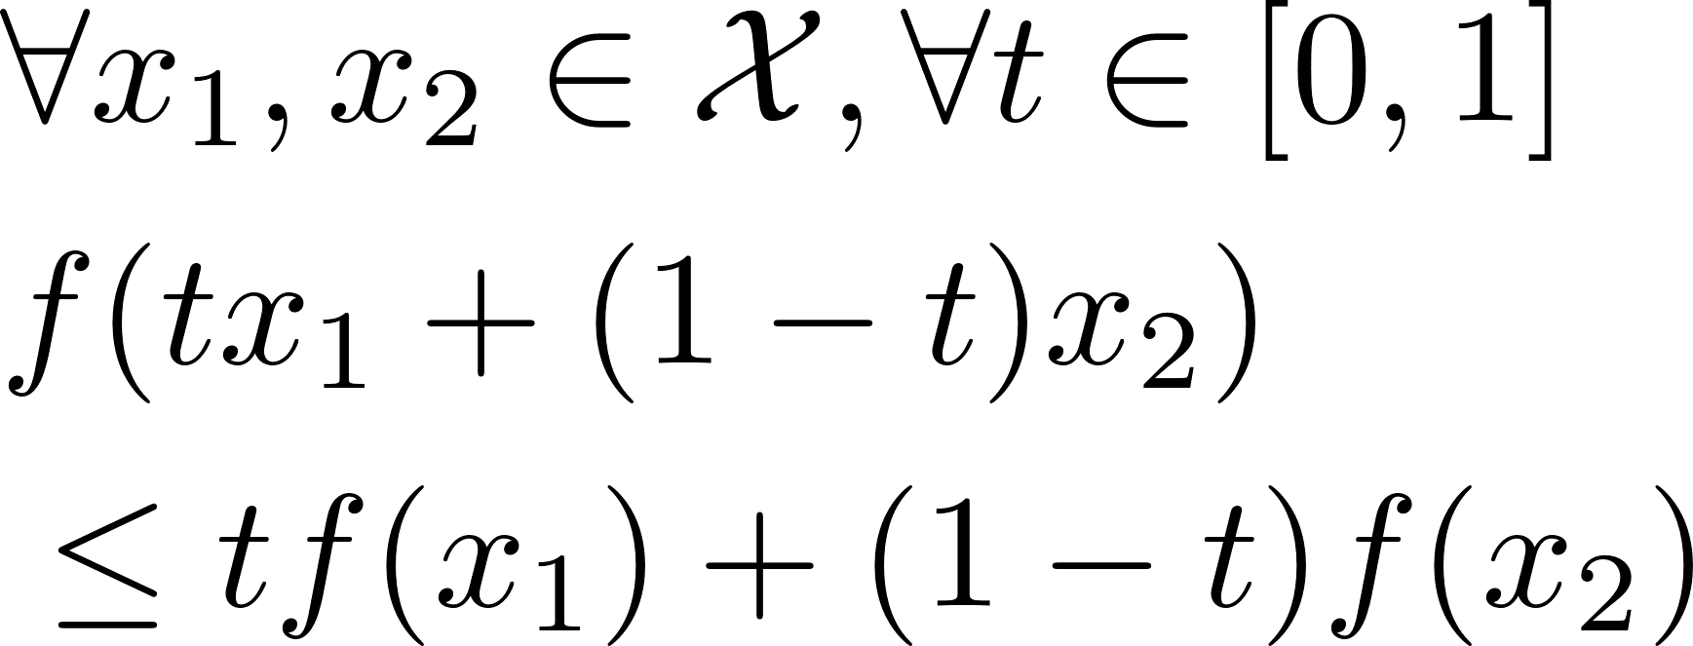
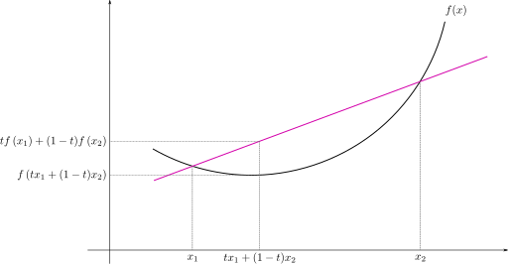
Jensen’s Inequality
A function f is convex if
If there are multiple points,
what the graph would be in
the Cartesian coordinate?

Slide 27
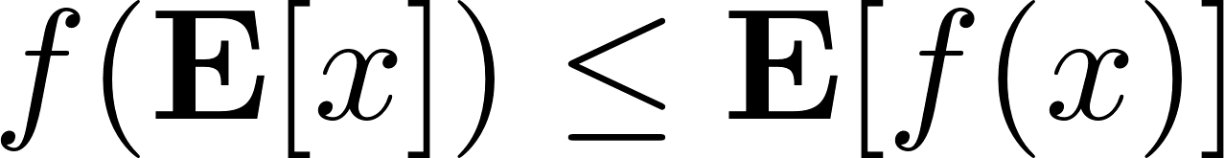
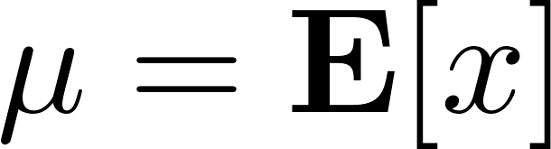
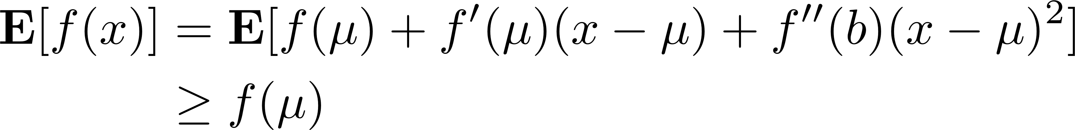
Jensen’s Inequality in Probability
If f is convex, .
Proof: let ,
For any x-integrable function h,

Slide 28
App: Random Quicksort
In quicksort, a random element is picked to be pivot.
The complexity is the comparison number X .
X_{ij} = 1 if in the sorted sequence S_{i} and S_{j} are compared,
= 0 otherwise.
X=ΣXij , i∈[1,n-1], j∈[i+1,n] .
Only after a pivot in [i,j] is selected, the value of X_{ij} can be determined.
And only in two cases that X_{ij}=1 : the pivot is S_{i} or S_{j} .

Slide 29
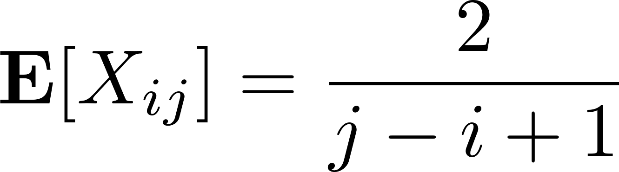
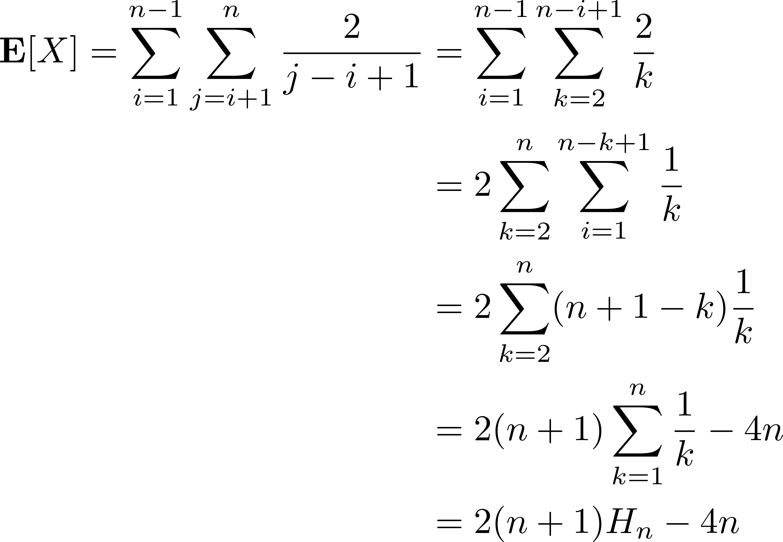
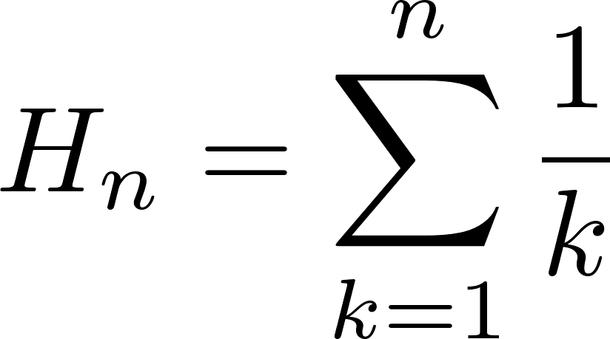
App: Random Quicksort
H_{n} is the Harmonic number.

Slide 30
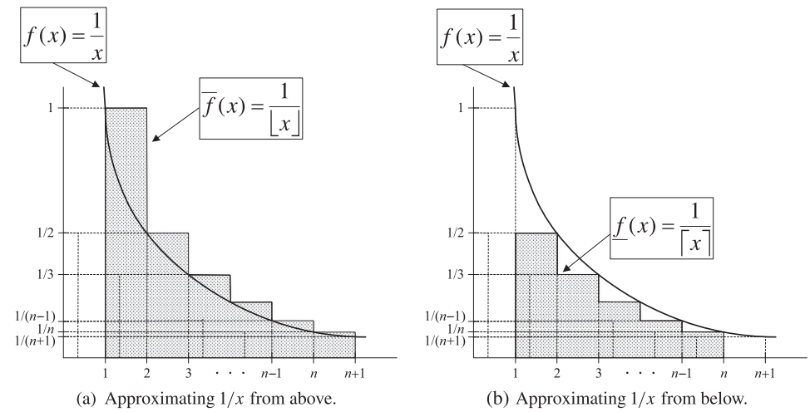
Harmonic Number

Slide 31
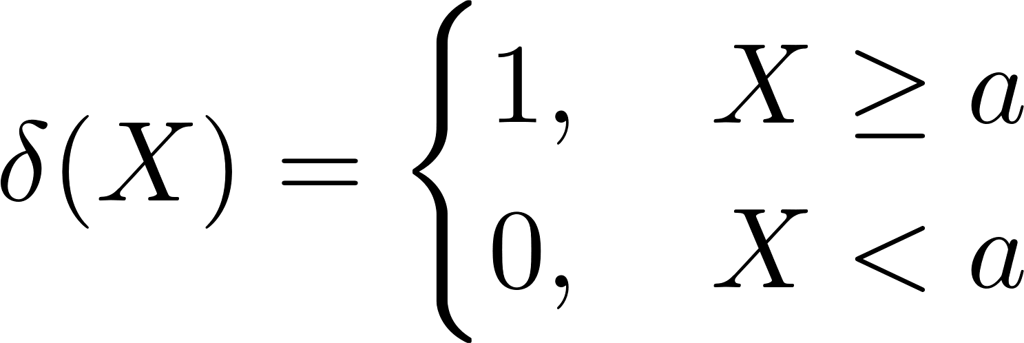
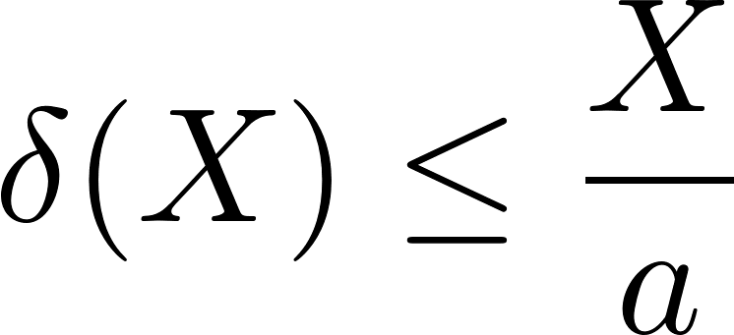
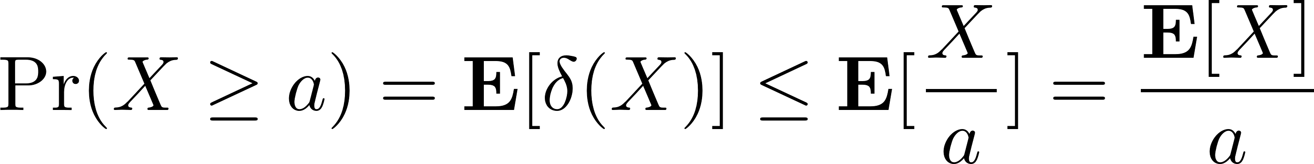
Markov’s Inequality
Let X be a nonnegative random variable (r.v.)
Proof: let

Slide 32
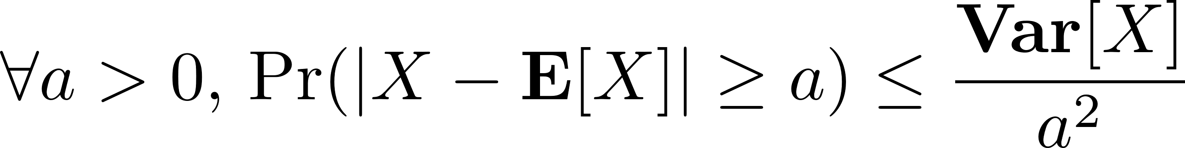

Chebyshev’s Inequality
Proof:
The result is obtained by Markov’s Inequality.

Slide 33
Coupon Collector's Problem
Each box has 1 of n different coupons with equal chance. How many boxes need to be bought to obtain a set of all n coupons?
E.g.: Packets are sent along fixed routers. The destination host wants all routers’ IDs. But there is no enough room in a packet header to store all of them.
The solution is that every packet picks a random router and store its ID. The destination host collects them.

Slide 34
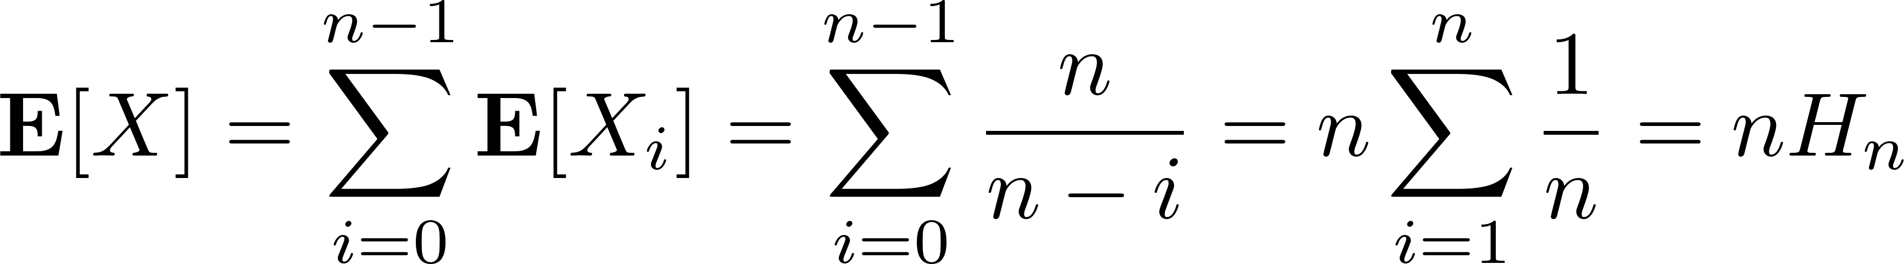
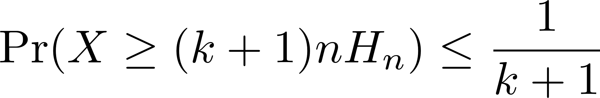
Coupon Collector's Problem
X_{i} : boxes bought to get a new coupon after having exactly i different coupons. It follows geometric distribution:
The total boxes to be bought X=ΣX_{i} :
By Markov’s Inequality,

Slide 35
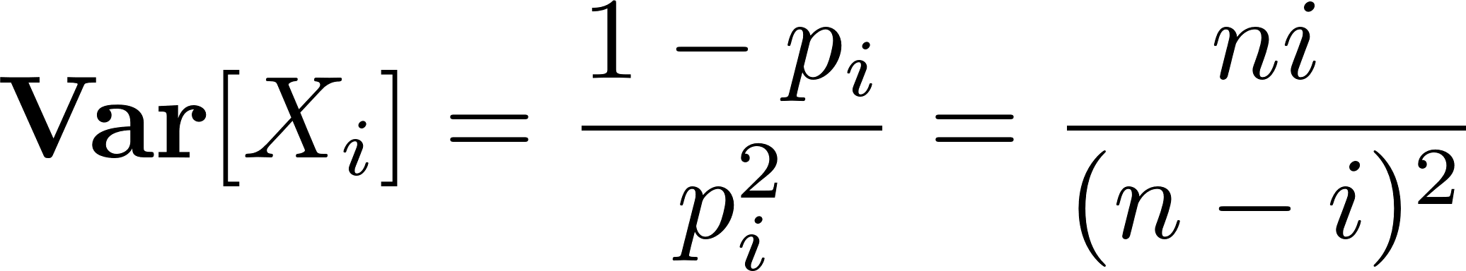
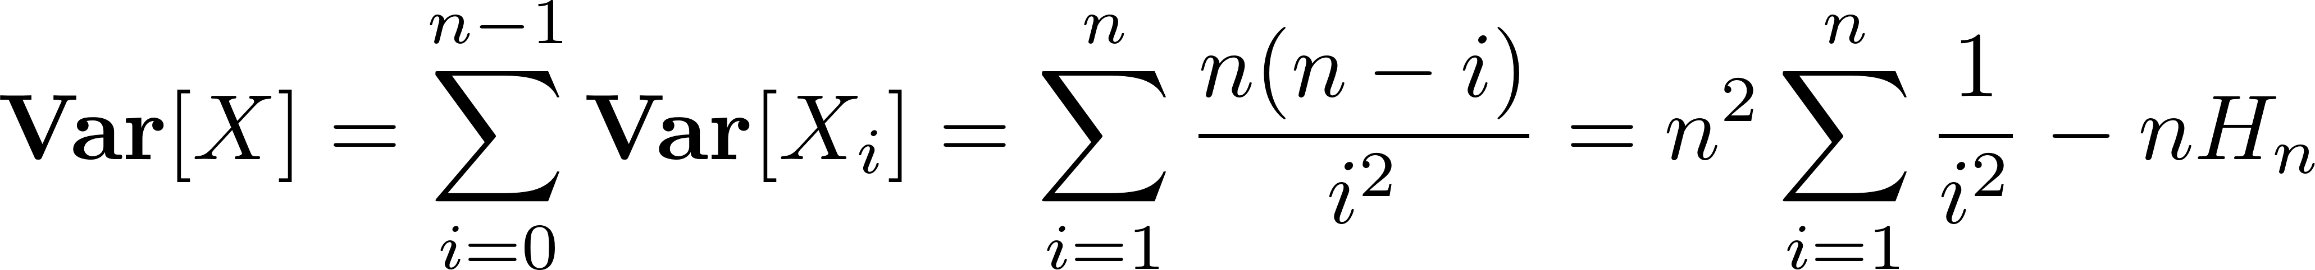
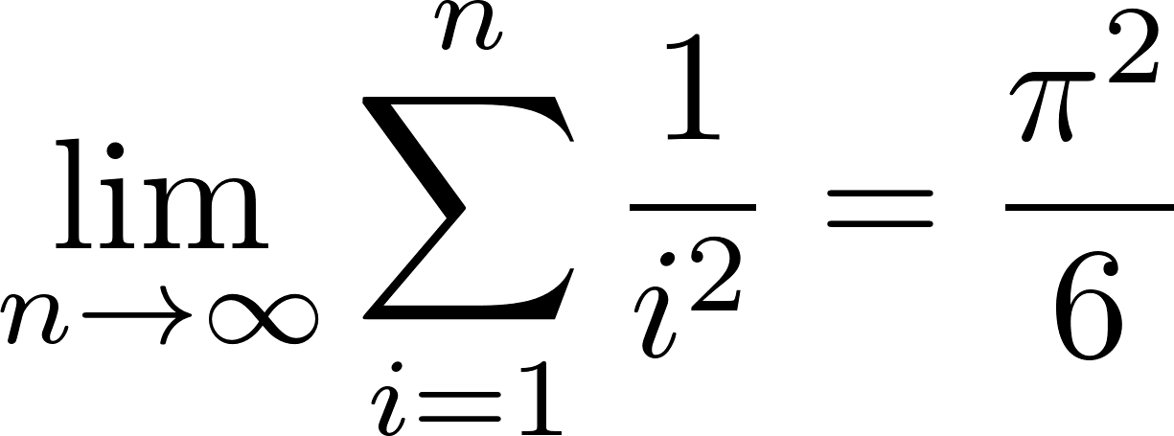
Coupon Collector's Problem
Note {X_{i}} are independent to each other. As geometric r.v.,
By solution to the Basel Problem:

Slide 36
Coupon Collector's Problem
By Chebyshev’s Ineq.,
With the same steps, it has a much better bound than Markov’s Ineq., but it is still weak.

Slide 37
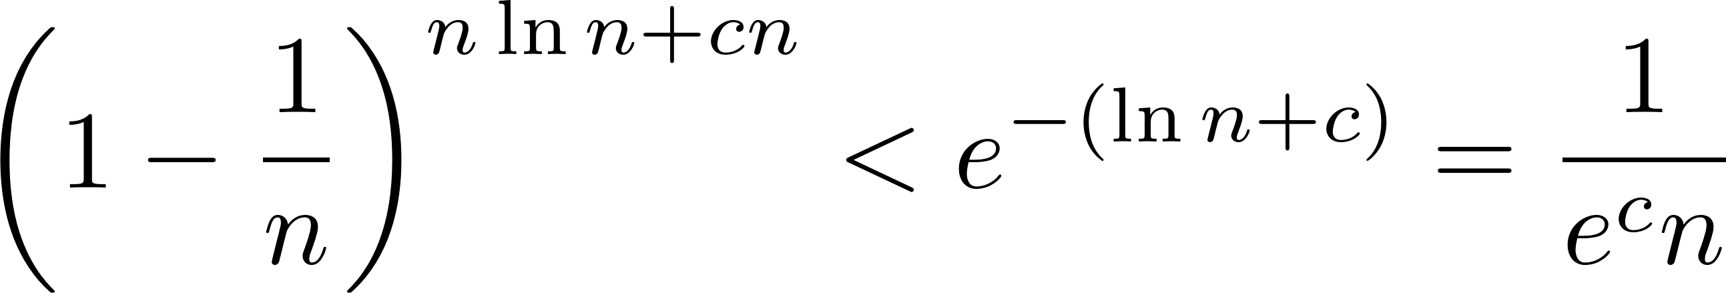
Coupon Collector's Problem
Actually after nln(n)+cn steps, the probability of a specific coupon not being obtained is
Thus any of the n coupons not obtained is at most e^{-c} . Let c=kln(n) , the bound is n^{-k} .

Slide 38
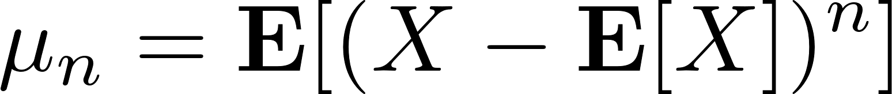
Moments
Moment generating function and (raw) moments for h>0:
Central moments
1st raw moment – expectation
2nd central moment – variation
3rd central moment – skewness
4th central moment – kurtosis

Slide 39
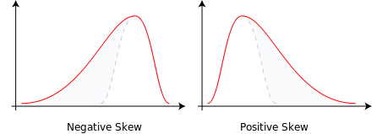
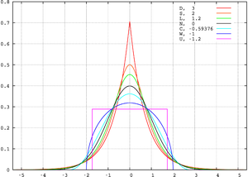
Moments

Slide 40
Moments
Theorem: let X and Y be two r.v., if there is δ>0 such that
then X and Y have the same distribution.
If two r.v. X and Y are independent,

Slide 41
Summary
Typical basic randomized algorithms:
verifications of polynomial identities and matrix multiplication, naive Bayes classifier, randomized Min-Cut, random quicksort
Basic inequalities:
Markov’s inequality, Chebyshev’s inequality, convex inequalities
Coupon collector's problem
Moments and their generating functions

