Slide 1
华东师范大学计算机学院
具体数学 Concrete Mathematics
2021年5月4日星期二

Slide 2
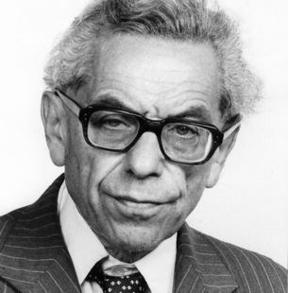
The Man Who Loved Only Numbers
Name: Paul Erdös
Sex: Male
Life: 1913-1996
Nationality: Hungarian
Vocation: Mathematician
Interesting Activities/Speech:
我们数学家都有些疯狂……
1970年，宣称自己25亿岁了。（Why：小的时候，科学家说地球有20亿岁，now，他们又宣称为45亿岁，so…）
我终于不再愈变愈蠢了。（自撰墓志铭）

Slide 3
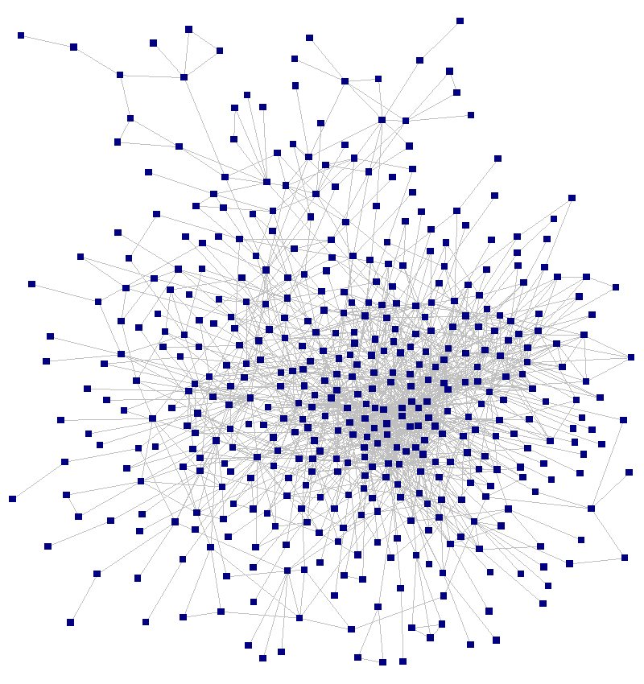
E-Numbers
A famous number, E-Number, how far are you away from Paul Erdös, mathematically
0 : You are Paul Erdös himself!
1 : Cooperate with Paul Erdös!
2 : Cooperate with E-N-1 men! 爱因斯坦、陈省身、丘成桐、…
3 :冯 诺伊曼、香农、
4 : 杨振宁、盖茨
…………
∞ : Nothing but a freshman! (We’re here ☹ )
E-Number project on http://www.oakland.edu/enp

Slide 4
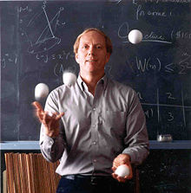
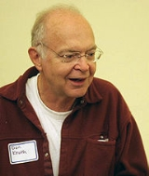
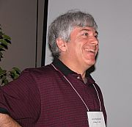
Erdös and Authors of CM
Person E-Number
Graham 1 (A chief coauthor of Erdös.)
Married with a Chinese American 金芳蓉
前国际耍球协会主席
Knuth 2 (Knuth- Graham- Erdös.)
author of The Art of Computer Programming
Turing Award in 1974
Patashnik 2 (Patashnik-Graham- Erdös.)
I don’t know much more than CM about Pata.

Slide 5
Outline
Course Description
Why deserve learning?
Topics in the Class
Text Book and Other Materials
Evaluation

Slide 6
Course Description
Concrete mathematics is a blending of continuous and discrete mathematics. See,
Chap. 3 – Integer Functions 实数的整数部分运算
Chap. 9 – Asymptotics 离散到连续的渐进
It introduces the mathematics that supports the analysis of algorithms, modeling probems in real world. See,
Chap. 1 – Recurrence 递归的计数
Chap. 2 – Sum 各种求和，用于算法复杂度计算等
Chap. 6 – Special Numbers 叠卡片问题中的调和数列
The goal is for the student to have mathematical skills to solve complex problems, and to discover subtle patterns in data.
Chap. 7 – Generating Functions 用于概率计算的母函数
Chap. 8 – Discrete Probability 离散问题概率(最有趣的一章)

Slide 7
Why deserve learning?
Useful in Computer Science
designing algorithms and estimating problem complexity
not taught in other courses
involves lots of Mathematical Subject, Tools and Conclusions
A start-point and preparation to advanced CS.
Help to decide which problem to improve, which problem to avoid (especially reply your BOSS!!!)
Helpful when seeking jobs of top IT companies (See B. Gates’ words on the back-cover of TAOCP by D. E. Knuth)

Slide 8
Topics in the Class
Chap.1 Recurrent Problems
Chap. 2 Sums
Chap. 3 Integer Functions
Chap. 6 Special Numbers
Chap. 7 Generating Functions
Chap. 8 Discrete Probabilities

Slide 9
Text Book
Concrete Mathematics—A foundation For Computer Science (第2版)
GRAHAM, KNUTH, PATASHNIK
中译版(第2版)：“具体数学—计算机科学基础”

Slide 10
Other Materials
大夏学堂：https://elearning.ecnu.edu.cn/
The Art of Computer Programming, Vol. I, II, III, IV, Donald. E. Knuth
The so-called Bible in Computer Science
Need tough effort to finish reading
The Introduction to Algorithms
Combinatorial Mathematics, Bruldi
The Man Who loved only Numbers – Paul Erdös(中译本，上海世纪出版集团)

