Slide 1


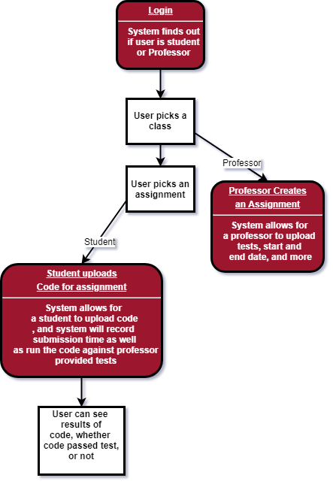



Compile.io DEVS: Joshua Palamuttam, Mike Riley ,Zach Foote, Zach Thelen
CLIENTS: Sam Pastoriza, Donald Sisco, James Edwards
What is this?
Typical Use Case
Tools Used
Compile.io is a web-based application for students and professors to be used as a central system for all CSSE courses at Rose-Hulman. Students are able to submit code that will be compiled and have tests ran on it with quick feedback for the student and ease of grading for the professor.
Features
Students can submit code in multiple languages to a server and receive feedback.
Professors can configure homework assignments
The system is scalable to handle multiple classes worth of submissions at a time.
System uses Authentication through RoseFire
Challenges
Development with tools the team hasn’t used before.
Getting JUnit to work inside of Docker and be flexible
Finding the right Gradle dependencies within Spring and Docker
Incorporating skills from CSSE374, CSSE371, CSSE376, CSSE333 all into one project
First time doing our own project planning and management

