Slide 1

A Compiler of C-Minus
Compiler Principle and Technology
第九组
谢文想 徐正韬 汪辉
2022/6/8

Slide 2
About the language
What’s in it? Reserved words:
char ,int ,float ,void ,
if ,else ,for ,while ,
continue ,break , return
Global declaration
What’s not in it? Pointer
Array’s initialized declaration
Nested declaration
#define and other macro definitions

Slide 3
Given an AST, build the LLVM-IR code. Implement the instructions including variable’s addressing and valuing, expression and branch. Implement type casting within the scope of valid types. Implement IO functions printf() and scanf() by llvm::Function::ExternalLinkage
- What to do in Sematic analysis

Slide 4
Variable
Declare before use.
Use
Left value
When variable is assigned
Right value
When variable is used in expression

Slide 5
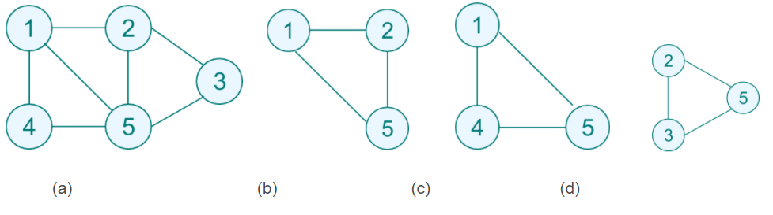
Expression
Maximum Clique
Maximum Independent Set
Complement Graph

Slide 6
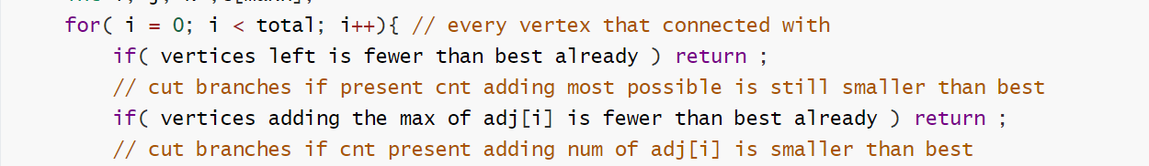
Branch
When enumerating the i-th point, only those whose subscript is larger than it are considered to avoid repetition. That’s to say the current number of vertices CNT plus the maximum number that can be increased is still less than best, exit and return false.
Pseudo code

Slide 7
Type casting
Key Point if P and X are both empty: report R as a maximal clique choose a pivot vertex u in P ⋃ X for each vertex v in P \ N(u): Key Point (R ⋃ {v}, P ⋂ N(v), X ⋂ N(v)) P := P \ {v} X := X ⋃ {v}

Slide 8
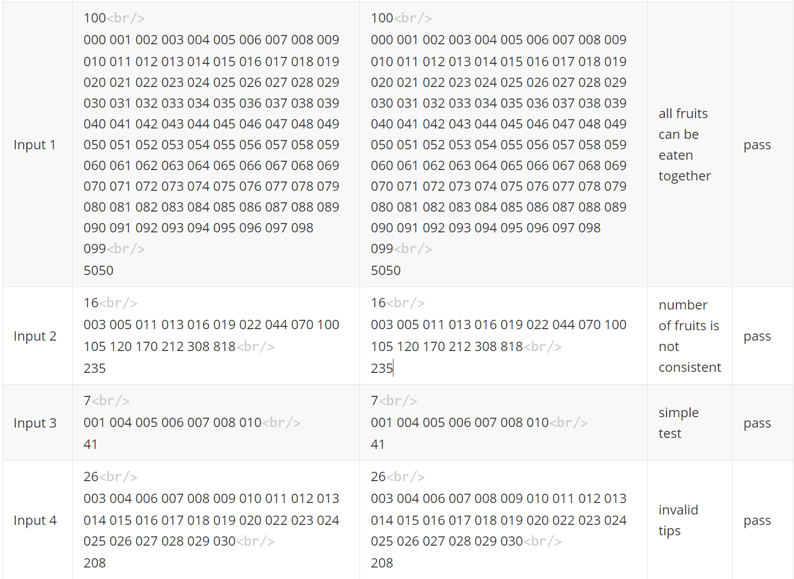
Some Test Sample and Results

Slide 9
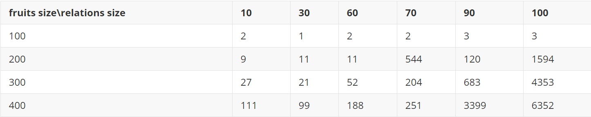
Time Test

Slide 10
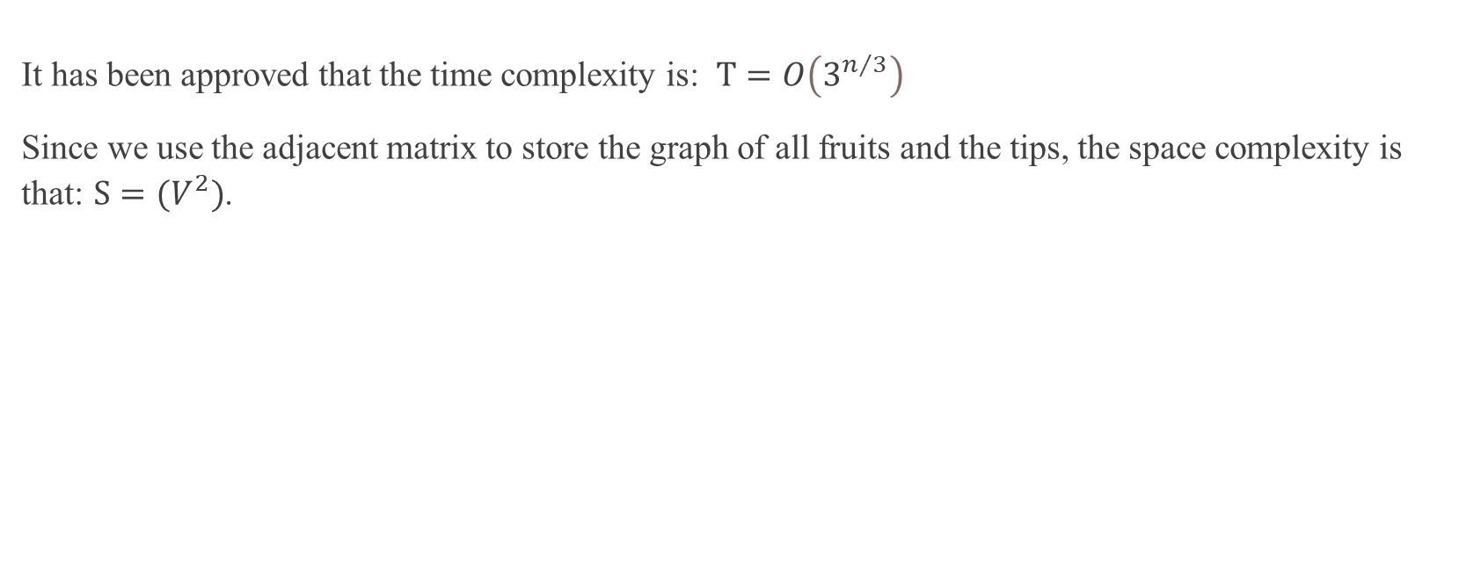
Complexity Analysis
It has been approved that the time complexity is: $T=O\left(3^{n/3}\right)$
Since we use the adjacent matrix to store the graph of all fruits and the tips, the space complexity is that: $S={(V}^{2})$.

