Slide 1

A Compiler of C-Minus
Compiler Principle and Technology
第九组
谢文想 徐正韬 汪辉
2022/6/8

Slide 2
About the language
What’s in it? Reserved words:
char ,int ,float ,void ,
if ,else ,for ,while ,
continue ,break , return
Global declaration
What’s not in it? Pointer
Array’s initialized declaration
Nested declaration
#define and other macro definitions

Slide 3
Given an AST, build the LLVM-IR code. Implement the instructions including variable’s addressing and valuing, expression and branch. Implement type casting within the scope of valid types. Implement IO functions printf() and scanf() by llvm::Function::ExternalLinkage
- What to do in Sematic analysis

Slide 4
Variable
Declare before use.
Use
Left value
When variable is assigned
Right value
When variable is used in expression

Slide 5
Expression
Constant
Unary Operation
Binary Operation
Function Call

Slide 6
Branch
if(…){…}else{…}
while(…){…}
for(…;…;…){…}
return
break
continue

Slide 7
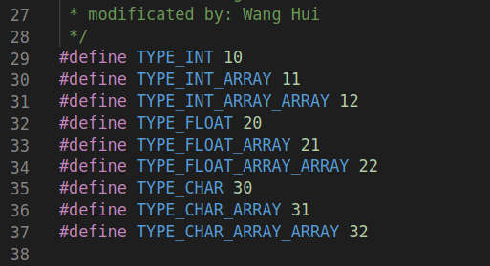
Type casting
int → float
float → int
char → int
int → char

Slide 8
Some Test Sample and Results

Slide 9
Thanks

