Slide 1

A Compiler of C-Minus
Compiler Principle and Technology
第九组
谢文想 徐正韬 汪辉
2022/6/10

Slide 2
About the language
What’s in it? Reserved words:
char ,int ,float ,void ,
if ,else ,for ,while ,
continue ,break , return
Global declaration
What’s not in it? Pointer
Array’s initialized declaration
Nested declaration
#define and other macro definitions

Slide 3
Input a stream of characters, and output tokens Identify most keywords and identifiers in C language Implement data type identification Generate AST leaf nodes for each token
- What to do in Lexical analysis

Slide 4

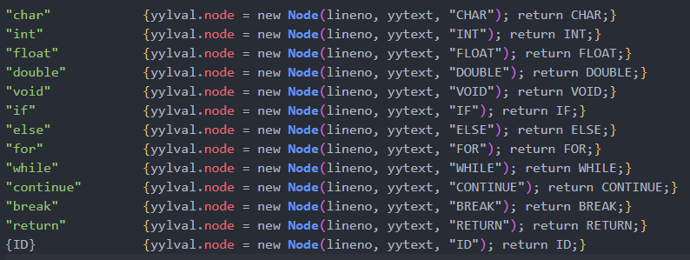
Keywords & Identifiers

Slide 5
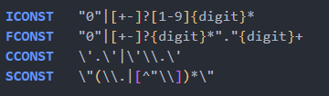

Data type

Slide 6
Input the forms of tokens, and output a parse tree Implemented the generation of AST Implemented optimization of constant expressions
- What to do in Syntax analysis

Slide 7
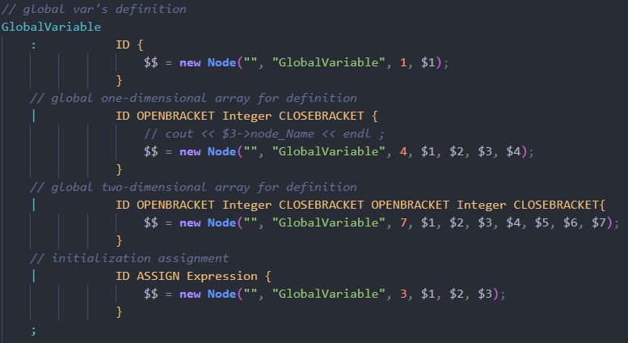
Syntax analysis
GlobalVariable for example

Slide 8
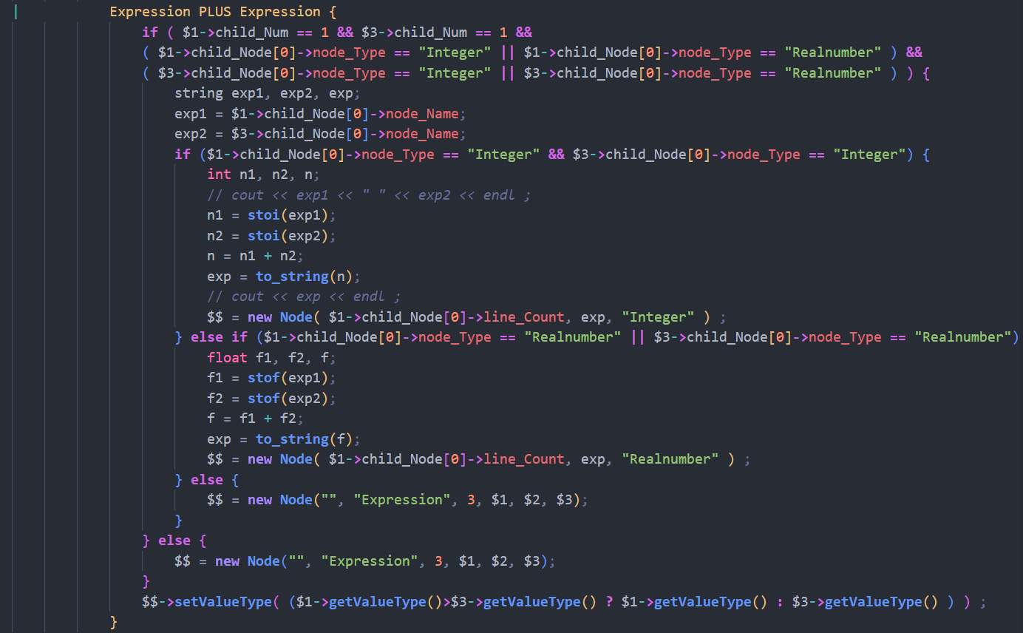
Constant expression

Slide 9
Given an AST, build the LLVM-IR code. Implement the instructions including variable’s addressing and valuing, expression and branch. Implement type casting within the scope of valid types. Implement IO functions printf() and scanf() by llvm::Function::ExternalLinkage
- What to do in Semantic analysis

Slide 10
Variable
Declare before use.
Use
Left value
When variable is assigned
Right value
When variable is used in expression

Slide 11
Expression
Constant
Unary Operation
Binary Operation
Function Call

Slide 12
Branch
if(…){…}else{…}
while(…){…}
for(…;…;…){…}
return
break
continue

Slide 13
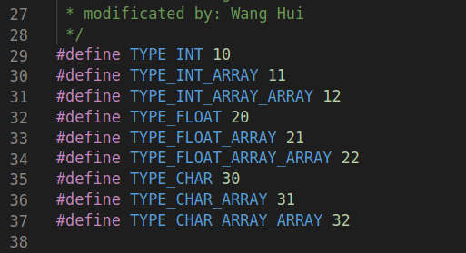
Type casting
int → float
float → int
char → int
int → char

Slide 14
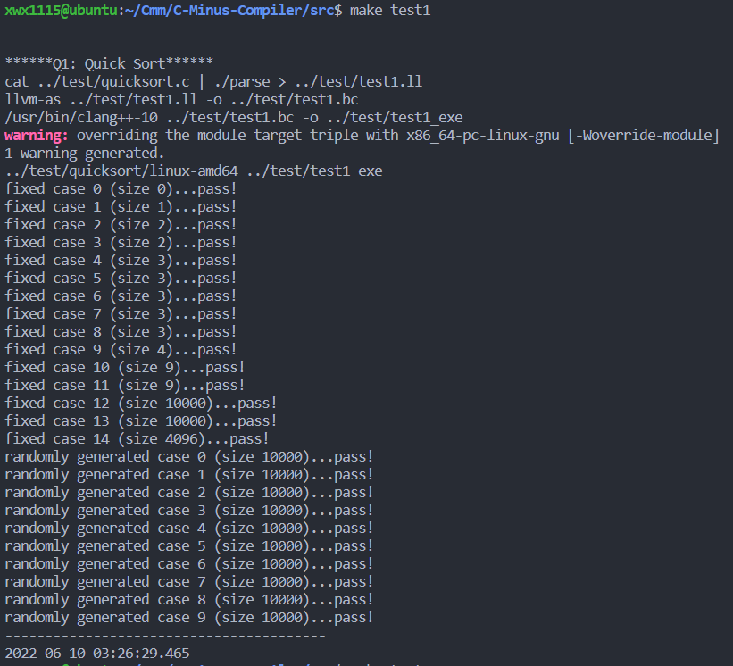
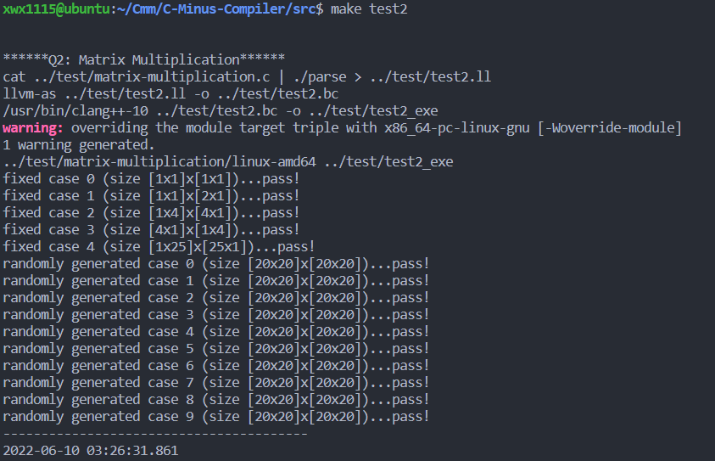
Some Test Sample and Results

Slide 15
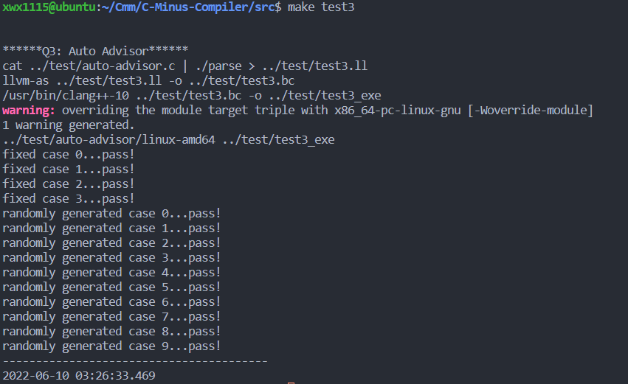
Some Test Sample and Results

Slide 16
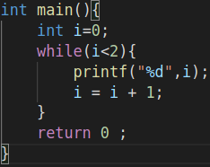
AST Visualization

Slide 17
Thanks

