Slide 1





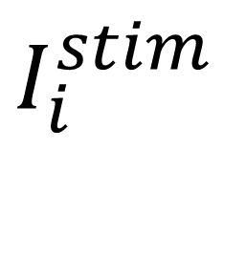








Trial 1
Trial 2
Trial 3
Trial 1000
$I_{i}^{stim}$
$${δt}_{i}$$
$$I_{0}$$
$${δt}_{i}$$
$${δt}_{i}$$
$${δt}_{i}$$
$$ε$$
$$ε$$
$$ε$$
$$ε$$
Time
$$∆T$$
$$∆T$$
$$∆T$$
$$∆T$$

Slide 2
Stimulation Protocol
Trial 1
Trial 2
Trial 3
Trial 4
Trial 1000
Stimulation Current
2 ms
2 ms
2 ms
2 ms
2 ms
Time
100 ms
100 ms
100 ms
100 ms

