Slide 1

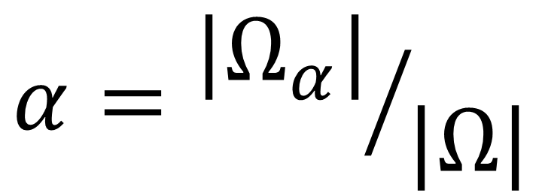
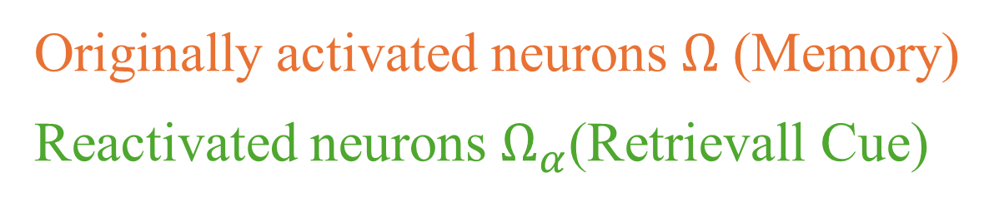


$$Ω$$
$$Ω_{α}$$
Originally activated neurons $Ω$ (Memory)
Reactivated neurons $Ω_{α}$(Retrievall Cue)
$$α={|Ω_{α}|}/{|Ω|}$$

