Slide 1
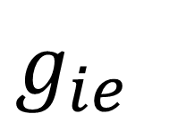
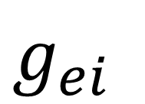

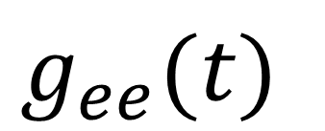
Excitatory
320 neurons
$$g_{ee}(t)$$
Inhibitory 80 neurons
$$Ω$$
Targeted Stimulation
50 neurons
$$g_{ei}$$
$$g_{ie}$$

Slide 2
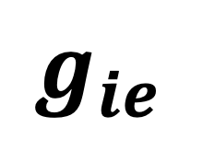
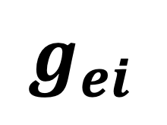
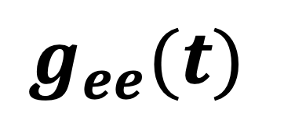
Excitatory
320 neurons
$$g_{ee}(t)$$
Inhibitory 80 neurons
Targeted Stimulation
$$g_{ei}$$
$$g_{ie}$$

