Slide 1
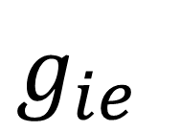
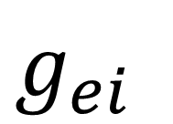


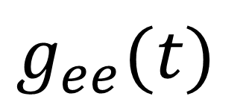
Excitatory
320 neurons
Targeted Stimulation B
Inhibitory 80 neurons
$$Ω_{B}$$
$$g_{ee}(t)$$
$$Ω_{A}$$
$$g_{ei}$$
Targeted Stimulation A
$$g_{ie}$$

