Slide 1


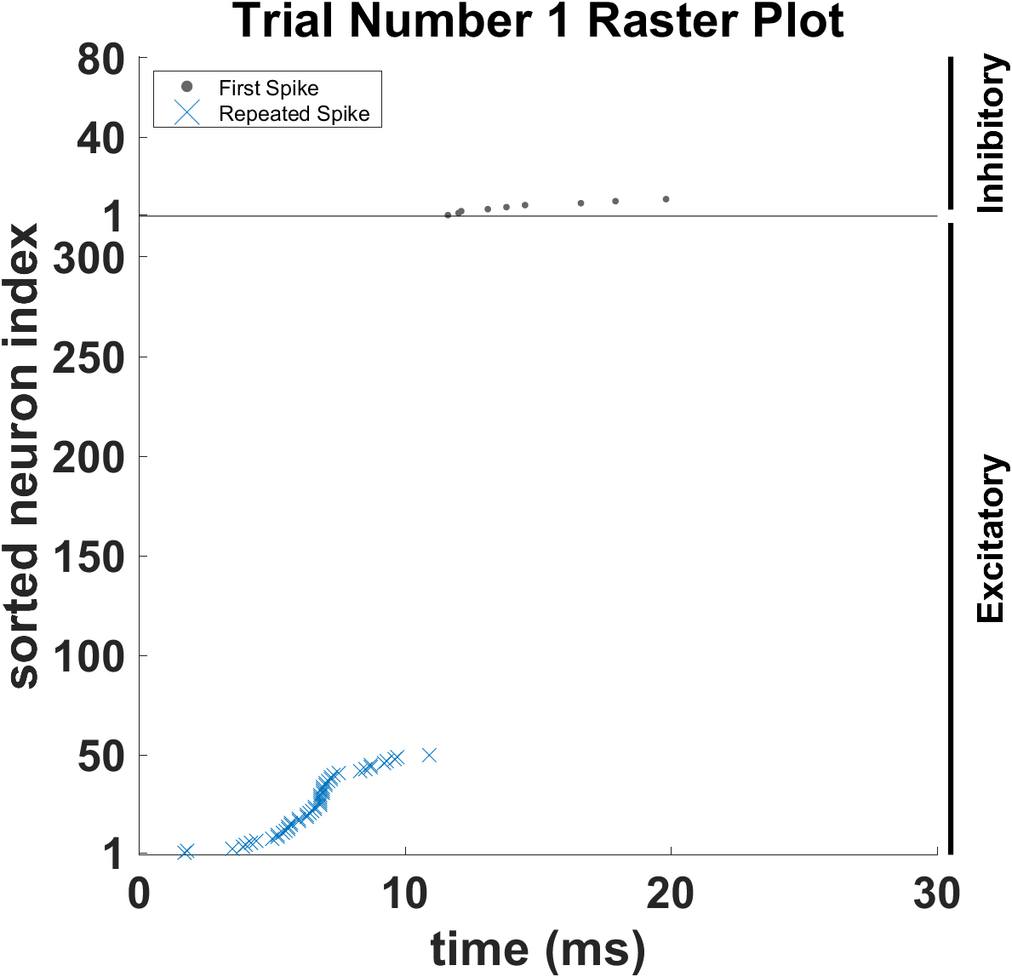
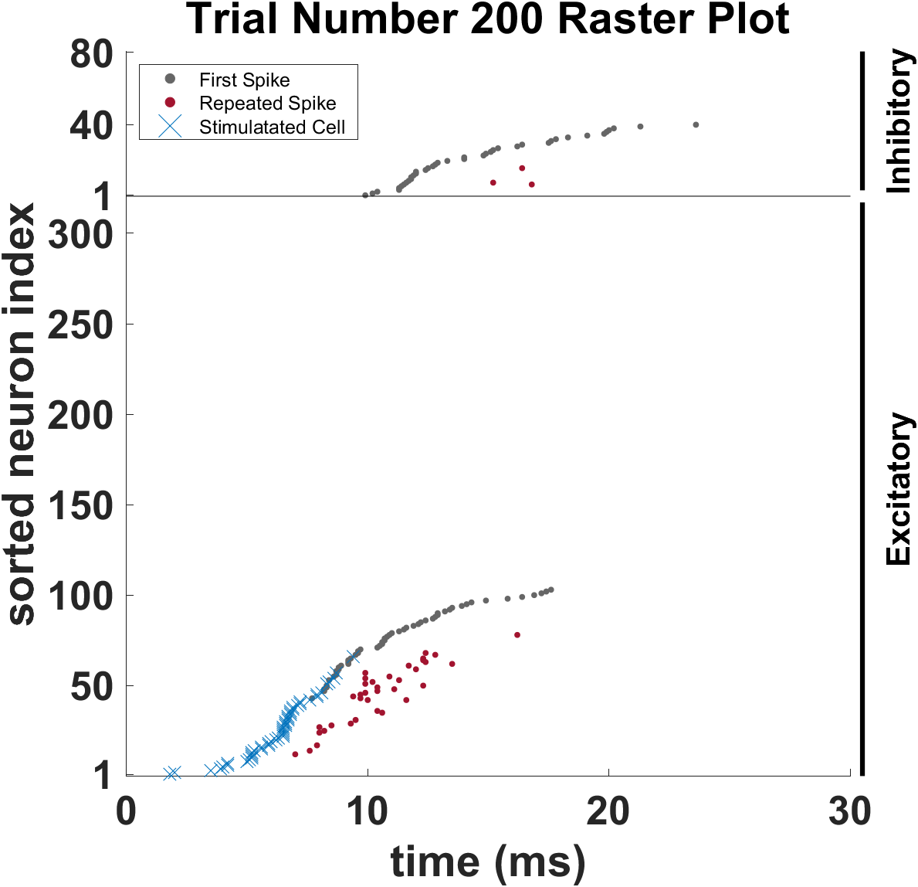
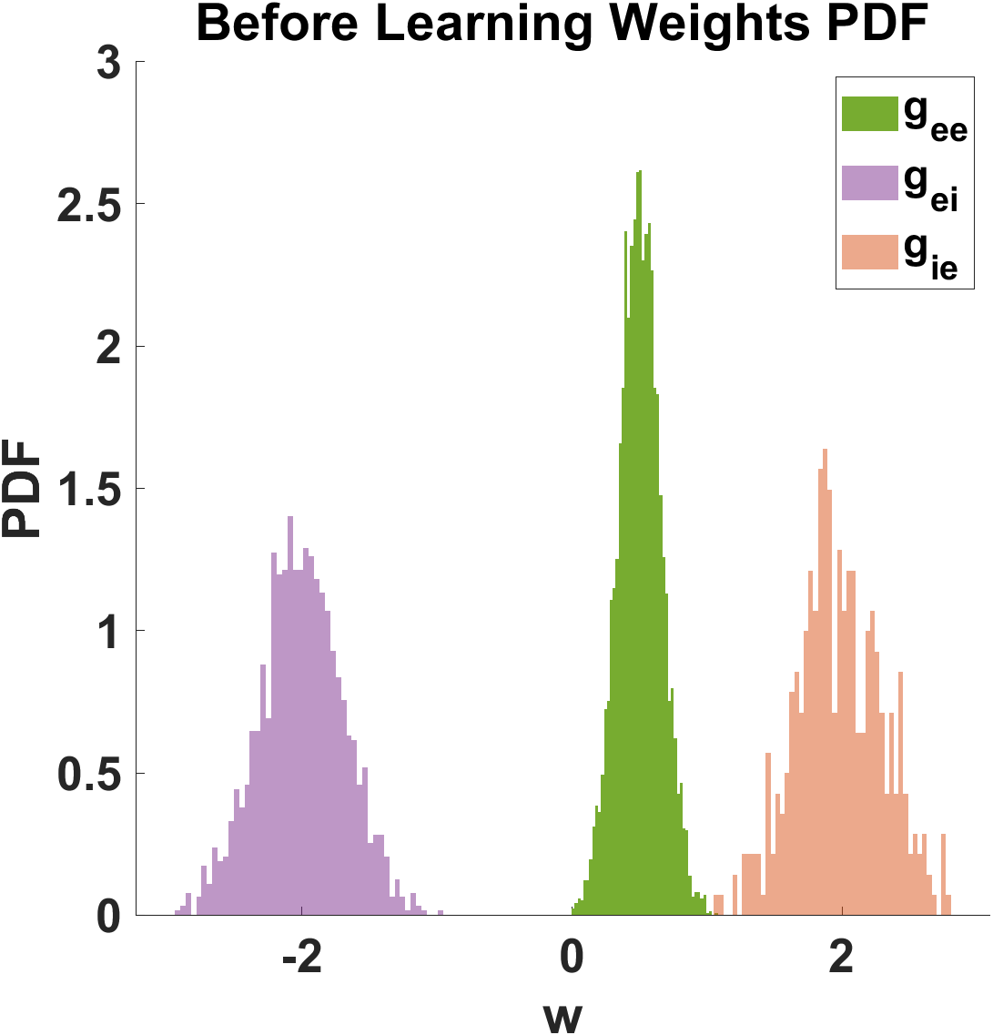
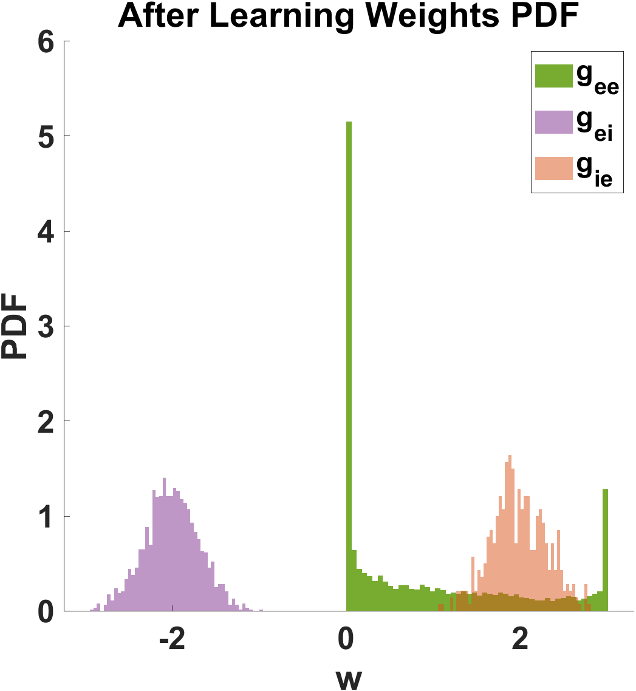
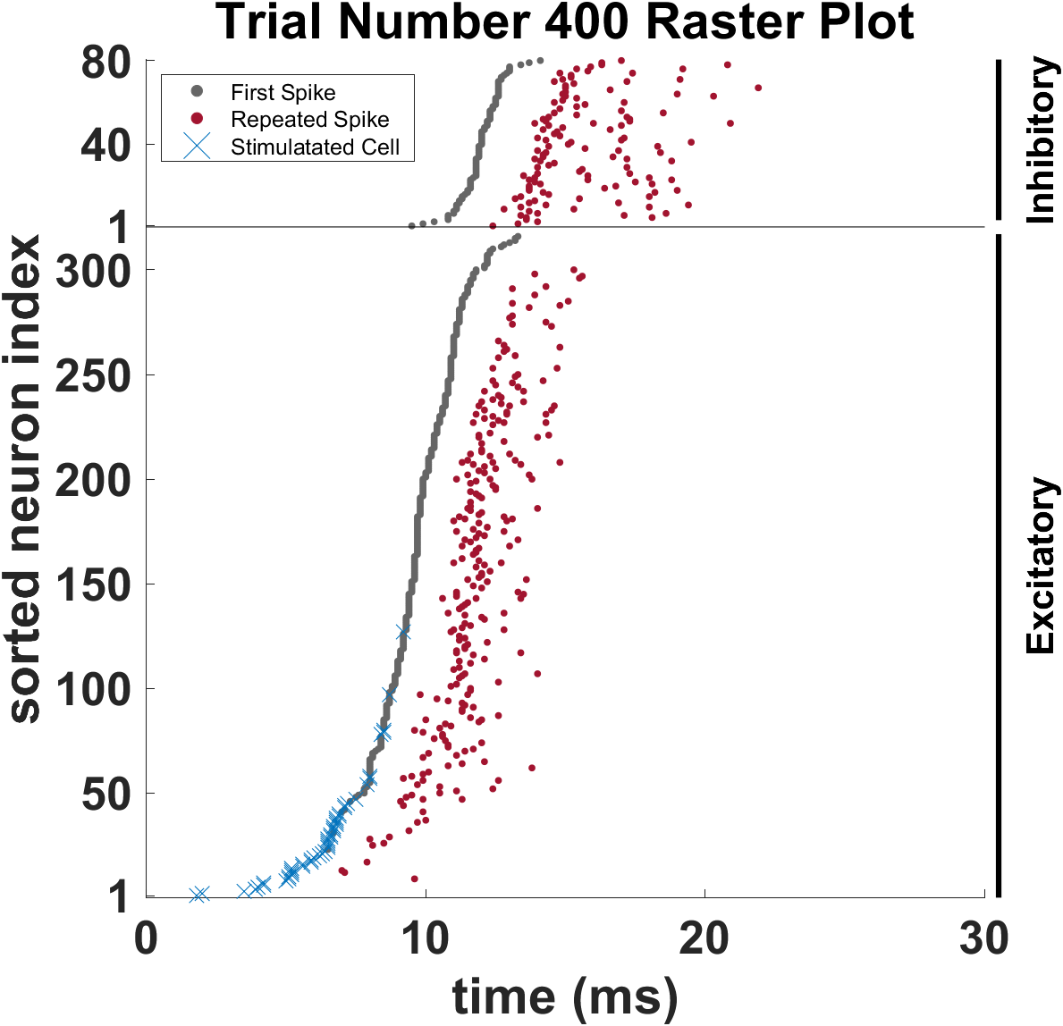
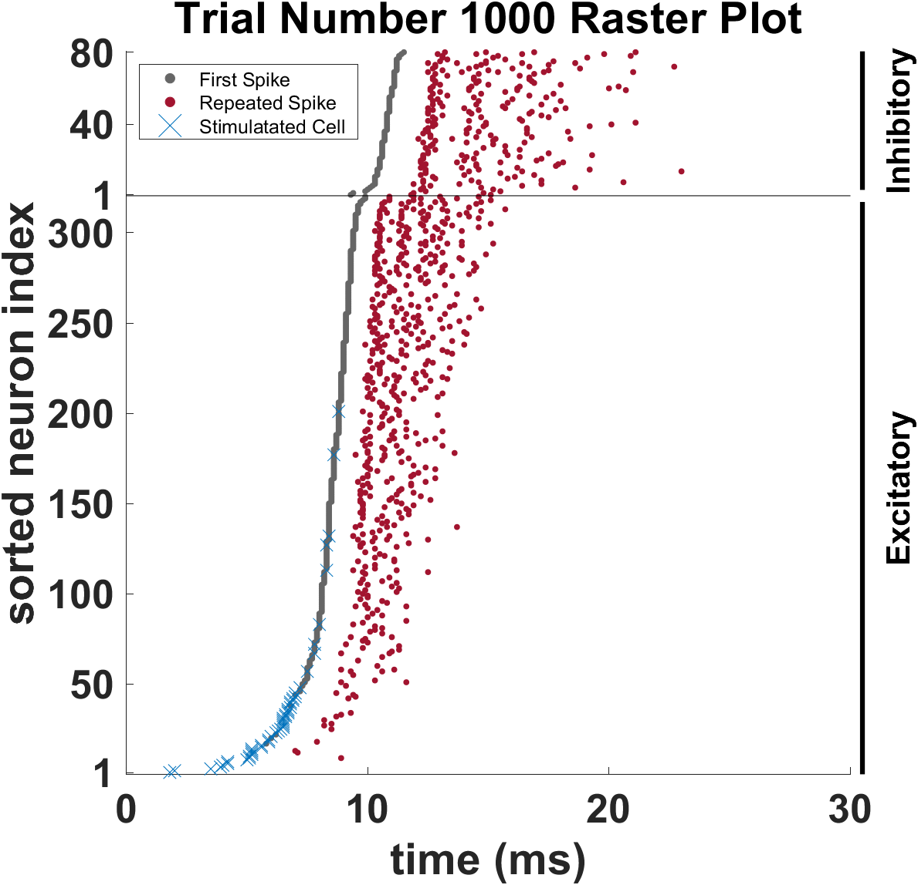
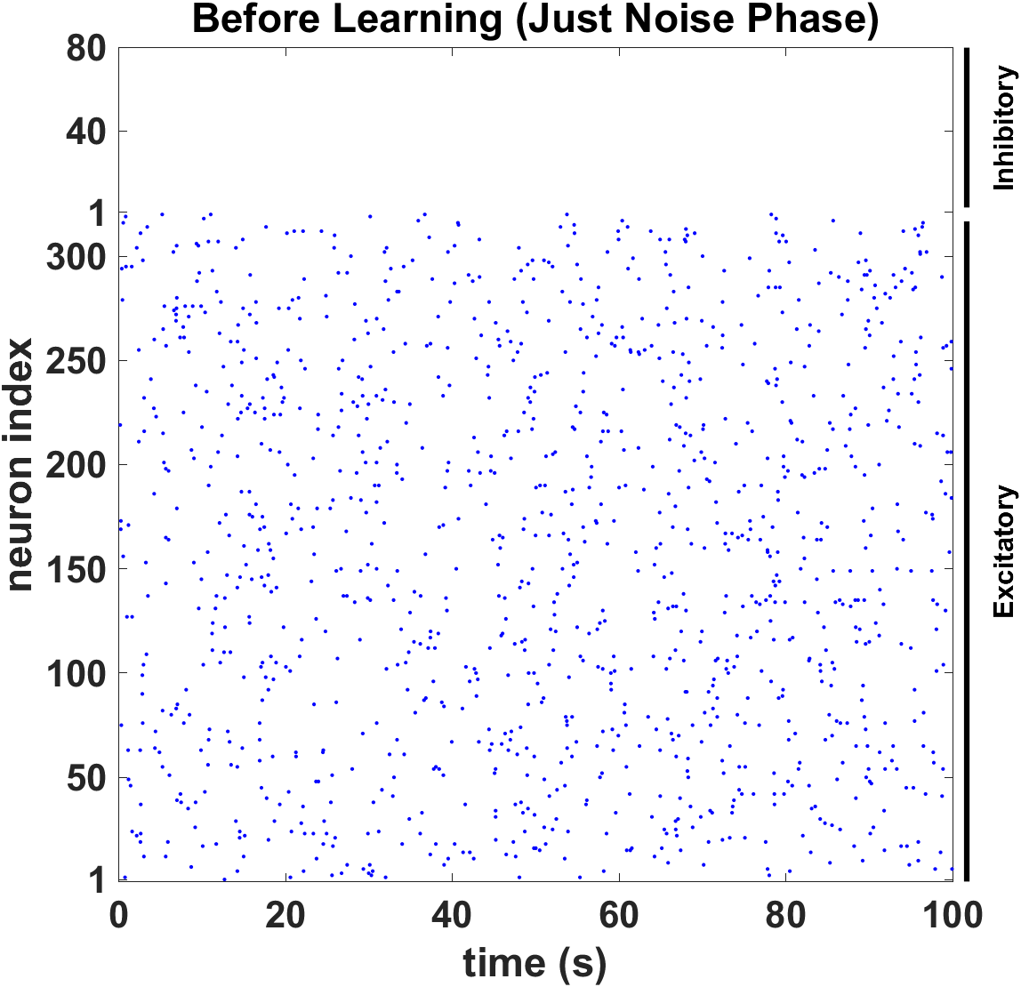
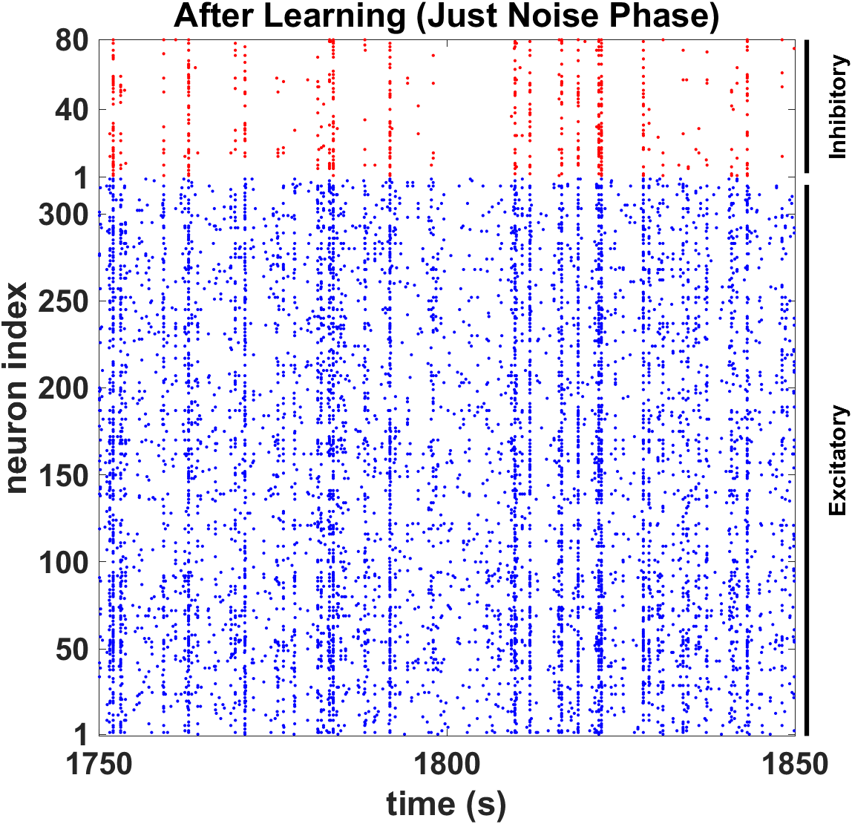
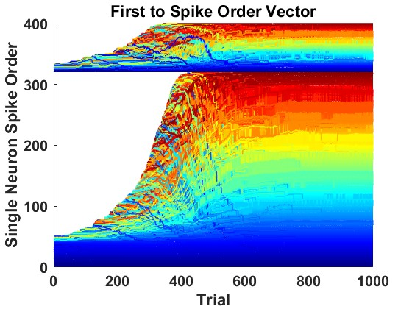
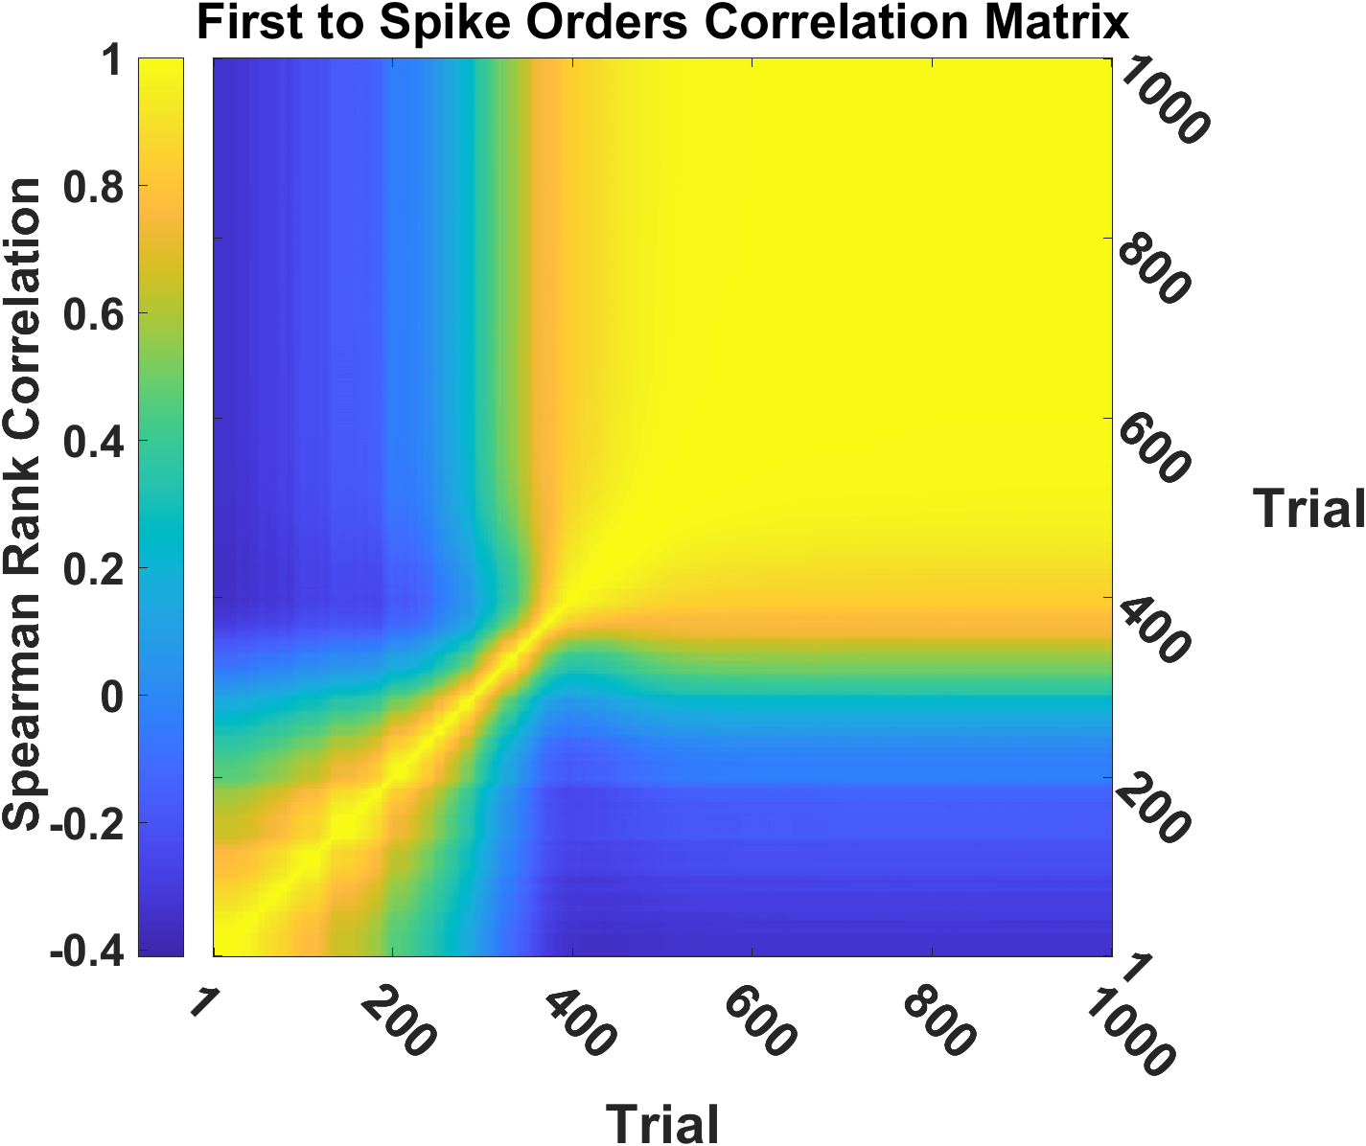
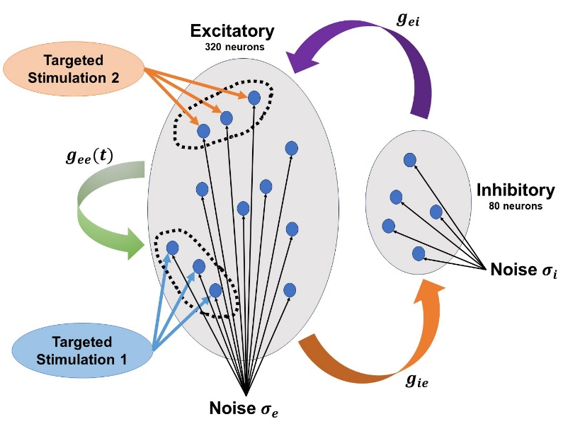
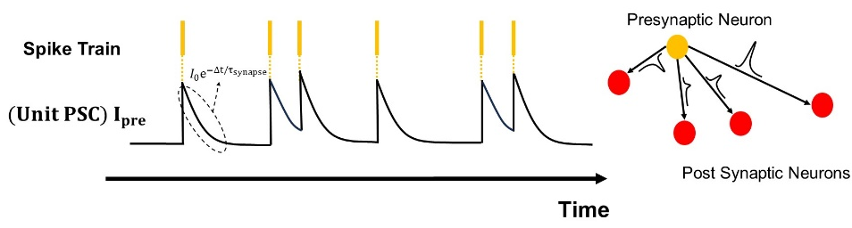
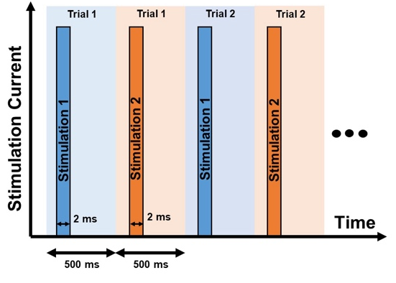
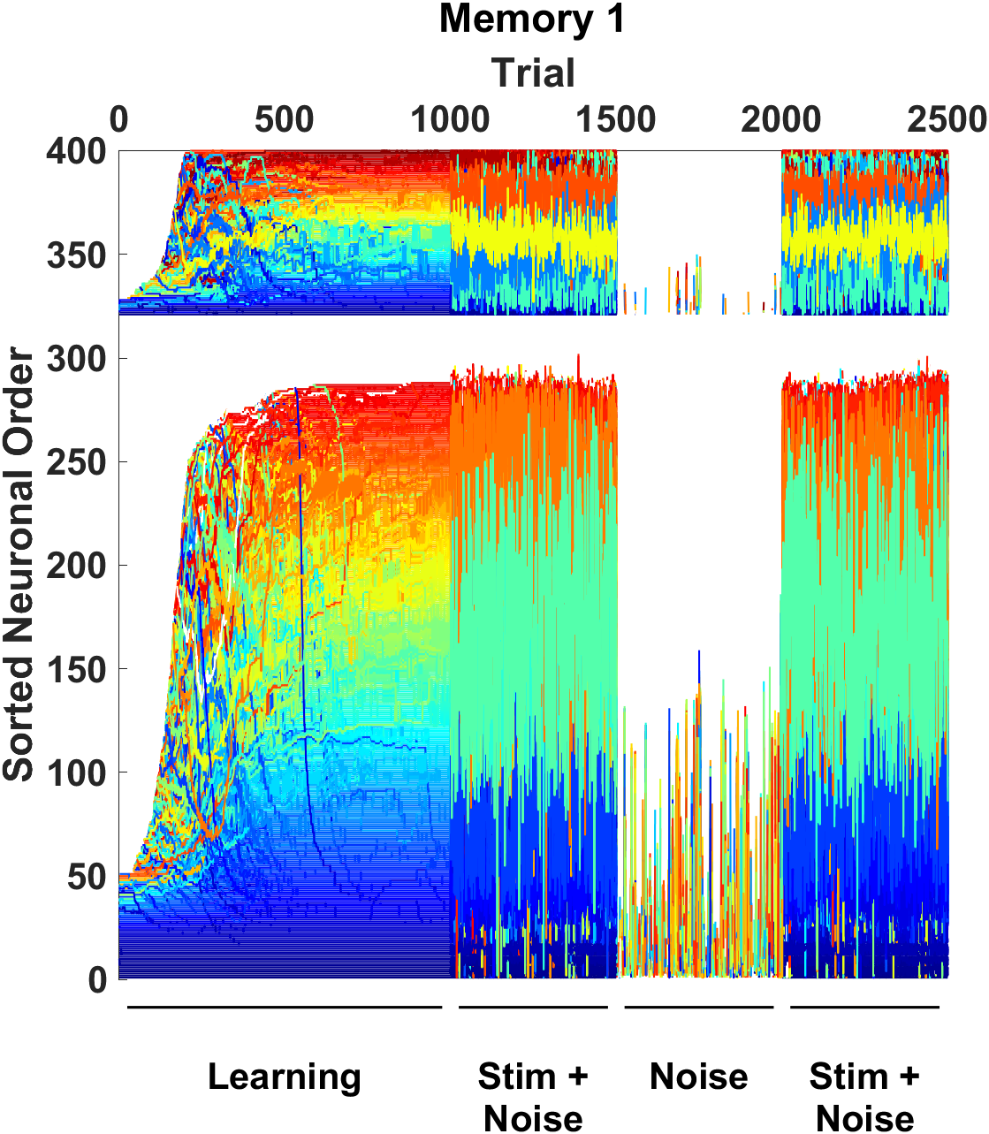
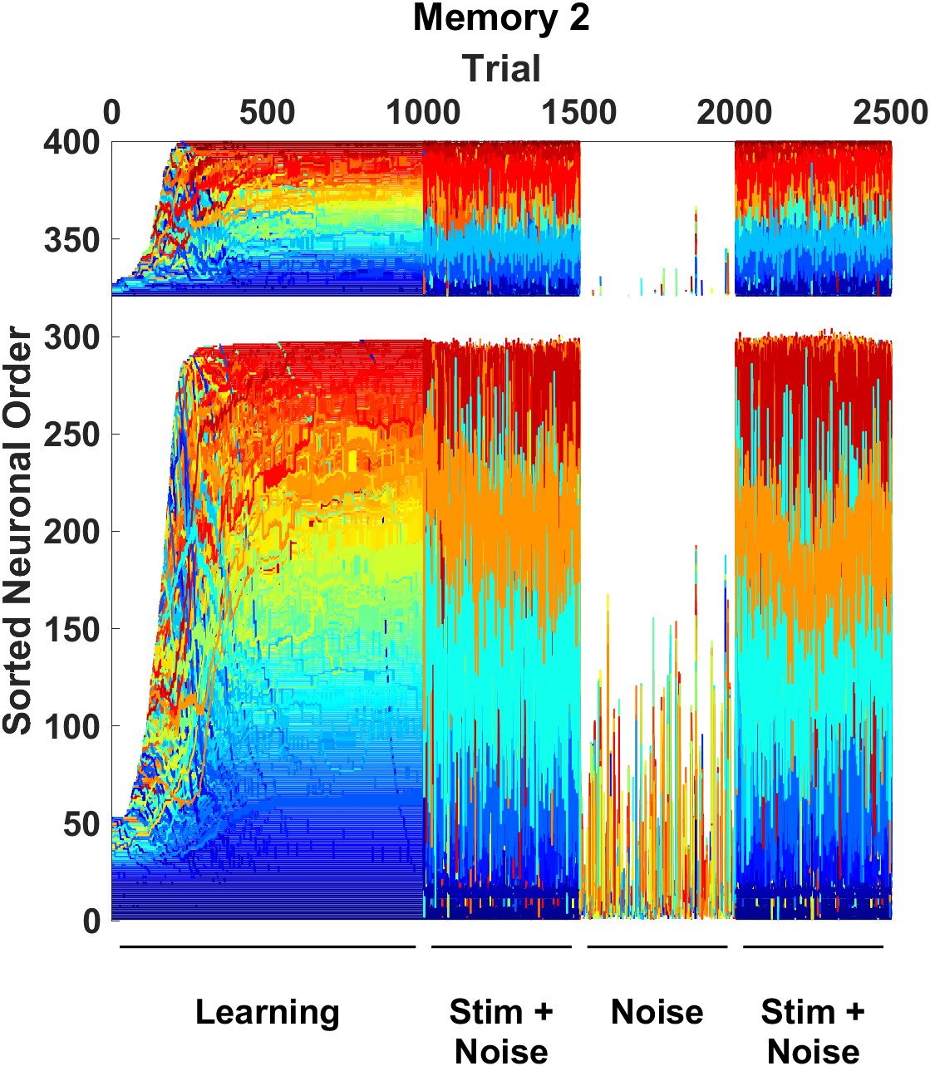
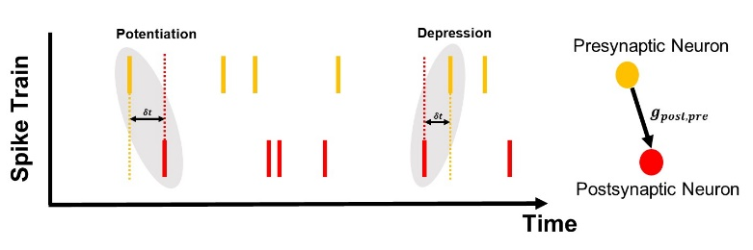
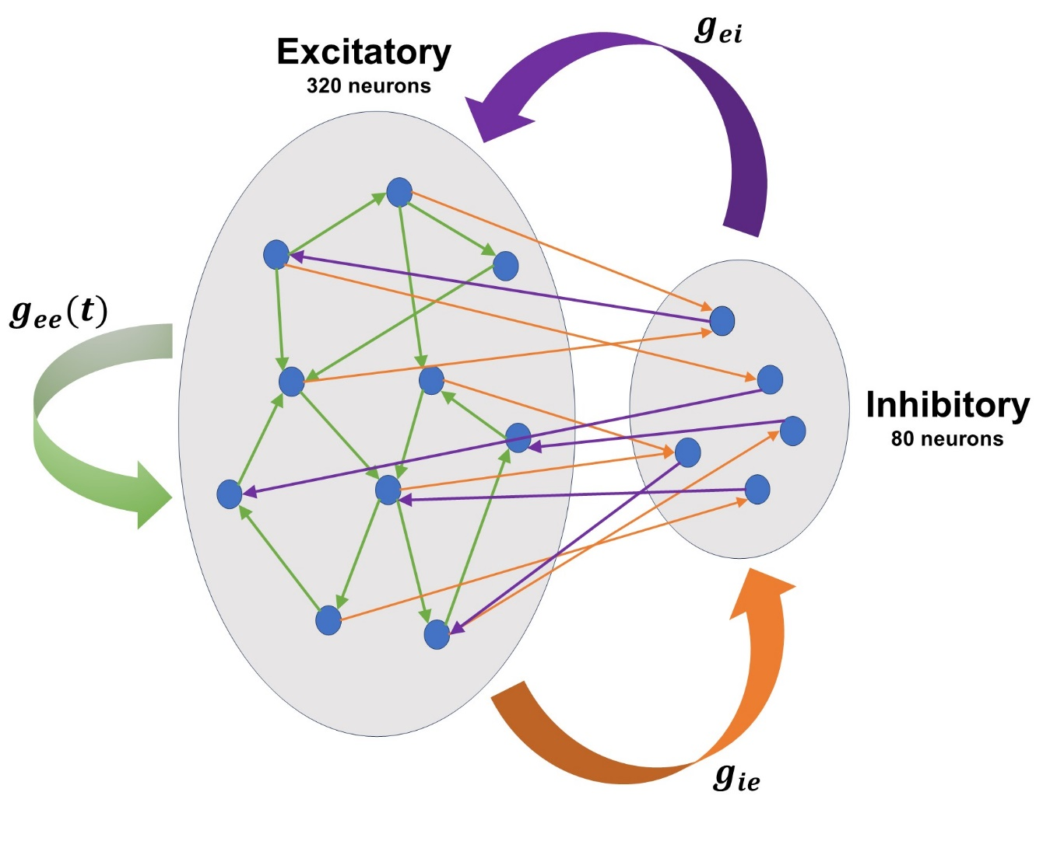
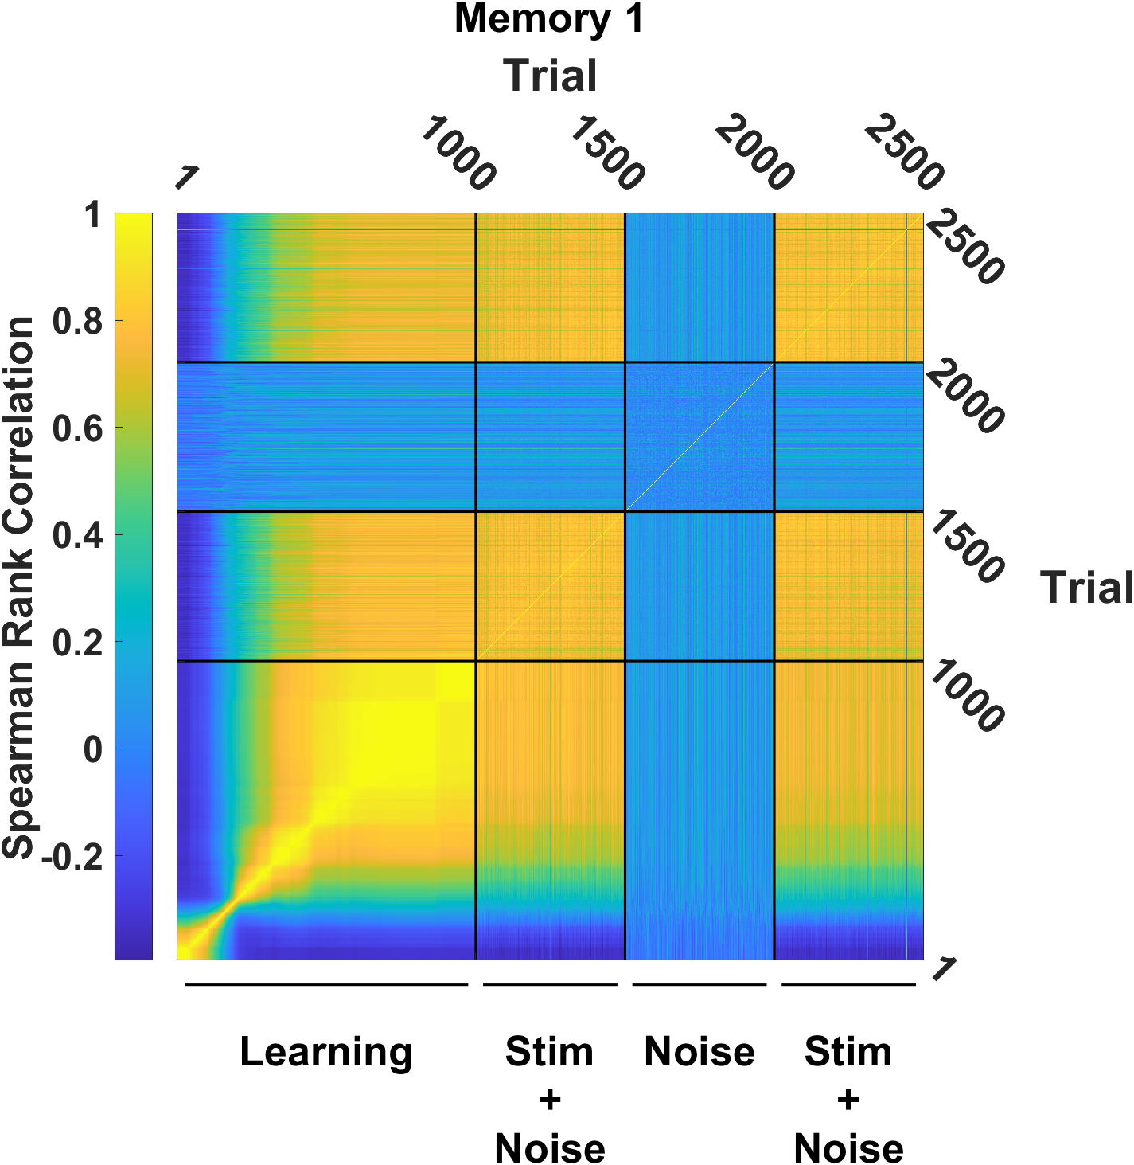
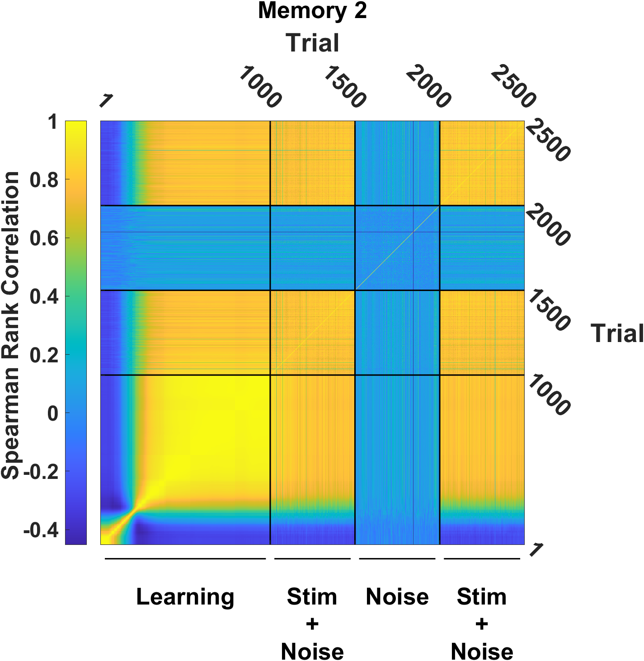
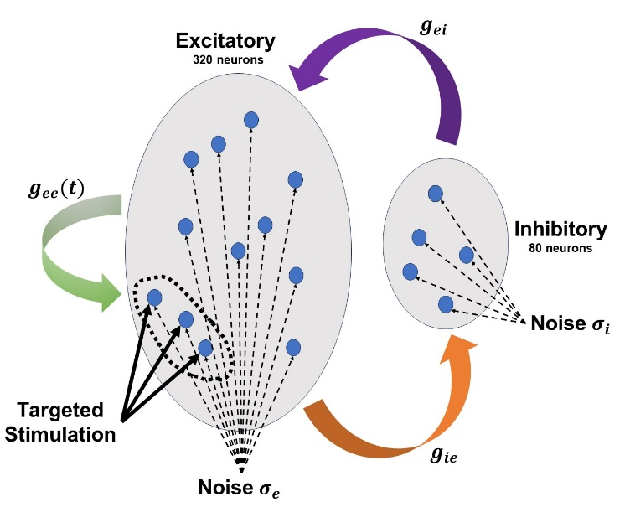
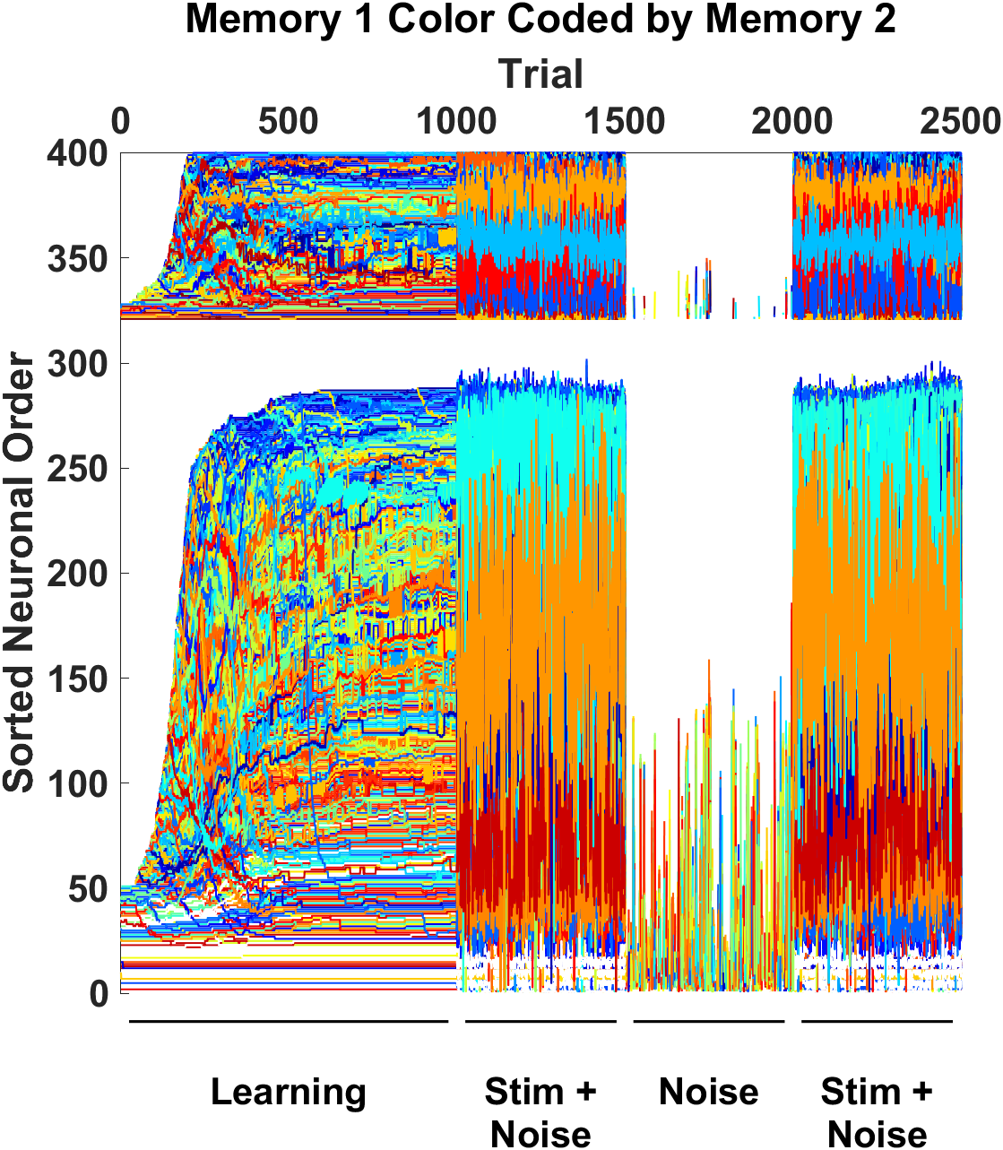
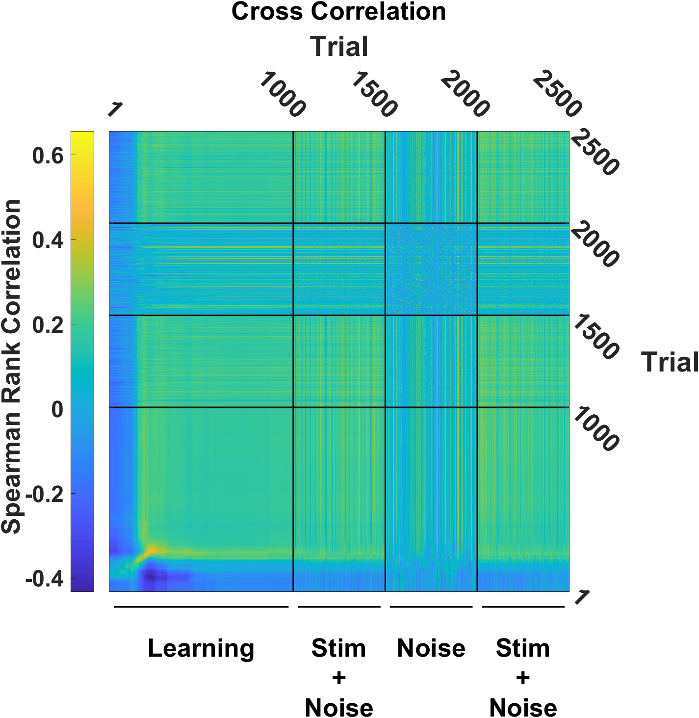
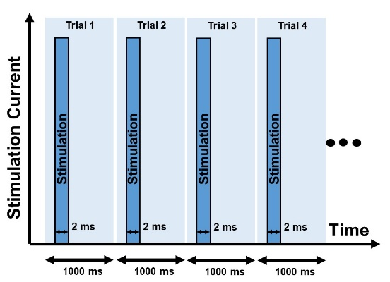



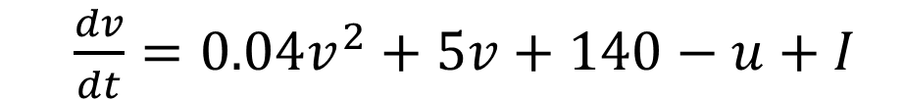
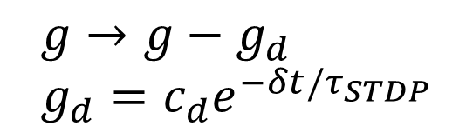
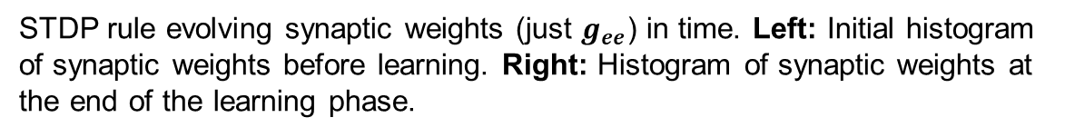
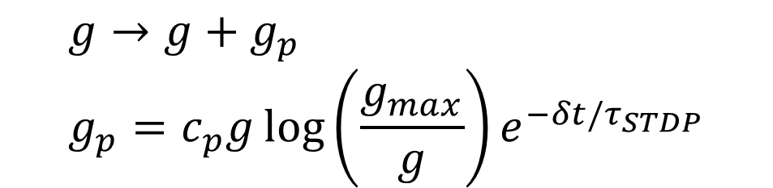
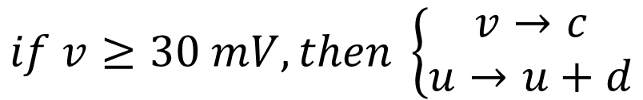
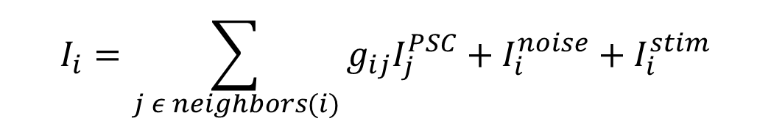
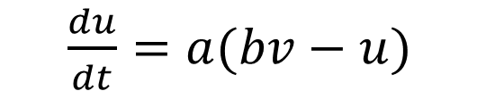
Learning and Stabilizing Memories in Noisy Recurrent Spiking Neural Networks
Arshia Razavi, Javier G. Orlandi
Department of Physics and Astronomy, University of Calgary
Hotchkiss Brain Institute, University of Calgary
Introduction
Imprinting a Single Memory
Pre and Post Learning
How does the brain encode and stabilize a new memory or activity pattern in a noisy environment? Although current prevailing theories suggest that memories are encoded in patterns of synaptic weights within brain networks, the mechanisms by which these patterns are stabilized and reliably accessed are not well understood. Individual synapses are unreliable, and their weights and responses change over time.
Recent studies suggest that network activity patterns could be stabilized in rate based neural networks via complex plasticity mechanisms. However, it is still unclear whether the same mechanisms could produce stable memories in spiking neural networks and whether these rules are biologically plausible.
In our work, we are developing a biologically inspired spiking neural network that can learn and store multiple memories despite the presence of noise.
STDP rule evolving synaptic weights (just $g_{ee}$) in time. Left: Initial histogram of synaptic weights before learning. Right: Histogram of synaptic weights at the end of the learning phase.
Methodology
Raster plots of the network response to the stimulation along four different trials throughout the stimulation protocol. By trial 400 the sequence has stabilized, and its order barely changes until the end of the stimulation protocol (trial 1000)
Izhikevich Model of Spiking Neurons
Raster plots of spontaneous network activity (driven by noise). Left: Noise driven activity of the network before learning. Right: Noise driven activity of the network after learning showing the presence of network bursts.
$\frac{dv}{dt}=0.04v^{2}+5v+140−u+I$
$\frac{du}{dt}=a(bv−u)$
Neuron Input Current
Conclusions
$$if v≥30 mV, then \left\{\begin{aligned}v→c \\ u→u+d\end{aligned}\right.$$
Left: Order vector of cells across different trials . Indices in each trial are sorted based on time to first spike. Color coding is based on last trial which this order stabilizes. Right: Correlation matrix of order vectors. Evidence for stability of order (our memory) after trial 400.
The results of this research demonstrate that it is feasible to construct a biologically inspired spiking neural network capable of storing memories in a manner similar to classical Hopfield networks.
Our findings indicate that such networks can stabilize and maintain memory patterns despite the presence of noise, which is a significant challenge in neural network models.
Input Current Model
Imprinting Two Memories
Unit Post Synaptic Current Modulated by $g_{ij}$
$$I_{i}=\sum_{j ε neighbors(i)}{g_{ij}I_{j}^{PSC}}+I_{i}^{noise}+I_{i}^{stim}$$
Protocol for two memories
Future Work
Hebbian Spike Time Dependent Plasticity Rule
Interleaving stimulation protocol, where two different subpopulations (no overlap) are stimulated every 0.5 s
Decoder Development: Build a decoder population of neurons to read the current network activity and identify active memories online.
Heterogeneity: Introduce parameters variability in the Izhikevich model to better describe actual neural circuits, e.g., cortex or hippocampus.
Memory Capacity: Quantify the network memory storage and retrieval capabilities.
Feature Analysis: Examine additional features beyond time to first spike ordering of learned activity which could be timing of other neuronal spikes after the first one.
Plasticity Mechanisms: incorporate additional plasticity mechanisms, including synaptic scaling and more detailed STDP rules. Also apply plasticity to the other two $g_{ei}$ and $g_{ie}$connections.
Potentiation
$$g→g+g_{p} \\ g_{p}=c_{p}{g\log\left(\frac{g_{max}}{g}\right)e}^{−δt/τ_{STDP}}$$
Depression
$$g→g−g_{d } \\ g_{d}=c_{d}e^{−δt/τ_{STDP}}$$
Network Architecture
Neuronal indices sorted by first to spike order in each trial. Each curve is one neuron first to spike order in time. Neurons are color coded by order in the last trial in the learning phase.
Plasticity is applied here
References
1. E. M. Izhikevich, Simple model of spiking neurons, IEEE Transactions on Neural Networks, 2003
2. E. M. Izhikevich, Which model to use for cortical spiking neurons?, IEEE Transactions on Neural Networks, 2004
3. M. C. W. Van Rossum MC, Bi GQ, Turrigiano GG. Stable Hebbian learning from spike timing-dependent plasticity. Journal of Neuroscience, 2000
4. D. V. Buonomano, A learning rule for the emergence of stable dynamics and timing in recurrent networks. Journal of Neurophysiology, 2005
5. L. Susman, N. Brenner, & O. Barak, Stable memory with unstable synapses. Nature Communications, 2019
Spearman rank correlation of each memory (first to spike order) with itself across trials. Both memories stabilize halfway through the learning phase. Left: Memory 1 order correlation matrix. Right: Memory 2 order correlation matrix.
Stimulation and Noise Protocol
A selected subpopulation (50 cells) is stimulated via 2 ms step-wise input currents every second.
All neurons receive a white noise input current of the same strength.
Left: First to spike order vector of cells in memory 1 across trials, color coded based on the stable order vector of memory 2. We can see that the two orders are unrelated. Right: Spearman correlation between the order of memory 1 and 2 across the same trial index. The low correlation indicates that memories are easily discriminable.
Contact Information
SeyedArshia.Razavi@ucalgary.ca

