Slide 1
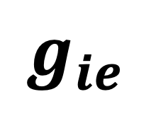
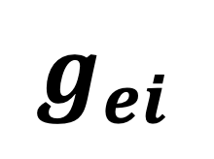
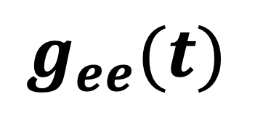
Excitatory
320 neurons
Targeted Stimulation B
Inhibitory 80 neurons
$$g_{ee}(t)$$
$$g_{ei}$$
Targeted Stimulation A
$$g_{ie}$$

