Slide 1
Stimulation Protocol
Trial 1
Trial 2
Trial 3
Trial 4
Trial 1000
Stimulation Current
2 ms
2 ms
2 ms
2 ms
2 ms
Time
100 ms
100 ms
100 ms
100 ms

Slide 2

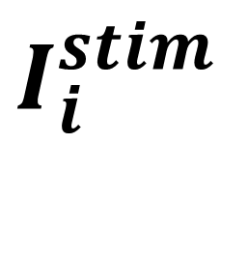



Stimulation Protocol
Trial 1
Trial 2
Trial 3
Trial 1000
$I_{i}^{stim}$
$${δt}_{i}$$
$${δt}_{i}$$
$${δt}_{i}$$
$${δt}_{i}$$
2 ms
2 ms
2 ms
2 ms
Time
100 ms
100 ms
100 ms
100 ms

