Slide 1





Coupling Agent-based Model with Territorial LCA to Support Agricultural Land Use Planning
Presenter: Tianran DING
Institute: Luxembourg Institute of Science and Technology
IE Day 2024 November 21

Slide 2

Bioenergy is the new trend
01
Renewable
Adopt it
02
Reduce GHG
Adopt it
03
Energy Security
Adopt it
04
Rural Economies
Adopt it

Slide 3


One Possibility of Adopting Bioenergy Crop
I don’t know technology…
Is it really profitable?
Policy
Yes
No
Land use
Carbon neutral
Replace fossil fuel
Farmer

Slide 4

Incentives motivation
I don’t know technology…
BUT, I will try this year
Policy
Yes
Yes
Land use
Carbon neutral
Replace fossil fuel
Farmer

Slide 5

One IDEAL scenario
Satisfy regional target
We all want to try !!!!
Policy
Yes
Yes
Land use
Carbon neutral
Replace fossil fuel
Farmer

Slide 6
Complex Real World
01
02
Problems
Policy
Farmer
Is bioenergy crops really “green”?
Will farmers will make adoption decisions?
ASSESS
SIMULATE

Slide 7
Assessment
Territorial level
Life cycle
01
02
Overall impacts
Crops’ full life cycle
Comprehensive
Spatial specific
04
03
Multi-criteria
Location matters
Climate change, Eutrophication

Slide 8
Territorial Life Cycle Assessment
Loiseau et al., 2013
Climate change
Environmental impacts
1 | 1 | 1
2 | 2 | 2
2 | 2 | 2
Freshwater eutrophication
Land use scenario
Bioenergy production
Land use functions
Food production

Slide 9
Territorial Life Cycle Assessment
Climate change
Environmental impacts
2 | 2 | 2
2 | 2 | 2
1 | 1 | 1
Freshwater eutrophication
Land use scenario
1 | 1 | 1
2 | 2 | 2
2 | 2 | 2
Bioenergy production
Land use functions
Food production

Slide 10
Spatial Territorial Life Cycle Assessment
Nitschelm et al., 2016
Spatial Climate change
Environmental impacts
2 | 2 | 2
2 | 2 | 2
1 | 1 | 1
Spatial Freshwater eutrophication
Land use scenario
Spatial Bioenergy production
Land use functions
Spatial Food production
Geographical Information System (GIS)

Slide 11
Spatial Territorial Life Cycle Assessment
Spatial Climate change
Environmental impacts
2 | 2 | 2
2 | 3 | 3
1 | 3 | 1
Spatial Freshwater eutrophication
Land use scenario
Spatial Bioenergy production
Land use functions
Spatial Food production

Slide 12
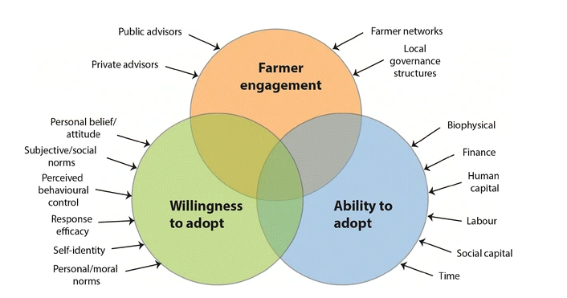
Factors influencing farmer decision-making
Mills et al., 2016

Slide 13

Agent Based Modeling
Time 0
Time 1
Time 2
Time 3
2 | 2 | 2
2 | 2 | 2
1 | 1 | 1
2 | 2 | 2
2 | 3 | 2
1 | 1 | 1
2 | 2 | 2
2 | 3 | 3
1 | 1 | 1
2 | 2 | 2
2 | 3 | 3
1 | 3 | 1
Land use scenario
Land use scenario
Land use scenario
Land use scenario

Slide 14
Linking Assessment with Simulation
Spatial explicit
Spatial Territorial Life Cycle Assessment
Agent Based Model
Multi-criteria
Spatial explicit
Human behavior
Life-Cycle
Multi-criteria
Time dimension
Territorial level
Territorial level
Human behavior
Life-Cycle
Time dimension

Slide 15
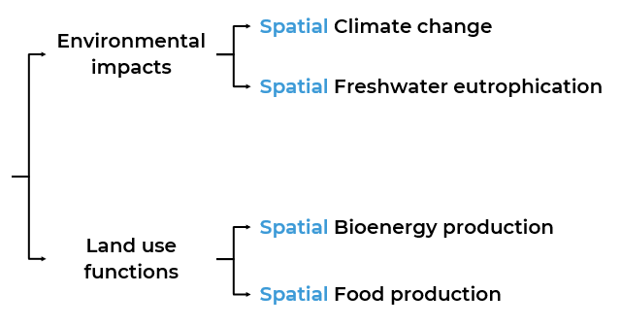
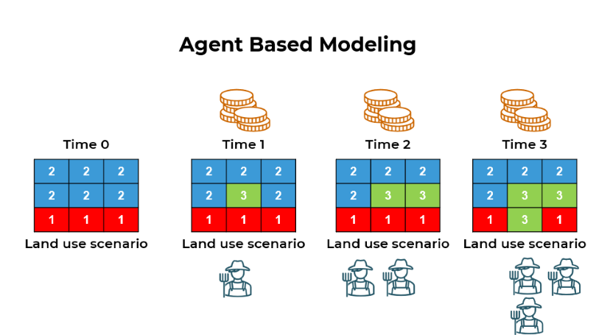

Framework
Ding et al., 2023
Spatial Territorial LCA

Slide 16
Spatial Territorial Life Cycle Assessment (LCA) – Agent Based (ABM)
01
Goal and scope
STLCA
02
Spatial specific inventory
ABM
STLCA
03
Spatial specific impact assessment
STLCA
04
Interpretation
STLCA

Slide 17
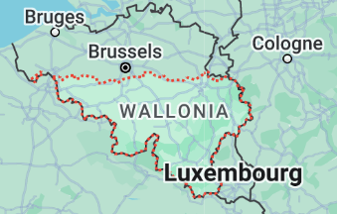
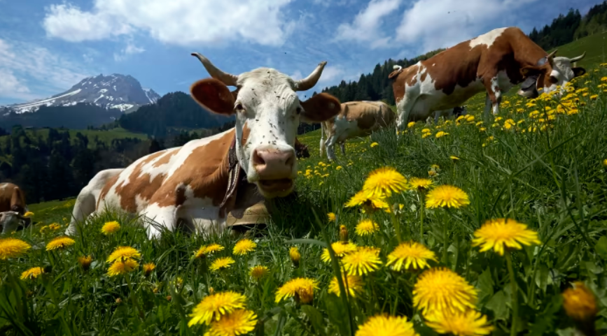
CASE STUDY
Managing for one year the agricultural territory that is currently occupied for animal production in the Walloon region (112 Kha), to produce various agricultural products.
https://www.ft.com/content/e452383c-ee35-11e8-89c8-d36339d835c0

Slide 18
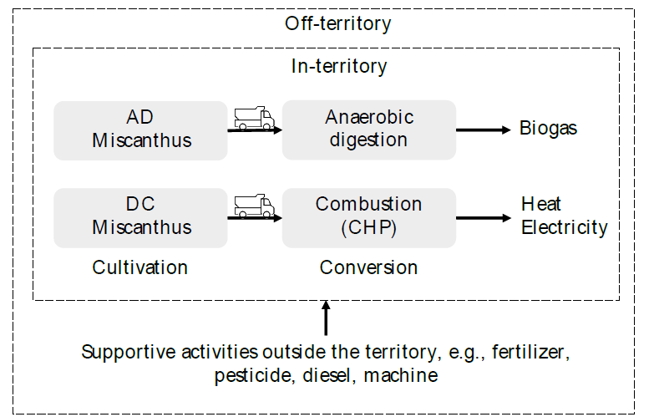
CASE STUDY
Managing for one year the agricultural territory that is currently occupied for animal production in the Walloon region (112 Kha), to produce various agricultural products.

Slide 19
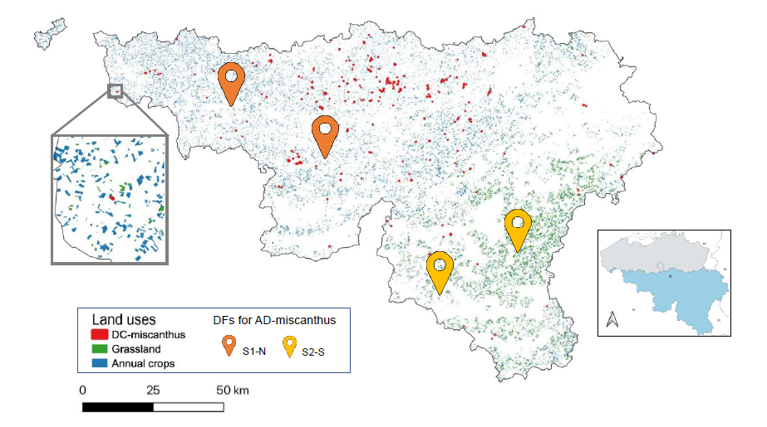
Assumed Demonstration Farms & Subsidies
Assume adopters will be
provided with subsidies over simulation time

Slide 20
Farmers’ decision
Potential profit
Neighbor profit
Own current profit
Farm size
Bigger farm, less risk aversion
Probability to adopt
Familiarity to bioenergy crops
Higher if closer to neighbor adopters

Slide 21
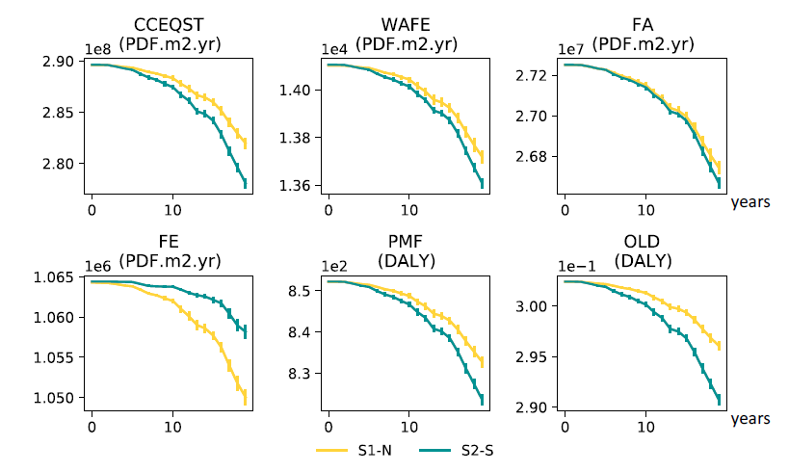
Simulated & Assessed Environmental Impacts
Different initial locations for
demonstration farms would lead to different dynamic impacts at the territorial level.

Slide 22
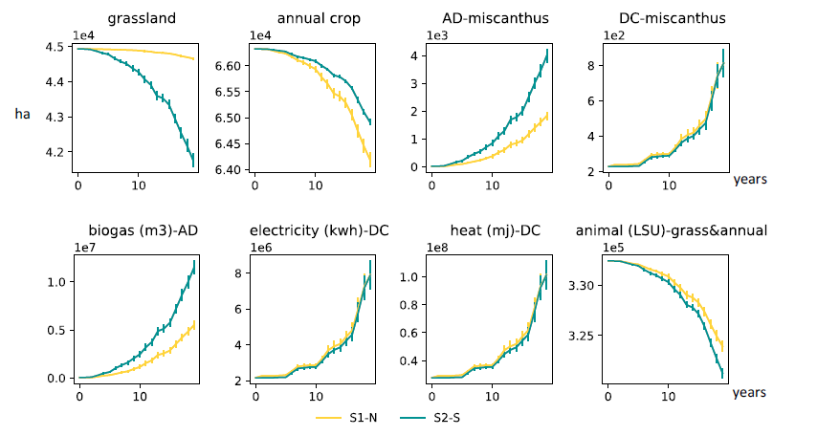
Simulated & Assessed Land Use Functions
Different initial locations for
demonstration farms would lead to different dynamic land use functions at the territorial level.

Slide 23
Decision support for land use planning
Where to locate demonstration farm?
How much incentives needs to be considered to reach the bioenergy target?
Need social science, local survey data to back up

Slide 24
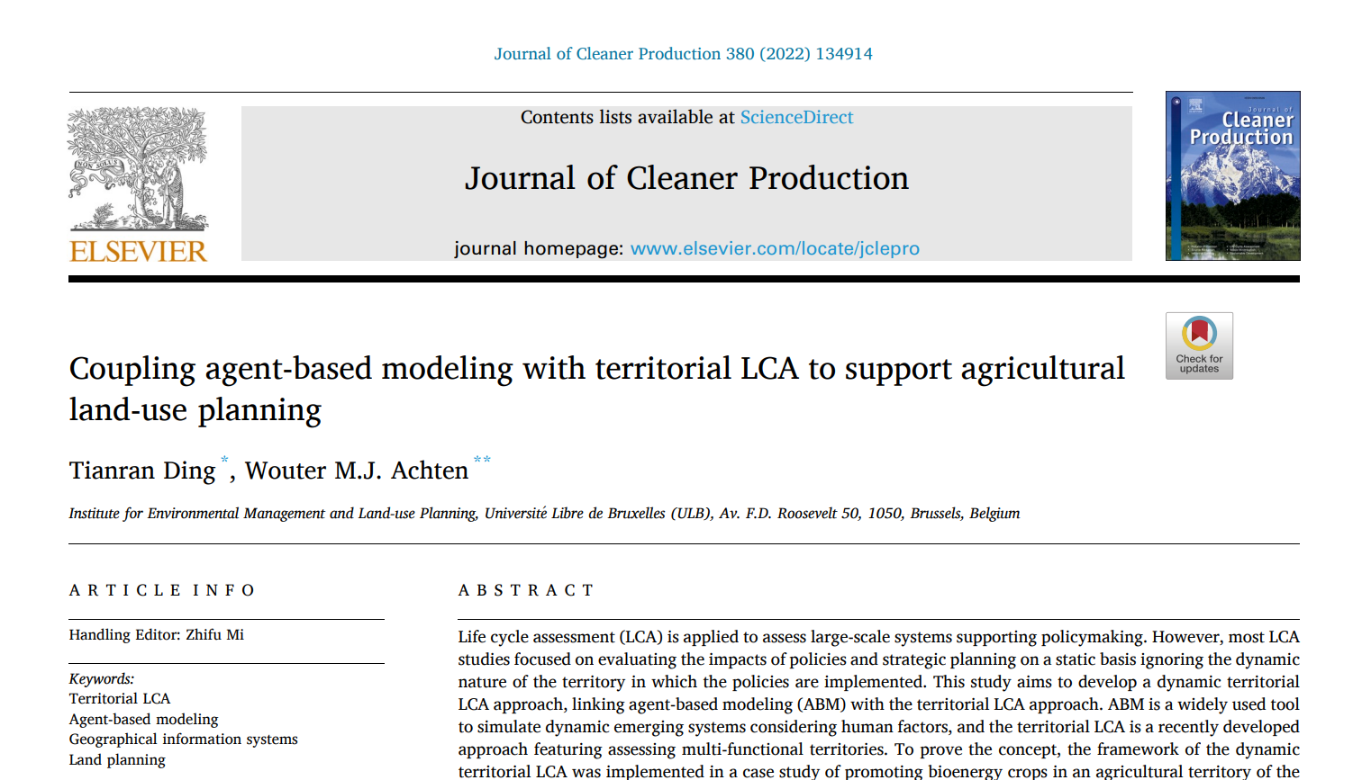
Thanks!
Do you have any questions?
tianran.ding@list.lu

