Slide 1

PYQs on EVOLUTION OF UNIVERSE, STARS AND GALAXIES

Slide 2
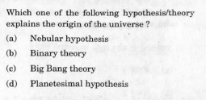

Slide 3
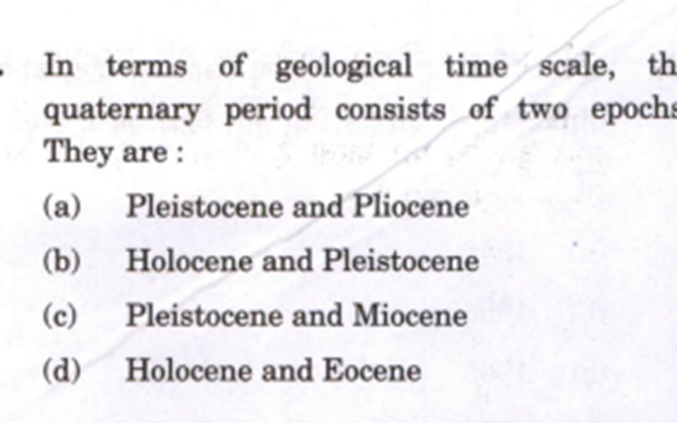

Slide 4
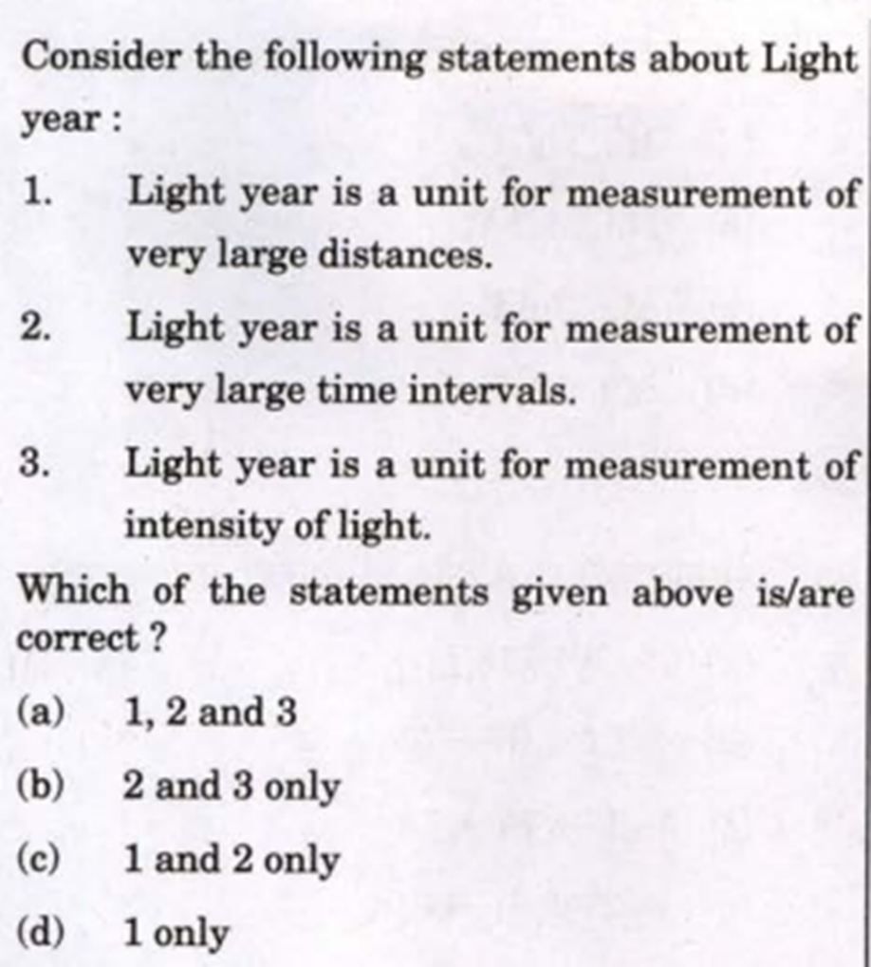

Slide 5
