Slide 1

PYQs on Solar System, Planets and moon

Slide 2
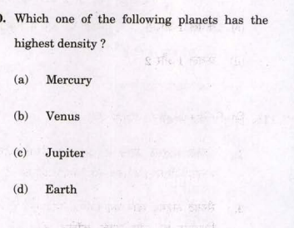

Slide 3
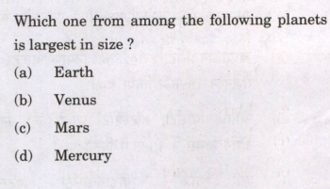

Slide 4
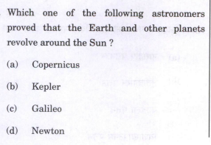

Slide 5
