Slide 1

PYQs on Eclipse and Tides

Slide 2
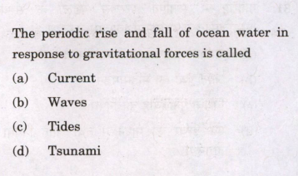

Slide 3
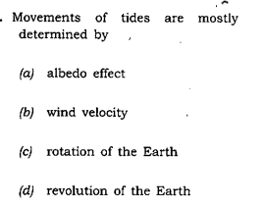

Slide 4
