Slide 1

PYQs on CDT, Plate Tectonics and Sea Floor Theory

Slide 2
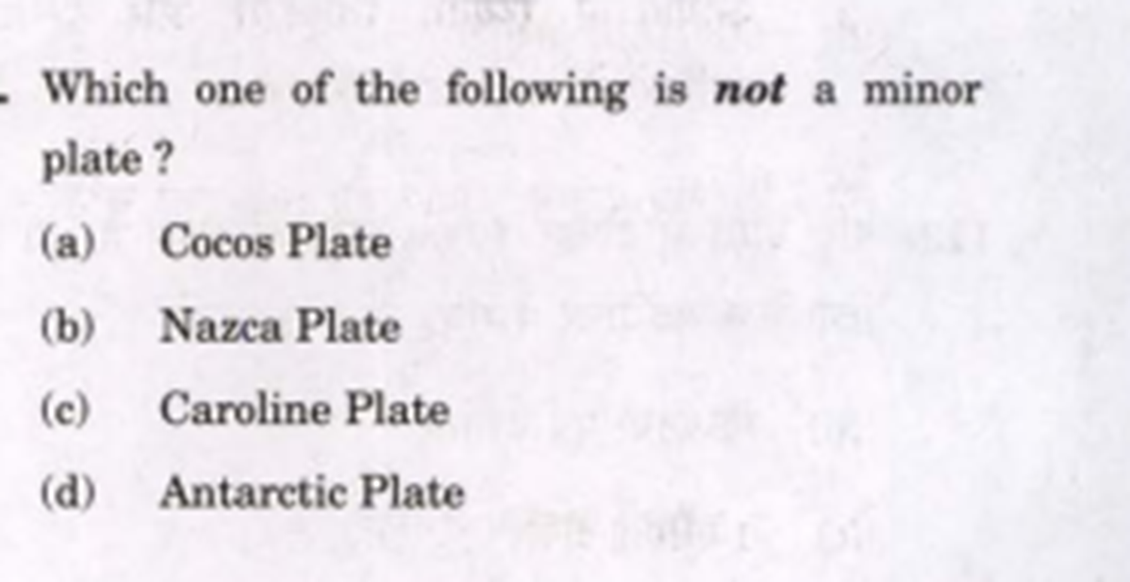

Slide 3
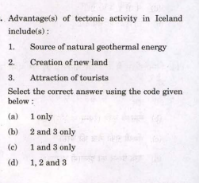

Slide 4
