Slide 1

PYQs on Earth’s Interior

Slide 2
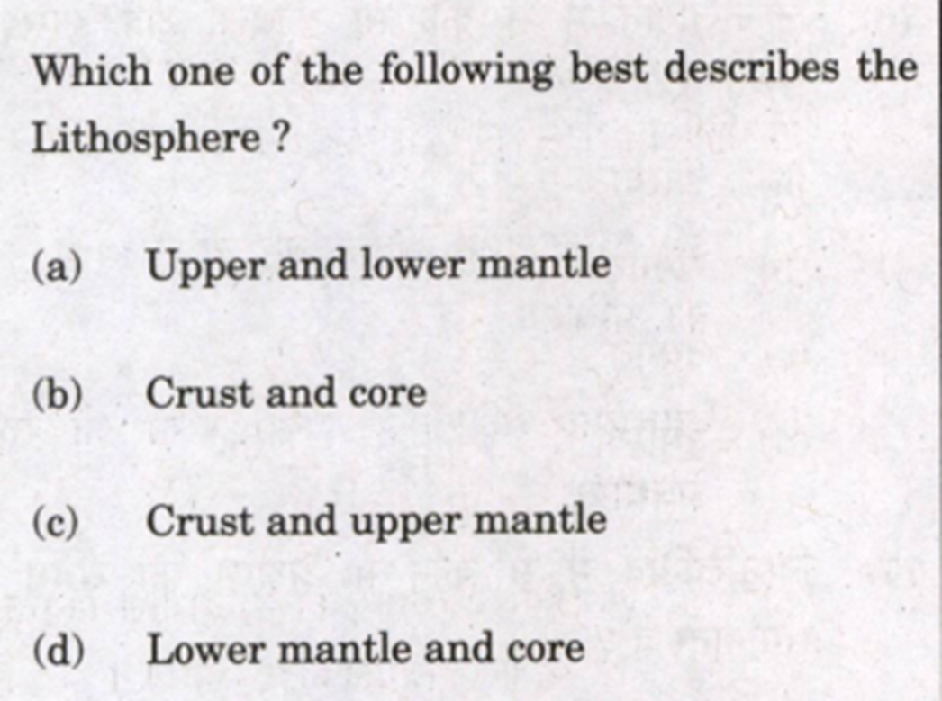

Slide 3
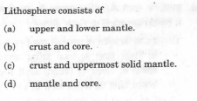

Slide 4
