Slide 1

PYQs on Temperature Distribution
& Heat Budget

Slide 2
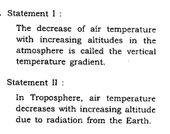
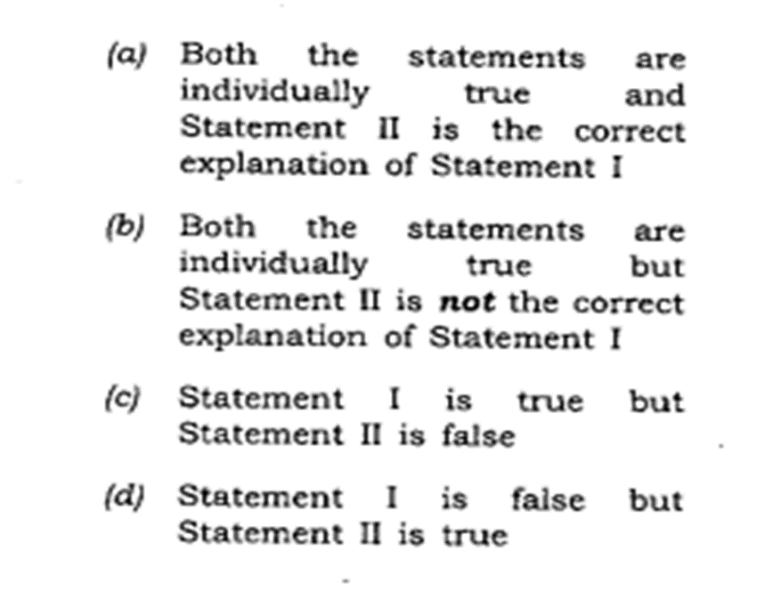

Slide 3
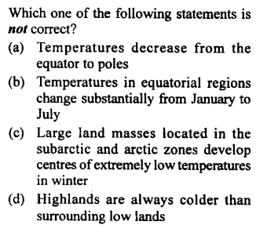

Slide 4
