Slide 1

PYQs on Humidity and Condensation

Slide 2
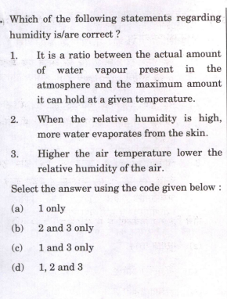

Slide 3
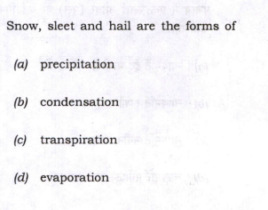

Slide 4
