Slide 1

PYQs on Clouds and Classification

Slide 2
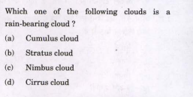

Slide 3
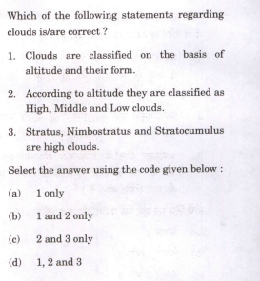

Slide 4
