Slide 1

Indian Climate and Monsoon PYQs

Slide 2
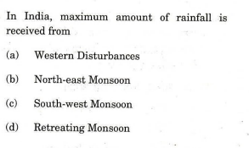

Slide 3
