Slide 1

PYQs on Vedic Age and Mahajanapadas

Slide 2
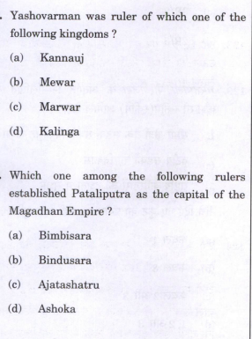

Slide 4
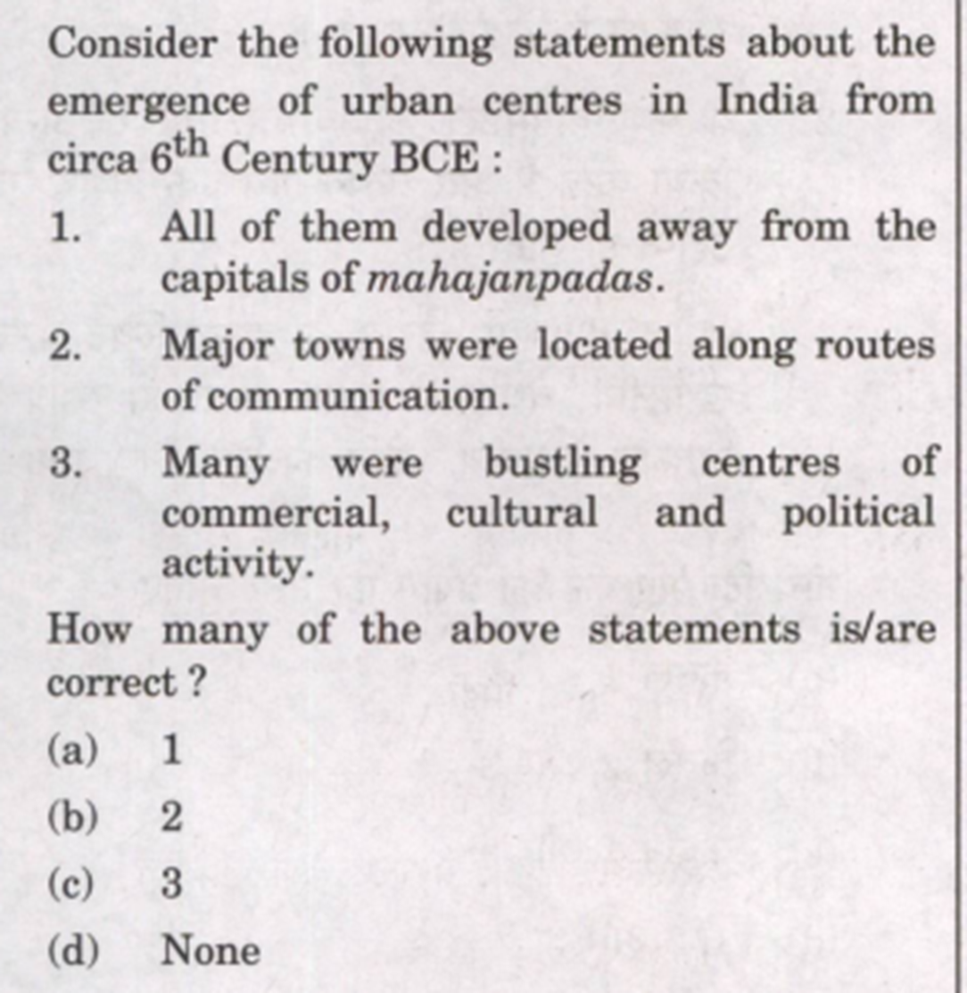

Slide 5
