Slide 1

PYQs on Buddhism

Slide 2
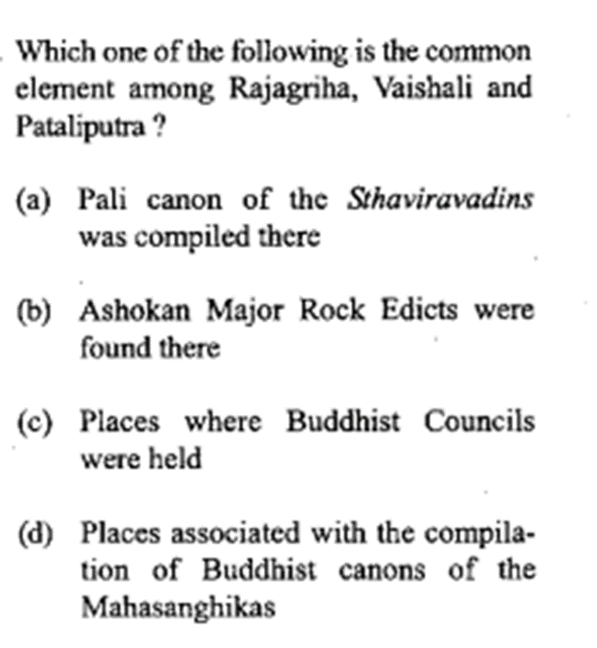

Slide 3
