Slide 1

PYQs on Vijayanagar Empire and other provinces

Slide 2
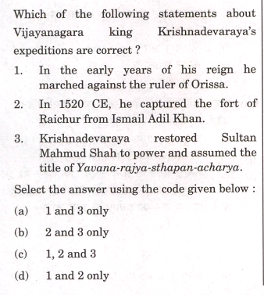

Slide 3
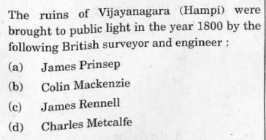

Slide 4
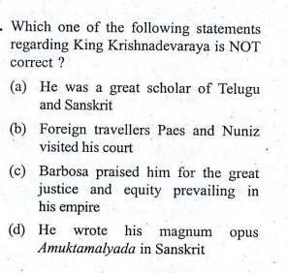

Slide 5
