Slide 1

PYQs on SC BOSE AND INA AND INDIA’S INDEPENDENCE

Slide 2
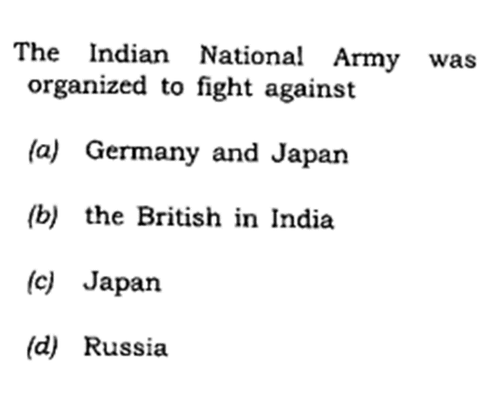

Slide 3
