Slide 1
BACKPROPAGATION: A METHOD FOR SUPERVISED NEURAL NETWORK LEARNING
MATH/COMP 402
Devin King

Slide 2





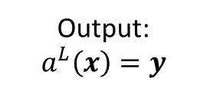

Neural Network - Feedforward
NEURAL NETWORK
Identify Person
Output: $a^{L}\left(x\right)=y$
Input: $x$
$$x= \left\langle x_{1},x_{2},x_{3},…,x_{n}\right\rangle$$
$$y= \left\langle y_{1},y_{2},y_{3},…,y_{m}\right\rangle$$
Image represented as a vector
Vector of probabilities for each person
https://archive.ics.uci.edu/ml/datasets/CMU+Face+Images

Slide 3


Neural Network – Backpropagate
Neural network adjusts itself to account for error in identification
NEURAL NETWORK
Actual
Identity
Input: $y′$
$$y′= \left\langle {y′}_{1},{y′}_{2},{y′}_{3},…,{y′}_{m}\right\rangle$$
Vector containing correct identification

Slide 4



The Backpropagation Neural Network
Units are organized in layers
Element of guess vector comes out, correct answer goes in
y₁
y'₁
y₂
y‘₂
Legend:
Layer 3
Fully interconnected
Layer Unit: contains many processing elements
Layer 2
$$y= \left\langle y_{1},y_{2}\right\rangle$$
Fully interconnected
Vector of probabilities for YES or NO (guess vector)
Layer 1
$$y′= \left\langle {y′}_{1},{y′}_{2}\right\rangle$$
Vector containing correct answer
Broadcast to all units
$$x= \left\langle x_{1},x_{2},x_{3},x_{4}\right\rangle$$
Image represented as a vector

Slide 5
Inside a Layer Unit – Element Hierarchy
Number of children depends on output from previous layer
Parent Processing Element
1
2
3
4
…
Child Processing Element

Slide 6

Inside a Processing Element
Parents and children are unique processing elements!
…
u₁
u₁
u₁
Broadcast output: Single output value is copied to all receiving elements
Transfer function performs an operation(s) on elements of input vector
u₁
Transfer Function
Local memory stores relevant persistent information (such as weights)
Local Memory
…
i₁
i₂
i₃
i_{k}
$$i= \left\langle i_{1},i_{2},i_{3},…,i_{k}\right\rangle$$
Vector of input to processing element

Slide 7

The Feedforward Operation
Producing a Guess Vector
$$y= \left\langle y_{1},y_{2}\right\rangle$$
Vector of probabilities for YES or NO (guess vector)

Slide 8
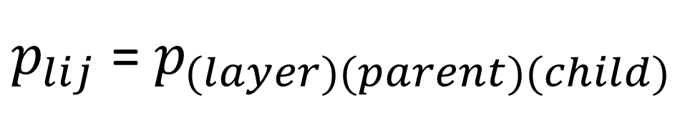
Layer Unit Indexing Scheme
$p_{lij}$ = $p_{(layer)(parent)(child)}$

Slide 9

Context: Feedforward Operation at Layer 1
[Upper Layer Units]
Layer 1
Broadcast to all units
$$x= \left\langle x_{1},x_{2},x_{3},x_{4}\right\rangle$$
Image represented as a vector

Slide 10



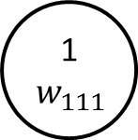
The Feedforward Operation
The elements of the previous layer’s result vector are used as inputs to the children in each layer unit
Forward Pass:
Step 1
Each child has a weight for its associated input vector element
Legend:
Child
(j indexes)
Parent
(i indexes)
1
$$w_{111}$$
$$z_{1}= \left\langle z_{11},{ z}_{12},{ z}_{13},{ z}_{14}\right\rangle$$
Layer Unit
2
3
$$z_{1}= \left\langle z_{11},{ z}_{12},{ z}_{13},{ z}_{14}\right\rangle$$
1
2
3
4
Vector of output from layer 1
Layer 1
1
4
Input Layer
(Layer 0)
$$x= \left\langle x_{1},{ x}_{2},{ x}_{3},{ x}_{4}\right\rangle$$

Slide 11


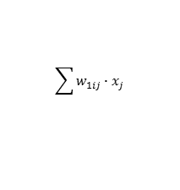


The Feedforward Operation
The child elements apply their weight to their inputs and the parent element receives these results from each of its children elements
Forward Pass:
Step 2
Legend:
Child
(j indexes)
Parent
(i indexes)
A parent element takes a summation of each child element’s output
$$z_{1}= \left\langle z_{11},{ z}_{12},{ z}_{13},{ z}_{14}\right\rangle$$
Layer Unit
$p_{lij}$ = $p_{(layer)(parent)(child)}$
1
2
3
4
2
3
Layer 1
1
$$w_{11j}∙x_{j}$$
1
4
Each green line represents the weight applied to the input for its associated child element
$$\sum{w_{1ij}∙x_{j} }$$
Input Layer
(Layer 0)
$$x= \left\langle x_{1},{ x}_{2},{ x}_{3},{ x}_{4}\right\rangle$$

Slide 12
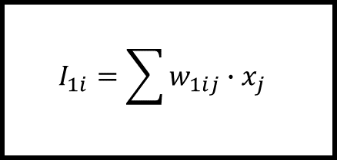

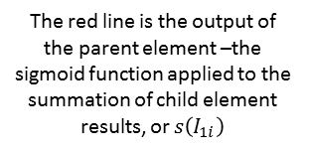

The Feedforward Operation
Inside a Parent Element
The red line is the output of the parent element –the sigmoid function applied to the summation of child element results, or $s\left(I_{1i}\right)$
The sigmoid function – which smooths the output from a layer unit – is part of a parent element’s transfer function
Legend:
Child
(j indexes)
Parent
(i indexes)
$p_{lij}$ = $p_{(layer)(parent)(child)}$
Local Memory
$$s\left(x\right)=σ\left(x\right)=\frac{1}{1+e^{−x}}$$
Local Memory
$$I_{1i}=\sum{w_{1ij}∙x_{j} }$$
A parent element takes a summation of each child element’s output and stores this result in its local memory
Each green line is the result from a child element applying its weight to the previous layers vector element

Slide 13
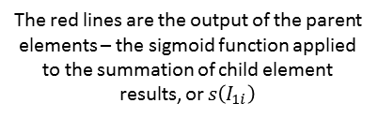

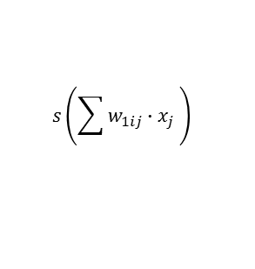
The Feedforward Operation
The parent element from each layer unit contributes its output to the output vector for the whole layer
Forward Pass:
Step 3
Legend:
Child
(j indexes)
Parent
(i indexes)
$$z_{1}= \left\langle z_{11},{ z}_{12},{ z}_{13},{ z}_{14}\right\rangle$$
Layer Unit
1
2
3
4
4
$$z_{1}= \left\langle z_{11},{ z}_{12},{ z}_{13},{ z}_{14}\right\rangle$$
2
Vector of output from layer 1
Layer 1
1
$p_{lij}$ = $p_{(layer)(parent)(child)}$
3
$$s\left(\sum{w_{1ij}∙x_{j} }\right)$$
The red lines are the output of the parent elements – the sigmoid function applied to the summation of child element results, or $s\left(I_{1i}\right)$
Input Layer
(Layer 0)
$$x= \left\langle x_{1},{ x}_{2},{ x}_{3},{ x}_{4}\right\rangle$$

Slide 14
The Backpropagation Operation
Correcting the Error

Slide 15
Context: Backpropagation Operation at Layer 1
Layer 2
Error from layers 2 and 3
Layer 1

Slide 16
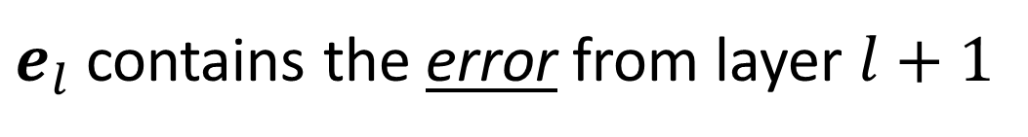
IMPORTANT!
$$z_{l}=e_{l}=\left\langle z_{l1},{ z}_{l2},{ z}_{l3},{ z}_{l4},…,{ z}_{{lM}_{l}}\right\rangle$$
Result vectors for each layer now contain the error propagation from the layer above!
that is…
$e_{l}$ contains the error from layer $l+1$

Slide 17


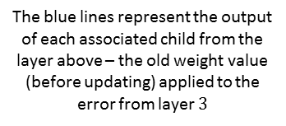
The Backpropagation Operation
The associated children from layer 2 give their error output to the corresponding parent element in a layer unit in layer 1
Backward Pass:
Step 1
Legend:
3
4
3
4
3
4
3
4
3
4
Layer 2
1
2
3
4
5
Child
(j indexes)
Parent
(i indexes)
2
1
2
1
2
1
2
1
2
1
Layer Unit
$p_{lij}$ = $p_{(layer)(parent)(child)}$
$$w_{2i1}^{old}∙e_{2i}$$
1
2
3
1
Layer 1
3
The blue lines represent the output of each associated child from the layer above – the old weight value (before updating) applied to the error from layer $3$
2
4
4

Slide 18
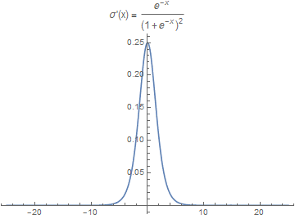
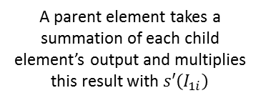


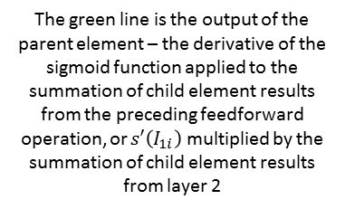
The Backpropagation Operation
Inside a Parent Element
The sigmoid derivative function – which describes how the sigmoid function changes – is also part of a parent element’s transfer function
Each blue line is the result from a child element in layer 2 applying its weight to the error vector from layer 3
Legend:
Child
(j indexes)
Parent
(i indexes)
$p_{lij}$ = $p_{(layer)(parent)(child)}$
$$s′\left(x\right)=σ′\left(x\right)=\frac{e^{−x}}{{(1+e^{−x})}^{2}}$$
Local Memory
$$s′(I_{1i})\sum{w_{2ii}^{old}∙e_{2i}}$$
The green line is the output of the parent element – the derivative of the sigmoid function applied to the summation of child element results from the preceding feedforward operation, or $s′\left(I_{1i}\right)$ multiplied by the summation of child element results from layer 2
A parent element takes a summation of each child element’s output and multiplies this result with $s′\left(I_{1i}\right)$

Slide 19



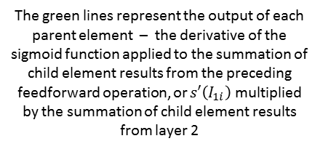

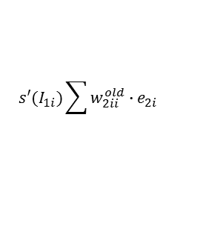
The Backpropagation Operation
$$z_{l}= \left\langle z_{1},{ z}_{2},{ z}_{3},{ z}_{4},…,{ z}_{M_{l}}\right\rangle$$
Each layer unit’s parent element contributes its output to the error vector for the layer above
Backward Pass:
Step 2
Legend:
Child
(j indexes)
Parent
(i indexes)
Layer Unit
1
2
3
4
$$e_{1}= \left\langle e_{11},{ e}_{12},{ e}_{13},{ e}_{14}\right\rangle$$
1
2
3
Vector containing ERROR from layer 2
4
$p_{lij}$ = $p_{(layer)(parent)(child)}$
Layer 1
$$s′(I_{1i})\sum{w_{2ii}^{old}∙e_{2i}}$$
$$e_{1}= \left\langle e_{11},{ e}_{12},{ e}_{13},{ e}_{14}\right\rangle$$
The green lines represent the output of each parent element – the derivative of the sigmoid function applied to the summation of child element results from the preceding feedforward operation, or $s′\left(I_{1i}\right)$ multiplied by the summation of child element results from layer 2
$e_{l}$ is the ERROR from layer 2

Slide 20



The Backpropagation Operation (I)
$${z′}_{N}= \left\langle {y′}_{1},{ y′}_{2},{ y′}_{3},{ y′}_{4},…,{ y′}_{M_{l}}\right\rangle$$
The elements of the error vector from layer 2 are used as inputs to the children in each layer unit
Backward Pass:
Step 3
$e_{1}$ is still the ERROR from layer 2
Legend:
Child
(j indexes)
Parent
(i indexes)
$$e_{1}= \left\langle e_{11},{ e}_{12},{ e}_{13},{ e}_{14}\right\rangle$$
Layer Unit
$$e_{1}= \left\langle e_{11},{ e}_{12},{ e}_{13},{ e}_{14}\right\rangle$$
1
2
3
4
4
Vector containing ERROR from layer 2
Layer 1
1
3
2

Slide 21
The Backpropagation Operation
Weight Updates

Slide 22
Two Cases
Haven’t completed a full batch of training examples
Full batch completed
Update weight based on accumulated error
Accumulate error

Slide 23






The Backpropagation Operation
Inside a Child Element
(Haven’t reached batch_size yet)
After output, the child element updates its delta value – a measure of change
Each child element outputs its old weight value applied to the error from layer 2 BEFORE MODIFYING LOCAL MEMORY
Legend:
Child
(j indexes)
Parent
(i indexes)
Local Memory
Local Memory
Read
$$w_{1ij}^{old}$$
$$∆_{1ij}^{old}$$
$$w_{1ij}^{old}∙e_{1i}$$
Write
$$∆_{1ij}^{new}={∆_{1ij}^{old}+e}_{1i}∙x_{j}$$
$e_{1i}$ is the ERROR from a particular parent element from layer 2
$x$ is the input (from layer 0)

Slide 24








The Backpropagation Operation
Inside a Child Element
(Reached batch_size)
After output, the child element resets its delta value and updates its weight value (due to a full batch’s worth of accumulated error)
Each child element outputs its old weight value applied to the error from layer 2 BEFORE MODIFYING LOCAL MEMORY
$e_{1i}$ is the ERROR from a particular parent element from layer 2
Legend:
Child
(j indexes)
Parent
(i indexes)
Local Memory
Local Memory
Read
$$w_{1ij}^{old}$$
$$∆_{1ij}^{old}$$
$$w_{1ij}^{old}∙e_{1i}$$
Write
$$∆_{1ij}^{new}=e_{1i}∙x_{j}$$
$$w_{lij}^{new}=w_{lij}^{old}+η\frac{∆_{1i}^{old}}{batch_size}$$
$x$ is the input (from layer 0)
$e_{1i}$ is the ERROR from a particular parent element from layer 2

Slide 25
Everything Generalizes to N Layers!

Slide 26



The Backpropagation Neural Network
Element of guess vector comes out, correct answer goes in
Layer units are organized in layers
y₁
y'₁
y₂
y‘₂
y₃
y‘₃
…
y_{m}
y‘_{m}
Layer N
…
Fully interconnected
Layer Unit: contains many processing elements
Layer 2
$$y= \left\langle y_{1},y_{2},y_{3},…,y_{m}\right\rangle$$
Fully interconnected
Vector of probabilities for each class
Layer 1
$$y′= \left\langle {y′}_{1},{y′}_{2},{y′}_{3},…,{y′}_{m}\right\rangle$$
Vector containing correct classification
$$x= \left\langle x_{1},x_{2},…,x_{n}\right\rangle$$
Element to classify

Slide 27

The Generalized Feedforward Operation
Producing a Classification Vector
$$y= \left\langle y_{1},y_{2},y_{3},…,y_{m}\right\rangle$$
Vector of probabilities for each class

Slide 28






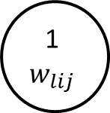


The Feedforward Operation
The elements of the previous layer’s result vector are used as inputs to the children in each layer unit
Forward Pass:
Step 1
Each child has a weight for its associated input vector element
Legend:
Child
(j indexes)
Parent
(i indexes)
1
$$w_{lij}$$
$$z_{l}= \left\langle z_{l1},{ z}_{l2},{ z}_{l3},{ z}_{l4},…,{ z}_{{lM}_{l}}\right\rangle$$
Layer Unit
$M_{l}$= number of layer units in layer $l$
1
2
3
4
…
$$M_{l}$$
2
3
$$z_{l}= \left\langle z_{l1},{ z}_{l2},{ z}_{l3},{ z}_{l4},…,{ z}_{lM_{l}}\right\rangle$$
Layer L
Vector of output from layer $l$
1
$$z_{l−1}= \left\langle z_{(l−1)1},{ z}_{(l−1)2},…,{ z}_{{(l−1)M}_{l}}\right\rangle$$
Vector of output from layer $l−1$
4
…
$$M_{l}$$
Layer L-1
$$z_{l−1}= \left\langle z_{(l−1)1},{ z}_{(l−1)2},{ z}_{(l−1)3},{ z}_{(l−1)4},…,{ z}_{(l−1)M_{l}}\right\rangle$$

Slide 29


The Feedforward Operation
The child elements apply their weight to their inputs and the parent element receives these results from each of its children elements
Forward Pass:
Step 2
Legend:
Child
(j indexes)
Parent
(i indexes)
$$z_{l}= \left\langle z_{l1},{ z}_{l2},{ z}_{l3},{ z}_{l4},…,{ z}_{{lM}_{l}}\right\rangle$$
A parent element takes a summation of each child element’s output
Layer Unit
$M_{l}$= number of layer units in layer $l$
1
2
3
4
…
$$M_{l}$$
2
3
$$z_{l}= \left\langle z_{l1},{ z}_{l2},{ z}_{l3},{ z}_{l4},…,{ z}_{lM_{l}}\right\rangle$$
Layer L
Vector of output from layer $l$
1
$$z_{l−1}= \left\langle z_{(l−1)1},{ z}_{(l−1)2},…,{ z}_{{(l−1)M}_{l}}\right\rangle$$
1
Vector of output from layer $l−1$
4
…
$$M_{l}$$
$$w_{lij}∙z_{\left(l−1\right)j}$$
$$\sum{w_{lij}∙z_{\left(l−1\right)j}}$$
Each green line represents the weight applied to the input for its associated child element
Layer L-1
$$z_{l−1}= \left\langle z_{(l−1)1},{ z}_{(l−1)2},{ z}_{(l−1)3},{ z}_{(l−1)4},…,{ z}_{(l−1)M_{l}}\right\rangle$$

Slide 30
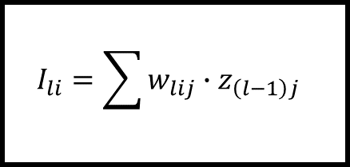
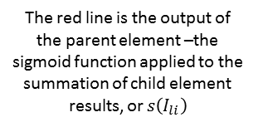
The Feedforward Operation
Inside a Parent Element
The red line is the output of the parent element –the sigmoid function applied to the summation of child element results, or $s\left(I_{li}\right)$
The sigmoid function – which smooths the output from a layer unit – is part of a parent element’s transfer function
Legend:
Child
(j indexes)
Parent
(i indexes)
Local Memory
$$s\left(x\right)=σ\left(x\right)=\frac{1}{1+e^{−x}}$$
Local Memory
$$I_{li}=\sum{w_{lij}∙z_{\left(l−1\right)j} }$$
…
A parent element takes a summation of each child element’s output and stores this result in its local memory
Each green line is the result from a child element applying its weight to the previous layers vector element

Slide 31
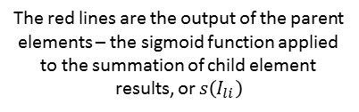

The Feedforward Operation
The parent element from each layer unit contributes its output to the output vector for the whole layer
Forward Pass:
Step 3
Legend:
Child
(j indexes)
Parent
(i indexes)
$$z_{l}= \left\langle z_{l1},{ z}_{l2},{ z}_{l3},{ z}_{l4},…,{ z}_{{lM}_{l}}\right\rangle$$
Layer Unit
$M_{l}$= number of layer units in layer $l$
1
2
3
4
…
$$M_{l}$$
$$z_{l}= \left\langle z_{l1},{ z}_{l2},{ z}_{l3},{ z}_{l4},…,{ z}_{lM_{l}}\right\rangle$$
Layer L
2
3
Vector of output from layer $l$
1
$$z_{l−1}= \left\langle z_{(l−1)1},{ z}_{(l−1)2},…,{ z}_{{(l−1)M}_{l}}\right\rangle$$
Vector of output from layer $l−1$
4
…
$$M_{l}$$
$$s\left(\sum{w_{lij}∙z_{\left(l−1\right)j} }\right)$$
The red lines are the output of the parent elements – the sigmoid function applied to the summation of child element results, or $s\left(I_{li}\right)$
Layer L-1
$$z_{l−1}= \left\langle z_{(l−1)1},{ z}_{(l−1)2},{ z}_{(l−1)3},{ z}_{(l−1)4},…,{ z}_{(l−1)M_{l}}\right\rangle$$

Slide 32
The Generalized Backpropagation Operation
Correcting the Error

Slide 33
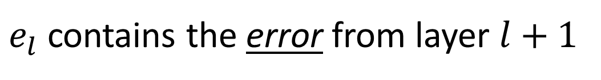
IMPORTANT!
$$e_{l}=z_{l}= \left\langle e_{l1},{ e}_{l2},{ e}_{l3},{ e}_{l4},…,{ e}_{{lM}_{l}}\right\rangle$$
Result vectors for each layer now contain the error propagation from the layer above!
that is…
$e_{l}$ contains the error from layer $l+1$

Slide 34

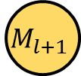


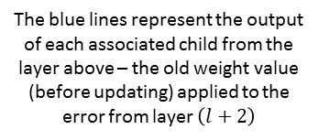
The Backpropagation Operation
$$z_{l}= \left\langle z_{1},{ z}_{2},{ z}_{3},{ z}_{4},…,{ z}_{M_{l}}\right\rangle$$
The associated children from the layer above give their error output to the corresponding parent element in a layer unit in the layer below
Backward Pass:
Step 1
Legend:
4
5
4
5
4
5
4
5
Child
(j indexes)
Parent
(i indexes)
Layer L+1
1
2
3
…
$$M_{l+1}$$
3
…
3
…
3
…
3
…
Layer Unit
2
1
2
1
2
1
2
1
$M_{l}$= number of layer units in layer $l$
$$w_{(l+1)i1}^{old}∙e_{\left(l+1\right)i}$$
1
2
3
2
1
Layer L
4
The blue lines represent the output of each associated child from the layer above – the old weight value (before updating) applied to the error from layer $\left(l+2\right)$
3
…
$$M_{l}$$
4
…
$$M_{l}$$

Slide 35







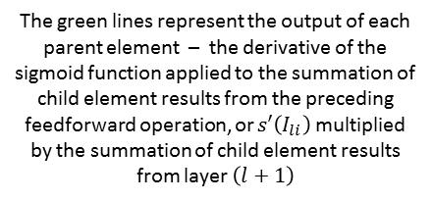
The Backpropagation Operation
$$z_{l}= \left\langle z_{1},{ z}_{2},{ z}_{3},{ z}_{4},…,{ z}_{M_{l}}\right\rangle$$
Each layer unit’s parent element contributes its output to the error vector for the layer above
Backward Pass:
Step 2
Legend:
Child
(j indexes)
Parent
(i indexes)
Layer Unit
$M_{l}$= number of layer units in layer $l$
1
2
3
4
…
$$M_{l}$$
2
3
1
$$e_{l}= \left\langle e_{l1},{ e}_{l2},{ e}_{l3},{ e}_{l4},…,{ e}_{lM_{l}}\right\rangle$$
Vector containing ERROR from layer $\left(l+1\right)$
Layer L
4
…
$$M_{l}$$
$$s′(I_{li})\sum{w_{(l+1)ii}^{old}∙e_{\left(l+1\right)i}}$$
$$e_{l}= \left\langle e_{l1},{ e}_{l2},{ e}_{l3},{ e}_{l4},…,{ e}_{lM_{l}}\right\rangle$$
The green lines represent the output of each parent element – the derivative of the sigmoid function applied to the summation of child element results from the preceding feedforward operation, or $s′\left(I_{li}\right)$ multiplied by the summation of child element results from layer $\left(l+1\right)$
$e_{l}$ is the ERROR from layer $\left(l+1\right)$

Slide 36




The Backpropagation Operation
$${z′}_{N}= \left\langle {y′}_{1},{ y′}_{2},{ y′}_{3},{ y′}_{4},…,{ y′}_{M_{l}}\right\rangle$$
The elements of the error vector from the layer above are used as inputs to the children in each layer unit
Backward Pass:
Step 3
$e_{l}$ is still the ERROR from layer $\left(l+1\right)$
Legend:
Child
(j indexes)
Parent
(i indexes)
$$e_{l}= \left\langle e_{l1},e_{l2},e_{l3},e_{l4},…,e_{lM_{l}}\right\rangle$$
Layer Unit
$M_{l}$= number of layer units in layer $l$
1
2
3
4
…
$$M_{l}$$
$$e_{l}= \left\langle e_{l1},{ e}_{l2},{ e}_{l3},{ e}_{l4},…,{ e}_{lM_{l}}\right\rangle$$
Layer L
2
3
Vector containing ERROR from layer $\left(l+1\right)$
1
4
…
$$M_{l}$$

Slide 37
The Generalized Backpropagation Operation
Weight Updates

Slide 38
Two Cases
Haven’t completed a full batch of training examples
Full batch completed
Update weight based on accumulated error
Accumulate error

Slide 39

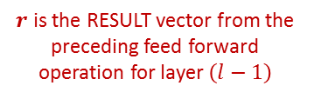

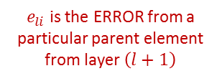


The Backpropagation Operation
Inside a Child Element
(Haven’t reached batch_size yet)
After output, the child element updates its delta value – a measure of change
Each child element outputs its old weight value applied to the error from the previous layer BEFORE MODIFYING LOCAL MEMORY
Legend:
Child
(j indexes)
Parent
(i indexes)
Local Memory
Local Memory
Read
$$w_{lij}^{old}$$
$$∆_{lij}^{old}$$
$$w_{lij}^{old}∙e_{li}$$
Write
$$∆_{lij}^{new}={∆_{lij}^{old}+e}_{li}∙r_{\left(l−1\right)j}$$
$e_{li}$ is the ERROR from a particular parent element from layer $\left(l+1\right)$
$r$ is the RESULT vector from the preceding feed forward operation for layer $\left(l−1\right)$

Slide 40







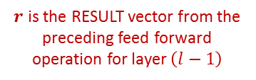
The Backpropagation Operation
Inside a Child Element
(Reached batch_size)
After output, the child element resets its delta value and updates its weight value (due to a full batch’s worth of accumulated error)
Each child element outputs its old weight value applied to the error from the previous layer BEFORE MODIFYING LOCAL MEMORY
$e_{li}$ is the ERROR from a particular parent element from layer $\left(l+1\right)$
Legend:
Child
(j indexes)
Parent
(i indexes)
Local Memory
Local Memory
Read
$$w_{lij}^{old}$$
$$∆_{lij}^{old}$$
$$w_{lij}^{old}∙e_{li}$$
Write
$$∆_{lij}^{new}=e_{li}∙r_{\left(l−1\right)j}$$
$$w_{lij}^{new}=w_{lij}^{old}+α\frac{∆_{li}^{old}}{batch_size}$$
$r$ is the RESULT vector from the preceding feed forward operation for layer $\left(l−1\right)$
$e_{li}$ is the ERROR from a particular parent element from layer $\left(l+1\right)$

