Slide 1
Improving Neural Network Accuracy and Efficiency Through Hyperparameter Variation
MATH/COMP 401
FINAL PRESENTATION FOR SENIOR RESEARCH
DEVIN KING

Slide 2
Background
General:
Image Identification:
Applicable to many areas of technology
Huge market for CNNs
General structure allows for generics (libraries & primitives)
Excellent intersection of computer vision, CNNs, and mathematics (hence the dual capstone)
Identification Tasks are tedious for humans
Computing what a camera “sees” is challenging for sufficiently large images
Classification and Identification can be unified allowing CNNs to shine
Clear security & safety applications
(The mathematics informs the use of the libraries)
Notes:
ANNs are used for financial, medical, and industrial applications. Neural networks can be used to classify information, extrapolate based on trends in high-dimensional data, and make decisions based on input state information. These applications are all useful in the sense that they show their users valuable information about the data they have collected.
-Manufacturing processes
-Economic trends
-Self-driving cars
-Image recognition

Slide 3
Project Description

Slide 4
How do changes in training sets and hyperparameters of a image classification feedforward convolutional neural network affect its training time, memory usage, and percentage of items correctly classified in the final validation set?
What performance benefits do GPUs offer in training time in these networks and how are these benefits achieved?
Notes:
Architecture – number of layers

Slide 5
Project Description
Build an image classification CNN and train on school GPU using test data from Stanford’s IMAGENET.

Slide 6
Project Description
Test a prebuilt CNN using the LeNet and ImageNet NN architectures on GPU and CPU
IMAGENET 2015 Large Scale Visual Recognition Challenge dataset
Ten disjoint image classes
Implement a Neuron & Backpropagation operations on GPU

Slide 7
Project Description
2.2 Experimental Training and Testing by Variation of Hyperparameters:
Eta (Learning Rate)
Number of Epochs (Training Cycles)
Variation of Training Set Size
80/20 split
K-fold cross validation with k = 10

Slide 8
Project Description
2.3 Presentation of Backpropagation Algorithm
Poster/PowerPoint Illustration of Backpropagation algorithm
Derivation of Neilson Text Equations
Example Network with Single Hidden Layer

Slide 9
Fallback Plan
Experimental, Empirical test data for ONE neural network architecture on the CPU/GPU
No k-fold cross-validation for data point averaging
Used pre-baked architecture and auxiliary code to train on the full IMAGENET 2012 challenge dataset
Data collection complete – data points exist for training loss and intermediate data points on accuracy
Completed script and Mathematica document to parse training loss, speedup, and accuracy and produce graphs
Git repository created and all files stored there:
https://github.com/ComposerKing/senior-project

Slide 10
Foundations

Slide 11
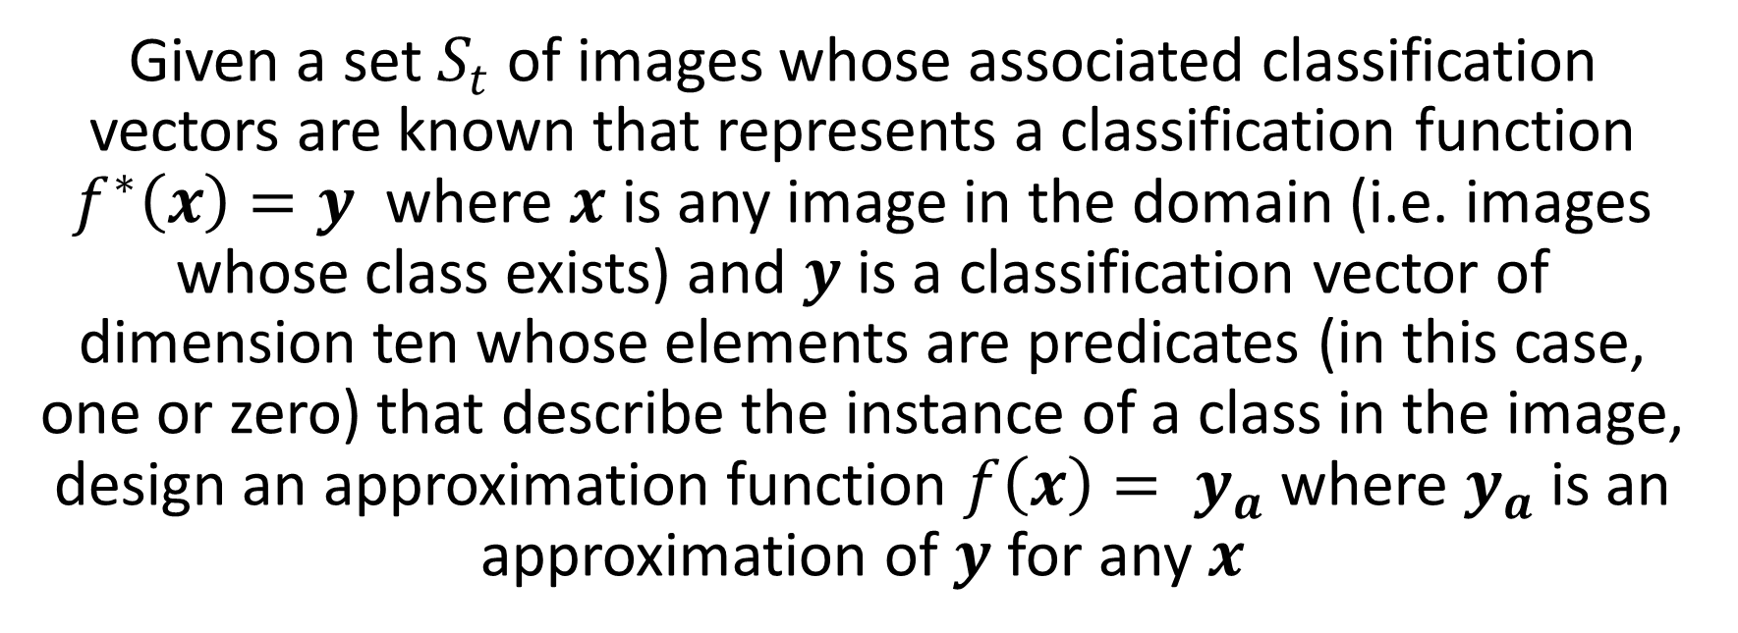
Foundations
THE IMAGE CLASSIFICATION PROBLEM
Given a set $S_{t}$ of images whose associated classification vectors are known that represents a classification function $f^{∗}\left(x\right)=y$ where $x$ is any image in the domain (i.e. images whose class exists) and $y$ is a classification vector of dimension ten whose elements are predicates (in this case, one or zero) that describe the instance of a class in the image, design an approximation function $f\left(x\right)= y_{a}$ where $y_{a}$ is an approximation of $y$ for any $x$

Slide 12
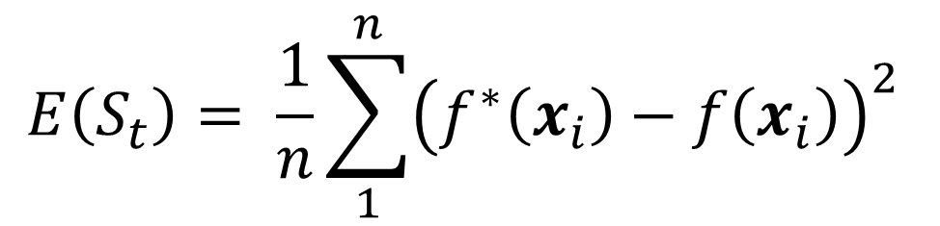
Foundations
$$E\left(S_{t}\right)= \frac{1}{n}\sum_{1}^{n}{{\left(f^{∗}\left(x_{i}\right)−f\left(x_{i}\right)\right)}^{2}}$$

Slide 13
CNNs can Help!
Foundations

Slide 14
CNN Design Process Flow Chart
Foundations
CONSTRUCT NETWORK
TRAIN NETWORK
TEST/BENCHMARK NETWORK
DEPLOY NETWORK

Slide 15

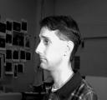

Foundations
CONSTRUCT NETWORK
NEURAL NETWORK
Identify Person
INPUT $x$
Output: $a^{L}(x)$
https://archive.ics.uci.edu/ml/datasets/CMU+Face+Images
Notes:
http://image-net.org/challenges/LSVRC/2015/browse-det-synsets

Slide 16

Foundations
x₁
w₁
w₂
x₂
Output/
Activation
$$threshold$$
…
x_{j}
w_{j}
$$\sum_{j}{w_{j}x_{j}}≡w∙x⇒a\left(x\right)= \left\{\begin{aligned}&0 if w∙x ≤threshold \\ &1 if w∙x >threshold\end{aligned}\right.⇒a\left(x\right)=\left\{\begin{aligned}0 if w∙x+b ≤0 \\ 1 if w∙x+b >0\end{aligned}\right.$$

Slide 17
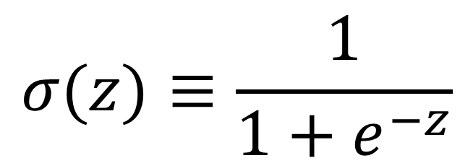
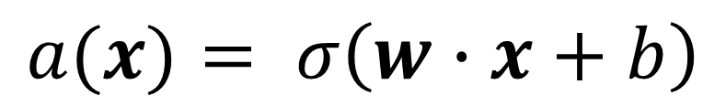
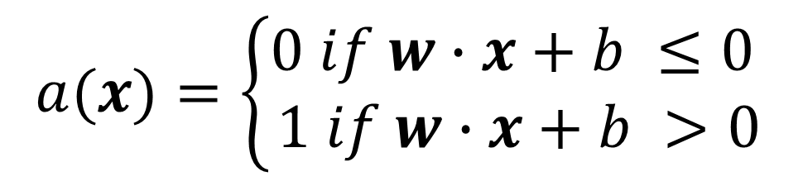
Foundations
$$a(x)=\left\{\begin{aligned}0 if w∙x+b ≤0 \\ 1 if w∙x+b >0\end{aligned}\right.$$
$$σ(z)≡\frac{1}{1+e^{−z}}$$
$$a(x)= σ\left(w∙x+b\right)$$

Slide 18
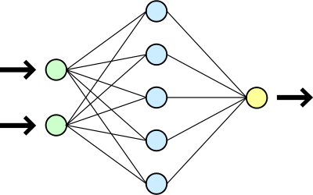
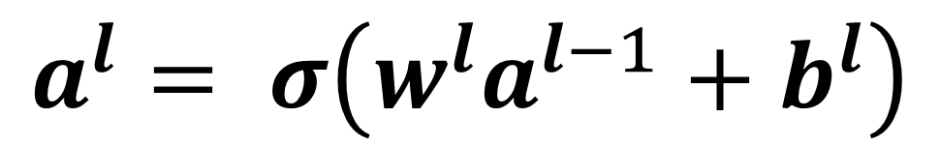



Foundations
$$l$$
$$l−1$$
$$l+1$$
$$a^{l}= σ\left(w^{l}a^{l−1}+b^{l}\right)$$

Slide 19
Foundations
CONSTRUCT NETWORK
W x H x C image
W x H x C input neurons
NEURAL NETWORK
Input Layer
$$a^{L}(x)$$
“Hidden” or “Deep” layers
Output Layer
“Convolution”
Feature Maps
Notes:
-Deep -> Convolutions -> Feature maps

Slide 20
Foundations
CONSTRUCT NETWORK
“Convolution”
Feature Maps
Feature map
Notes:
http://deeplearning.net/tutorial/lenet.html
Biology of visual cortex inspires CNN design
Sparse Connectivity (spatially local correlation), allows for feature detection in any region
Each neuron in the feature map is a “convolution” against a region
Sigmoid function – changes based on application

Slide 21
Foundations
TRAIN NETWORK
Select Learning Rate/Epochs
Select a training set (or subset)
Adjust Weights and Biases
Compute Cost (error)
Feedforward

Slide 22
Foundations
TRAIN NETWORK
$$a^{l}= σ(w^{l}a^{l−1}+b^{l})$$
Adjust Weights and Biases
Compute Cost (error)
Backpropagation

Slide 23
Results

Slide 24
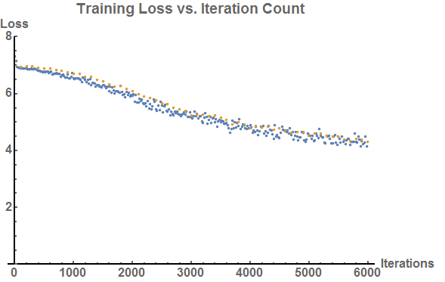
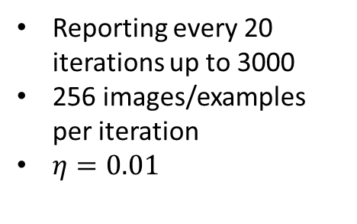
Plateau suggests need for variable eta
Validation Loss
Training Loss
Reporting every 20 iterations up to 3000
256 images/examples per iteration
$η=0.01$

Slide 25
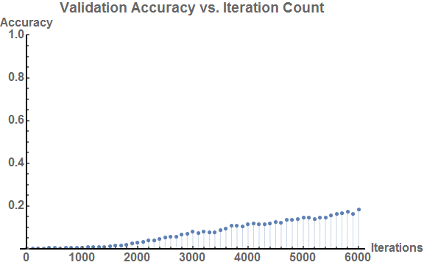
Accuracy (Decimal %)

Slide 26
Resultant Loss and Accuracy for Seven Hyperparameter Configurations
Iteration Count | Learning Rate | Validation Set Accuracy (Decimal %) | Training Set Loss
1000 | 0.01 | 0.0064 | 6.6715
1000 | 0.1 | 0.0012 | 6.9469
1000 | 1.0 | 0.0012 | Divergent
3500 | 0.01 | 0.0866 | 4.9811
3500 | 0.1 | 0.0008 | 6.8678
6000 | 0.01 | 0.183 | 4.2999
6000 | 0.1 | 0.0014 | 7.0222

Slide 27
FIN

