Slide 1
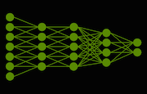
Neural Network Investigation Using Image Recognition
MATH/COMP 401
Checkpoint 3

Slide 2
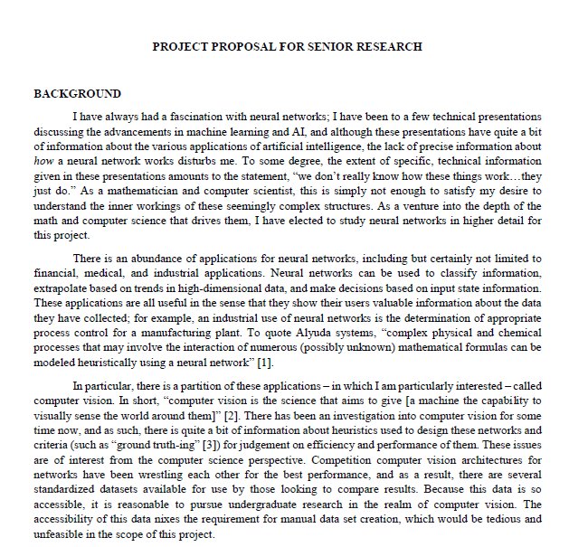
Current Proposal Progress
Background section framed as journey
Neural networks
Applications
Computer Vision
Mathematics?

Slide 3



Background Challenges (MATH)
What constitutes as appropriate background for the mathematics portion?
Avoid specific information about the math used or include it?
How to frame questions without leaning too much toward CompSci? (Inception?)
What particular questions am I answering?
$$\sum_{j}{w_{j}x_{j}}$$
$$Output= \left\{\begin{aligned}0 if w ∙ x+b ≤0 \\ 1 if w ∙ x+b >0\end{aligned}\right.$$

Slide 4
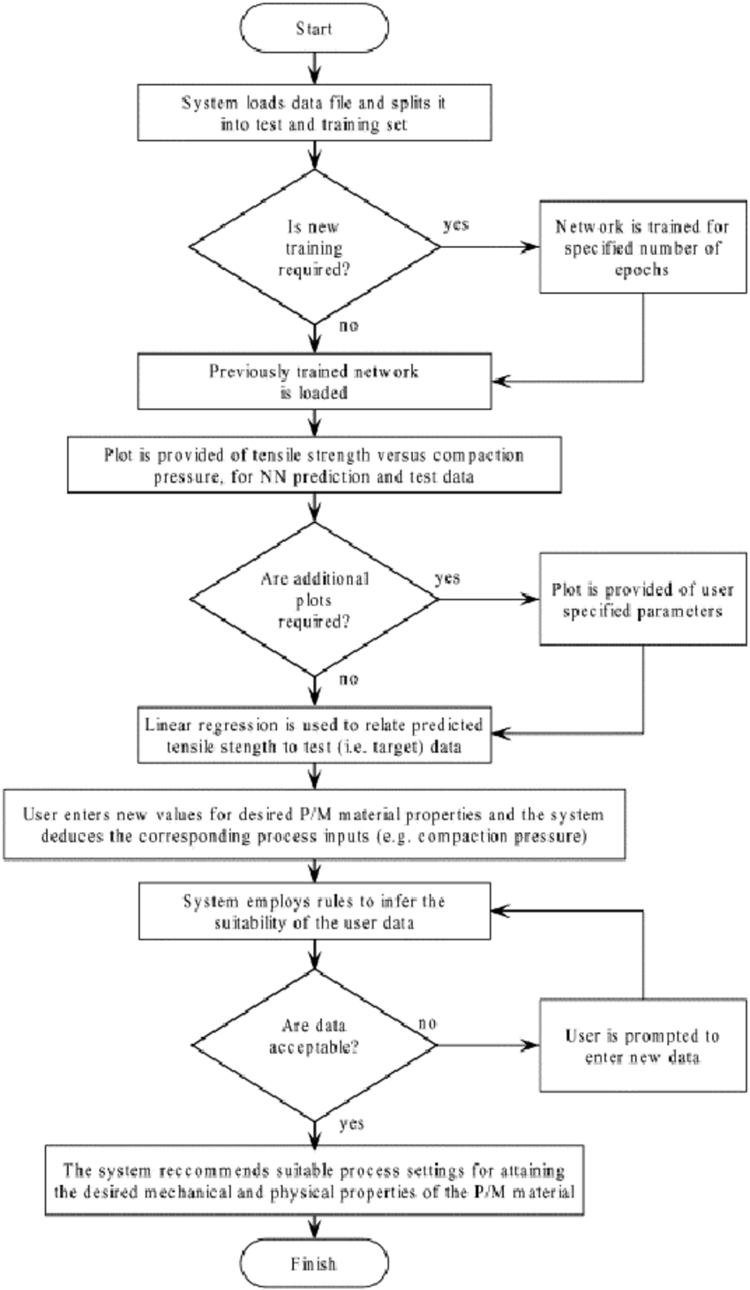
Background Challenges (COMP)
Framework: My journey or the state of the “finished” project?
Historical context somewhat difficult to find/acquire
History of neural networks? Or Computer Vision? Or both?
GPU background?
What particular questions am I answering?

Slide 5

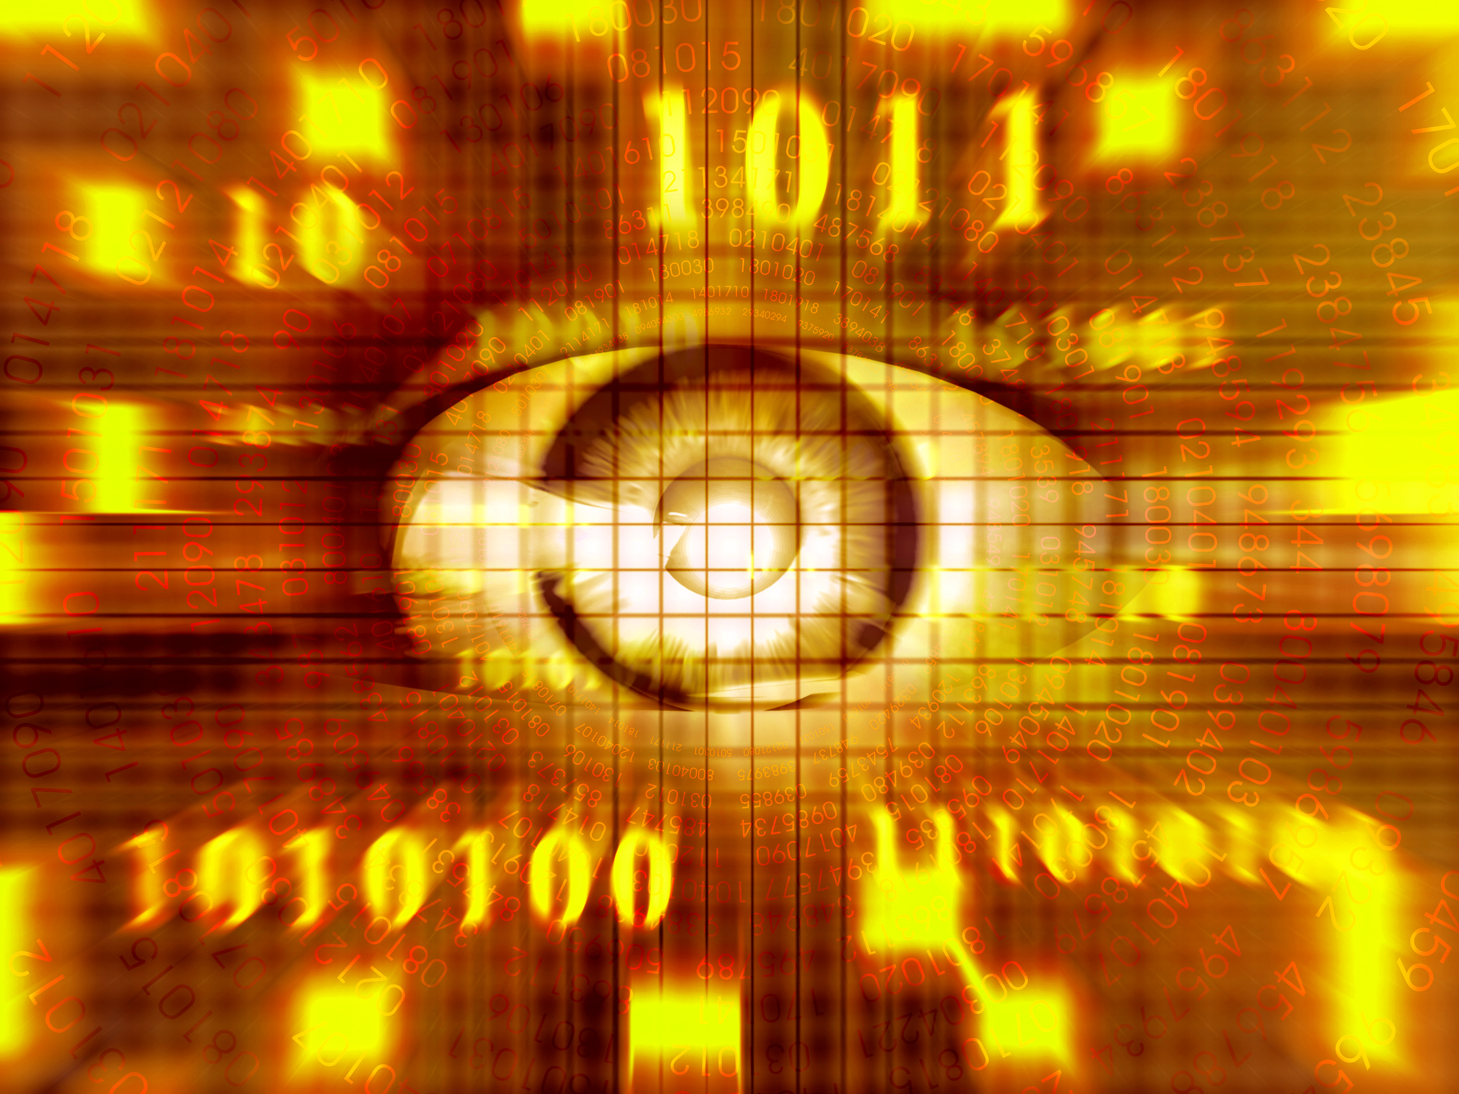
Next Steps
Frame Background information in context of Computer Vision
Image Recognition in particular

Slide 6
Next Steps (II)
Revise framework to use Computer Vision as basis for investigation
Investigate history of Computer Vision
Redo entire introduction and repeat the background investigation again using framework listed above
Research computer vision history and identify where neural networks become relevant
Hone down the definite mathematics background (distinct from computer science background)

Slide 7
Any Pointers (in MATH in particular)?

Slide 8
Current Bibliography
[1] Alyuda Research Company, "Alyuda | Products & Solutions. Decision Making Software," Alyuda Research Company, 2016. [Online]. Available: http://www.alyuda.com/products/forecaster/neural-network-applications.htm. [Accessed 12 September 2016].
[2] The British Machine Vision Association (BMVA), "The British Machine Vision Association (BMVA)," The British Machine Vision Association (BMVA), 2016. [Online]. Available: http://www.bmva.org/aims. [Accessed 12 September 2016].
[3] T. Nitta, Complex-Valued Neural Networks: Utilizing High-Dimensional Parameters, Hershey, Pennsylvania: IGI Global, 2009.
[4] M. Neilsen, "Neural Networks and Deep Learning," January 2016. [Online]. Available: http://neuralnetworksanddeeplearning.com/. [Accessed 04 September 2016].
[5] S. Krig, Computer Vision Metrics: Survey, Taxonomy, and Analysis, New York: Apress, 2014.

