Slide 1
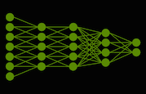
Neural Network Investigation Using Image Recognition
MATH/COMP 401
Checkpoint 4

Slide 2
Background Progress (MATH)
“Dig into the process of building and testing the network and the different algorithms used…What about training? Testing and comparing different networks? Testing for things like over-fitting? Convolutions? These things all have, I think, well established mathematical formulations.”
-Logan Mayfield
Write a book!

Slide 3
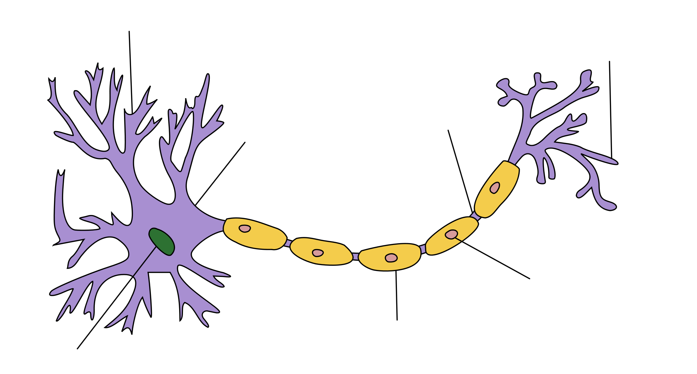
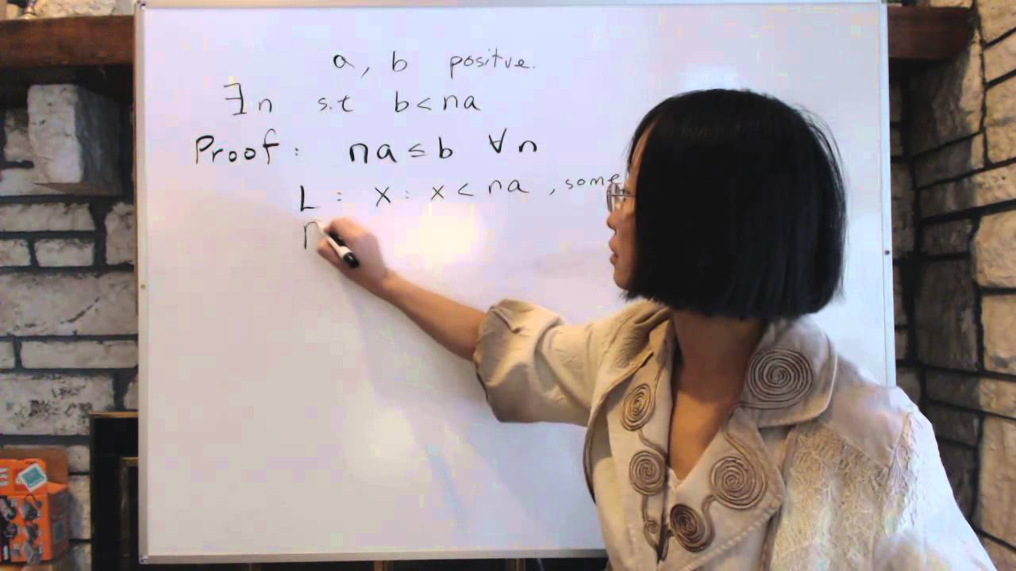
Foundations Progress (MATH)
McCulloch and Pitts [7]
Began analysis of McCulloch and Pitts’s Paper about the “calculus of ideas immanent in nervous activity”
Axiomatic and logical basis to work – physical assumptions are made about the physical properties of the nervous system to allow a calculus to be made.
Notational concerns – what areas of math are being utilized in these papers?
“…the most appropriate symbolism is that of Language II of Carnap (1938), augmented with various notations drawn from Russell and Whitehead (1927), including the Principia conventions for dots” [7].
Math using objects -> Abstract Algebra?
Operations(functors) whose function are dependent on an property P.
Neurons “constructed” as mathematical objects
Assertion functions?

Slide 4

Foundations Progress (MATH) II
McCulloch and Pitts [7]
S(P) (t) . ≡ . P(Kx) . t = x’)
“we shall introduce a functor S,
whose value for a property P is the property which holds of a number when P
holds of its predecessor” [7].

Slide 5

Background Progress (COMP)
Started study into Computer Vision history (reframing of context).
Multitude of information – lack of focus on real concerns?
Algorithms aplenty – Correct framing of context?
Answer to overarching question of how neural networks function and elimination of mystery taking backseat
Concern with reconstruction of 3D structure implicit 2D in represented scene (Szeliski 2010).
Feature Detection and Segmentation areas of Computer Vision focus more precisely on the Image Recognition process
Unclear precisely when these algorithms originated in (Szeliski 2010).

Slide 6
Background Progress (COMP) II
(Szeliski 2010)

Slide 7


Foundations Progress (COMP)
Michael Nielsen [5]
x₁
x₁
output
…
x_{j}
≡
$$Output= \left\{\begin{aligned}0 if w ∙ x+b ≤0 \\ 1 if w ∙ x+b >0\end{aligned}\right.$$
$$\sum_{j}{w_{j}x_{j}}$$

Slide 8
Bibliography
[1] Alyuda Research Company, "Alyuda | Products & Solutions. Decision Making Software," Alyuda Research Company, 2016. [Online]. Available: http://www.alyuda.com/products/forecaster/neural-network-applications.htm. [Accessed 12 September 2016].
[2] The British Machine Vision Association (BMVA), "The British Machine Vision Association (BMVA)," The British Machine Vision Association (BMVA), 2016. [Online]. Available: http://www.bmva.org/aims. [Accessed 12 September 2016].
[3] S. Krig, Computer Vision Metrics: Survey, Taxonomy, and Analysis, New York: Apress, 2014.
[4] T. Nitta, Complex-Valued Neural Networks: Utilizing High-Dimensional Parameters, Hershey, Pennsylvania: IGI Global, 2009.
[5] M. Neilsen, "Neural Networks and Deep Learning," January 2016. [Online]. Available: http://neuralnetworksanddeeplearning.com/. [Accessed 04 September 2016].
[6] J. D. Cowan and D. H. Sharp, "Neural Nets and Artificial Intelligence," Daedalus, vol. 177, no. 1, pp. 85-121, 1988.
[7] W. S. McCulloch and W. Pitts, "A Logical Calculus of the Ideas Immanent in Nervous Activity," Bulletin of Mathematical Biophysics, vol. 5, no. 1, pp. 115-133, 1943.

