Slide 1
Neural Network Investigation Using Image Recognition
MATH/COMP 401
Checkpoint 6

Slide 2
How do changes in training sets and architecture of a feedforward convolutional neural network change its efficiency and performance in the image classification problem?
Notes:
Architecture – number of layers

Slide 3
Relevance
Applicable to many areas of technology
Huge market for CNNs
General structure allows for generics (libraries & primitives)
Excellent intersection of computer vision, CNNs, and mathematics (hence the dual capstone)
Notes:
ANNs are used for financial, medical, and industrial applications. Neural networks can be used to classify information, extrapolate based on trends in high-dimensional data, and make decisions based on input state information. These applications are all useful in the sense that they show their users valuable information about the data they have collected.
-Manufacturing processes
-Economic trends
-Self-driving cars
-Image recognition

Slide 4
Project Goals
Approximate a simple function (periodic or low-order polynomial) using the calculus based structure of a neural network
Build an image classification ANN and train on school GPU using test data from UCI Machine Learning Repository.
(Vary ANN type and repeat to collect data)
The mathematics informs the use of the libraries

Slide 5
Feedforward Neural Networks
Multidimensional Minimization
Notes:
“These models are called feedforward because information flows through the function being evaluated from x, through the intermediate computations used to define f , and finally to the output y.”
These networks do not strictly model brain function but they are loosely based on the calculus derived to describe brain function (i.e. McCollough and Pitts)
(Neilsen 2016)

Slide 6


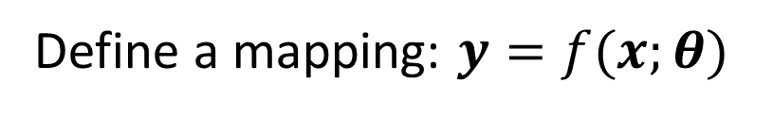
Feedforward Neural Networks
Multidimensional Minimization
Given data points of function f* to approximate, and any $x$ in the domain:
Define a mapping: $y=f(x;θ)$
Find $θ$ such that a cost function E comparing f and f* is minimized
(Neilson 2016)
Notes:
-Select an optimizer
-Cost function (minimize)
-Form of output units (classification problem)
-$θ$ = paramaters of f

Slide 7
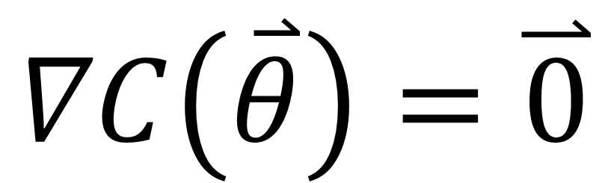
Feedforward Neural Networks (II)
Multidimensional Minimization
System of linear equations
Calculus of Variations
$$∇C\left(\overset{⃑}{θ}\right)=\overset{⃑}{0}$$
Thanks to Michael Sostarecz
(Neilson 2016)
Notes:
Minimization of objective (cost function)

Slide 8
Feedforward Neural Networks (III)
Intuition
“Learnability” is related to smoothness of representative function
Notes:
-backpropagation?

Slide 9
Multidimensional Minimization
General “linear” regression

Slide 10
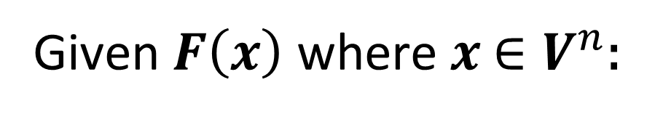
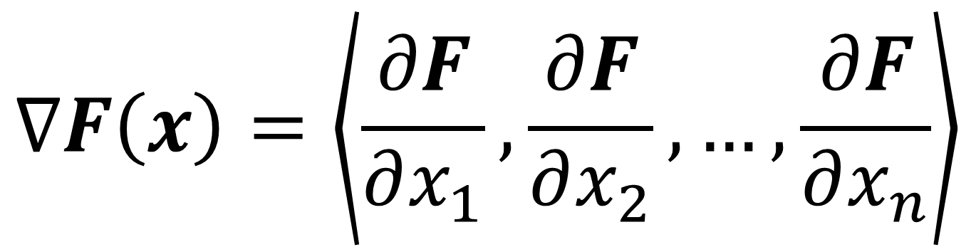
Multidimensional Minimization
Gradient Descent
Given$F\left(x\right)$ where $x$ $∈V^{n}$:
$$∇F\left(x\right)=\left\langle \frac{∂F}{∂x_{1}},\frac{∂F}{∂x_{2}},…,\frac{∂F}{∂x_{n}}\right\rangle$$

Slide 11
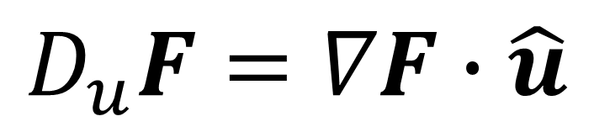
Multidimensional Minimization (II)
Gradient Descent
$$D_{u}F=∇F∙\hat{u}$$

Slide 12
Multidimensional Minimization (II)
Gradient Descent
$$D_{u}F=∇F∙\hat{u}=\left\|∇F\right\|\left\|\hat{u}\right\|\cos{θ}=\left\|∇F\right\|\cos{θ}$$

Slide 13
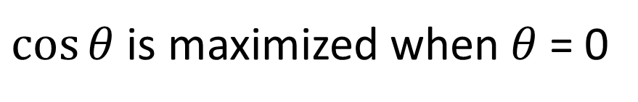
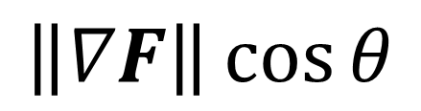
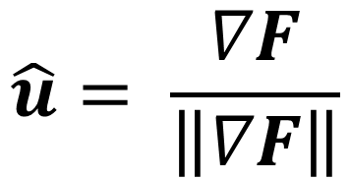
Multidimensional Minimization (II)
Gradient Descent
$$\left\|∇F\right\|\cos{θ}$$
$\cos{θ}$ is maximized when $θ$ = 0
$$\hat{u}= \frac{∇F}{\left\|∇F\right\|}$$

Slide 14
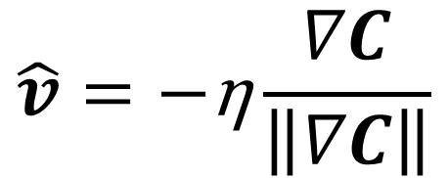
Multidimensional Minimization (III)
Algorithm for “moving down the curve”
$$\hat{v}=\text{−}\text{η}\frac{∇C}{\left\|∇C\right\|}$$
v → v ′ = v − η∇C
(Neilson 2016)
Notes:
Eta(η) = learning rate

Slide 15
Technical Presentation Possibilities
Simple Neural net to approximate a smooth representative function f(x)
Gathering information changes due modification on an pre-built network
Hand minimization of simple smooth gradient (hyperbolic paraboloid?) using steepest descent algorithm

Slide 16
Outstanding Challenges
Calculus of Variations approach to minimization problem
Kernels
Generic mapping of input data
Format of output data
Backpropagation

Slide 17
Next Steps
CUDA review and cuDNN practice
Continue Background Investigation (Perceptrons - Minsky)
Backpropagation study
Convolutions? ‘C’ in CNN
Neilson text digestion
McCollugh and Pitts?

Slide 18
Bibliography
[1] Alyuda Research Company, "Alyuda | Products & Solutions. Decision Making Software," Alyuda Research Company, 2016. [Online]. Available: http://www.alyuda.com/products/forecaster/neural-network-applications.htm. [Accessed 12 September 2016].
[2] The British Machine Vision Association (BMVA), "The British Machine Vision Association (BMVA)," The British Machine Vision Association (BMVA), 2016. [Online]. Available: http://www.bmva.org/aims. [Accessed 12 September 2016].
[3] S. Krig, Computer Vision Metrics: Survey, Taxonomy, and Analysis, New York: Apress, 2014.
[4] T. Nitta, Complex-Valued Neural Networks: Utilizing High-Dimensional Parameters, Hershey, Pennsylvania: IGI Global, 2009.
[5] M. Neilsen, "Neural Networks and Deep Learning," January 2016. [Online]. Available: http://neuralnetworksanddeeplearning.com/. [Accessed 04 September 2016].
[6] J. D. Cowan and D. H. Sharp, "Neural Nets and Artificial Intelligence," Daedalus, vol. 177, no. 1, pp. 85-121, 1988.
[7] W. S. McCulloch and W. Pitts, "A Logical Calculus of the Ideas Immanent in Nervous Activity," Bulletin of Mathematical Biophysics, vol. 5, no. 1, pp. 115-133, 1943.

