Slide 1
Empirical Studies in Parameter Adjustment for an Image Classification Neural Network
Devin King

Slide 2
How do changes in training sets, parameters, and architecture of a feedforward convolutional neural network change its efficiency and performance in the image classification problem?
Notes:
Architecture – number of layers

Slide 3
Relevance
Applicable to many areas of technology
Huge market for CNNs
General structure allows for generics (libraries & primitives)
Excellent intersection of computer vision, CNNs, and mathematics (hence the dual capstone)
Notes:
ANNs are used for financial, medical, and industrial applications. Neural networks can be used to classify information, extrapolate based on trends in high-dimensional data, and make decisions based on input state information. These applications are all useful in the sense that they show their users valuable information about the data they have collected.
-Manufacturing processes
-Economic trends
-Self-driving cars
-Image recognition

Slide 4
Project Goals
Approximate a simple function (periodic or low-order polynomial) using the calculus based structure of a neural network
Build an image classification ANN and train on school GPU using test data from UCI Machine Learning Repository.
(Vary ANN type and repeat to collect data)
The mathematics informs the use of the libraries

Slide 5
Nielson’s Image Classification Network Performance
An empirical study

Slide 6
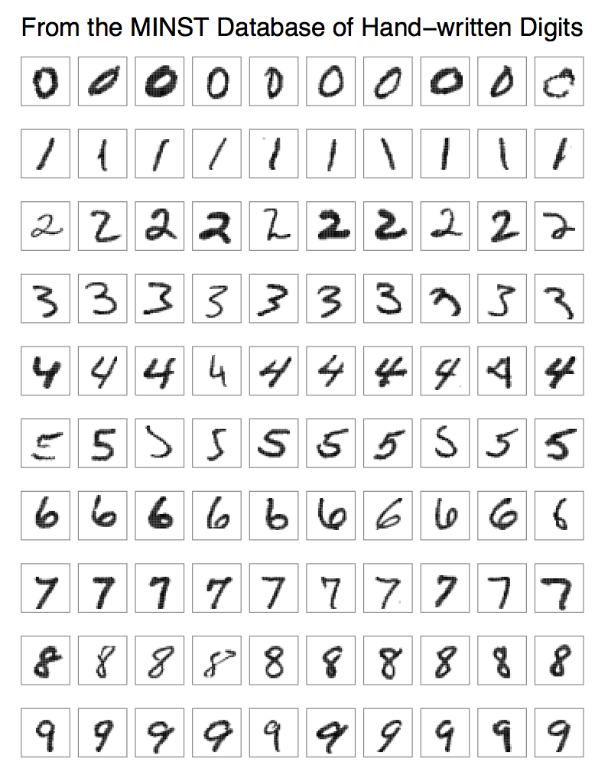
MINST Data Set
Various handwritten digits
Excellent classification studies problem
Neilson’s Network

Slide 7
Parameters for the Classification Network
Number of layers and nodes per layer
Epochs (training cycles)
Eta (Learning Rate)
Relationships?
Notes:
-All are a function of time

Slide 8
Data Collection
Ran on CHURCH (Ubuntu, remote server)
Ran for various parameter combinations
Investigation into performance (Validation set)
Notes:
-Performance:
-Classification score is the number correct out of total on a set that does not intersect with the training set.
-Time is apparent.

Slide 9
Data from Trials
LAYERS | NODES PER LAYER | LEARNING RATE | TRAINING CYCLES | FOREIGN SET PERFORMANCE | TIME (HH:MM:SS)
3 | [784, 11, 10] | 3.0 | 10 | 91.22% | 00:01:34
3 | [784, 11, 10] | 3.0 | 30 | 95.02% | 00:07:13
3 | [784, 30, 10] | 3.0 | 10 | 94.84% | 00:02:27
3 | [784, 30, 10] | 3.0 | 30 | 95.04% | 00:07:14
3 | [784, 100, 10] | 3.0 | 10 | 86.69% | 00:05:06
3 | [784, 100, 10] | 3.0 | 30 | 87.64% | 00:15:32
4 | [784, 20, 12, 10] | 3.0 | 10 | 92.83% | 00:02:25
4 | [784, 20, 12, 10] | 3.0 | 30 | 93.61% | 00:07:21
4 | [784, 50, 30, 10] | 3.0 | 10 | 95.05% | 00:03:45
4 | [784, 50, 30, 10] | 3.0 | 30 | 95.80% | 00:11:07
4 | [784, 90, 50, 10] | 3.0 | 10 | 86.03% | 00:05:30
4 | [784, 90, 50, 10] | 3.0 | 30 | 96.62% | 00:16:32

Slide 10
Data from Trials II
LAYERS | NODES PER LAYER | LEARNING RATE | TRAINING CYCLES | FOREIGN SET PERFORMANCE | TIME (HH:MM:SS)
3 | [784, 11, 10] | 5.0 | 10 | 92.02% | 00:01:32
3 | [784, 11, 10] | 5.0 | 30 | 91.26% | 00:04:35
3 | [784, 30, 10] | 5.0 | 10 | 94.30% | 00:02:27
3 | [784, 30, 10] | 5.0 | 30 | 95.01% | 00:07:16
3 | [784, 100, 10] | 5.0 | 10 | 95.72% | 00:05:19
3 | [784, 100, 10] | 5.0 | 30 | 79.45% | 00:14:02
4 | [784, 20, 12, 10] | 5.0 | 10 | 91.08% | 00:02:27
4 | [784, 20, 12, 10] | 5.0 | 30 | 92.60% | 00:07:18
4 | [784, 50, 30, 10] | 5.0 | 10 | 94.78% | 00:03:47
4 | [784, 50, 30, 10] | 5.0 | 30 | 94.38% | 00:11:24
4 | [784, 90, 50, 10] | 5.0 | 10 | 95.21% | 00:05:34
4 | [784, 90, 50, 10] | 5.0 | 30

Slide 11
Fin

