Slide 1
Neural Network Investigation Using Image Recognition
MATH/COMP 401
Checkpoint 7

Slide 2
How do changes in training sets and architecture of a feedforward convolutional neural network change its efficiency and performance in the image classification problem?
Notes:
Architecture – number of layers

Slide 3
Relevance
Applicable to many areas of technology
Huge market for CNNs
General structure allows for generics (libraries & primitives)
Excellent intersection of computer vision, CNNs, and mathematics (hence the dual capstone)
Notes:
ANNs are used for financial, medical, and industrial applications. Neural networks can be used to classify information, extrapolate based on trends in high-dimensional data, and make decisions based on input state information. These applications are all useful in the sense that they show their users valuable information about the data they have collected.
-Manufacturing processes
-Economic trends
-Self-driving cars
-Image recognition

Slide 4
Project Goals
Approximate a simple function (periodic or low-order polynomial) using the calculus based structure of a neural network
Build an image classification ANN and train on school GPU using test data from UCI Machine Learning Repository.
(Vary ANN type and repeat to collect data)
The mathematics informs the use of the libraries

Slide 5
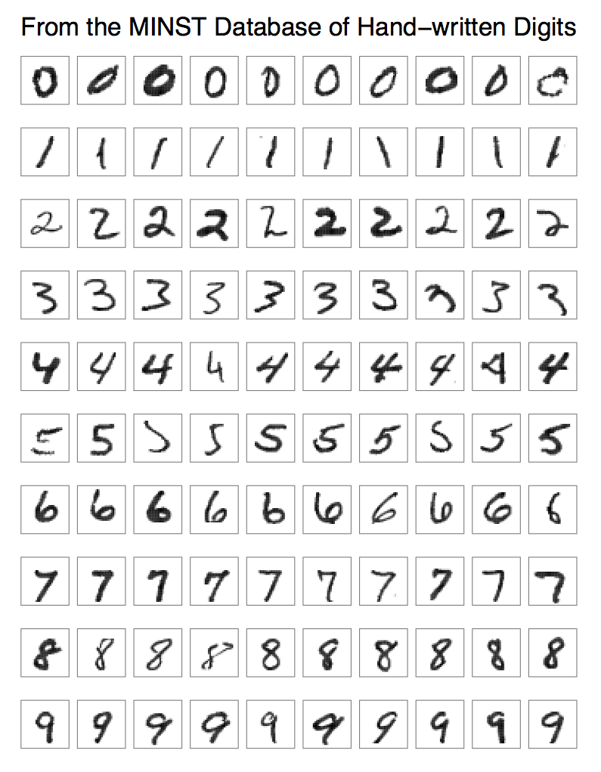
MINST Data Set
Various handwritten digits
Greyscale
28 x 28 image size (784 inputs)
Excellent classification studies problem
Neilson’s Network

Slide 6
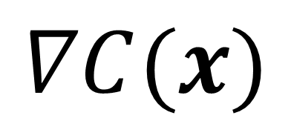
Concrete Perspective
$$∇C(x)$$
self.backprop(x, y)
Notes:
In each epoch,
starts by randomly shuffling the training data, and then partitions it into mini-batches of the appropriate size.
For each mini_batch we apply a single step of gradient descent
-backprop (calculate gradient quickly)
-

Slide 7
Concrete Perspective (II)
Net.SGD(training_data, epochs, mini_batch_size, eta, test_data)
self.update_mini_batch (x, y)
self.backprop(x, y)
Notes:
In each epoch,
starts by randomly shuffling the training data, and then partitions it into mini-batches of the appropriate size.
For each mini_batch we apply a single step of gradient descent
-backprop (calculate gradient quickly)
-

Slide 8
Concrete Perspective (III)

Slide 9
FIN

