Slide 1
Neural Network Investigation Using Image Recognition
MATH/COMP 401
Checkpoint 8

Slide 2
How do changes in training sets, parameters, and architecture of a feedforward convolutional neural network change its classification efficiency and performance in the image classification problem?
Notes:
Architecture – number of layers

Slide 3
Relevance
Applicable to many areas of technology
Huge market for CNNs
General structure allows for generics (libraries & primitives)
Excellent intersection of computer vision, CNNs, and mathematics (hence the dual capstone)
Notes:
ANNs are used for financial, medical, and industrial applications. Neural networks can be used to classify information, extrapolate based on trends in high-dimensional data, and make decisions based on input state information. These applications are all useful in the sense that they show their users valuable information about the data they have collected.
-Manufacturing processes
-Economic trends
-Self-driving cars
-Image recognition

Slide 4
Project Goals
Approximate a simple function (periodic or low-order polynomial) using the calculus based structure of a neural network
Build an image classification ANN and train on school GPU using test data from UCI Machine Learning Repository.
(Vary ANN type and repeat to collect data)
The mathematics informs the use of the libraries

Slide 5
Design Process Flow Chart
CONSTRUCT NETWORK
TRAIN NETWORK
TEST/BENCHMARK NETWORK
DEPLOY NETWORK

Slide 6

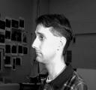



Network Construction (I)
CONSTRUCT NETWORK
NEURAL NETWORK
Identify Person
INPUT $x$
Output: $a^{L}(x)$
https://archive.ics.uci.edu/ml/datasets/CMU+Face+Images
Notes:
http://image-net.org/challenges/LSVRC/2015/browse-det-synsets

Slide 7

Network Construction (II)
CONSTRUCT NETWORK
W x H x C image
W x H x C input neurons
NEURAL NETWORK
Input Layer
$$a^{L}(x)$$
“Hidden” or “Deep” layers
Output Layer
“Convolution”
Feature Maps
Notes:
-Deep -> Convolutions -> Feature maps

Slide 8
Network Training (I)
TRAIN NETWORK
Select Learning Rate/Epochs
Select a training set (or subset)
Adjust Weights and Biases
Compute Cost (error)
Feedforward

Slide 9

Network Training (II)
TRAIN NETWORK
$$a^{l}= σ(w^{l}a^{l−1}+b^{l})$$
Adjust Weights and Biases
Compute Cost (error)
Backpropagation

Slide 10
Testing and Benchmarking
TEST/BENCHMARK NETWORK
Efficiency and Performance – what specifically?
Classification Error Rate (%)
Resources Required (Memory usage and Computation time)
GPU vs CPU memory consumption data points?

Slide 11
Next Steps
“Convolution”
Feature Maps
TEST/BENCHMARK NETWORK
DEPLOY NETWORK
Notes:
http://deeplearning.net/tutorial/lenet.html

Slide 12
Backpropagation
Computing the gradient of the cost function

Slide 13
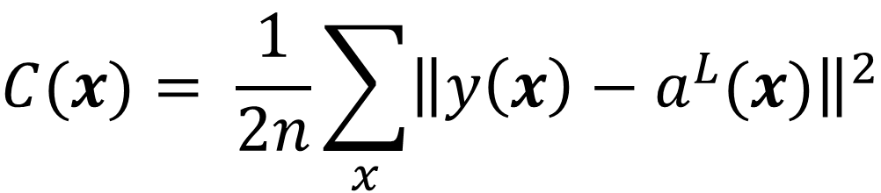
Cost Function
Mean Squared Error (MSE):
$$C(x)= \frac{1}{2n}\sum_{x}{{\left\|y\left(x\right)−a^{L}(x)\right\|}^{2}}$$
(Neilson 2016)
Notes:
- y(x) is the desired output
- al(x) is the actual output (activations)

Slide 14
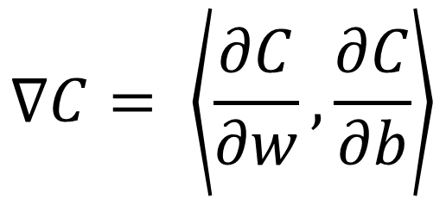

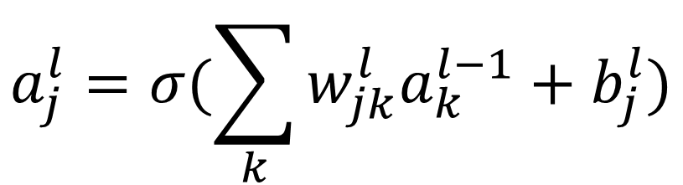
Backpropagation
$$a_{j}^{l}=σ(\sum_{k}{w_{jk}^{l}a_{k}^{l−1}+b_{j}^{l}})$$
$$a^{l}= σ(w^{l}a^{l−1}+b^{l})$$
$$∇C= \left\langle \frac{∂C}{∂w},\frac{∂C}{∂b}\right\rangle$$
(Neilson 2016)
Notes:
“The goal of backpropagation is to compute the partial derivatives of the cost function C with respect to any weight w or bias b in the network”

Slide 15
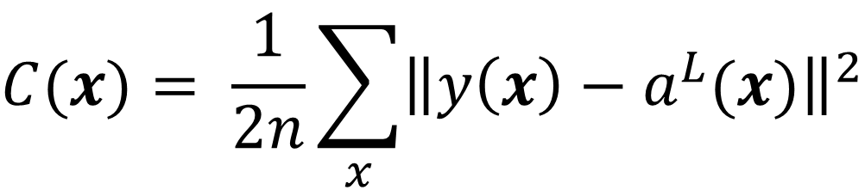
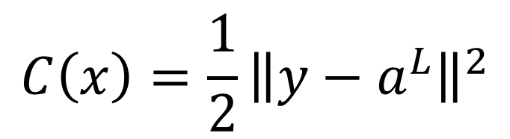
Cost Function
$$C(x)= \frac{1}{2n}\sum_{x}{{\left\|y\left(x\right)−a^{L}(x)\right\|}^{2}}$$
$$C\left(x\right)=\frac{1}{2}{\left\|y−a^{L}\right\|}^{2}$$
(Neilson 2016)
Notes:
Fix input x and make cost a function of the final output layer’s activations

Slide 16
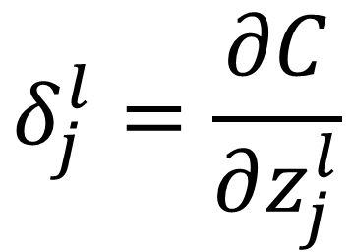
Error (Change) to Neuron Input
$$δ_{j}^{l}=\frac{∂C}{∂z_{j}^{l}}$$
(Neilson 2016)
Notes:
Particular input z to a layer l

Slide 17
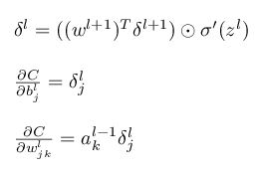
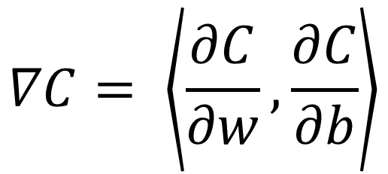
4 Equations
$$∇C= \left\langle \frac{∂C}{∂w},\frac{∂C}{∂b}\right\rangle$$
(Neilson 2016)

Slide 18
FIN

