Slide 1
CONSTRUCT NETWORK
TRAIN NETWORK
TEST/BENCHMARK NETWORK
DEPLOY NETWORK

Slide 2





NEURAL NETWORK
Identify Person
INPUT $x$
Output: $a^{L}(x)$

Slide 3
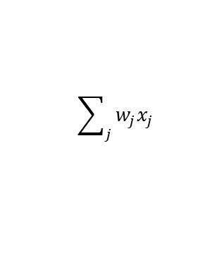
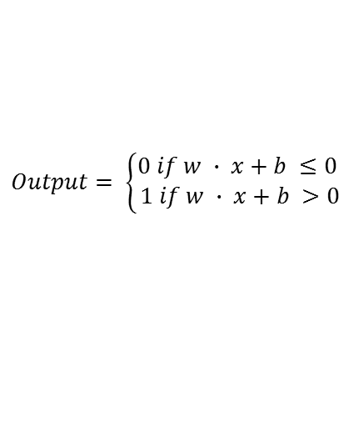
x₁
x₂
output
…
x_{j}
≡
$$\sum_{j}{w_{j}x_{j}}$$
$$Output= \left\{\begin{aligned}0 if w ∙ x+b ≤0 \\ 1 if w ∙ x+b >0\end{aligned}\right.$$

Slide 4
W x H x C image
W x H x C input neurons
NEURAL NETWORK
Input Layer
“Hidden” or “Deep” layers
$$a^{L}(x)$$
Output Layer
“Convolution”
Feature Maps

Slide 5
EPOCH
MINI-BATCH
= TRAINING CYCLE

