Slide 1
INVESTIGATION OF “DEEP” LEARNING CATALYZED BY TOPICS IN COMPUTER VISION
MATH/COMP 401
PROJECT PROPOSAL FOR SENIOR RESEARCH
DEVIN KING

Slide 2
Background
General:
Image Identification:
Applicable to many areas of technology
Huge market for CNNs
General structure allows for generics (libraries & primitives)
Excellent intersection of computer vision, CNNs, and mathematics (hence the dual capstone)
Identification Tasks are tedious for humans
“Computing” what a camera sees is challenging for sufficiently large images
Classification and “Identification” can be unified allowing CNNs to shine
Clear security & safety applications
(The mathematics informs the use of the libraries)
Notes:
ANNs are used for financial, medical, and industrial applications. Neural networks can be used to classify information, extrapolate based on trends in high-dimensional data, and make decisions based on input state information. These applications are all useful in the sense that they show their users valuable information about the data they have collected.
-Manufacturing processes
-Economic trends
-Self-driving cars
-Image recognition

Slide 3
Project Description

Slide 4
How do changes in training sets and hyperparameters of a image classification feedforward convolutional neural network affect its training time, memory usage, and percentage of items correctly classified in the final validation set?
What performance benefits do GPUs offer in training time in these networks?
Notes:
Architecture – number of layers

Slide 5
Project Description
Test a prebuilt CNN using the LeNet and ImageNet NN architectures on GPU and CPU
IMAGENET 2015 Large Scale Visual Recognition Challenge dataset
Ten disjoint image classes
Implement a Neuron & Backpropagation operations on GPU

Slide 6
Project Description
2.2 Experimental Training and Testing by Variation of Hyperparameters:
Eta (Learning Rate)
Number of Epochs (Training Cycles)
Variation of Training Set Size
80/20 split
K-fold cross validation with k = 10

Slide 7
Project Description
2.3 Presentation of Backpropagation Algorithm
Poster/PowerPoint Illustration of Backpropagation algorithm
Derivation of Neilson Text Equations
Example Network with Single Hidden Layer

Slide 8
Project Description
2.4.1 GPU Speed-Up Graphs:
Eta (Learning Rate)
Number of Epochs (Training Cycles)
Variation of Training Set Size
80/20 split
K-fold cross validation with k = 10
Fixed Time Speedup-graph from CPU
2.4.2 GPU Neural Network Primitives:
Implement Single Neuron Layer
Implement a key backpropagation fundamental operation

Slide 9
Project Description
Build an image classification CNN and train on school GPU using test data from Stanford’s IMAGENET.

Slide 10
Foundations

Slide 11
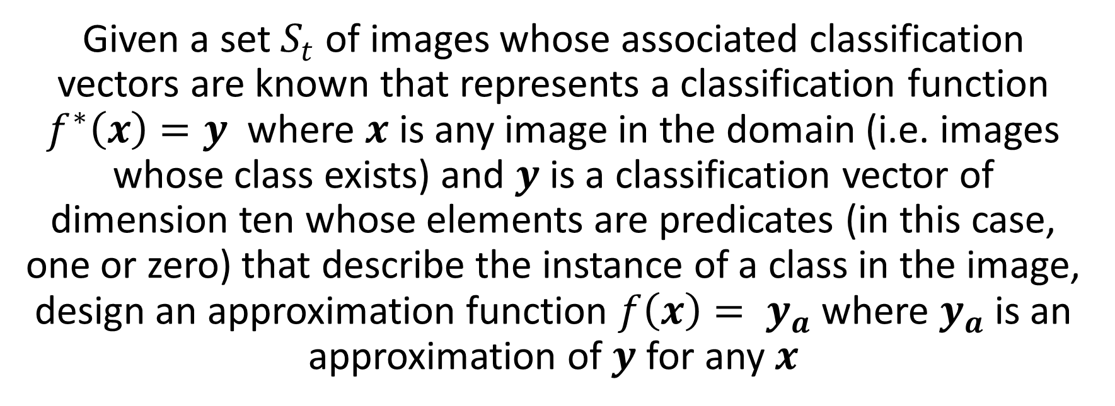
Foundations
THE IMAGE CLASSIFICATION PROBLEM
Given a set $S_{t}$ of images whose associated classification vectors are known that represents a classification function $f^{∗}\left(x\right)=y$ where $x$ is any image in the domain (i.e. images whose class exists) and $y$ is a classification vector of dimension ten whose elements are predicates (in this case, one or zero) that describe the instance of a class in the image, design an approximation function $f\left(x\right)= y_{a}$ where $y_{a}$ is an approximation of $y$ for any $x$

Slide 12
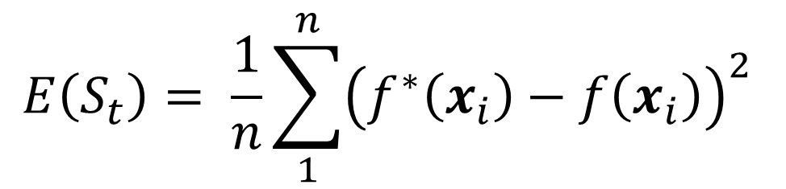
Foundations
$$E\left(S_{t}\right)= \frac{1}{n}\sum_{1}^{n}{{\left(f^{∗}\left(x_{i}\right)−f\left(x_{i}\right)\right)}^{2}}$$

Slide 13
CNNs can Help!
Foundations

Slide 14
CNN Design Process Flow Chart
Foundations
CONSTRUCT NETWORK
TRAIN NETWORK
TEST/BENCHMARK NETWORK
DEPLOY NETWORK

Slide 15
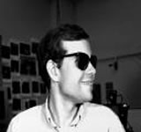
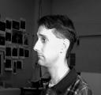
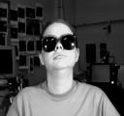
Foundations
CONSTRUCT NETWORK
NEURAL NETWORK
Identify Person
INPUT $x$
Output: $a^{L}(x)$
https://archive.ics.uci.edu/ml/datasets/CMU+Face+Images
Notes:
http://image-net.org/challenges/LSVRC/2015/browse-det-synsets

Slide 16

Foundations
x₁
w₁
w₂
x₂
Output/
Activation
$$threshold$$
…
x_{j}
w_{j}
$$\sum_{j}{w_{j}x_{j}}≡w∙x⇒a\left(x\right)= \left\{\begin{aligned}&0 if w∙x ≤threshold \\ &1 if w∙x >threshold\end{aligned}\right.⇒a\left(x\right)=\left\{\begin{aligned}0 if w∙x+b ≤0 \\ 1 if w∙x+b >0\end{aligned}\right.$$

Slide 17
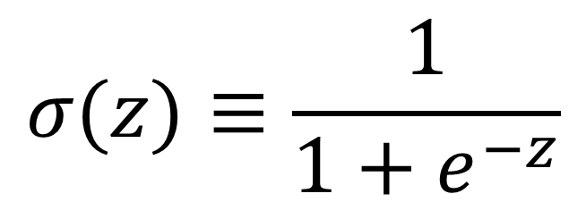
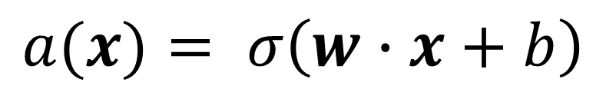
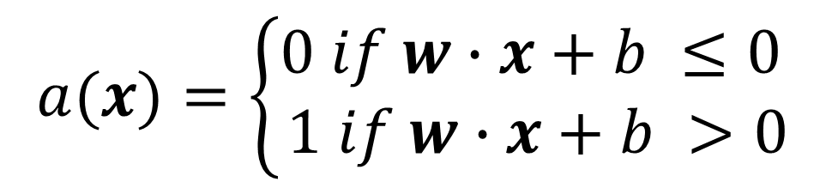
Foundations
$$a(x)=\left\{\begin{aligned}0 if w∙x+b ≤0 \\ 1 if w∙x+b >0\end{aligned}\right.$$
$$σ(z)≡\frac{1}{1+e^{−z}}$$
$$a(x)= σ\left(w∙x+b\right)$$

Slide 18
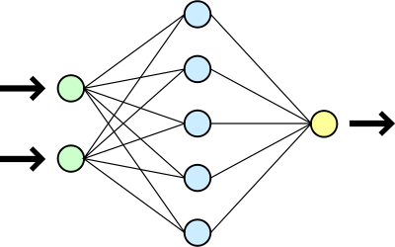
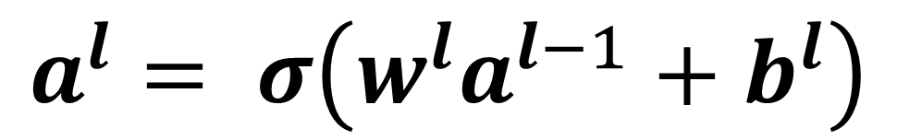



Foundations
$$l$$
$$l−1$$
$$l+1$$
$$a^{l}= σ\left(w^{l}a^{l−1}+b^{l}\right)$$

Slide 19
Foundations
CONSTRUCT NETWORK
W x H x C image
W x H x C input neurons
NEURAL NETWORK
Input Layer
$$a^{L}(x)$$
“Hidden” or “Deep” layers
Output Layer
“Convolution”
Feature Maps
Notes:
-Deep -> Convolutions -> Feature maps

Slide 20
Foundations
CONSTRUCT NETWORK
“Convolution”
Feature Maps
Feature map
Notes:
http://deeplearning.net/tutorial/lenet.html
Biology of visual cortex inspires CNN design
Sparse Connectivity (spatially local correlation), allows for feature detection in any region
Each neuron in the feature map is a “convolution” against a region
Sigmoid function – changes based on application

Slide 21
Foundations
TRAIN NETWORK
Select Learning Rate/Epochs
Select a training set (or subset)
Adjust Weights and Biases
Compute Cost (error)
Feedforward

Slide 22
Foundations
TRAIN NETWORK
$$a^{l}= σ(w^{l}a^{l−1}+b^{l})$$
Adjust Weights and Biases
Compute Cost (error)
Backpropagation

Slide 23
Testing and Benchmarking
TEST/BENCHMARK NETWORK
Russel/Norvig Suggestion:
Collect a large set of examples
Divide it into two disjoint sets: the training set and the test [or validation] set
Apply the learning algorithm [in this case, SGD] to the training set and produce a hypothesis h
Measure the percentage of examples correctly classified by h
Repeat steps 2 to 4 for different sizes of training sets and different randomly selected training sets of each size.
K-fold cross-validation to avoid single observation/data-point

Slide 24
Multidimensional Minimization
Foundations of Backpropogation

Slide 25
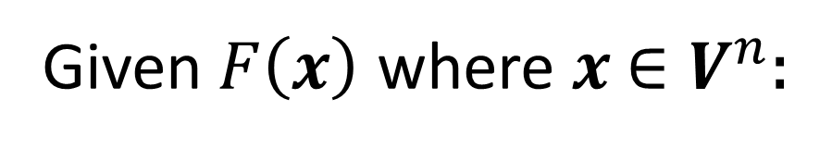
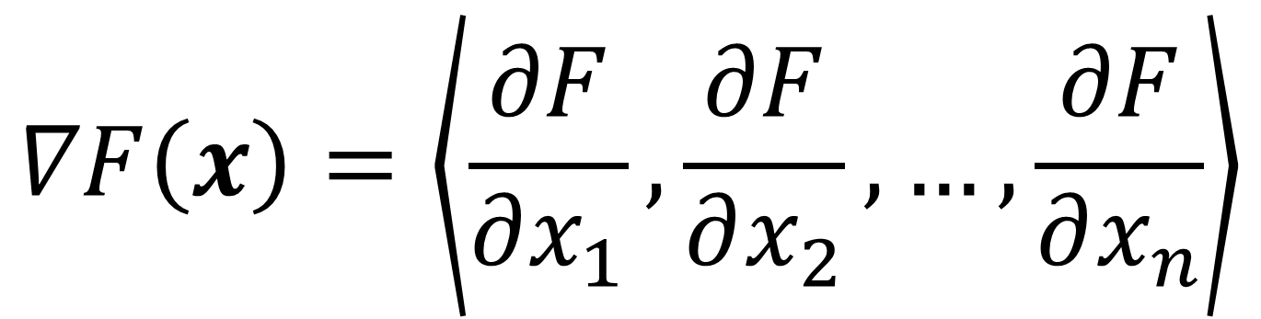
Multidimensional Minimization
Gradient Descent
Given$F\left(x\right)$ where $x$ $∈V^{n}$:
$$∇F\left(x\right)=\left\langle \frac{∂F}{∂x_{1}},\frac{∂F}{∂x_{2}},…,\frac{∂F}{∂x_{n}}\right\rangle$$

Slide 26
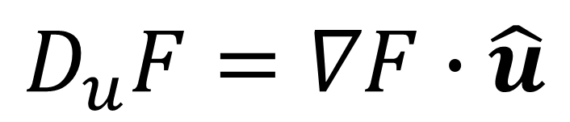
Multidimensional Minimization (II)
Gradient Descent
$$D_{u}F=∇F∙\hat{u}$$

Slide 27
Multidimensional Minimization (II)
Gradient Descent
$$D_{u}F=∇F∙\hat{u}=\left\|∇F\right\|\left\|\hat{u}\right\|\cos{θ}=\left\|∇F\right\|\cos{θ}$$

Slide 28
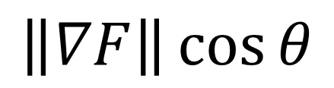
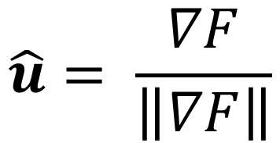
Multidimensional Minimization (II)
Gradient Descent
$$\left\|∇F\right\|\cos{θ}$$
$\cos{θ}$ is maximized when $θ$ = 0
$$\hat{u}= \frac{∇F}{\left\|∇F\right\|}$$

Slide 29
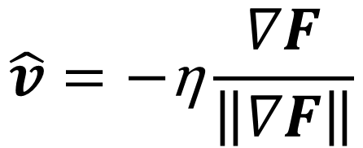
Multidimensional Minimization (III)
Gradient Descent
Algorithm for “moving down the curve”
$$\hat{v}=\text{−}\text{η}\frac{∇F}{\left\|∇F\right\|}$$
v → v ′ = v − η∇F
(Neilson 2016)
Notes:
Eta(η) = learning rate

Slide 30
Implementation Plan
Timeline Constraints:
Construct and run a MINST network from the tutorials
Use the Caffe framework for MINST to determine training cycle time
Restructure timeline to adhere to appropriate constraints:
Is cross-validation feasible?
Hyperparameter variation limits

Slide 31
Timeline (Ideal)
Checkpoint 1:
Construct bash scripts & C++ files for compiling test data from the IMAGENET archive
Checkpoint 2:
Boilerplate Caffe Code (Caffe)
Backpropagation Derivation of final two equations in Neilsen text
Checkpoint 3:
Network Construction (cuDNN and Caffe)
Boilerplate CUDA code for Neuron Construction and Backpropagation Operations
Rough-draft of Backpropagation Explanation using example single layer network
Checkpoint 4:
Network Construction (cuDNN and Caffe):
Neuron & Backpropagation Operation Implementation Progress Check
Checkpoint 5:
Network Testing
Complete Backpropagation Explanation using example single layer network
Checkpoint 6:
Completed Implementation of Neuron and Backpropagation operations
Final Poster and Presentation of Data

Slide 32
Fallback Plan
Implementation Plan
Experimental, Empirical test data for ONE neural network architecture on the CPU
No k-fold cross-validation for data point averaging
Experimental, Empirical test data for THE SAME neural network architecture on the GPU and associated speedup factor
Backpropagation derivation from Neilson

Slide 33
Tools
Implementation Plan
Caffe Deep Learning Framework
NVIDIA CUDA (Compute Unified Device Architecture):
The C++11 Programming Language
GNU/Linux -- Ubuntu

Slide 34
Wrap Up

