Slide 1
BACKPROPAGATION: A METHOD FOR SUPERVISED NEURAL NETWORK LEARNING
MATH/COMP 402
Devin King

Slide 2

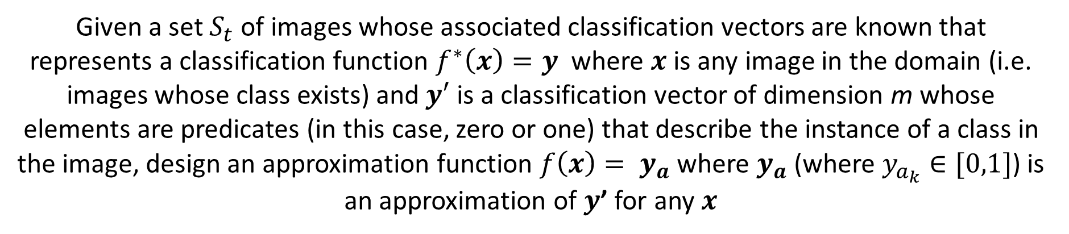

Image Classification Problem
Given a set $S_{t}$ of images whose associated classification vectors are known that represents a classification function $f^{∗}\left(x\right)=y$ where $x$ is any image in the domain (i.e. images whose class exists) and $y′$ is a classification vector of dimension m whose elements are predicates (in this case, zero or one) that describe the instance of a class in the image, design an approximation function $f\left(x\right)= y_{a}$ where $y_{a}$ (where $y_{a_{k}}∈[0,1]$) is an approximation of $y$’ for any $x$
$$x= \left\langle x_{1},x_{2},x_{3},…,x_{n}\right\rangle$$
$$y′= \left\langle {y′}_{1},{y′}_{2},{y′}_{3},…,{y′}_{m}\right\rangle$$

Slide 3



The Backpropagation Neural Network
$$y_{a}= \left\langle y_{1},y_{2},y_{3},…,y_{m}\right\rangle$$
$$y′= \left\langle {y′}_{1},{y′}_{2},{y′}_{3},…,{y′}_{m}\right\rangle$$
y₁
y'₁
y₂
y‘₂
y₃
y‘₃
…
y_{m}
y‘_{m}
Layer N
Fully interconnected
…
Layer 2
Fully interconnected
Layer 1
$$X= \left\langle x_{1},x_{2},…,x_{n}\right\rangle$$

Slide 4
Processing Element (Generalized Perceptron)
i₁
i₂
i₃
…
i_{k}
Act
Utilized local memory and associated (layer-wise) transfer function
Any number of inputs and an activation control
ONE broadcast output
Transfer Function
Local Memory
u₁
…
u₁
u₁
u₁

Slide 5
Inside a Unit – Information Transfer
Planet
Sun
1
2
3
…
n
Layer L+1
1
2
Each processing element has a single output value
…
Layer L
3
4
1
2
3
4
…
Layer L-1

Slide 6




The Feedforward Operation
Forward Pass:
Step 1
Planet
(j indexes)
Sun
(i indexes)
1
$$w_{lij}$$
$$z_{l}= \left\langle z_{1},{ z}_{2},{ z}_{3},{ z}_{4},…,{ z}_{M_{l}}\right\rangle$$
Each processing element has a single output value
$M_{l}$= number of units in layer $l$
1
2
3
4
…
j
Layer L
2
3
1
…
i
4
Layer L-1
$$z_{l−1}= \left\langle z_{1},{ z}_{2},{ z}_{3},{ z}_{4},…,{ z}_{M_{l}}\right\rangle$$

Slide 7


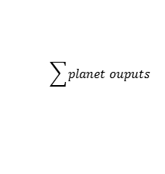
The Feedforward Operation (II)
Forward Pass:
Step 2
Planet
(j indexes)
Sun
(i indexes)
$$z_{l}= \left\langle z_{1},{ z}_{2},{ z}_{3},{ z}_{4},…,{ z}_{M_{l}}\right\rangle$$
Each processing element has a single output value
$M_{l}$= number of units in layer $l$
1
2
3
4
…
j
$$w_{lij}∙z_{\left(l−1\right)j}$$
Layer L
2
3
1
…
$$M_{l}$$
1
4
$$\sum{planet ouputs}$$
Layer L-1
$$z_{l−1}= \left\langle z_{1},{ z}_{2},{ z}_{3},{ z}_{4},…,{ z}_{M_{l}}\right\rangle$$

Slide 8


The Feedforward Operation (IIB)
…
Planet
(j indexes)
Sun
(i indexes)
Each processing element has a single output value
$$s\left(x\right)=σ\left(x\right)=\frac{1}{1+e^{x}}$$
$M_{l}$= number of units in layer $l$
$$I_{li}=\sum{planet ouputs}$$
Local Memory

Slide 9

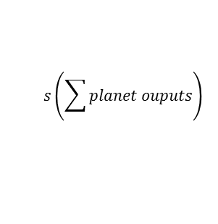
The Feedforward Operation (III)
Forward Pass:
Step 3
Planet
(j indexes)
Sun
(i indexes)
$$z_{l}= \left\langle z_{1},{ z}_{2},{ z}_{3},{ z}_{4},…,{ z}_{M_{l}}\right\rangle$$
Each processing element has a single output value
$M_{l}$= number of units in layer $l$
1
2
3
4
…
j
$$s\left(\sum{planet ouputs}\right)$$
Layer L
2
3
1
…
$$M_{l}$$
4
$$s\left(x\right)=σ\left(x\right)=\frac{1}{1+e^{x}}$$
Layer L-1
$$z_{l−1}= \left\langle z_{1},{ z}_{2},{ z}_{3},{ z}_{4},…,{ z}_{M_{l}}\right\rangle$$

Slide 10

The Backpropagation Operation (I)
$${z′}_{N}= \left\langle {y′}_{1},{ y′}_{2},{ y′}_{3},{ y′}_{4},…,{ y′}_{M_{l}}\right\rangle$$
Backward Pass:
Step 1
Planet
(j indexes)
Sun
(i indexes)
$$z_{l}= \left\langle z_{1},{ z}_{2},{ z}_{3},{ z}_{4},…,{ z}_{M_{l}}\right\rangle$$
Each processing element has a single output value
$M_{l}$= number of units in layer $l$
1
2
3
4
…
j
Layer L
2
3
1
…
$$M_{l}$$
4
Layer L-1
$$z_{l−1}= \left\langle z_{1},{ z}_{2},{ z}_{3},{ z}_{4},…,{ z}_{M_{l}}\right\rangle$$

Slide 11






The Backpropagation Operation (IB)
(Haven’t reached batch_size yet)
Read
Write
Planet
(j indexes)
Sun
(i indexes)
Local Memory
Each processing element has a single output value
$$w_{lij}^{old}$$
$$∆_{lij}^{old}$$
$$w_{lij}^{old}∙z_{li}$$
$M_{l}$= number of units in layer $l$
$$z_{li}=output from sun i of layer l$$
Output value before modifying local memory
i
$$∆_{lij}^{new}={∆_{lij}^{old}+z}_{li}∙z_{\left(l−1\right)j}$$
$$z_{li}$$

Slide 12




The Backpropagation Operation (IC)
(Reached batch_size)
Read
Write
Planet
(j indexes)
Sun
(i indexes)
Local Memory
Each processing element has a single output value
$$w_{lij}^{old}$$
$$∆_{lij}^{old}$$
$$w_{lij}^{old}∙z_{li}$$
$M_{l}$= number of units in layer $l$
$$z_{li}=output from sun i of layer l$$
Output value before modifying local memory
i
$$∆_{lij}^{new}=z_{li}∙z_{\left(l−1\right)j}$$
$$z_{li}$$
$$w_{lij}^{new}=w_{lij}^{old}+\frac{α∆_{li}^{old}}{batch_size}$$

Slide 13





The Backpropagation Operation (II)
$$z_{l}= \left\langle z_{1},{ z}_{2},{ z}_{3},{ z}_{4},…,{ z}_{M_{l}}\right\rangle$$
Backward Pass:
Step 2
4
5
4
5
4
5
4
5
Layer L+1
1
2
3
…
$$M_{l+1}$$
3
…
3
…
3
…
3
…
Planet
(j indexes)
Sun
(i indexes)
2
1
2
1
2
1
2
1
Each processing element has a single output value
$M_{l}$= number of units in layer $l$
1
2
3
$$w_{(l+1)ij}^{old}∙z_{(l+1)i}$$
1
Layer L
4
…
…
$$M_{l}$$
3
2
j
4
Layer L-1
$$z_{l−1}= \left\langle z_{1},{ z}_{2},{ z}_{3},{ z}_{4},…,{ z}_{M_{l}}\right\rangle$$

Slide 14

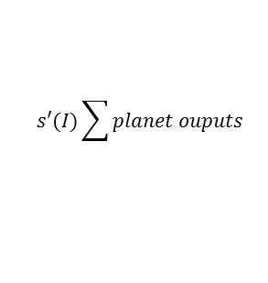

The Backpropagation Operation (III)
$$z_{l}= \left\langle z_{1},{ z}_{2},{ z}_{3},{ z}_{4},…,{ z}_{M_{l}}\right\rangle$$
Backward Pass:
Step 3
Planet
(j indexes)
Sun
(i indexes)
Each processing element has a single output value
1
1
2
3
$M_{l}$= number of units in layer $l$
3
4
…
…
$$M_{l}$$
2
$$s′(I)\sum{planet ouputs}$$
Layer L
j
4
$$z_{l}= \left\langle z_{1},{ z}_{2},{ z}_{3},{ z}_{4},…,{ z}_{M_{l}}\right\rangle$$

Slide 15
The Backpropagation Operation

