Slide 1
BACKPROPAGATION: A METHOD FOR SUPERVISED NEURAL NETWORK LEARNING
MATH/COMP 402
Devin King

Slide 2





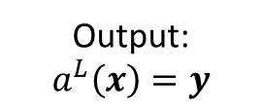

Neural Network - Feedforward
NEURAL NETWORK
Identify Person
Output: $a^{L}\left(x\right)=y$
Input: $x$
$$x= \left\langle x_{1},x_{2},x_{3},…,x_{n}\right\rangle$$
$$y= \left\langle y_{1},y_{2},y_{3},…,y_{m}\right\rangle$$
Image represented as a vector
Vector of probabilities for each person
https://archive.ics.uci.edu/ml/datasets/CMU+Face+Images

Slide 3


Neural Network – Backpropagate
Neural network adjusts itself to account for error in identification
NEURAL NETWORK
Actual
Identity
Input: $y′$
$$y′= \left\langle {y′}_{1},{y′}_{2},{y′}_{3},…,{y′}_{m}\right\rangle$$
Vector containing correct identification

Slide 4



The Backpropagation Neural Network
Element of guess vector comes out, correct answer goes in
Layer units are organized in layers
y₁
y'₁
y₂
y‘₂
y₃
y‘₃
…
y_{m}
y‘_{m}
Layer N
…
Fully interconnected
Layer Unit: contains many processing elements
Layer 2
$$y= \left\langle y_{1},y_{2},y_{3},…,y_{m}\right\rangle$$
Fully interconnected
Vector of probabilities for each person (guess vector)
Layer 1
$$y′= \left\langle {y′}_{1},{y′}_{2},{y′}_{3},…,{y′}_{m}\right\rangle$$
Vector containing correct identification
$$x= \left\langle x_{1},x_{2},…,x_{n}\right\rangle$$
Image represented as a vector

Slide 5
Inside a Layer Unit – Element Hierarchy
Number of children depends on output from previous layer
Parent Processing Element
1
2
3
4
…
Child Processing Element

Slide 6

Inside a Processing Element
Parents and children are unique processing elements!
$$i= \left\langle i,i_{2},i_{3},…,i_{k}\right\rangle$$
Vector of input to processing element
i₁
i₂
i₃
…
i_{k}
Transfer function performs an operation(s) on elements of input vector
Transfer Function
Local memory stores relevant persistent information (such as weights)
Local Memory
u₁
Broadcast output: Single output value is copied to all receiving elements
…
u₁
u₁
u₁

Slide 7

The Feedforward Operation
Producing a Guess Vector
$$y= \left\langle y_{1},y_{2},y_{3},…,y_{m}\right\rangle$$
Vector of probabilities for each person

Slide 8






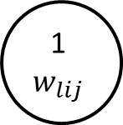



The Feedforward Operation
Information about operations in a step will be in this box
First Look at Diagram Structure
Enunciation of a part of the diagram
Child
(j indexes)
Parent
(i indexes)
1
$$w_{lij}$$
$$z_{l}= \left\langle z_{1},{ z}_{2},{ z}_{3},{ z}_{4},…,{ z}_{M_{l}}\right\rangle$$
Layer Unit
$M_{l}$= number of layer units in layer $l$
1
2
3
4
…
$$M_{l}$$
$$z_{l}= \left\langle z_{1},{ z}_{2},{ z}_{3},{ z}_{4},…,{ z}_{M_{l}}\right\rangle$$
Layer L
2
3
Vector of output from layer $l$
1
…
$$z_{l−1}= \left\langle z_{1},{ z}_{2},{ z}_{3},{ z}_{4},…,{ z}_{M_{l}}\right\rangle$$
$$M_{l}$$
Vector of output from layer $l−1$
4
Layer L-1
$$z_{l−1}= \left\langle z_{1},{ z}_{2},{ z}_{3},{ z}_{4},…,{ z}_{M_{l}}\right\rangle$$

Slide 9

The Feedforward Operation
The elements of the previous layer’s result vector are used as inputs to the children in each layer unit
Forward Pass:
Step 1
Each child has a weight for its associated input vector element
Child
(j indexes)
Parent
(i indexes)
1
$$w_{lij}$$
$$z_{l}= \left\langle z_{1},{ z}_{2},{ z}_{3},{ z}_{4},…,{ z}_{M_{l}}\right\rangle$$
Layer Unit
$M_{l}$= number of layer units in layer $l$
1
2
3
4
…
$$M_{l}$$
$$z_{l}= \left\langle z_{1},{ z}_{2},{ z}_{3},{ z}_{4},…,{ z}_{M_{l}}\right\rangle$$
Layer L
2
3
Vector of output from layer $l$
1
…
$$z_{l−1}= \left\langle z_{1},{ z}_{2},{ z}_{3},{ z}_{4},…,{ z}_{M_{l}}\right\rangle$$
$$M_{l}$$
Vector of output from layer $l−1$
4
Layer L-1
$$z_{l−1}= \left\langle z_{1},{ z}_{2},{ z}_{3},{ z}_{4},…,{ z}_{M_{l}}\right\rangle$$

Slide 10


The Feedforward Operation (II)
The child elements apply their weight to their inputs and the parent element receives these results from each of its children elements
Forward Pass:
Step 2
Child
(j indexes)
Parent
(i indexes)
$$z_{l}= \left\langle z_{1},{ z}_{2},{ z}_{3},{ z}_{4},…,{ z}_{M_{l}}\right\rangle$$
A parent element takes a summation of each child element’s output
Layer Unit
$M_{l}$= number of layer units in layer $l$
1
2
3
4
…
$$M_{l}$$
$$z_{l}= \left\langle z_{1},{ z}_{2},{ z}_{3},{ z}_{4},…,{ z}_{M_{l}}\right\rangle$$
Layer L
2
3
Vector of output from layer $l$
1
…
$$z_{l−1}= \left\langle z_{1},{ z}_{2},{ z}_{3},{ z}_{4},…,{ z}_{M_{l}}\right\rangle$$
$$M_{l}$$
1
Vector of output from layer $l−1$
4
$$w_{lij}∙z_{\left(l−1\right)j}$$
$$\sum{w_{lij}∙z_{\left(l−1\right)j}}$$
Each green line represents the weight applied to the input for its associated child element
Layer L-1
$$z_{l−1}= \left\langle z_{1},{ z}_{2},{ z}_{3},{ z}_{4},…,{ z}_{M_{l}}\right\rangle$$

Slide 11
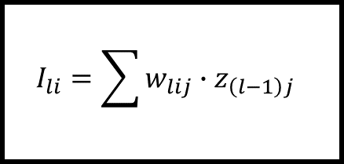
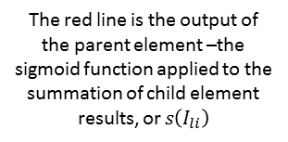

The Feedforward Operation (IIB)
Child
(j indexes)
Parent
(i indexes)
Inside a Parent Element
Each green line is the result from a child element applying its weight to the previous layers vector element
The sigmoid function – which smooths the output from a layer unit – is part of a parent element’s transfer function
…
Local Memory
$$s\left(x\right)=σ\left(x\right)=\frac{1}{1+e^{−x}}$$
Local Memory
$$I_{li}=\sum{w_{lij}∙z_{\left(l−1\right)j} }$$
The red line is the output of the parent element –the sigmoid function applied to the summation of child element results, or $s\left(I_{li}\right)$
A parent element takes a summation of each child element’s output and stores this result in its local memory

Slide 12
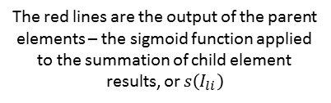

The Feedforward Operation (III)
The parent element from each layer unit contributes its output to the output vector for the whole layer
Forward Pass:
Step 3
Child
(j indexes)
Parent
(i indexes)
$$z_{l}= \left\langle z_{1},{ z}_{2},{ z}_{3},{ z}_{4},…,{ z}_{M_{l}}\right\rangle$$
Layer Unit
$M_{l}$= number of layer units in layer $l$
1
2
3
4
…
$$M_{l}$$
$$z_{l}= \left\langle z_{1},{ z}_{2},{ z}_{3},{ z}_{4},…,{ z}_{M_{l}}\right\rangle$$
Layer L
2
3
Vector of output from layer $l$
1
…
$$z_{l−1}= \left\langle z_{1},{ z}_{2},{ z}_{3},{ z}_{4},…,{ z}_{M_{l}}\right\rangle$$
$$M_{l}$$
Vector of output from layer $l−1$
4
$$s\left(\sum{w_{lij}∙z_{\left(l−1\right)j} }\right)$$
The red lines are the output of the parent elements – the sigmoid function applied to the summation of child element results, or $s\left(I_{li}\right)$
Layer L-1
$$z_{l−1}= \left\langle z_{1},{ z}_{2},{ z}_{3},{ z}_{4},…,{ z}_{M_{l}}\right\rangle$$

Slide 13
The Backpropagation Operation
Correcting the Error

Slide 14
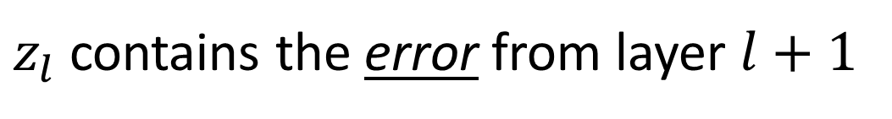

IMPORTANT!
$$z_{l}= \left\langle z_{1},{ z}_{2},{ z}_{3},{ z}_{4},…,{ z}_{M_{l}}\right\rangle$$
Result vectors for each layer now contain the error propagation from the layer above!
that is…
$z_{l}$ contains the error from layer $l+1$

Slide 15

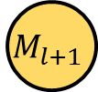



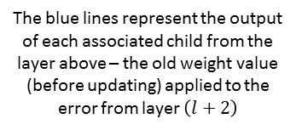
The Backpropagation Operation (I)
$$z_{l}= \left\langle z_{1},{ z}_{2},{ z}_{3},{ z}_{4},…,{ z}_{M_{l}}\right\rangle$$
The associated children from the layer above give their error output to the corresponding parent element in a layer unit in the layer below
Backward Pass:
Step 1
4
5
4
5
4
5
4
5
Child
(j indexes)
Parent
(i indexes)
Layer L+1
1
2
3
…
$$M_{l+1}$$
3
…
3
…
3
…
3
…
Layer Unit
2
1
2
1
2
1
2
1
$M_{l}$= number of layer units in layer $l$
$$w_{(l+1)i1}^{old}∙z_{\left(l+1\right)i}$$
1
2
3
2
1
Layer L
4
…
$$M_{l}$$
The blue lines represent the output of each associated child from the layer above – the old weight value (before updating) applied to the error from layer $\left(l+2\right)$
3
…
$$M_{l}$$
4

Slide 16
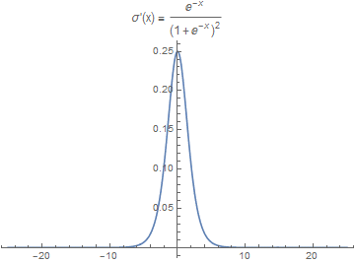
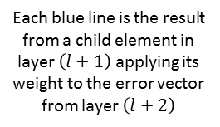

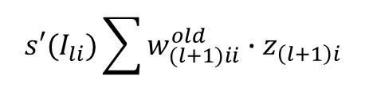
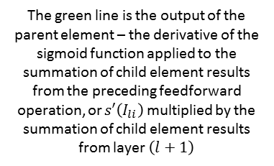
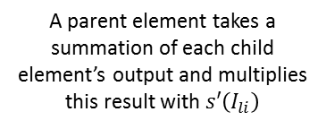
The Backpropagation Operation(IIB)
Child
(j indexes)
Parent
(i indexes)
Inside a Parent Element
The sigmoid derivative function – which describes how the sigmoid function changes – is part of a parent element’s transfer function
…
Each blue line is the result from a child element in layer $\left(l+1\right)$applying its weight to the error vector from layer $\left(l+2\right)$
$$s′\left(x\right)=σ′\left(x\right)=\frac{e^{−x}}{{(1+e^{−x})}^{2}}$$
Local Memory
$$s′(I_{li})\sum{w_{(l+1)ii}^{old}∙z_{\left(l+1\right)i}}$$
The green line is the output of the parent element – the derivative of the sigmoid function applied to the summation of child element results from the preceding feedforward operation, or $s′\left(I_{li}\right)$ multiplied by the summation of child element results from layer $\left(l+1\right)$
A parent element takes a summation of each child element’s output and multiplies this result with $s′\left(I_{li}\right)$

Slide 17







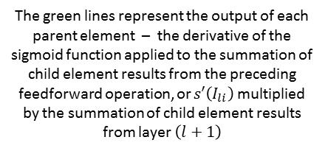
The Backpropagation Operation (III)
$$z_{l}= \left\langle z_{1},{ z}_{2},{ z}_{3},{ z}_{4},…,{ z}_{M_{l}}\right\rangle$$
Each layer unit’s parent element contributes its output to the error vector for the layer above
Backward Pass:
Step 2
Child
(j indexes)
Parent
(i indexes)
Layer Unit
$M_{l}$= number of layer units in layer $l$
1
2
3
4
…
$$M_{l}$$
2
3
1
$$z_{l}= \left\langle z_{1},{ z}_{2},{ z}_{3},{ z}_{4},…,{ z}_{M_{l}}\right\rangle$$
…
$$M_{l}$$
Vector containing ERROR from layer $\left(l+1\right)$
Layer L
4
$$s′(I_{li})\sum{w_{(l+1)ii}^{old}∙z_{\left(l+1\right)i}}$$
$$z_{l}= \left\langle z_{1},{ z}_{2},{ z}_{3},{ z}_{4},…,{ z}_{M_{l}}\right\rangle$$
The green lines represent the output of each parent element – the derivative of the sigmoid function applied to the summation of child element results from the preceding feedforward operation, or $s′\left(I_{li}\right)$ multiplied by the summation of child element results from layer $\left(l+1\right)$
$z_{l}$ is the ERROR from layer $\left(l+1\right)$

Slide 18



The Backpropagation Operation (I)
$${z′}_{N}= \left\langle {y′}_{1},{ y′}_{2},{ y′}_{3},{ y′}_{4},…,{ y′}_{M_{l}}\right\rangle$$
The elements of the error vector from the layer above are used as inputs to the children in each layer unit
Backward Pass:
Step 3
$z_{l}$ is still the ERROR from layer $\left(l+1\right)$
Child
(j indexes)
Parent
(i indexes)
$$z_{l}= \left\langle z_{1},{ z}_{2},{ z}_{3},{ z}_{4},…,{ z}_{M_{l}}\right\rangle$$
Layer Unit
$M_{l}$= number of layer units in layer $l$
1
2
3
4
…
j
$$z_{l}= \left\langle z_{1},{ z}_{2},{ z}_{3},{ z}_{4},…,{ z}_{M_{l}}\right\rangle$$
Layer L
2
3
Vector containing ERROR from layer $\left(l+1\right)$
1
…
$$M_{l}$$
4

Slide 19

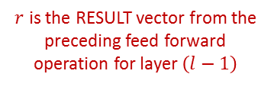

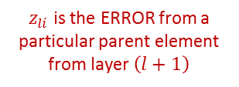


The Backpropagation Operation (IB)
Inside a Child Element
(Haven’t reached batch_size yet)
After output, the child element updates its delta value – a measure of change
Each child element outputs its old weight value applied to the error from the previous layer BEFORE MODIFYING LOCAL MEMORY
Child
(j indexes)
Parent
(i indexes)
Local Memory
Local Memory
Read
$$w_{lij}^{old}$$
$$∆_{lij}^{old}$$
$$w_{lij}^{old}∙z_{li}$$
Write
$$∆_{lij}^{new}={∆_{lij}^{old}+z}_{li}∙r_{\left(l−1\right)j}$$
$z_{li}$ is the ERROR from a particular parent element from layer $\left(l+1\right)$
$r$ is the RESULT vector from the preceding feed forward operation for layer $\left(l−1\right)$

Slide 20







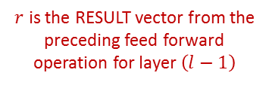
The Backpropagation Operation (IC)
Inside a Child Element
(Reached batch_size)
After output, the child element resets its delta value and updates its weight value (due to a full batch’s worth of accumulated error)
Each child element outputs its old weight value applied to the error from the previous layer BEFORE MODIFYING LOCAL MEMORY
$z_{li}$ is the ERROR from a particular parent element from layer $\left(l+1\right)$
Child
(j indexes)
Parent
(i indexes)
Local Memory
Local Memory
Read
$$w_{lij}^{old}$$
$$∆_{lij}^{old}$$
$$w_{lij}^{old}∙z_{li}$$
Write
$$∆_{lij}^{new}=z_{li}∙r_{\left(l−1\right)j}$$
$$w_{lij}^{new}=w_{lij}^{old}+α\frac{∆_{li}^{old}}{batch_size}$$
$r$ is the RESULT vector from the preceding feed forward operation for layer $\left(l−1\right)$
$z_{li}$ is the ERROR from a particular parent element from layer $\left(l+1\right)$

Slide 21
The Backpropagation Operation

