Slide 1
INVESTIGATION OF “DEEP” LEARNING CATALYZED BY TOPICS IN COMPUTER VISION
MATH/COMP 402
Checkpoint 4

Slide 2
How do changes in training sets and hyperparameters of a image classification feedforward convolutional neural network affect its training time, memory usage, and percentage of items correctly classified in the final validation set?
What performance benefits do GPUs offer in training time in these networks?
Notes:
Architecture – number of layers

Slide 3
Project Description
Test a prebuilt CNN using the LeNet and ImageNet NN architectures on GPU and CPU
IMAGENET 2015 Large Scale Visual Recognition Challenge dataset
Ten disjoint image classes
Implement a Neuron & Backpropagation operations on GPU

Slide 4
Project Description
2.2 Experimental Training and Testing by Variation of Hyperparameters:
Eta (Learning Rate)
Number of Epochs (Training Cycles)
Variation of Training Set Size
80/20 split
K-fold cross validation with k = 10

Slide 5
Project Description
2.3 Presentation of Backpropagation Algorithm
Poster/PowerPoint Illustration of Backpropagation algorithm
Derivation of Neilson Text Equations
Example Network with Single Hidden Layer

Slide 6
Checkpoint 4 Progress (COMP)
Checkpoint 4
Caffe Network Testing Progress
Neuron & Backpropagation Operation Implementation Progress Check
Spending time collecting data for backup plan rather than fixating on instantiation described in proposal
May not use abbreviated 2015 dataset…established procedure for prebaked net + time to modify dataset import/conversion code may not produce results needed for scholars day in a reasonable timeframe (extra if time)

Slide 7
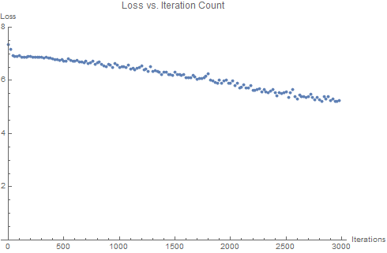
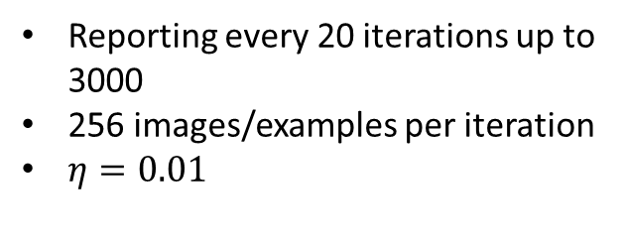

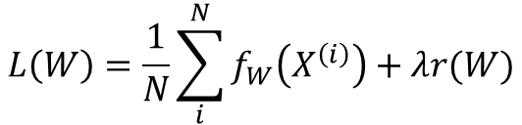
Checkpoint 4 Progress (COMP)
Checkpoint 4 - II
Caffe Network Testing Progress
Neuron & Backpropagation Operation Implementation Progress Check
Loss vs. Iteration Count
Reporting every 20 iterations up to 3000
256 images/examples per iteration
$η=0.01$
$$L\left(W\right)=\frac{1}{N}\sum_{i}^{N}{f_{W}\left(X^{\left(i\right)}\right)+λr(W)}$$
where $f_{W}\left(X^{\left(i\right)}\right)$ is the loss for example $i$
Notes:
loss13.txt

Slide 8
Checkpoint 4 Progress (COMP)
Checkpoint 4 - III
Caffe Network Testing Progress
Neuron & Backpropagation Operation Implementation Progress Check
Backpropagation:
Full Neurocomputing Text acquired – 1 section identical to 1989 survey
Complex Fourier analysis required for proof of generalized delta rule learning law
Complicated analogies to sun and planets – unclear construction of network
Textbook gave no extra insight here – will have to work from what is given and dissect pseudocode in book
R. Hecht-Nielsen, "Theory of the backpropagation neural network," International 1989 Joint Conference on Neural Networks, Washington, DC, USA, 1989, pp. 593-605 vol.1.

Slide 9
Checkpoint 4 Progress (COMP)
Checkpoint 4 - IV
Caffe Network Testing Progress
Neuron & Backpropagation Operation Implementation Progress Check
y₁
y'₁
y₂
y‘₂
y₃
y‘₃
y_{n}
y‘_{n}
Layer N
Layer 2
Layer 1
X₁
X₂
X_{n}

Slide 10
Checkpoint 4 Progress (COMP)
Checkpoint 4 - V
Caffe Network Testing Progress
Neuron & Backpropagation Operation Implementation Progress Check
i₁
i₂
i₃
…
i_{k}
Act
Utilized local memory and associated (layer-wise) transfer function
Any number of inputs and an activation control
ONE broadcast output
Transfer Function
Local Memory
…
u₁
u₂
u_{m}

Slide 11
Checkpoint 4 Progress (COMP)
Checkpoint 4 - VI
Caffe Network Testing Progress
Neuron & Backpropagation Operation Implementation Progress Check
Planet
Sun
1
2
3
…
n
Layer L+1
1
2
Each element has a single output value
…
Layer L
3
4
1
2
3
4
…
Layer L-1

Slide 12
Checkpoint 4 Progress (COMP)
Fallback Plan
Experimental, Empirical test data for ONE neural network architecture on the CPU/GPU
No k-fold cross-validation for data point averaging
Currently using pre-baked architecture and auxiliary code to train on the full IMAGENET 2012 challenge dataset
Data collection now in full progress after protobuff file modification and recalibration of network hyperparameters (CPU taking long time)
Script to parse relevant info from logs is complete (and somewhat involved)

Slide 13
FIN

Slide 14
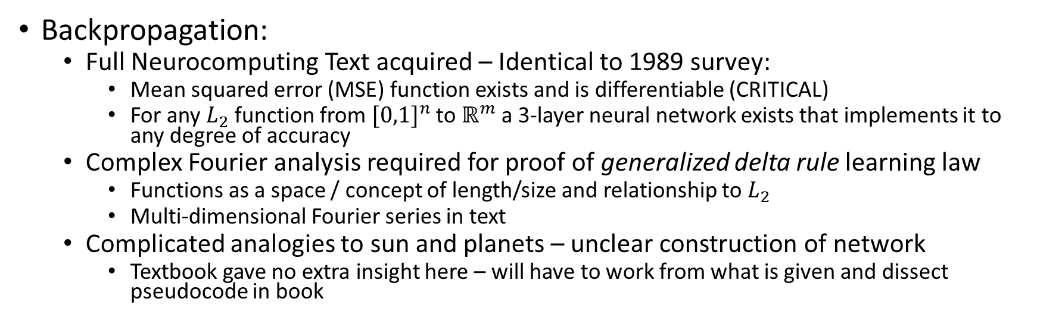
Checkpoint 4 Progress (MATH)
Checkpoint 4 - II
Caffe Network Testing Progress
Neuron & Backpropagation Operation Implementation Progress Check
Backpropagation:
Full Neurocomputing Text acquired – Identical to 1989 survey:
Mean squared error (MSE) function exists and is differentiable (CRITICAL)
For any $L_{2}$ function from ${[0,1]}^{n}$ to $ℝ^{m}$a 3-layer neural network exists that implements it to any degree of accuracy
Complex Fourier analysis required for proof of generalized delta rule learning law
Functions as a space / concept of length/size and relationship to $L_{2}$
Multi-dimensional Fourier series in text
Complicated analogies to sun and planets – unclear construction of network
Textbook gave no extra insight here – will have to work from what is given and dissect pseudocode in book
R. Hecht-Nielsen, "Theory of the backpropagation neural network," International 1989 Joint Conference on Neural Networks, Washington, DC, USA, 1989, pp. 593-605 vol.1.

Slide 15
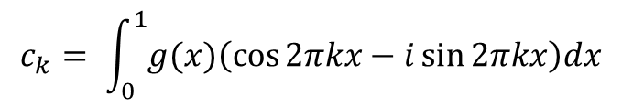
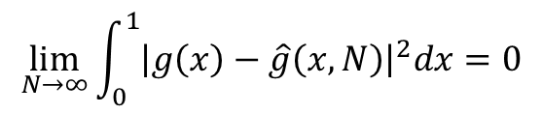
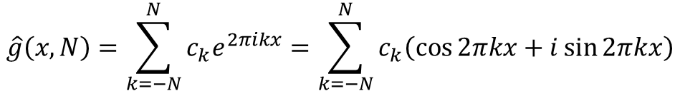


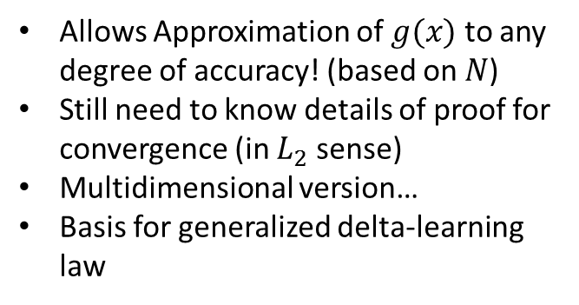
Checkpoint 4 Progress (MATH)
Checkpoint 4 - III
Given an $L_{2}$ function $g(x)$ where$x∈\left[0,1\right]$, consider the complex Fourier approximation:
Allows Approximation of $g(x)$ to any degree of accuracy! (based on $N$)
Still need to know details of proof for convergence (in $L_{2}$ sense)
Multidimensional version…
Basis for generalized delta-learning law
$$\hat{g}\left(x,N\right)=\sum_{k=−N}^{N}{c_{k}e^{2πikx}}=\sum_{k=−N}^{N}{c_{k}\left(\cos{2πkx}+i\sin{2πkx}\right)}$$
Euler formulas give (over unit interval):
$$c_{k}= \int_{0}^{1}{g(x)\left(\cos{2πkx}−i\sin{2πkx}\right)dx}$$
Approximation converges to $g\left(x\right)$:
$$\lim_{N→∞}{\int_{0}^{1}{{\left|g\left(x\right)−\hat{g}\left(x,N\right)\right|}^{2}dx}=0}$$

