Slide 1





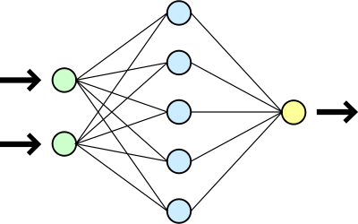
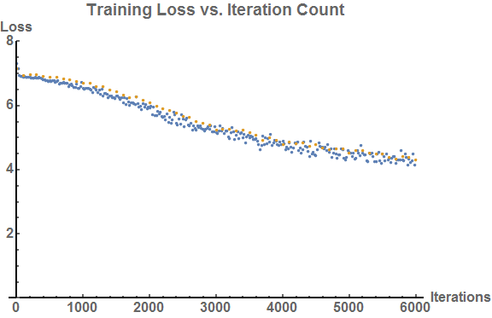
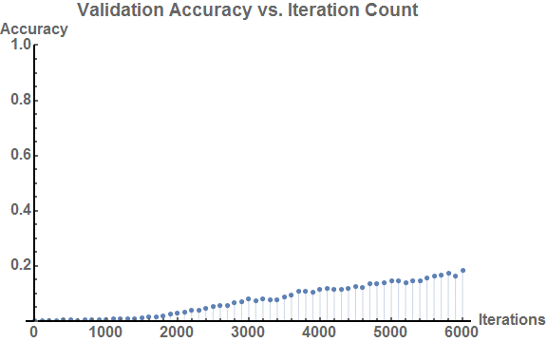
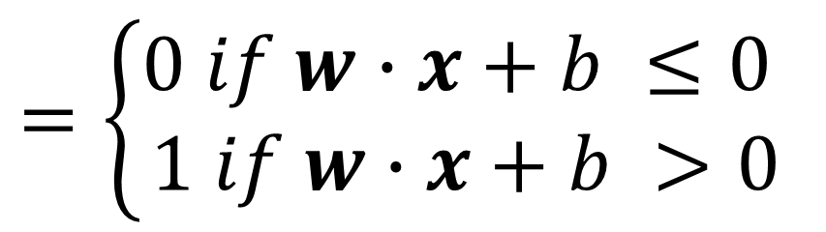

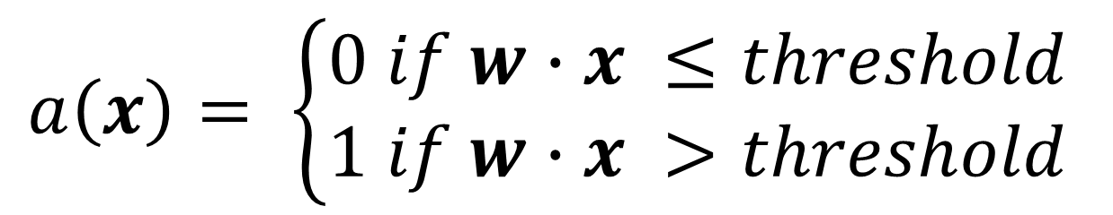


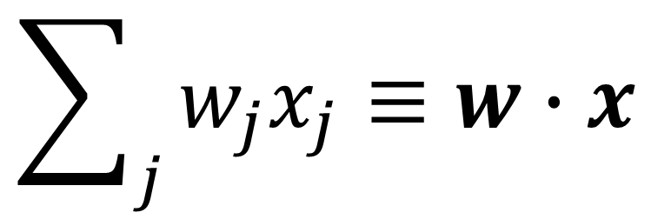
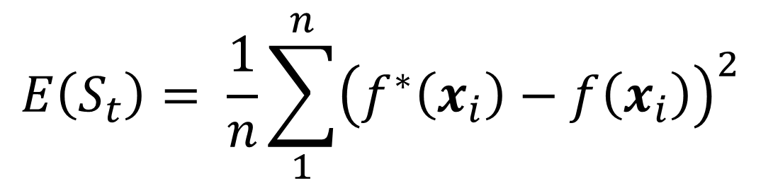
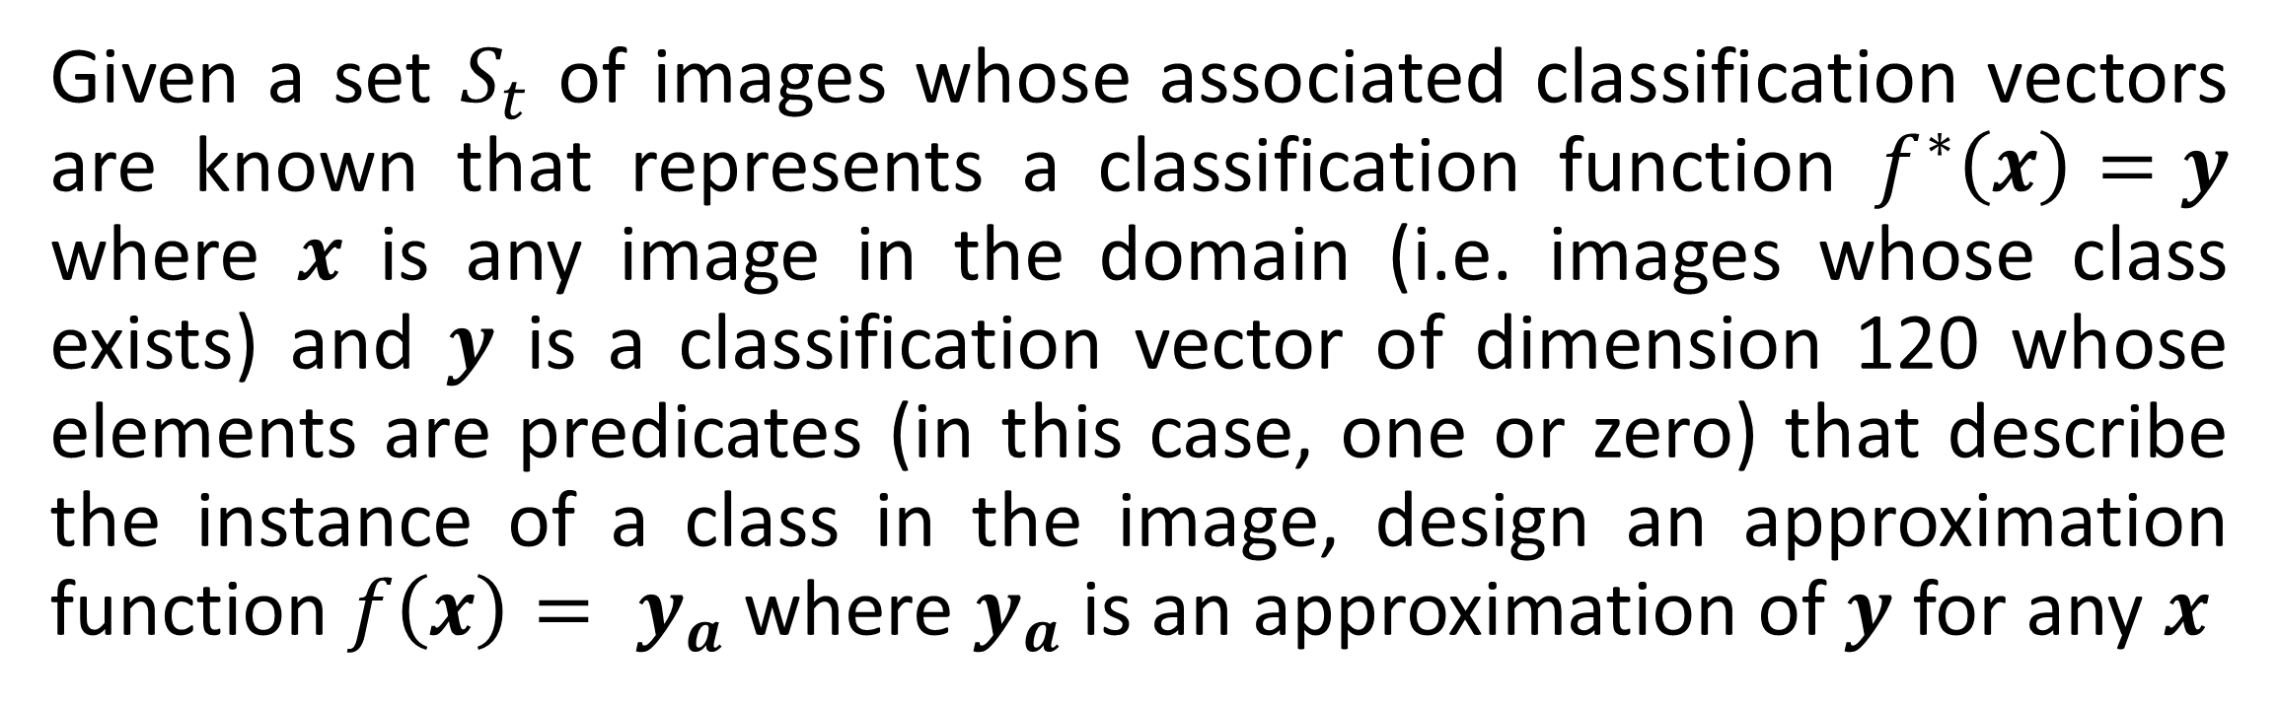
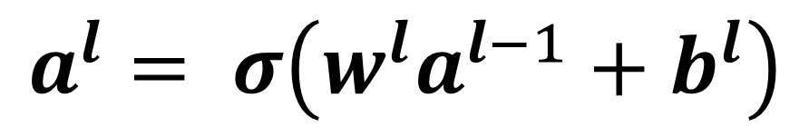
Improving Neural Network Accuracy and Efficiency Through
Hyperparameter Variation
Department of Mathematics and Computer Science
Devin King
Supervisors:
Marjorie Bond, Ph.D.
Joanne Eary, Ph.D.
James Logan Mayfield, Ph.D.
Michael Sostarecz, Ph.D.
Marta Tucker, Ph.D.
Andrew Ylvisaker, Ph.D.
RESEARCH QUESTION
IMAGE CLASSIFICATION PROBLEM
RESULTS & CONCLUSIONS
How do changes in training sets and hyperparameters of a image classification feedforward convolutional neural network affect its training time, memory usage, and percentage of items correctly classified in the final validation set?
The problem that this project addresses is the image classification problem, described below formally. Because this problem involves the creation of an approximation function, it is well attributed to solution via a neural network:
The training, as expected, progressed naturally through cost minimization. Figure 11 shows some highlights of the data collected during the trials:
Resultant Loss and Accuracy for Five Hyperparameter Configurations
Iteration Count | Learning Rate | Validation Set Accuracy (Decimal %) | Training Set Loss
1000 | 0.01 | 0.0064 | 6.6715
1000 | 0.1 | 0.0012 | 6.9469
1000 | 1.0 | 0.0012 | (Completely Divergent)
6000 | 0.01 | 0.183 | 4.2999
6000 | 0.1 | 0.0014 | 7.0222
NEURAL NETWORKS
Given a set $S_{t}$ of images whose associated classification vectors are known that represents a classification function $f^{∗}\left(x\right)=y$ where $x$ is any image in the domain (i.e. images whose class exists) and $y$ is a classification vector of dimension 120 whose elements are predicates (in this case, one or zero) that describe the instance of a class in the image, design an approximation function $f\left(x\right)= y_{a}$ where $y_{a}$ is an approximation of $y$ for any $x$
An image classification neural net can be conceptualized as a black box that takes an image as input and produces the class of the image as output (Fig. 1).
NEURAL NETWORK
Identify Person
FIGURE 11
INPUT $x$
FIGURE 1
Output: $a^{L}(x)$
TRAINING
An eta value of 0.01 and an iteration count of 6000 (Fig. 12) yielded a linear-like progression in the accuracy measure on the validation set (Fig. 13). The loss function appears to be reaching a plateau at this point so it may be beneficial to adjust the learning rate in agreement with the “decay” style in Caffe training. Doing the same training over 6000 iterations but with a learning rate of 0.1 resulted in an unexpected plateau. It would appear that this set of hyperparameters results in almost no accuracy increase on the validation set.
The neural net is made up of perceptrons (discussed below), and the perceptrons are interconnected to make a tree-like graph structure whose flow is captured by (Fig. 2).
Select Learning Rate/Epochs
Select a training set (or subset)
Adjust Weights and Biases
Compute Cost (error)
$$a^{l}= σ\left(w^{l}a^{l−1}+b^{l}\right)$$
FIGURE 2
Feedforward
This structure can be further divided into layers which can be mathematically conceptualized as vectors whose cardinality is determined by the number of perceptrons in the layer (Fig. 3).
FIGURE 8
Backpropagation
FIGURE 3
The training process allows a neural network to learn the right and wrong answers to a problem via supervision. The learning rate (eta) and number of epochs determine the speed of classification and repetitions of the training set, respectively (Fig. 8).
Validation Loss
Training Loss
PERCEPTRONS
$$E\left(S_{t}\right)= \frac{1}{n}\sum_{1}^{n}{{\left(f^{∗}\left(x_{i}\right)−f\left(x_{i}\right)\right)}^{2}}$$
x₁
Perceptrons, the building blocks of neural networks, consist of a set of inputs (usually conceptualized as a vector), and a single output or activation (Fig. 4).
x₂
…
Output
(Activation)
FIGURE 9
x_{j}
FIGURE 4
The value of any perceptron can be conceptualized mathematically as the summation of each input multiplied with its associated weight (Fig. 5).
The adjustment of the weights and bias values of the network based on a known example and computation of the cost function is done via a process called backpropagation (Fig. 8). The cost function determines how correct the network’s classification is – the cost function used in the network used for this project is MSE or mean squared error (Fig. 9).
FIGURE 12
FIGURE 13
$$\sum_{j}{w_{j}x_{j}}≡w∙x$$
Other experiments were performed with alternating eta between 0.01 and 0.1 (with 1.0 in some earlier runs) and increasing number of iterations. All experiments that were performed with an eta of 1.0 diverged in both training loss and validation loss (and as such accuracy as well). The other experiments appeared to be abbreviations of the longest experiment in terms of convergence and accuracy, which was somewhat expected. Longer trials could not be completed because of time constraints on data collection and processing.
FIGURE 5
This value contributes to a predicate activation function, giving a decision-like “yes” or “no” answer depending on the inputs, the weights associated with them, and a threshold that determines the switch. This threshold is conventionally added to the value of the perceptron as a bias (Fig. 6).
$$a\left(x\right)= \left\{\begin{aligned}&0 if w∙x ≤threshold \\ &1 if w∙x >threshold\end{aligned}\right.$$
This process of backpropagation uses a form of stochastic gradient decent, which iteratively updates the network weights and biases using the mathematical gradient and a multiplier called eta, which can be conceptualized as the step size when moving toward a solution. This, along with the training set constraints, constitute the hyperparameters whose variance and associated effect on performance are the subject of this project.
$$=\left\{\begin{aligned}0 if w∙x+b ≤0 \\ 1 if w∙x+b >0\end{aligned}\right.$$
Note that although varying the iteration count is similar to varying the training set size, the actual process of producing subsets of classes to be imported into the Caffe CNN framework was a task that was out of the scope of the adjusted project timeline. As such, the iteration variations substitute as the constraint on the training set.
FIGURE 6
The output of the perceptron as a predicate function does not fare well for detection of how small changes in input affect output in any layer - this is necessary for training. As such, it is necessary to smooth the output of the perceptron to allow for the detection of these changes. The sigmoid function allows for a smooth gradient form a “no” value to a “yes” value (Fig. 7).
CONSTRUCT NETWORK
TRAIN NETWORK
TEST/BENCHMARK NETWORK
DEPLOY NETWORK
SOURCES
FIGURE 10
- M. Minsky and S. Papert, Perceptrons, 3rd ed., Cambridge, Massachusetts: The MIT Press, 1988.
- M. Neilsen, "Neural Networks and Deep Learning," Determination Press, January 2016. [Online]. Available: http://neuralnetworksanddeeplearning.com/. [Accessed 04 September 2016].
- S. Russel and P. Norvig, Artificial Intelligence: A Modern Approach, 2nd ed., New Jersey: Pearson Education, 2003.
- J. D. Cowan and D. H. Sharp, "Neural Nets and Artificial Intelligence," Daedalus, vol. 177, no. 1, pp. 85-121, 1988.
- R. Hecht-Nielsen, Neurocomputing, Melo Park, California: Addison-Wesley Publishing Company, 1990.
- Y. Jia and E. Shelhamer, "Caffe: Convolutional Architecture for Fast Feature Embedding," Berkeley Artificial Intelligence Research Lab, 2014. [Online]. Available: http://caffe.berkeleyvision.org/. [Accessed November 2016].
The training process is part of a larger design paradigm that involves construction, a training and testing cycle, and eventual deployment. The deployment stage involves optimization by removing backpropagation constructs for distribution, thereby increasing speed (Fig. 10).
FIGURE 7
$$σ(x)≡\frac{1}{1+e^{−x}}$$

